Slide 1
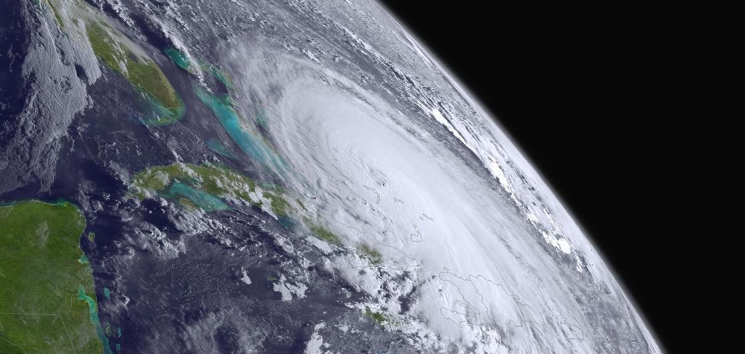
Evaluation and optimization of new observations under NOAA’s Quantitative Observing System Assessment Program (QOSAP)
Lidia Cucurull
Director, Quantitative Observing System Assessment Program (QOSAP)
National Oceanic and Atmospheric Administration (NOAA)
2nd PAZ Polarimetric Radio Occultations User Workshop
Pasadena (CA)
November 28-29, 2023

Slide 2
QOSAP background
Address capability gap to provide quantitative information on the impact of observations
Congress began funding in 2014, requirements included in Weather Act of 2017
Today, QOSAP maintains and improves infrastructure to conduct quantitative assessments
  Evaluation and optimization of current use of in-situ and satellite observations
  Quantitative information on the impact of proposed changes to the observing system
  Expected impact of new observing technologies
  Trade-off studies to optimize observing system configuration
NOAA-wide program with representatives from the different Line Offices
QOSAP transitioned to OAR Office of Research, Transition and Application on October 1, 2023

Slide 3
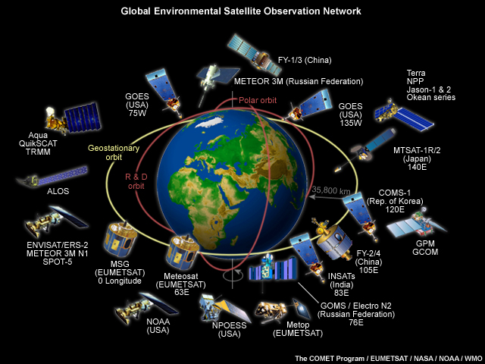


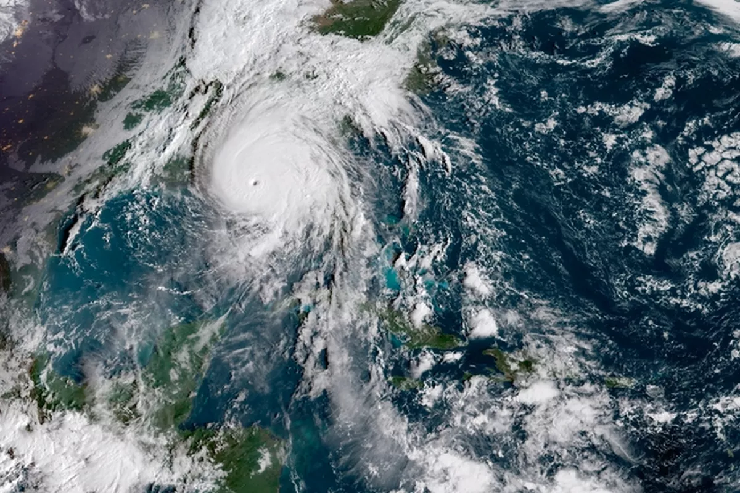
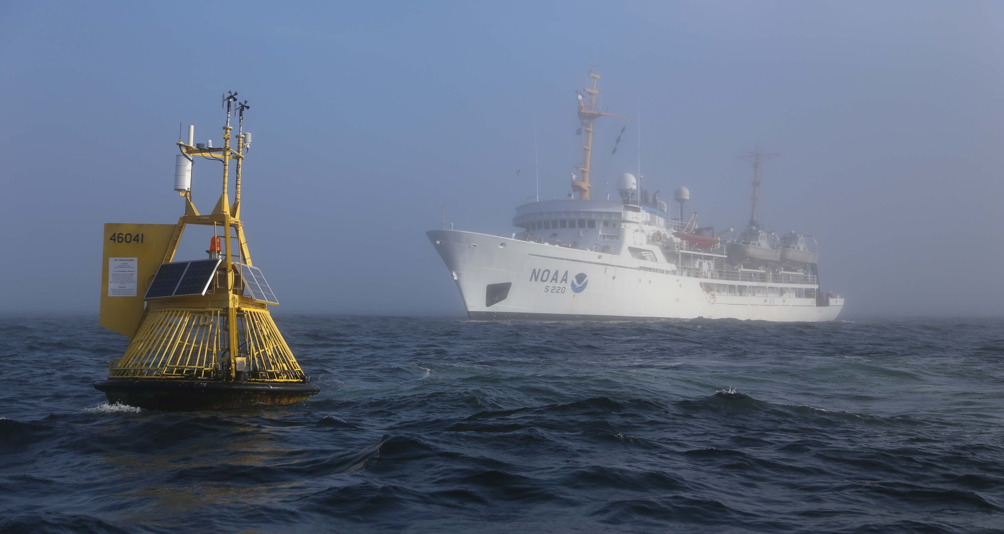
Today’s modeling and observing
systems capabilities:
Observing System Experiments
(OSEs)
Can we do better? - Optimize use of current observations in current modeling systems
  Enhanced data assimilation strategies
  More realistic characterization of observations
  Management of large volume of data
  Timeliness for model upgrades
Can we leverage existing observations not currently utilized?
  Driven by requirements and priorities
  Investment in personnel and HPC resources

Slide 4
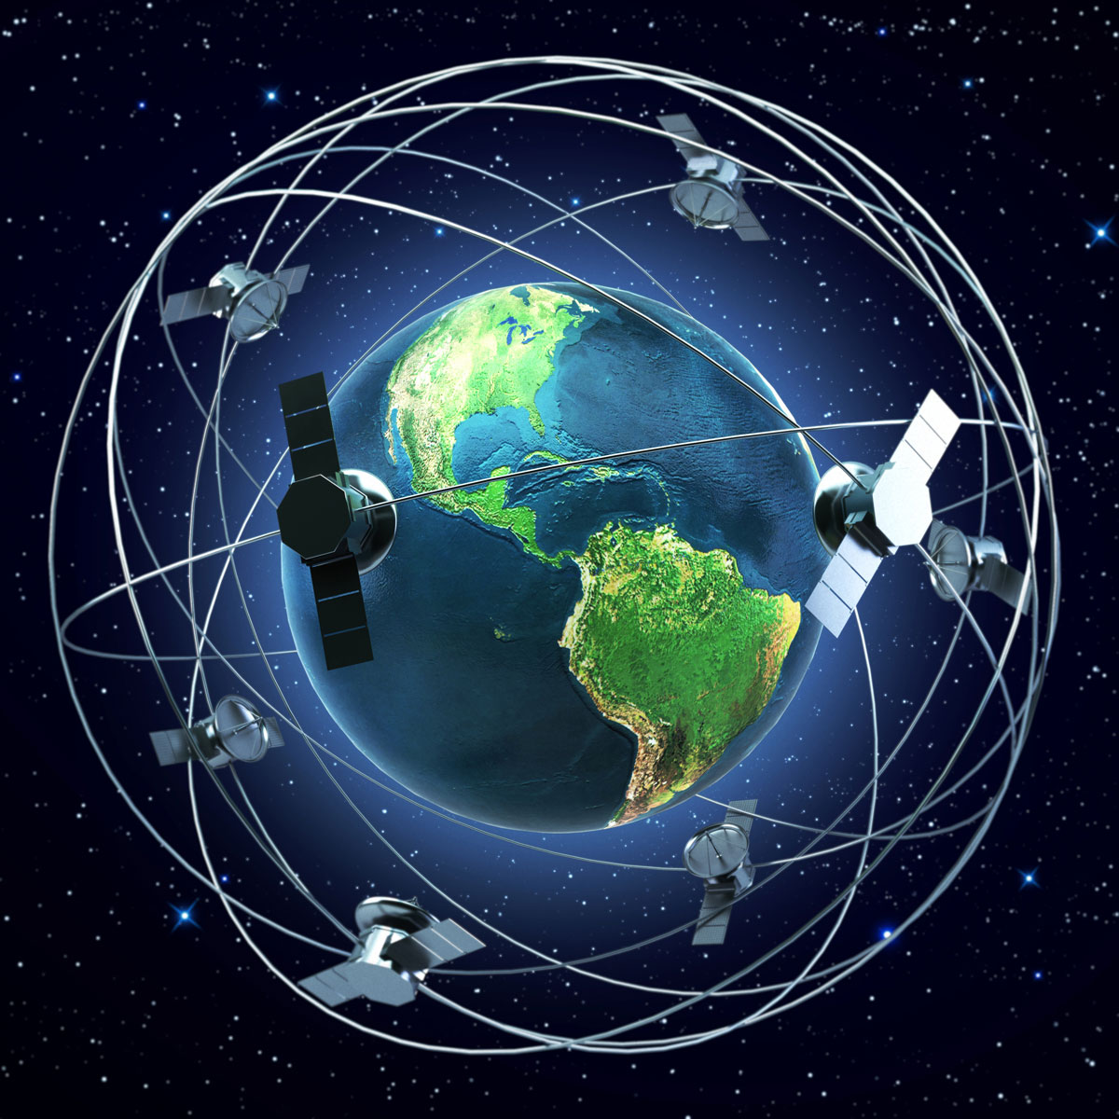

Looking ahead and simulating the future:
Observing System Simulation Experiments (OSSEs)
Costs of developing, deploying and maintaining new space-based architectures typically exceed $100-500 million/instrument.
Need to provide quantitative information on the impact of proposed observing systems in the next planned generation of numerical weather prediction systems.
Help inform major decisions by evaluating the impact of alternative mix of current and/or proposed instruments for better understanding and prediction of Earth Systems.
OSSE studies provide an ideal platform for this
  Analyze tradeoffs (coverage, resolution, accuracy and data redundancy)
  Optimize data assimilation and modeling strategies

Slide 5
OSE (real) vs. OSSE (simulated)
The truth is unknown
The truth is known

Slide 6
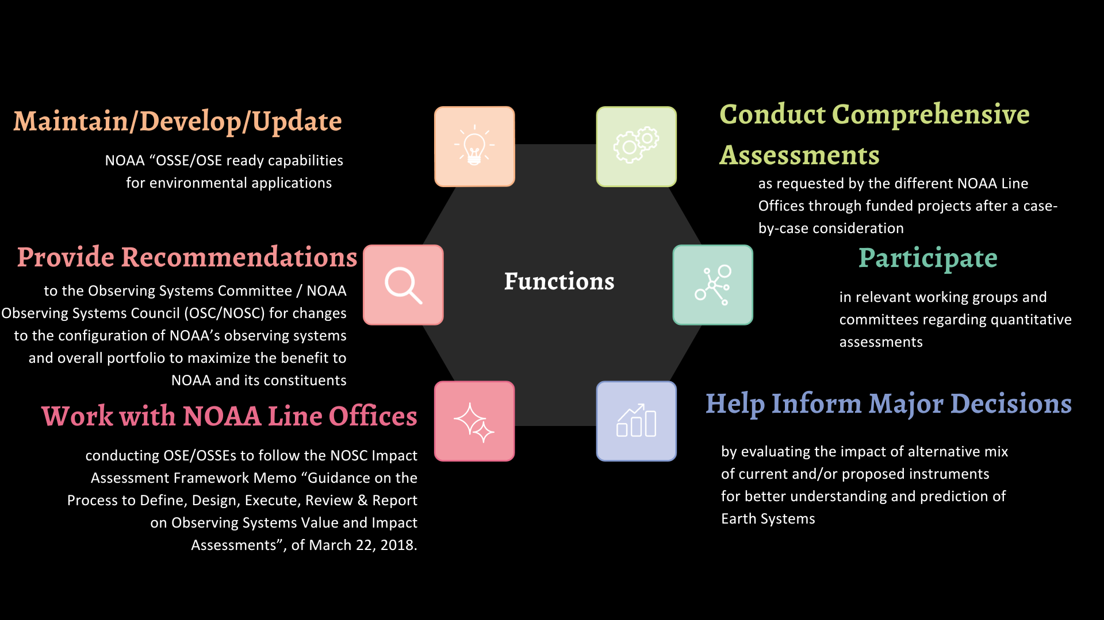
QOSAP Functions

Slide 7
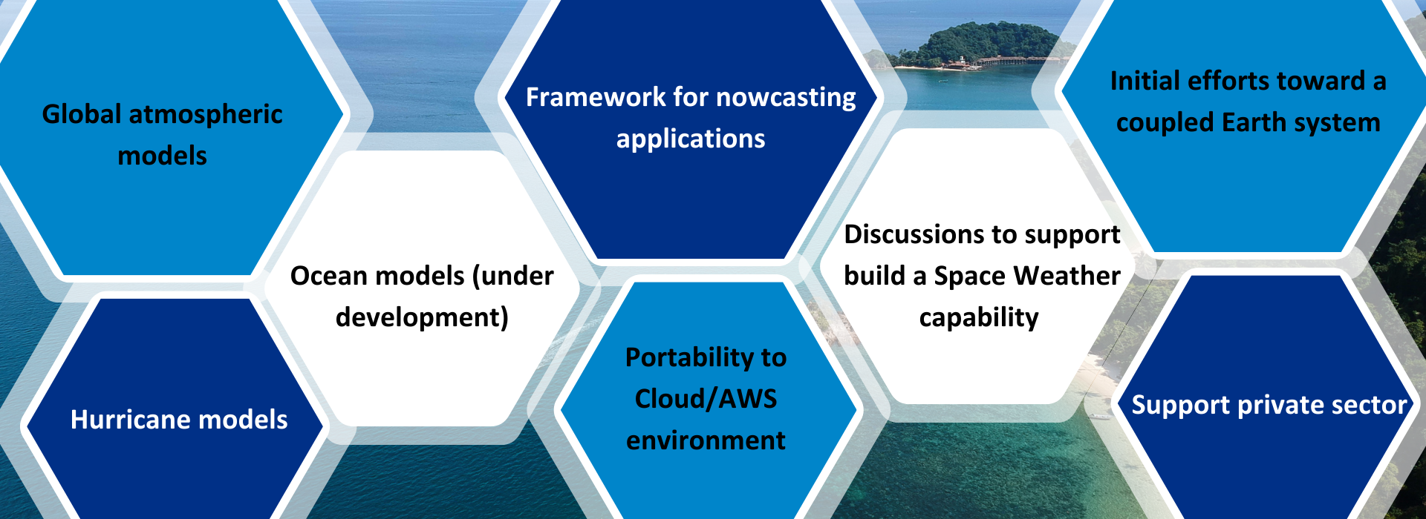
Quantitative assessment capabilities

Slide 8
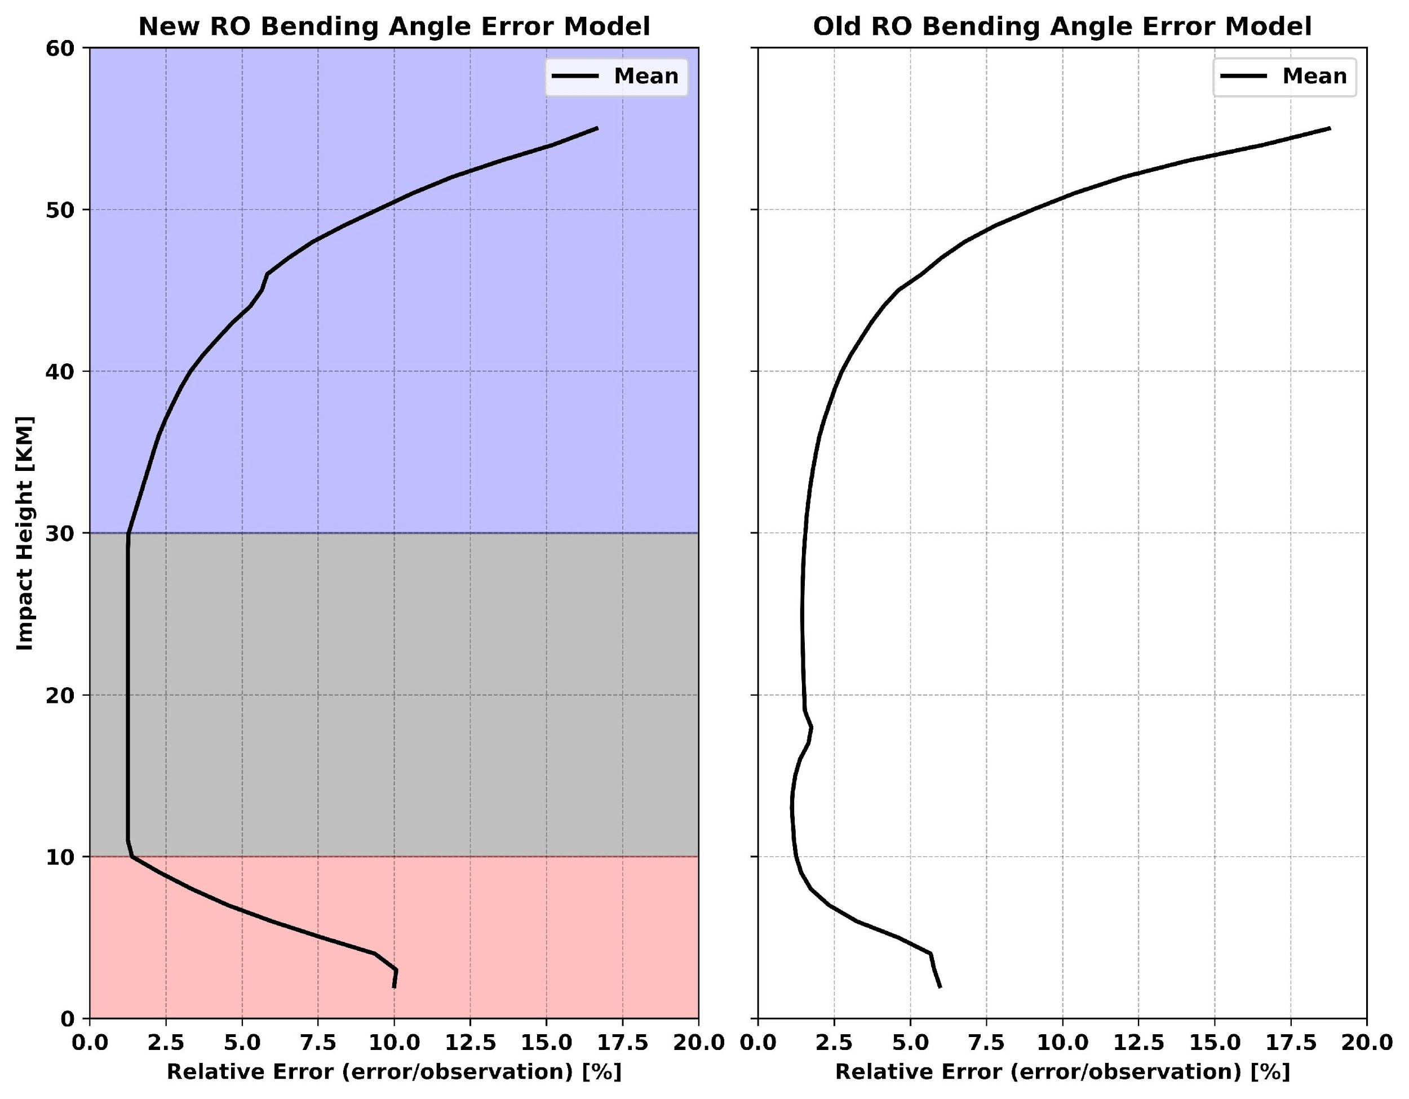
GNSS-RO Optimization in GFS
Chris Riedel
Accomplished in two ways:
Optimization of RO bending angle errors
Why?: Observation errors determine weight given to observation increments during data assimilation
Current RO bending angle error model is specific for different data processing, location, and satellite mission (commercial vs. non-commercial)
New RO error model is developed to be more generalized while using observation and profile dependent information for setting the error
2. Optimization of Statistical Quality Control (QC)
Why?: Statistical QC provides a check against assimilating bending angle observations that are too far from the background
New statistical QC uses a statistical error estimate for bending angle observations
STD4060
Region
3 Corner Hat Error Estimation
Region
Fractional LSW
Region

Slide 9
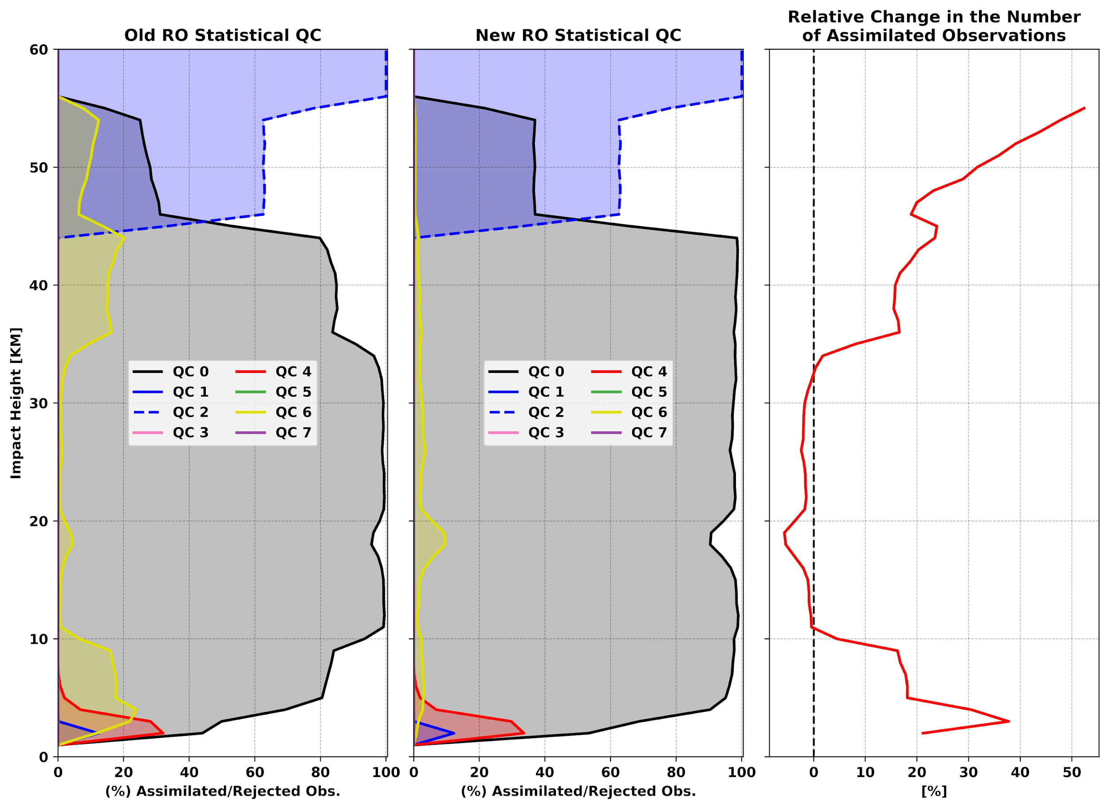
GNSS-RO Optimization in GFS
Optimization of Statistical QC
There is a decrease in the number of bending angle observations that are rejected with new statistical QC (QC 6)
This results in more observations being assimilated above 30 km and below 10 km
(QC 0)
More Observations Assimilated with New Statistical QC

Slide 10
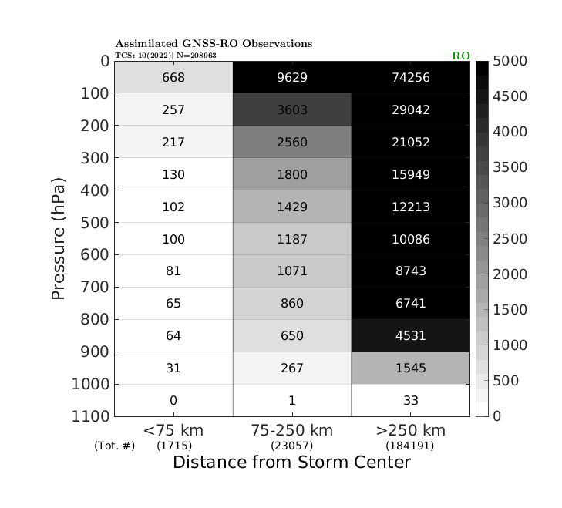
HAFS: GNSS-RO Impact Assessment
Ben Johnston
Time period: 2022 Atlantic Hurricane Season
Sample size: 10 tropical cyclones (TCs), mostly reaching hurricane strength
Model: HAFS-A v1 (current operational setup)
Control: “NoRO” - all RO data denied in both the GFS (used for ICs and BCs) and HAFS
Experiment: “RO” - all available RO data is assimilated in GFS and HAFS
      In the HAFS inner moving nest (where DA occurs), most RO bending angle obs are assimilated in the synoptic environment, with only a small percentage in the TC inner core

Slide 11
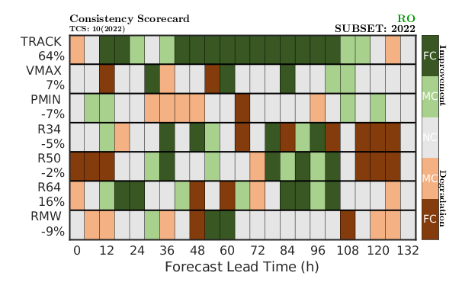
HAFS: GNSS-RO Impact Assessment
Consistency scorecard: shows consistency metrics (which includes mean/median absolute error and frequency of superior performance) from multiple variables compressed into one graphic
Allows for TC track, intensity, and size forecasts to be quickly evaluated together
Assimilation of RO data results in consistent improvement in TC track forecasts across almost all lead times
Mixed results are observed for the other TC variables

Slide 12
Saturation studies with RO (OSSE)
Investigate potential levels of saturation in NWP with increased number of RO (bending angle)
Complement studies conducted at other NWP centers
Identify needs for optimization of data assimilation algorithms
  Geographical region
  Quality control procedures
  Observation error characteristics
  Code used to simulate observations (forward operator)
Scenarios under investigation
  RO numbers from year 2020 (~6K prof/day) with current model configuration
  10K, 20K, 50K, 100K with updated data assimilation algorithms
  6K, 20K and 50K experiments – completed
  100K experiment – completed, evaluation of results is underway

Slide 13
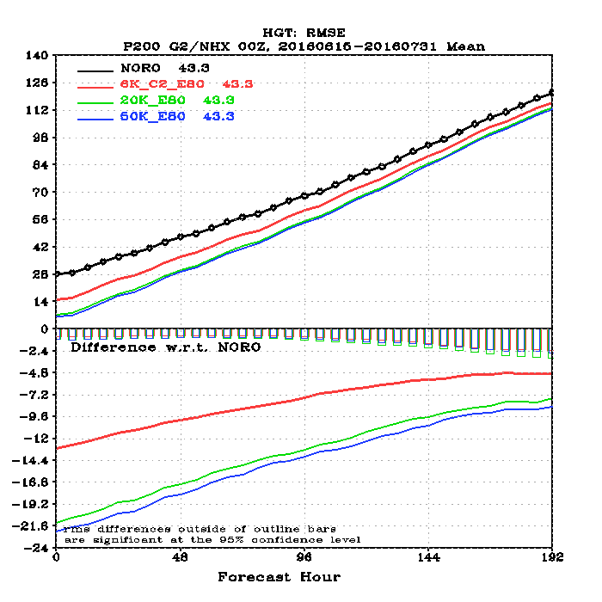
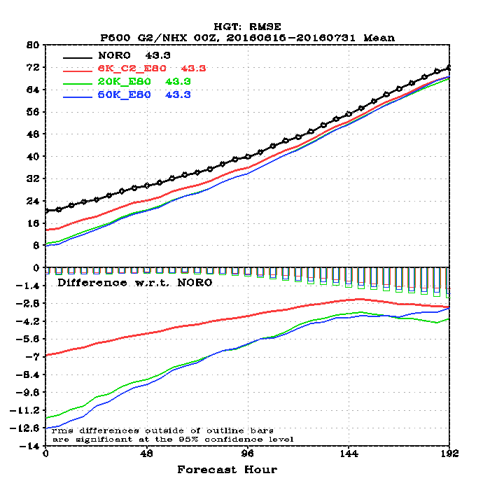
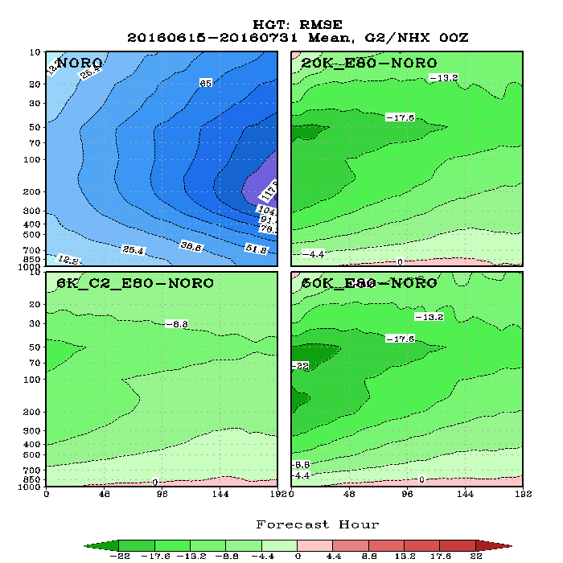
OSSE results: NHX RMS geopotential heights
Sean Casey
NORO = Control configuration (without RO)
6K_C2_E80 = Control configuration + ~6K RO prof/day
20K_E80 = Control configuration + 20K RO prof/day
50K_E80 = Control configuration + 50K RO prof/day
20K
6K
50K
Good
Good
Good
Bad

Slide 14
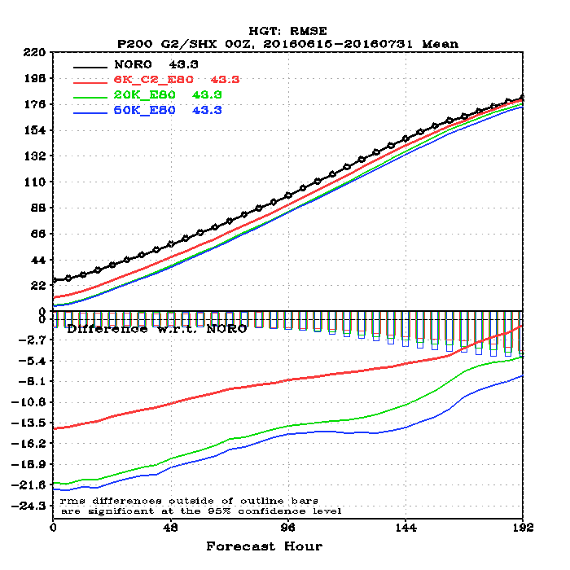
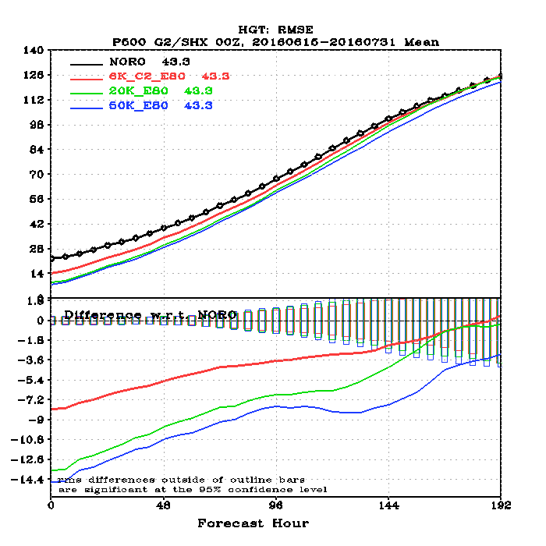
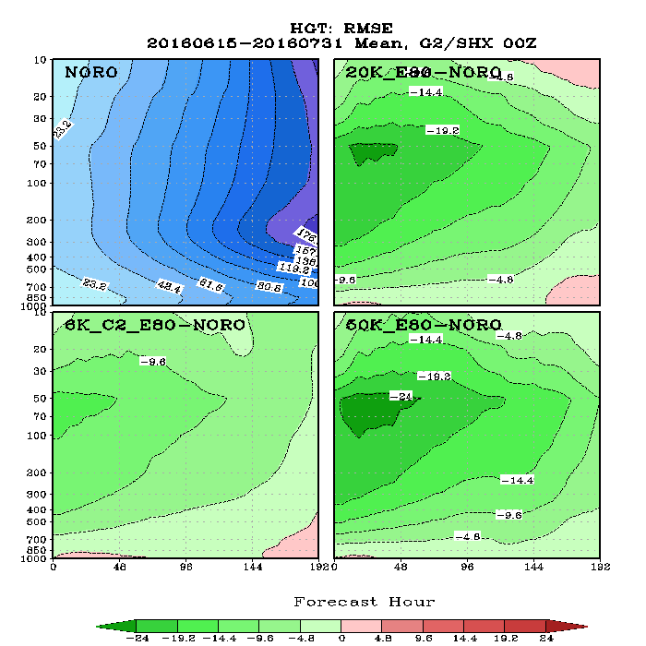
OSSE results: SHX RMS geopotential heights
NORO = Control configuration (without RO)
6K_C2_E80 = Control configuration + ~6K RO prof/day
20K_E80 = Control configuration + 20K RO prof/day
50K_E80 = Control configuration + 50K RO prof/day
20K
6K
50K
Good
Good
Good
Bad

Slide 15
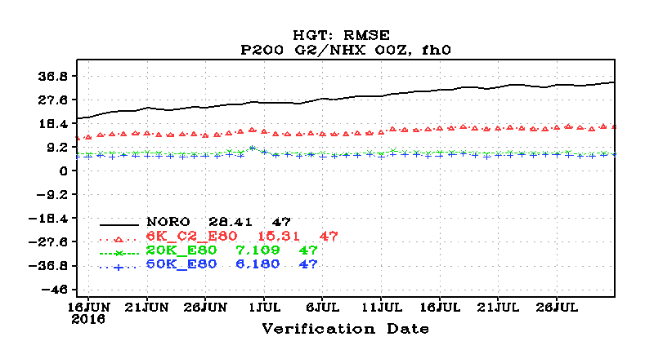
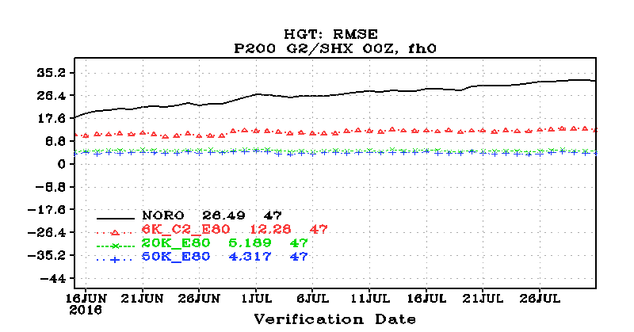
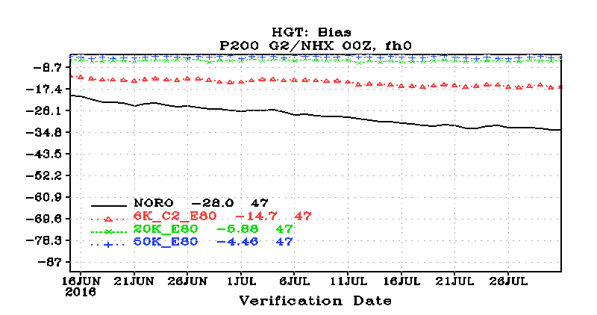
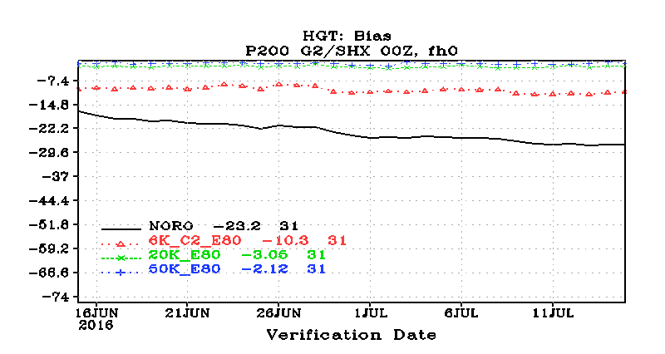
RO “anchoring” effect
Northern Hemisphere extra-tropics
Southern Hemisphere extra-tropics
RMS
RMS
Geopotential heights
BIAS
BIAS

Slide 16
Commercial Data Program (CDP)
RODB Data Purchase
Courtesy of Patricia Weir/ NESDIS SAE -
Commercial Data Program Manager

Slide 17
    IDIQ-1 Contracts awarded to Spire & GeoOptics in Nov 2020.
    Contract ceiling (2-year POP): $23M
Delivery Order | Vendor | Profiles per day | Duration (Months) | Period of Performance | Data Sharing | Notes
1-Test | Spire GeoOptics | 500 500 | 1 | Dec 2020 - Jan 2021 | US Gov. | Test data; prep for operations
2 | GeoOptics | 1300 | 6 | Mar - Sep 2021 | US Gov. | Operational use began May 2021
3 | Spire | 3000 | 6 | Sep 2021 - Mar 2022 | US Gov, WMO and CGMS Centers | Added Galileo GNSS occultations
4 | GeoOptics Spire | 500 5500 | 10 | Mar 2022 - Jan 2023 | US Gov, WMO and CGMS Centers | 10-month period began March 16, 2022
5 | Spire | 3300 | 6 | Jan 18 - Jul 18, 2023 | Unlimited distribution rights | Vendors were asked to provide 2 pricing options (1 & 3a)

Slide 18
    IDIQ-2 (RODB-2) Contracts awarded to Spire & PlanetiQ in Mar 2023.
    Contract ceiling (5-year POP): $59.31M
Delivery Order | Vendor | Profiles per day | Duration (Months) | Period of Performance | Data Sharing | Notes
1-Test | Spire PlanetiQ | 500 500 | 1 | Apr 5 - May 5, 2023 | Unlimited distribution rights | Test data; prep for operations
2 | PlanetiQ | 3100 | 6 | Jul 18, 2023 - Jan 18, 2024 | Unlimited distribution rights | First Operational Data Buy with PlanetiQ.
3 | TBD | TBD | TBD | Jan 18, 2024 - TBD | TBD | DO-3 RFP sent tp vendors in Oct ‘23. Duration TBD
4 | TBD | TBD | TBD | TBD | TBD | Post RFP in 3QFY24; DO-4 award: 4QFY24
DO-n | TBD | TBD | TBD | TBD | TBD
Notes:
GN-02 is only sat remaining; providing ~1200-1300 ROs/day

Slide 19
NESDIS Commercial Data Program (CDP)
Ocean Surface Winds Pilot
Project Status

Slide 20
Ocean Surface Winds (OSW) Pilot Schedule
Today
Aug
Sep
Oct
Nov
Dec
Jan
Feb
Mar
Apr
May
Jun
Jul
Aug
Sep
Oct
Nov
Dec
2023
2024
RFP
Evaluation
Preparation
Data Delivery Period
CDP Team: Data Intro & Prep.
Evaluation
CDP Team: Data Monitoring & Assessing
CDP Team: Data Assessment, Evaluation & Reporting
OSW Pilot Contract award
U.S. Gov Team
Pilot Contract (Spire)
OSW Pilot WG Kick-off
OSW Pilot Spire Kick-off (w/ NOAA AGO, CDP Team)
Notes:
Phase 1: Preparation. 3 months (10/25/2023 - 01/25/2024)
Phase 2: Data Delivery. 6 months (01/25/2024 – 07/25/2024)
Phase 3: Evaluation. 3 months (7/25/2024 – 10/25/2024)
AGO issued a firm fixed price award to Spire for at 500+ daily GNSS-R observations during the 6-month delivery period and overall life cycle project duration of 12 months.

Slide 21
Some concluding thoughts
NOAA has the capability to conduct quantitative assessment to optimize and evaluate impact of current and new observing systems on products and services.
Capability expands to atmospheric and ocean applications (global and regional).
Ideal framework to investigate tradeoffs and relative/complementary impact of in-situ and satellite observations.
Potential testing of Polarimetric RO observations (forward operator, error characteristics, quality control) to improve NWP skill.

