Slide 1
Potential use of Polarimetric RO in Numerical Weather
Prediction at GMAO
28 Nov 2023
Michael J. Murphy
Global Modeling & Assimilation Office (GMAO), NASA Goddard SFC
GESTAR-II, University of Maryland Baltimore County

Slide 2
Outline
Overview of previous feasibility study on use of Polarimetric RO (PRO)
to evaluate cloud microphysics in NWP
  Murphy et al. 2019
GNSS-RO observations at GMAO

Slide 3
Overview of Feasibility Study

Slide 4
Motivation
Accurate representation of cloud microphysical processes has proven challenging for numerical weather and climate models
Numerous competing microphysical parameterization schemes have been developed for use in numerical weather prediction models.
Relatively few observations to validate microphysical processes in numerical models, particularly over the ocean.
Question addressed:
  Could PRO obs be used for validating microphysical processes in NWP forecasts?
Notes:
Crucial in forecasting precipitation
Traditionally RADAR

Slide 5
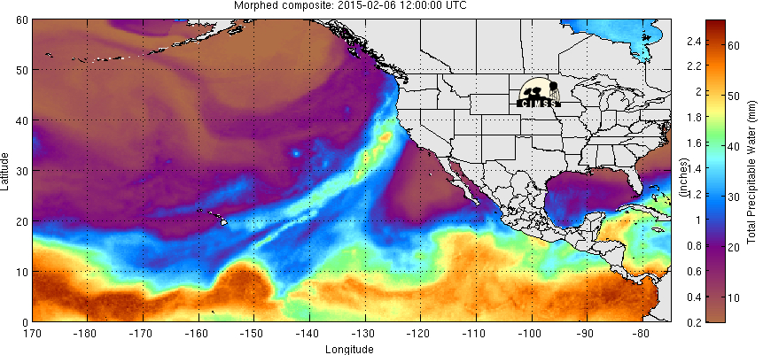
Case Study:
The 6-7 Feb 2015 Heavy Precipitation Event
Associated with an Atmospheric River (AR) that was classified as AR 5, the highest on the AR scale (Ralph et al 2019).
Accumulated precip > 8 cm for extensive regions of northern CA.
Ralph, F.M.; Rutz, J.J.; Cordeira, J.M.; Dettinger, M.; Anderson, M.; Reynolds, D.; Schick, L.J.; Smallcomb, C. A scale to characterize the strength and impacts of atmospheric rivers. Bulletin of the American Meteorological Society 2019, 100, 269–289.

Slide 6
Airborne Polarimetric RO Concept
Illustration of the PRO concept for an ARO receiver (after Cardellach et al., 2015).
The ray path crosses the lowest part of the atmosphere horizontally, parallel to the flattening of large rain drops.
The difference in excess phase delay of horizontally and vertically polarized GNSS signals is presumed to be due to forward scattering through rain droplets.
Currently in operation during AR Recon with H/V polarized antenna onboard NOAA G-IV.
Notes:
Usually the smaller effects due to liquid water, Ww, and ice content, Wi, are also neglected. However, in the case of heavy precipitation the effects of liquid water and ice on refractivity can be significant.
Where:
a₁ = 77.6K hPa⁻¹, a₂ = 3.73 × 10⁵ K² hPa⁻¹, and W_{w} and W_{i} are liquid and ice content (g m⁻³), and a_{w} and a_{i} are 1.4 and 0.6 (g⁻¹m³), respectively
Observing the Polarimetric Differential Delay from hydrometeors in the lowest parts of the ray path.

Slide 7
Airborne Polarimetric RO Concept
Illustration of the PRO concept for an ARO receiver (after Cardellach et al., 2015).
The ray path crosses the lowest part of the atmosphere horizontally, parallel to the flattening of large rain drops.
The difference in excess phase delay of horizontally and vertically polarized GNSS signals is presumed to be due to forward scattering through rain droplets.
Currently in operation during AR Recon with H/V polarized antenna onboard NOAA G-IV.
Notes:
Usually the smaller effects due to liquid water, Ww, and ice content, Wi, are also neglected. However, in the case of heavy precipitation the effects of liquid water and ice on refractivity can be significant.
Where:
a₁ = 77.6K hPa⁻¹, a₂ = 3.73 × 10⁵ K² hPa⁻¹, and W_{w} and W_{i} are liquid and ice content (g m⁻³), and a_{w} and a_{i} are 1.4 and 0.6 (g⁻¹m³), respectively
Observing the Polarimetric Differential Delay from hydrometeors in the lowest parts of the ray path.

Slide 8
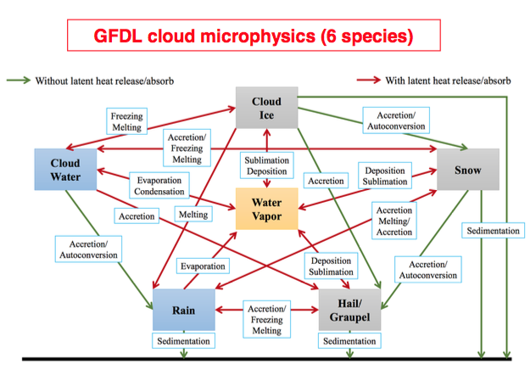
Double Moment Microphysical Parameterization
Hydrometeors = liquid or solid water particles suspended in the air
Double moment because both hydrometeor
Mass (Q), &
number concentration (N₀)
are resolved
Morrison WDM6 | Mass Variables Qc Qr Qi Qs Qg Qc Qr Qi Qs Qg | Number Vars N_{r} N_{i} N_{s} N_{g} N_{ccn} N_{c} N_{r}
Notes:
N₀, the number concentration is defined as the number of entities of a constituent in a mixture divided by the volume of the mixture : The SI unit is 1/m³.
Most bulk schemes use a Gamma distribution f(m) = N₀m^{ν} exp(−λm^{µ})
where N₀ is the intercept, ν is the shape parameter, λ is the slope or scale parameter and µ is the dispersion parameter

Slide 9
Design of Numerical Experiments
ARW-WRF model version 3.7.1
a regional (mesoscale) limited area model from NCAR
Initialized at 00 UTC 05 Feb 2015 using ECMWF Operational Analysis as initial and boundary conditions:
~ 15 x 15 km
25 press levels (~13 in tropophere)
6 hourly
Two experiments run that differ only by microphysical parameterization schemes:
WRF double moment 6-class (WDM6)
Morrison double moment
All analyses and plots shown are from the innermost domain
Notes:
Chose these two schemes because they are double moment and include the same 6 mass variables.

Slide 10
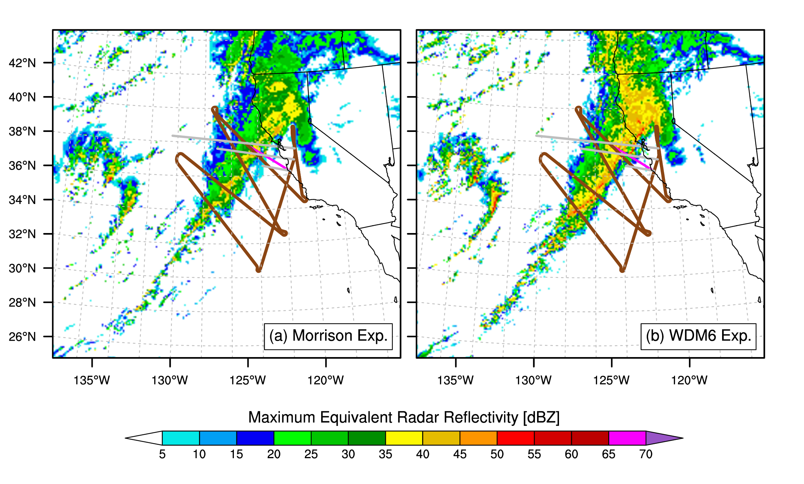
Differences in Characteristics of Convection
18 UTC 06 Feb 2015
Wider region of column max reflectivity > 35 dBZ in WDM6 exp
Flight path (brown) occultation prn03r (pink) selected ray paths (grey) are overlain
Notes:
Simulated column max RR is shown
Clear differences between the 2 exps
Overlain is:
Flight path in brown
Selected Occ in Pink
Selected raypaths in grey

Slide 11
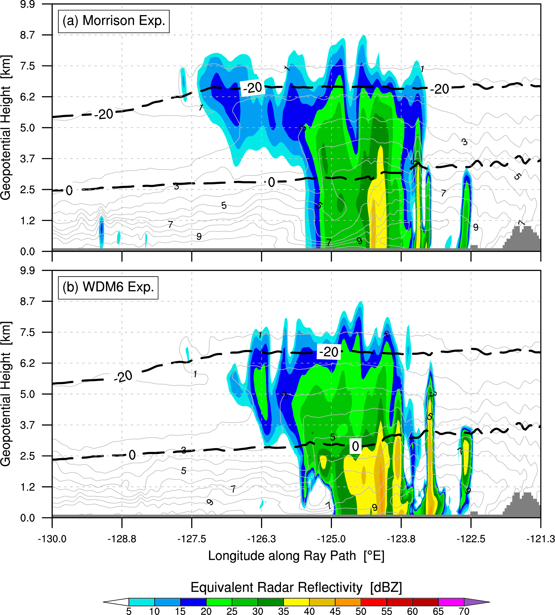
Vertical Cross Section through Convection
Cross-section taken along lowest raypath (longest grey line) in previous slide
Deeper convection in Morrsion Exp where reflectivity > 30 dBZ extends to nearly 6 km over a wide area

Slide 12
Polarimetric Simulation Method
Our approximate method for liquid hydrometeors (rain) using a Marshall-Palmer dropsize distribution
Approach used for ROHP-PAZ
Polarimetric phase shift =
Input WRF dBZ from rain only -->
Our approximate method for frozen hydrometeors (assumes oblate spheroids, because λ ~ 19 cm)
Notes:
Rather than using the drop size distribution to calculate Kdp we used a simplified mothod.
For liquid hydrometors, this method used the simulated RR from the simulation.
For frozen hydrometeors, the method used the Ice Water Content (IWC) along with some assumptions
Including that the hydrometeors are oblate Spheroids.
This approach has been applied in studies using remotely sensed rain rate data to infer a dropsize distribution and estimate the magnitude of the polarimetric delay [15,48].
They simulated the differential effect of the two orientations for raindrops compared to spherical particles integrated over
different length paths to show that the polarimetric delays were above the detectable limit (3mm in the absolute accuracy of the GPS phase measurement)
for rain rates above 3mm/hr and path lengths greater than 25 km.
This simulation method was used for planning the polarimetric RO mission for the ROHP-PAZ satellite [15,23] and in the preliminary analysis of the mission results.

Slide 13
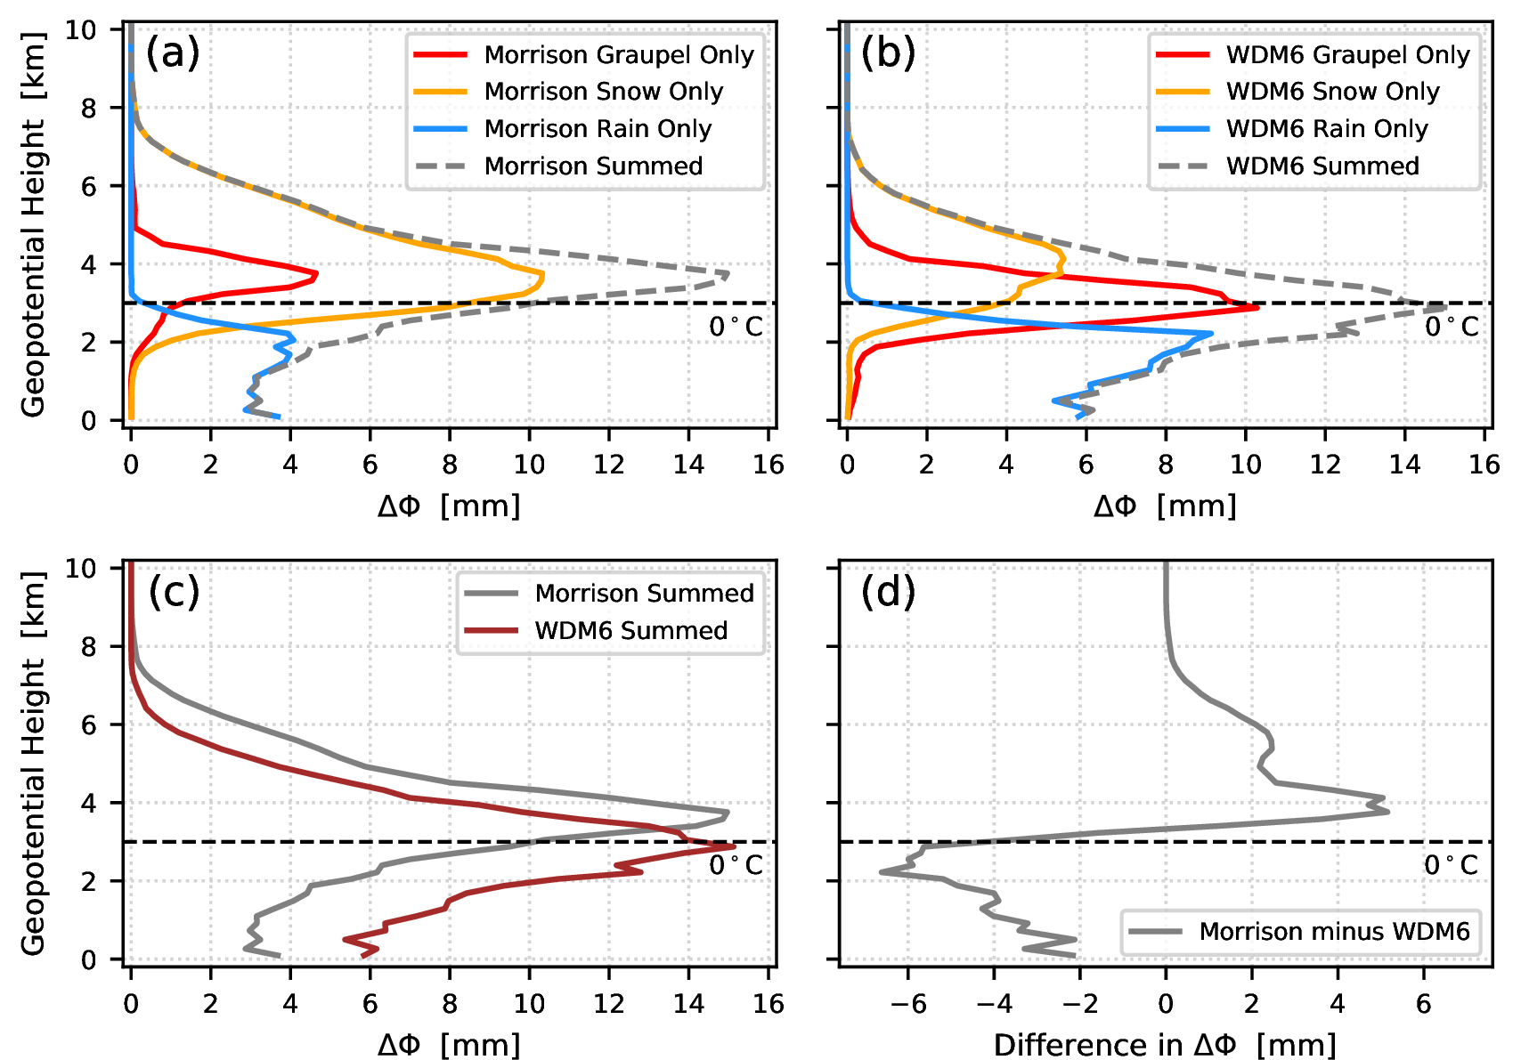
Performance of different parameterizations can be distinguished with PRO observations
Precision for PRO observations ⋍ 3 mm
Murphy et al., Remote Sensing, 2019
Notes:
Detectable difference in the height of the maximum polarimetric delay.
Difference between exps exceeds 3 mm threshold from
1-3 km (below freezing level) & 4 km (above freezing level)
Morrison exp -> more snow,
WDM6 exp -> more graupel
Resulting combined delays are similar
Largest signal is at ice/rain transition.

Slide 14
Performance of different parameterizations can be distinguished with PRO observations
Precision for PRO observations ⋍ 3 mm
Murphy et al., Remote Sensing, 2019
Notes:
Detectable difference in the height of the maximum polarimetric delay.
Difference between exps exceeds 3 mm threshold from
1-3 km (below freezing level) & 4 km (above freezing level)
Morrison exp -> more snow,
WDM6 exp -> more graupel
Resulting combined delays are similar
Largest signal is at ice/rain transition.

Slide 15
Summary and Conclusions
For the 6-7 Feb 2015 Atmospheric River (AR) event, the choice of microphysical parameterization used in the mesoscale model had a large effect on:
the characteristics of the simulated convection,
the vertical distribution of hydrometeors
the resulting spatial distribution of accumulated precip in mountainous regions
The Morrison exp produced deeper convection associated with a higher mass of frozen hydrometeors compared with the WDM6 exp that produced shallower convection associated with higher mass of rain below the freezing level
These differences in simulated hydrometeors produced by the parameterizations led to detectable differences in polarimetric differential delay as a function of height, despite relatively modest convection associated with the ARs.
Murphy, M. J., Jr., J. S. Haase, R. Padulles, and S.-H. Chen (2019), The Potential for Discriminating Microphysical Processes in Numerical Weather Forecasts using Airborne Polarimetric Radio Occultations, Remote Sensing Special Issue "Radar Polarimetry—Applications in Remote Sensing of the Atmosphere”

Slide 16
GNSS-RO at GMAO

Slide 17
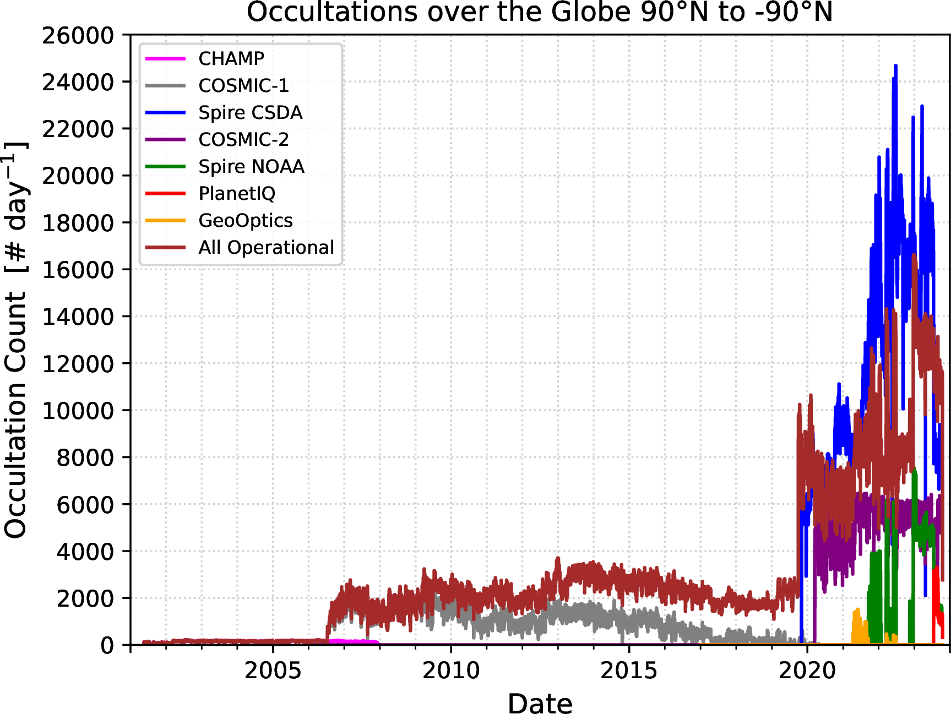
GNSS-RO Related Work at GMAO
Operational NWP
  Assimilation of RO in real-time into Goddard Earth Observing System (GEOS) model
  Using available suite of operationally available RO including commercial
High-volume Commercial RO Dataset
  Commercial Smallsat Data Acquisition (CSDA) Program
  Globally 5-20 thousand profiles/day from Spire alone
Research Projects
  Previous OSSE studies using GEOS
    RO obs saturation not reached with 100,000 profiles/day
    Privé et al. (2022, MWR) found
  Impact of Spire RO dataset on analyses and forecasts
    Potential use in upcoming MERRA 21C reanalysis product

Slide 18
Potential work with Polarimetric RO at GMAO
Model Validation using PRO
  Microphysical process in GEOS NWP products
  Particularly interested in deeper convection with
  frozen hydrometeors aloft
Data Assimilation
  Testing and further development of
  forward model(s) for PRO
    Differential excess phase
    Polarimetric bending angle (Wang et al. 2022)
Contact info:
Michael Murphy
mjmurphy@umbc.edu
Notes:
Some ideas of how GMAO could use these observations include:

Slide 19
Potential work with Polarimetric RO at GMAO
Forecast impact of PRO
  Assimilate all currently available PRO
    include commercial?
  Assess impact on GEOS forecasts
    Forecast Sensitivity-based Observation Impact (FSOI)
    Degrees of Freedom for Signal (DFS)
Observing System Simulation Experiments (OSSE)
  Assess added value of greatly increased PRO volume
  Inform design of new missions
Contact info:
Michael Murphy
mjmurphy@umbc.edu
Notes:
OSE is similar idea toFSOI

Slide 20
The End
Contact info:
Michael Murphy
mjmurphy@umbc.edu

