Slide 1
ESA Activities in Support of GNSS PRO
2nd PAZ Polarimetric Radio Occultations User Workshop, Nov. 28-29 2023
Thomas Burger ESA ESTEC
Roman Padulles, Estel Cardellach ICE-CSIC/IEEC

Slide 2
Overview
Commercial GNSS-PRO: ESA InCubed – “PROGRES.Lu”
  Activity Overview
  ICE-CSIC Results
Way Forward
  Science
  Operational Use
  Data Provision - TPM/Earthcare

Slide 3
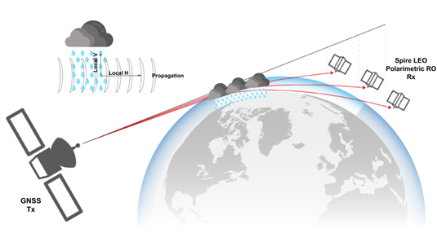




Commercial: PROGRES.Lu
Polarimetric Radio Occultation for Global Rain Estimation - Luxembourg
Spire activity within ESA InCubed programme
  https://incubed.esa.int/portfolio/progres/
  Industry proposal supported through co-funding
  Lemur cubesat
    with RO receiver for H- and V-polarisation
Scope
  PRO instrument development, s/c AIT, launch
  Ground processing
  Up to 6 months operation, evaluation
ICE-CSIC/IEEC Barcelona (Es) as scientific partner
Kick-Off July 2021, Final Review October 2023

Slide 4
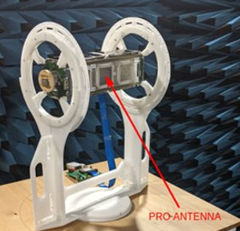
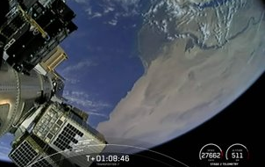
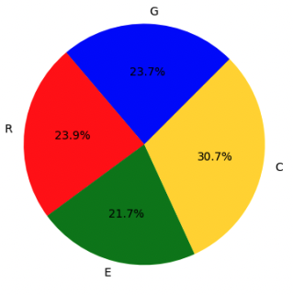
GNSS–PRO Operations went smoothly
Healthy s/c FM166 reported
~600…800 profiles / day from this s/c
Galileo, GPS, Beidou, Glonass
Geographic coverage as expected
PRO data quality and SNR’s as expected
Spire PRO FM deployment during SpaceX Transporter-6 launch
FM166
GPS
Glonass
Beidou
Latitude
Galileo
Local Solar Time [hours]
Source: IEEC

Slide 5
Initial PRO Analysis Results - IEEC
FM166
No Rain Rain
PRO processing performed at IEEC
Level 1 data from Spire
Sensitivity to Precipitation is demonstrated
Results are comparable to PAZ
GPS
Height [km]
Height [km]
Glonass
Avg ΔΦ grouped per IMERG SRR
ΔΦ Std Deviation
Galileo
Height [km]
Beidou
Height [km]
Source: IEEC
Source: IEEC
Source: IEEC
Notes:
Calibration: Linear fit of \Delta_\varphi in 20…80km
FM166 – most profiles are ‘setting’ geometry
Rain threshold about 1.5mm/h IMERG rain

Slide 6
Comparison Experiments – Preliminary State!
NEXRAD (US, ground based polarimetric weather Radars)
  3D info on rain profiles → ‘projected’ ΔΦ(h) derived from NEXRAD → compared to PRO measurement
  Preliminary, under development, just showing two exemplary good-looking profile results!
Source: IEEC
Source: IEEC

Slide 7
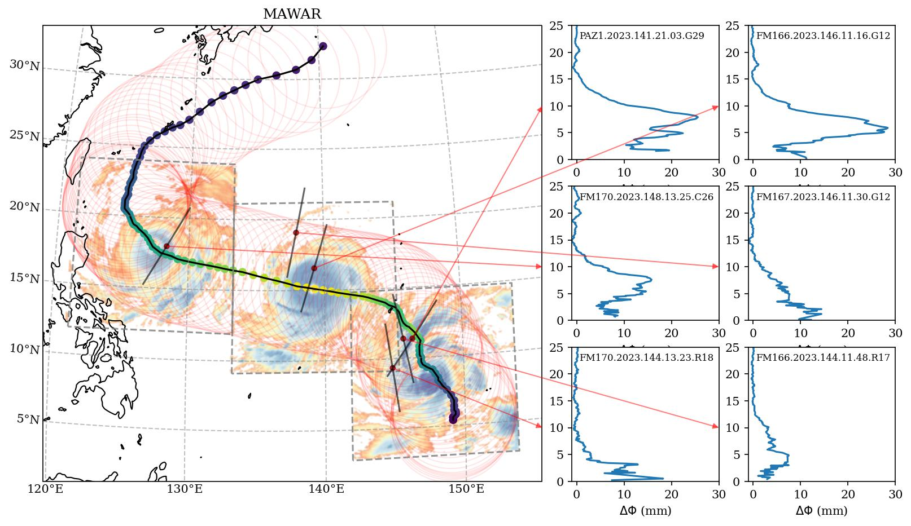
Sequences of Observations, Coincidences & Clusters
Combination of Observations over time:
Tropical Cyclones, example typhoon “Mawar”
Precipitation Detection is evident, comparable to PAZ
➔ Dense global PRO coverage → constellations
Clustering: Coincident observations
Cloud convective processes, entrainment
Example is one Spire, Multi-GNSS capable
➔ Clustering with s/c formations is beneficial
PAZ d141
Spire d146
Spire d148
Spire d146
148.2023
146.2023
141.2023
Source: IEEC
Source: IEEC

Slide 8
PRO - Summary Status
Status Quo PRO Production per 28/11/2023
  Measurements from PAZ – 1 s/c, operative and productive
    Data access open (registration), data since 2019
  Measurements from PROGRES – commercial s/c owned by Spire, one operative and productive
    Usefulness of Cubesat based PRO instrument is shown
    Data is ‘for sale’, data starting from Feb. 2023, lifetime of current PRO s/c is limited
    Spire plans for PRO s/c depend on demand and market
Scientific Users - ongoing work, and growing
  One ENABLER is AVAILABILITY of PRO measurements, at least non-realtime
  PRO s/c constellation and formations desired
Operational Use - in very early stage
  Forward operator under development, data needs under discussion
https://doi.org/10.5194/amt-2023-132

Slide 9


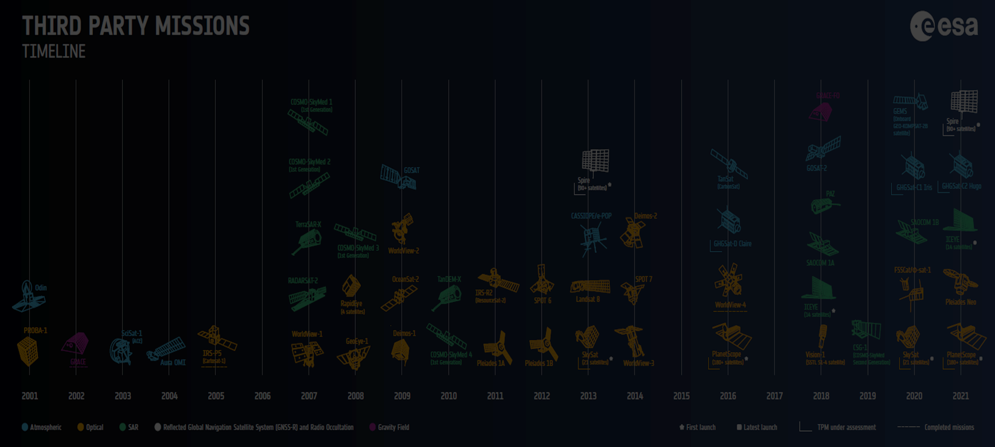
Ways towards PRO data: Third Party Missions
ESA buys data for its own purposes on behalf of other institutions
  ESA Third Party Missions (for R&D and Science)
    includes some coordination with NASA
On Nov 23rd Spire officially joined ESA’s Earthnet TPM programme
  Products covered could focus on GNSS-RO and GNSS-R; details tbc
  R&D stakeholders may receive data on a free basis
    pending submission and acceptance of a project proposal
https://earth.esa.int/eogateway/news/esa-promotes-radio-frequency-monitoring-as-spire-becomes-tpm
https://earth.esa.int/eogateway
Notes:
Spire constellation was approved for ESA Earthnet TPM at PB-EO Nov 21 2023
To be reminded: PRO can be used as RO
Continuation as long as supply and demand exist, no fixed time limit, regular re-assessment

Slide 10
PRO related Activities
EarthNet / TPM for Data access – under investigation
  Scientists will be invited to submit project proposals to ESA to assess the PRO data
ESA FutureEO Programme is open to support Scientific Users
  Considering studies e.g. for assimilation into NWP models
Cooperation with Operational Users
  ECMWF, Eumetsat, MetOffice ➔ Extend data usage to PRO, mainly for NWP
  Support through a combination of TPM and FutureEO
  Timeline is multi-year, not short term
Notes:
➔ the market is not yet stable – difficult for commercial providers
Patience will be needed

Slide 11
Conclusion
PROGRES.Lu is a success – PRO on Cubesats
GNSS-PRO is considered a serious upcoming evolution of RO
  PRO measurements provide classical RO plus new observable
ESA EarthNet discusses PRO data procurement – TPM
Science is needed,
  a lot of work still to be done – looking forward to this workshop
European operational users already looking at PRO – very promising
Time for Questions

