Slide 1

2nd PRO workshop 2023
PAZ RO signal processing and analysis in JPL
K.-N. Wang¹, C. O. Ao¹, M. de la Torre Juárez ¹, R. Padullés²
¹ Jet Propulsion Laboratory, California Institute of Technology, Pasadena, California, USA
² Institut de Ciències de l’Espai-CSIC, Bellaterra, Spain
Nov 28, 2023

Slide 2
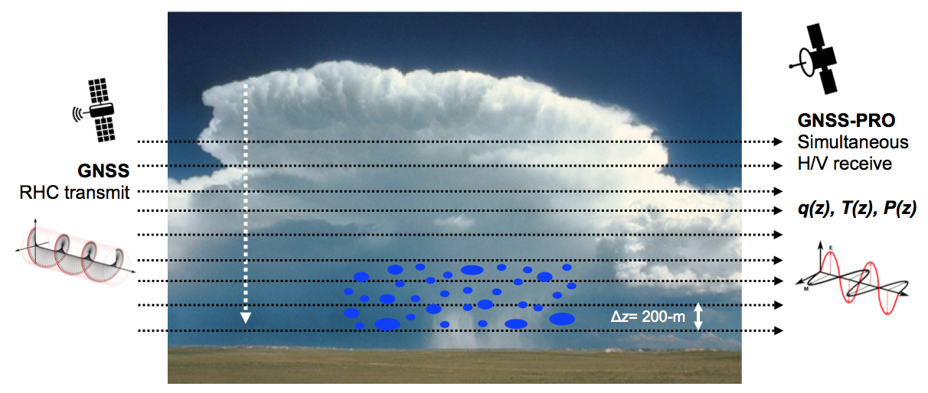
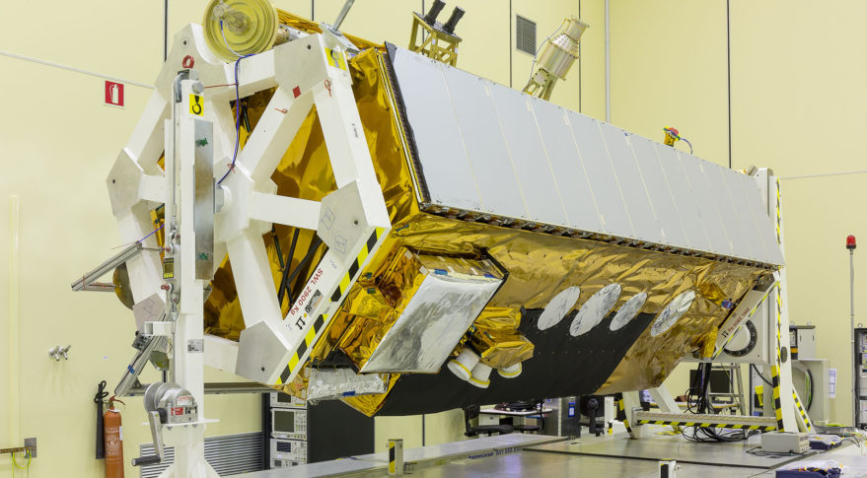

Introduction
Polarimetric RO (PRO)
GNSS signal (RHCP) will be depolarized when propagating through heavy precipitation
PRO is capable of measuring the phase difference between the polarization channels (H/V) induced by heavy precipitation
$$∆φ$$

Slide 3









Processing flowchart
JPL / ICE-CSIC / UCAR
JPL
ICE-CSIC
UCAR
$ΦH$, $ΦV$
$ΦH$, $ΦV$
$ΦH$, $ΦV$
$$∆Φ(t)$$
$$∆Φ(t)$$
$Φex(t)$
$α_{H}\left(a\right)$, $α_{v}\left(a\right)$
$α(a)$
$$∆Φ\left(a\right),∆α\left(a\right)$$

Slide 4
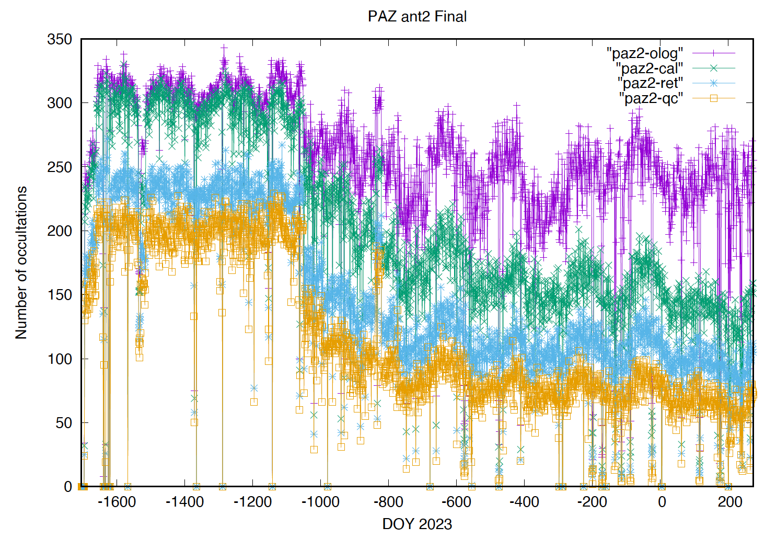
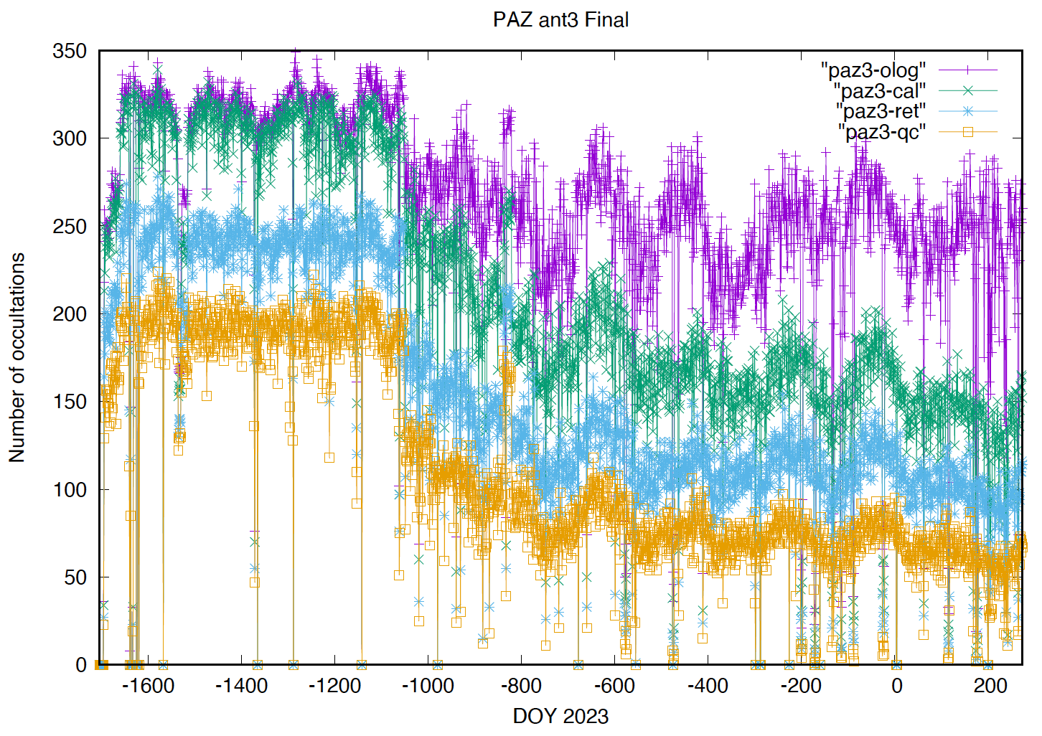
JPL PRO processing status
PAZ processing (Left: Horizontal, Right: Vertical)

Slide 5
JPL PRO processing status
TerraSAR-X flex power fix
Flex Power begins
Flex Power begins
IGOR fw upgrade
IGOR fw upgrade

Slide 6
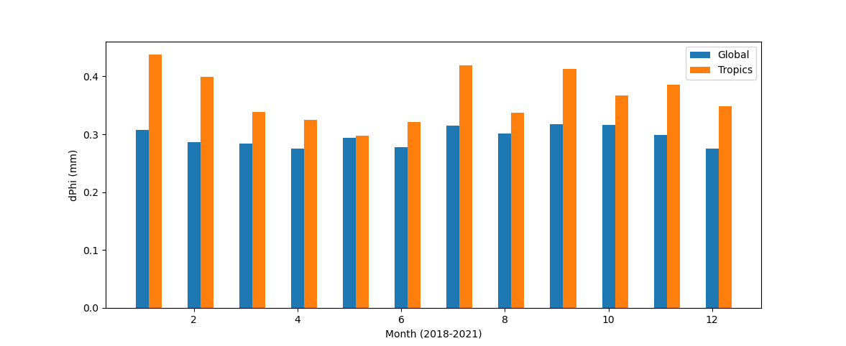
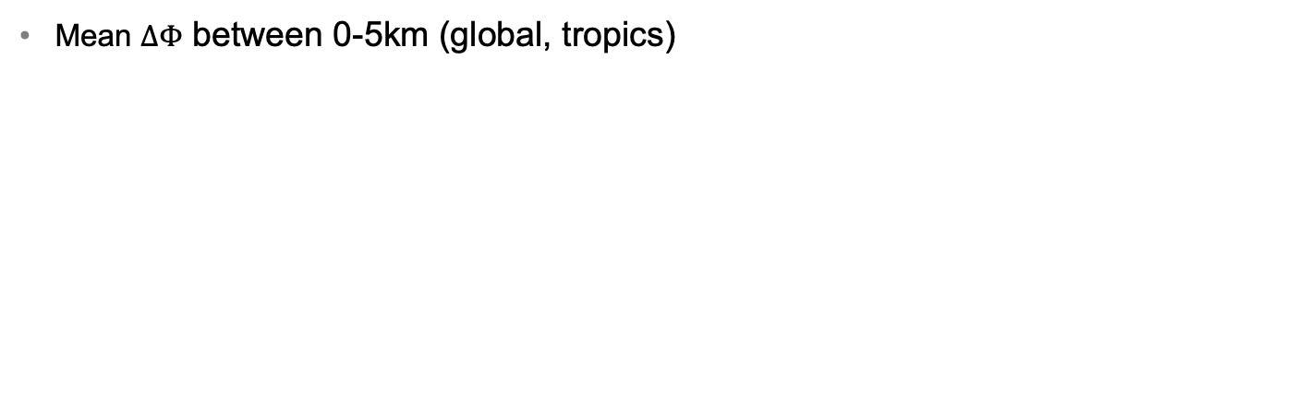
Statistics
Temporal distribution
Mean $∆Φ$ between 0-5km (global, tropics)

Slide 7
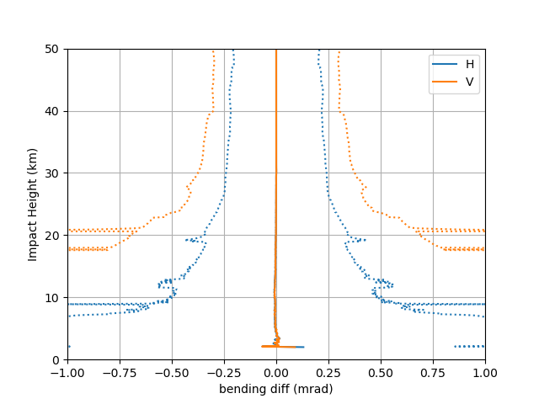
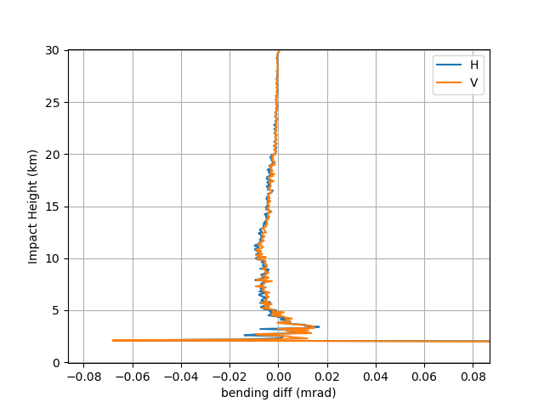

Statistics
JPL vs UCAR bending comparison (Jan. 2020) - Global
$$α_{H/V}\left(a\right)−α\left(a\right)$$

Slide 8
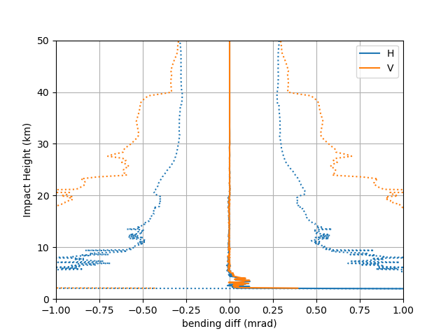
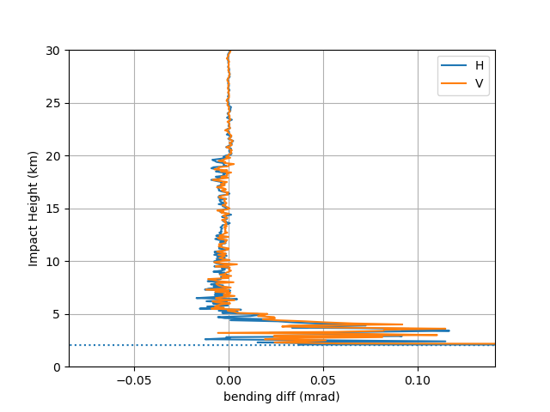
Statistics
JPL vs UCAR bending comparison (Jan. 2020) - Tropics
$$α_{H/V}\left(a\right)−α\left(a\right)$$

Slide 9
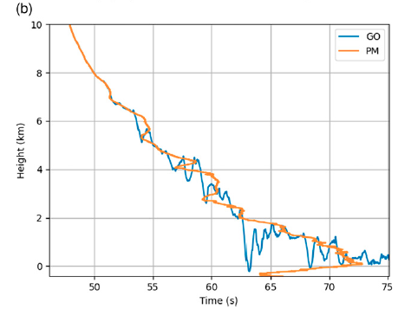
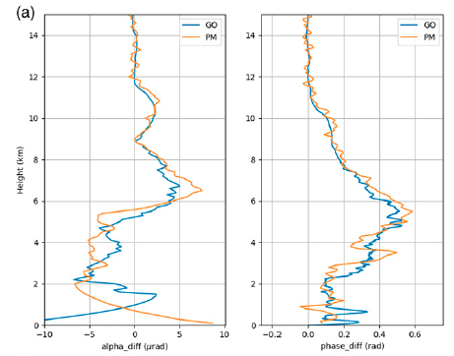
Path to data assimilation
$∆Φ$ on impact parameter domain
Multipath effect
  GO cannot resolve the multipath problem in the lower troposphere
[Wang et al., JTECH 2022]

Slide 10
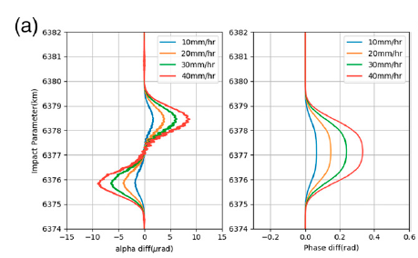
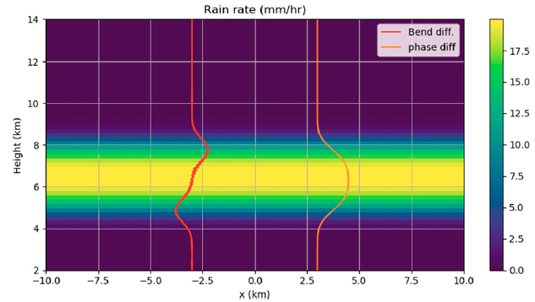
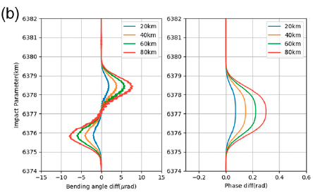
Path to data assimilation (cont.)
$∆Φ$ on impact parameter domain
Bending and phase shift
[Wang et al., JTECH 2022]

Slide 11
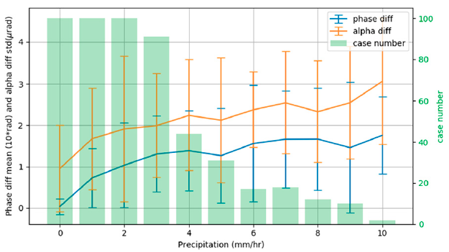
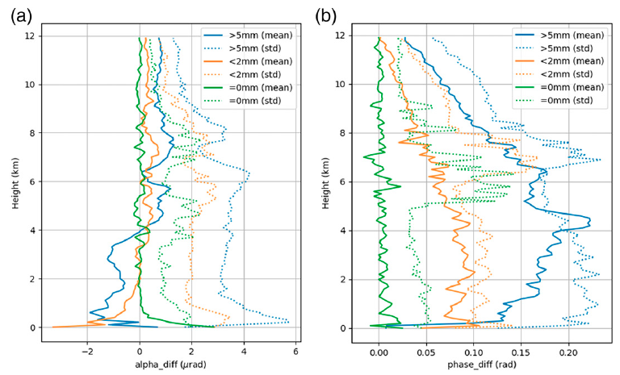

Path to data assimilation (cont.)
$∆Φ$ on impact parameter domain
Statistics (precipitation rate with $∆Φ$ )
[Wang et al., JTECH 2022]

Slide 12
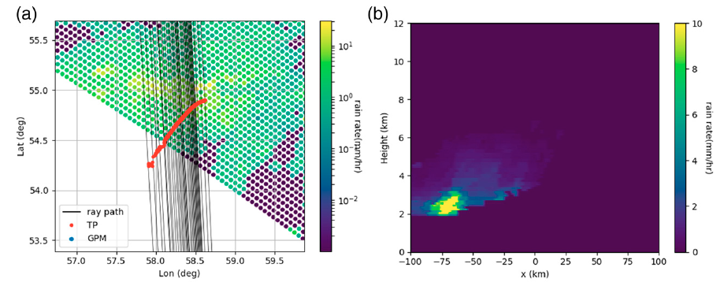
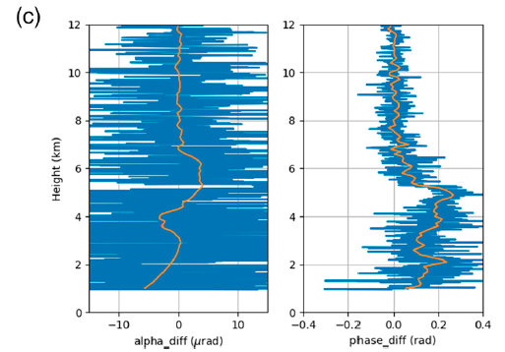
Path to data assimilation (cont.)
$∆Φ$ on impact parameter domain
Real RO/GPM case
[Wang et al., JTECH 2022]

Slide 13
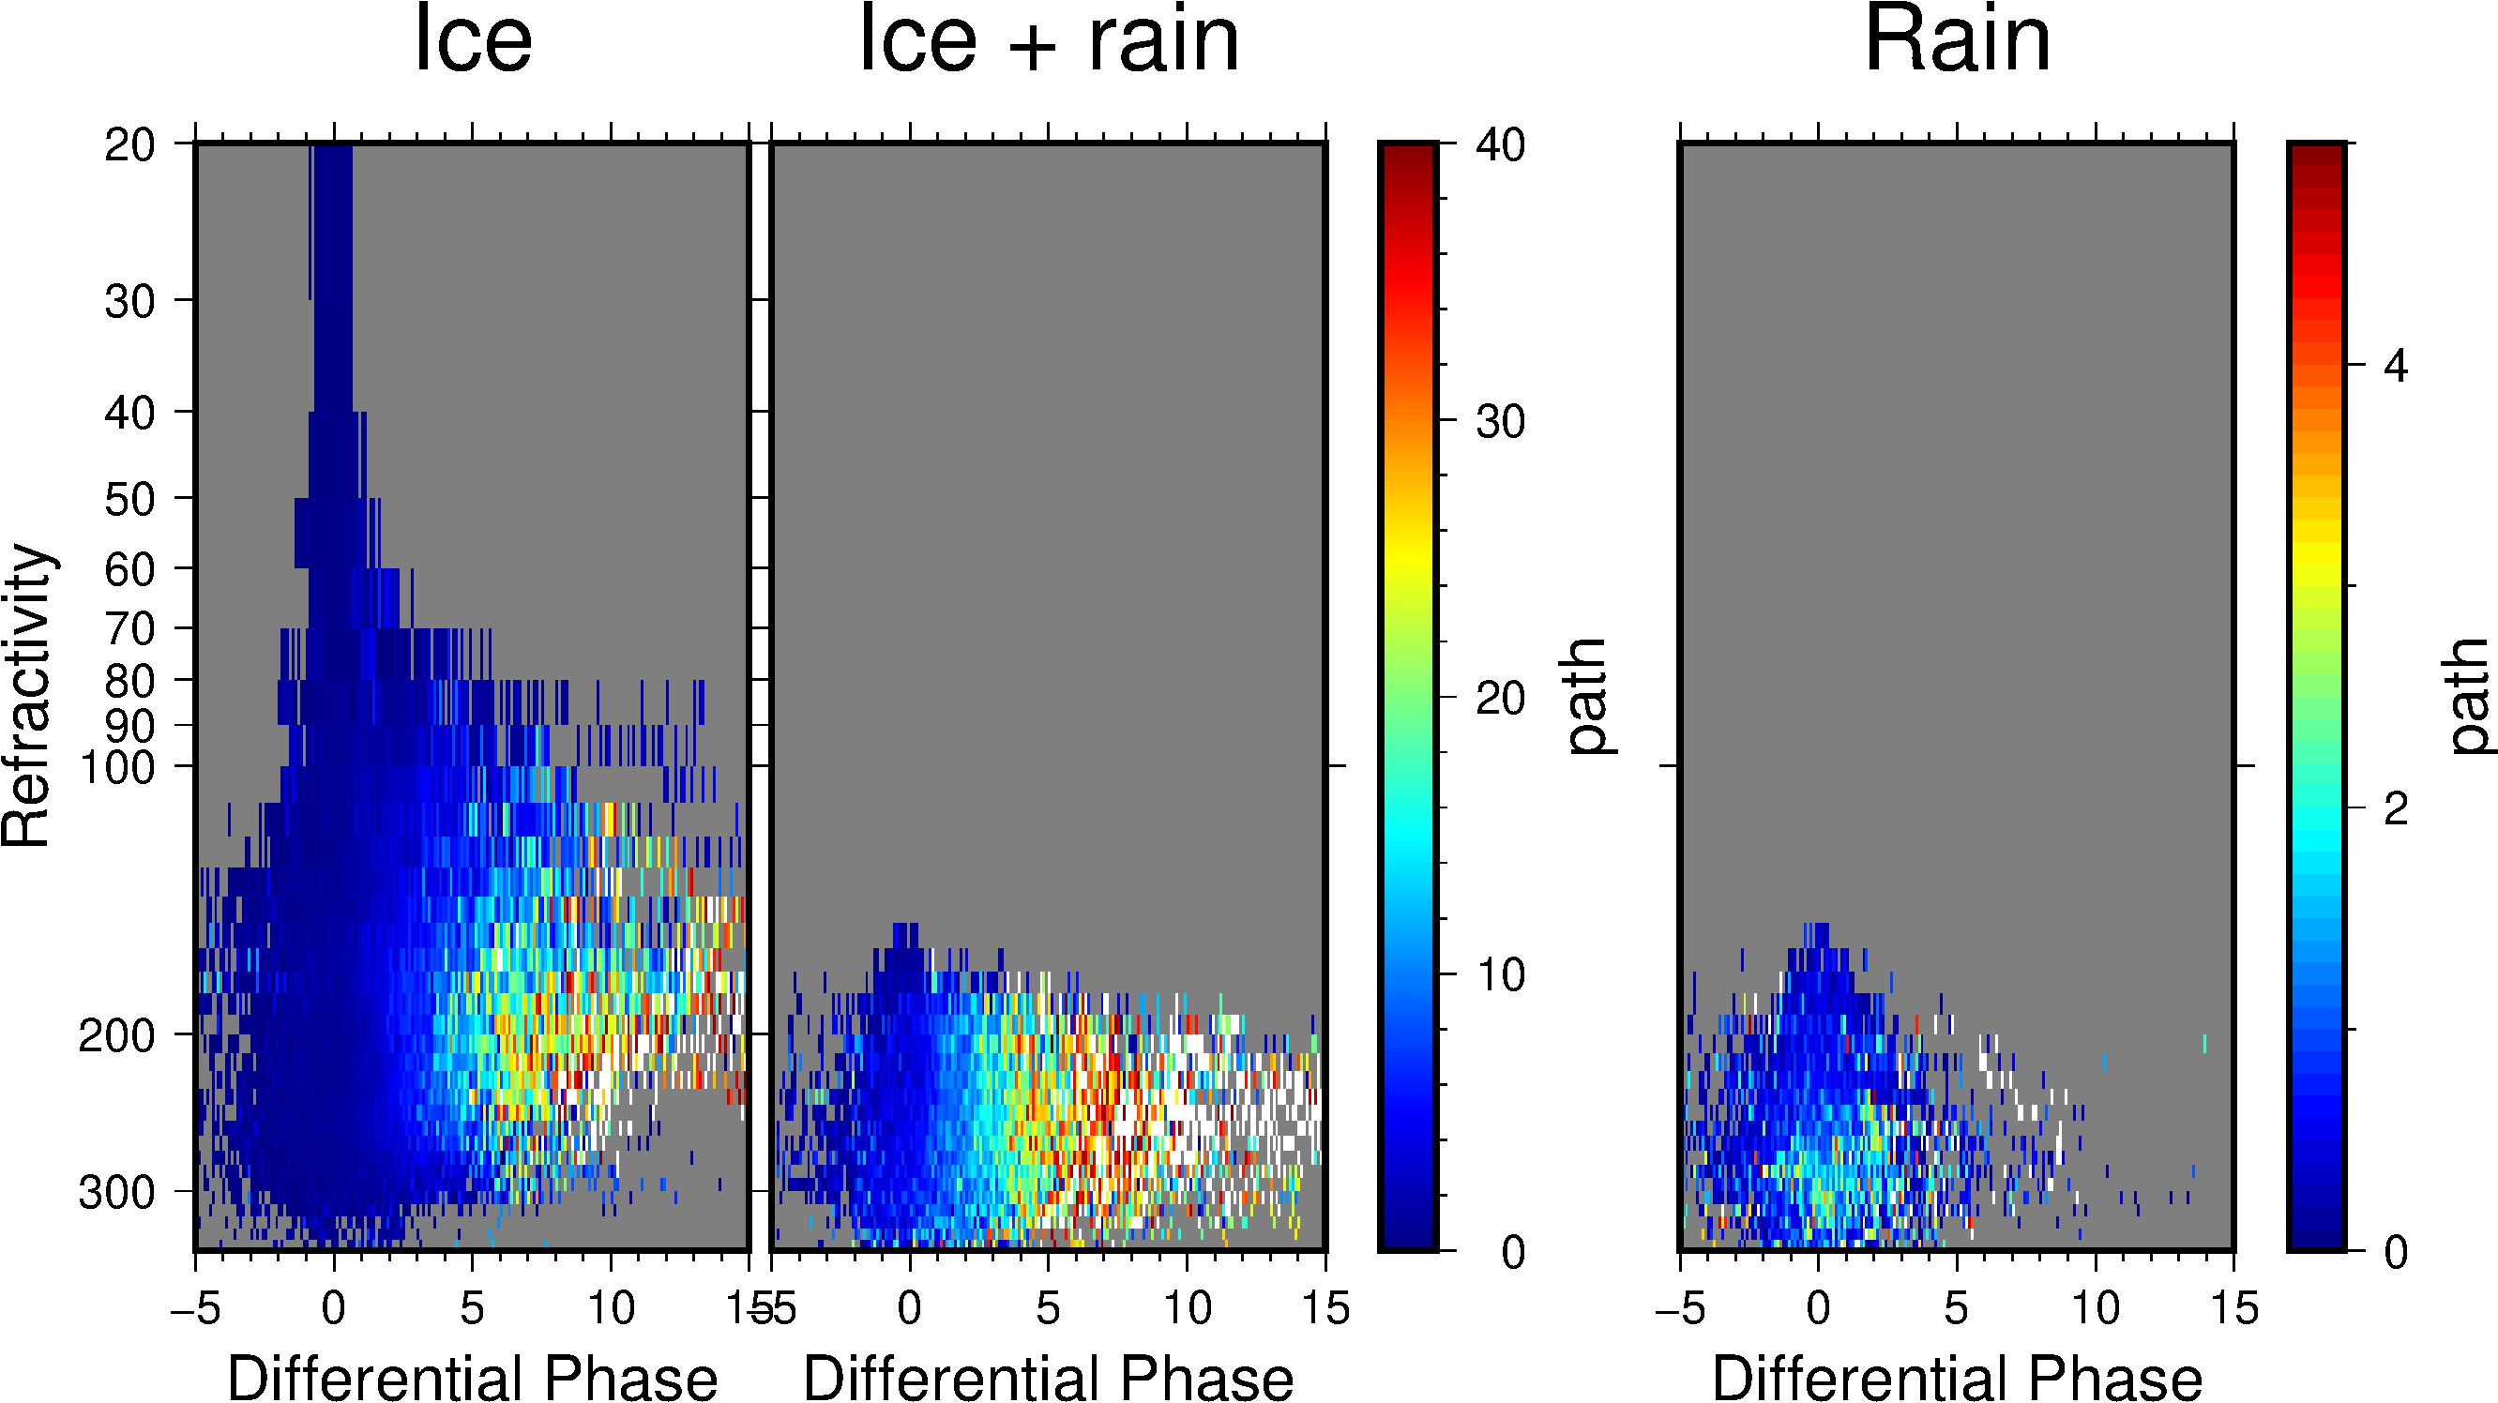
Rain rate retrieval - Look Up Table (LUT)
$∆Φ$ with precipitation rate
Left: PAZ PRO with collocated GPM data, Right: T-matrix simulation
[ Cardellach et al., QJRMS, 2017]

Slide 14
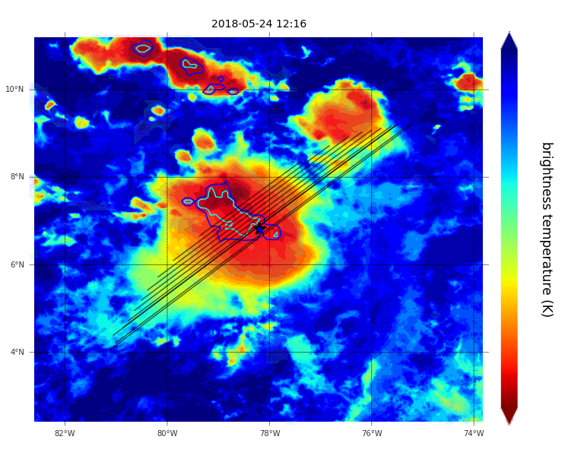
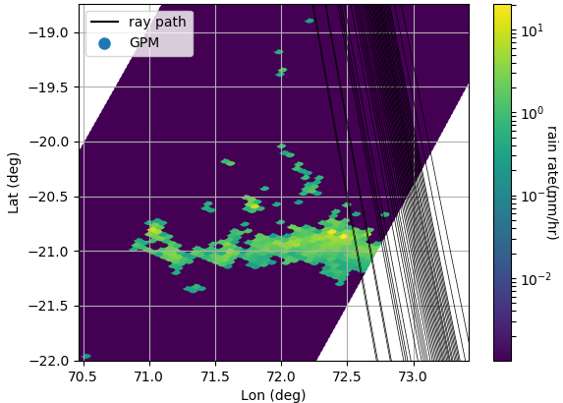
Rain rate retrieval – known horizontal extent
$∆Φ$ with precipitation rate
Goal: Estimate effective rain rate at each heights
Assumptions:
  Horizontal extent is known through other obs
  Rain rate remains constant between the extent
Horizontal extents can be acquired using collocated IR or microwave measurements

Slide 15
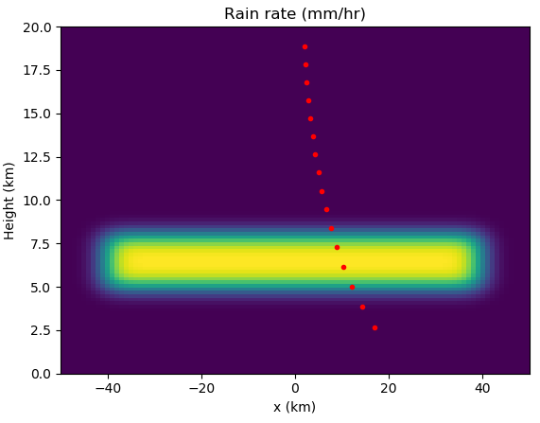
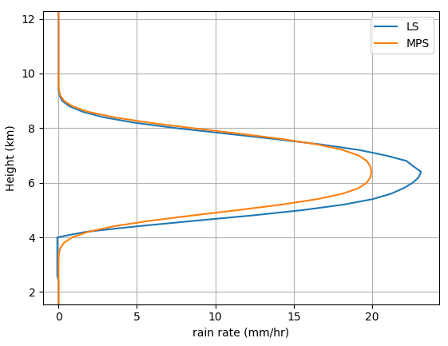
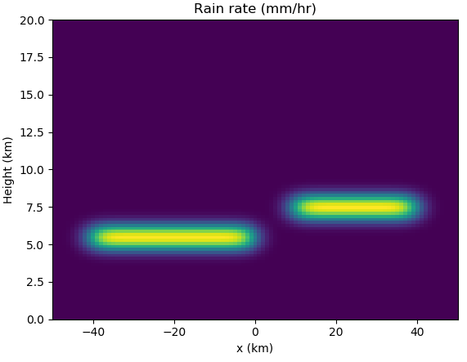
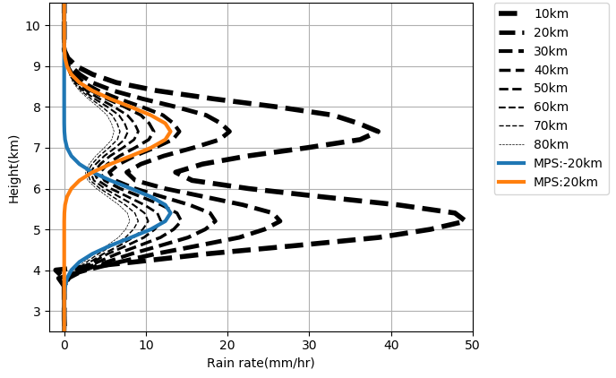
Rain rate retrieval – known horizontal extent
$∆Φ$ with precipitation rate
Multiple Phase Screen (MPS) Simulation
2D rain rate
MPS
Signal Phase
FW model
1D rain rate
Bending Angle
LS

Slide 16
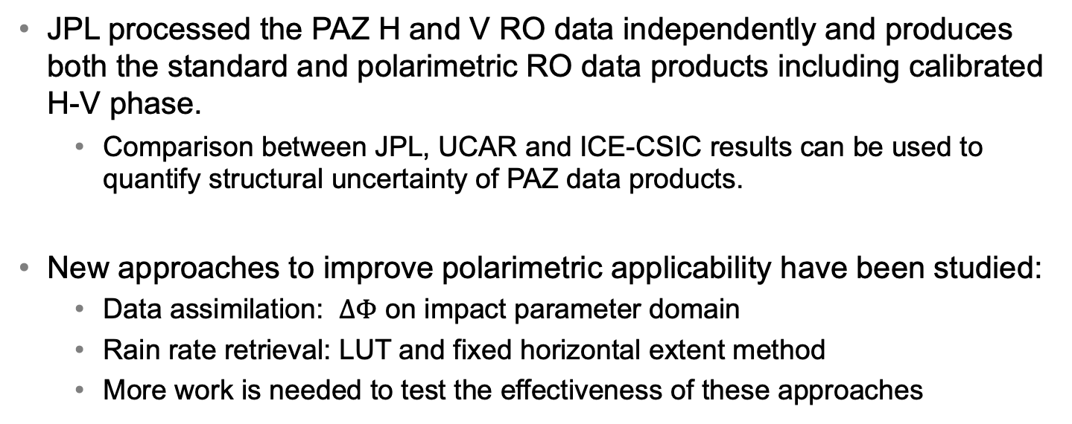
Conclusion
PAZ PRO processing and analysis
JPL processed the PAZ H and V RO data independently and produces both the standard and polarimetric RO data products including calibrated H-V phase.
  Comparison between JPL, UCAR and ICE-CSIC results can be used to quantify structural uncertainty of PAZ data products.
New approaches to improve polarimetric applicability have been studied:
  Data assimilation: $∆Φ$ on impact parameter domain
  Rain rate retrieval: LUT and fixed horizontal extent method
  More work is needed to test the effectiveness of these approaches

Slide 18
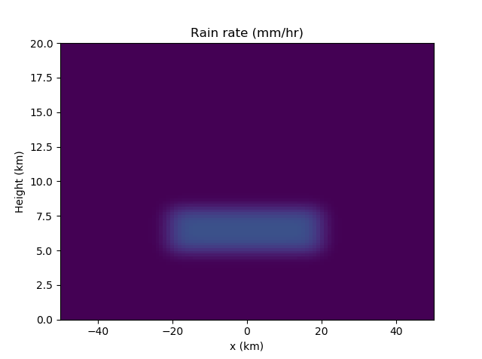
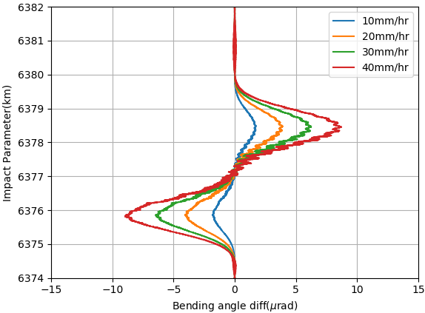
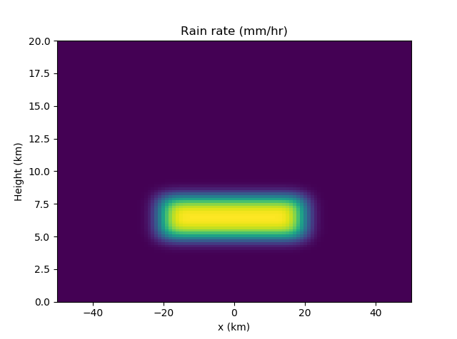
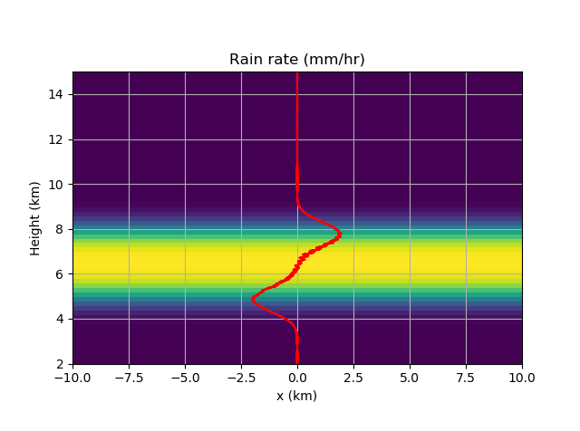
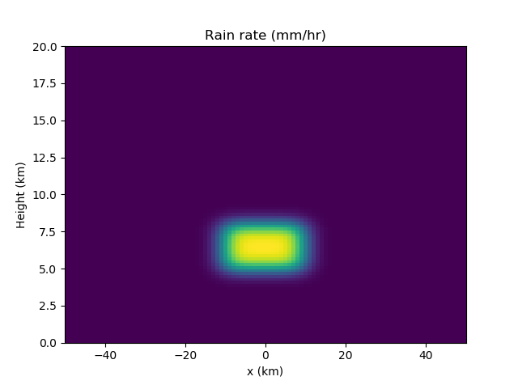
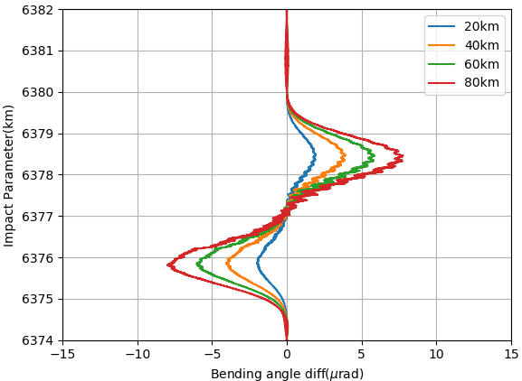
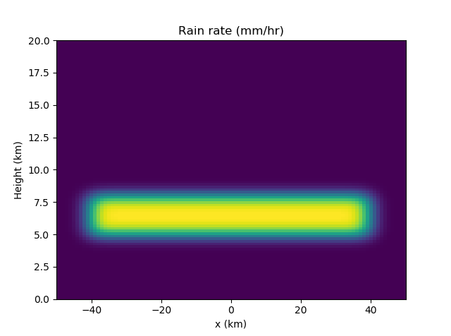
Rain rate retrieval – known horizontal extent
$∆Φ$ with precipitation rate
Depolarization results in different bending angle retrievals between H-V
However, the precipitation strength and the horizontal extent are coupled

Slide 19

Rain rate retrieval - LUT (cont.)
$∆Φ$ with precipitation rate
Using PM to calculate $∆Φ$

Slide 20
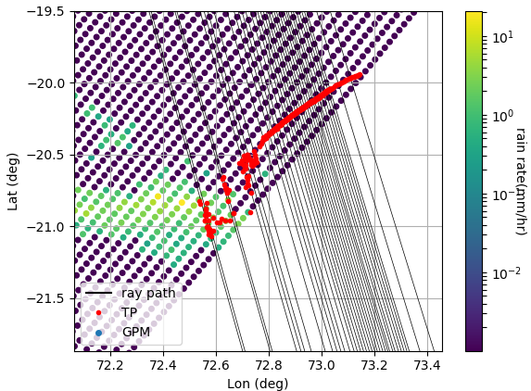
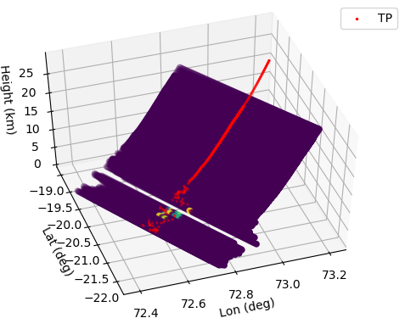
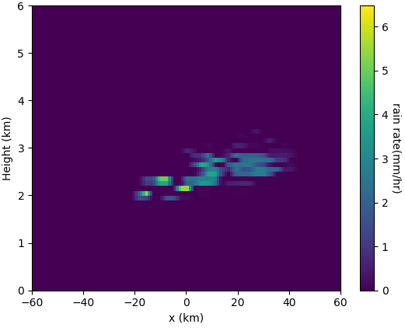
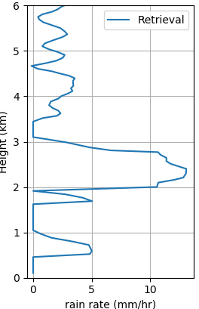
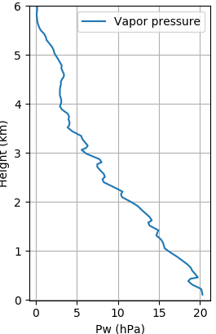
Rain rate retrieval – known horizontal extent
$∆Φ$ with precipitation rate
2018-07-16 Ind. Ocean
  Collocation with GPM data
  Horizontal extent width: 60km
  Rain rate over-estimation:
    - Noise
    - Mis-modeling
    - Low coverage of GPM swath

Slide 21




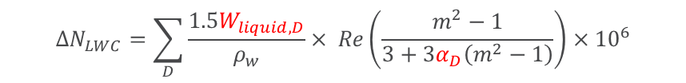




PRO rain rate retrieval
Forward Model
  Refractivity changes: For certain rain rate we can calculate the resulting drop size distribution (DSD) and its corresponding drop axis ratio.
$$ΔN_{LWC}=\sum_{D}{\frac{1.5W_{liquid,D}}{ρ_{w}}× Re\left(\frac{m^{2}−1}{3+3α_{D}\left(m^{2}−1\right)}\right)×{10}^{6}}$$
  2D ray tracing: propagating the ray path based on the calculated refractivity deviation for both H and V channels
$$x_{1}$$
$$x_{2}$$
$$N\left(r\right)$$
$$N_{H}\left(r\right)$$
$$N\left(r\right)$$
$$N_{V}\left(r\right)$$
Ray tracing:
$$a=nrsinψ=const$$
Bending angle: $α$

