Slide 1
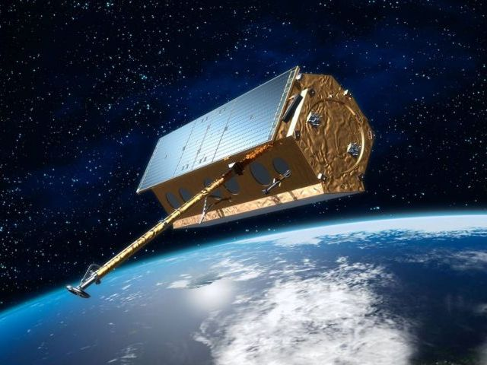
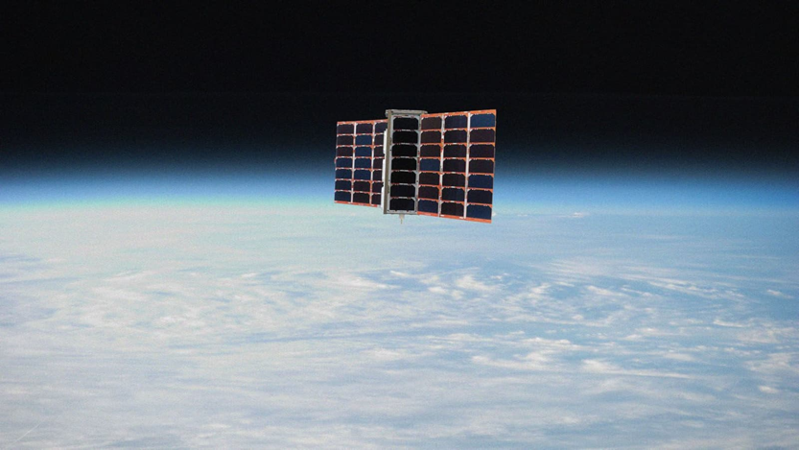
Polarimetric RO processing at UCAR
Doug Hunt, Teresa Vanhove, Jan Weiss
University Corporation for Atmospheric Research (UCAR, Boulder CO, USA)
Estel Cardellach
Institute of Space Sciences (ICE, CSIC)
Institute for Space Studies of Catalonia (IEEC) Barcelona, Spain
2nd PRO workshop, Pasadena CA, Nov 28-29, 2023

Slide 2
Contents
‘Normal’ Radio Occultation (RO) processing for PAZ at UCAR
CDAAC data flow
Single polarization processing
Combining polarizations
Results
Initial Spire results
Traditional RO
Differences with PAZ
First attempts at $∆φ$ computation
Conclusion
Notes:
As Josep Aparico noted, ‘careful execution’ is important,

Slide 3
PAZ Data Flow at CDAAC
HISDESAT ASCII data
SPID 28011 and 28012 (IGOR)
IGOR binary
RINEX data
opnGNS (occultation) data
Excess phase process
conPhs files (H, V or combined)
SPID 15001 (attitude)
leoAtt files
POD process
LEO orbits
Inversion process
--or--
atmPrf (occultation profile) files
New software:
Fairbanks PAZ download
Special purpose decoding software created for HISDESAT archive data and for Fairbanks downlink station binary data
Custom excess phase software to combine H and V polarizations

Slide 4
Single Polarization Processing
Normal RO processing
Start with high rate opnGns occultation data
Remove orbital motion (LEO and GNSS POD data), GNSS clocks (e.g. IGS products), and LEO clocks (via differencing with a high elevation (reference) satellite)
Compute an atmospheric Doppler model from climatology
Integrate this model to get a phase model, then difference it with the observed (excess) phase computed above
This phase angle $∆θ$ is now rotating slowly enough to generate meaningful I and Q components: $I=SNR ∗\cos\left(∆θ\right), Q=SNR ∗\sin\left(∆θ\right)$
Apply navigation bits to the open-loop portion of I and Q
Stitch open- and closed-loop I’s and Q’s together
Compute phase via $atan2\left(Q,I\right)$
Fix full cycle slips by adding or subtracting $2π$ to minimize the difference between samples
Add the phase model back in to get connected excess phase
These connected L1 and L2 phases are then submitted to the inversion process to compute bending angle, refractivity, and finally temperature and pressure profiles. This same inversion process is used by all other missions.

Slide 5
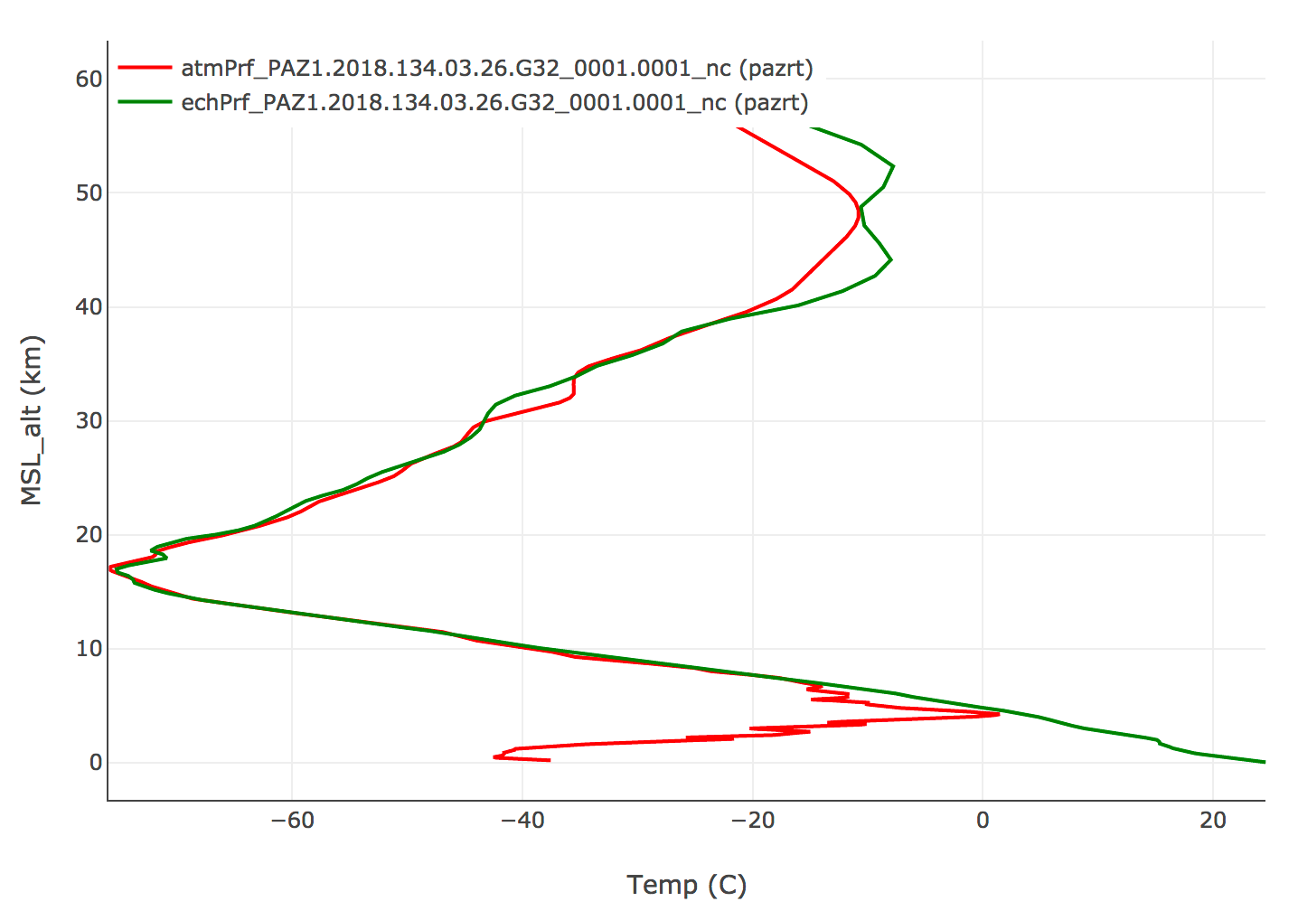
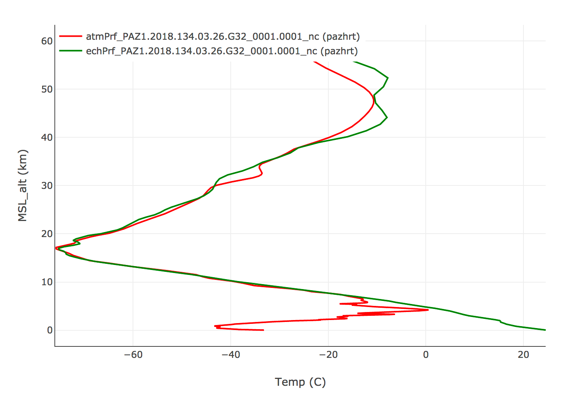
PAZ V and H Compared
Single-polarization processing generates reasonable results
Retrieved profile (red), ECMWF short term forecast derived profile (green)
Vertical
Horizontal

Slide 6
Dual Polarization Processing via Vector Sum of I and Q
Determine a ‘master’ polarization for this occultation. We use higher SNR to choose between H and V
Compute separate Horizontal and Vertical I and Q values as in the single-polarization example
Determine the phase alignment between H and V
Line the I’s and Q’s up and use the ‘master’ to fix ½ cycle slips in the ‘slave’
Find the point at which the slave polarization signal descends into noise. This is the point at which to stop the vector combination
Perform a vector sum of the lined up I and Q values from the master and slave: $I= I_{s}$+ $I_{m}$, $Q=Q_{s}$+ $Q_{m}$
Assemble the combined excess phase (as in steps 9-11 in the single polarization processing)
Compute the SNR of the combined signal as $\frac{\sqrt{I^{2}+Q^{2}}}{\sqrt{2}}$ (assumes similar random noise on H and V channels)
Q
combined
slave
master
I

Slide 7
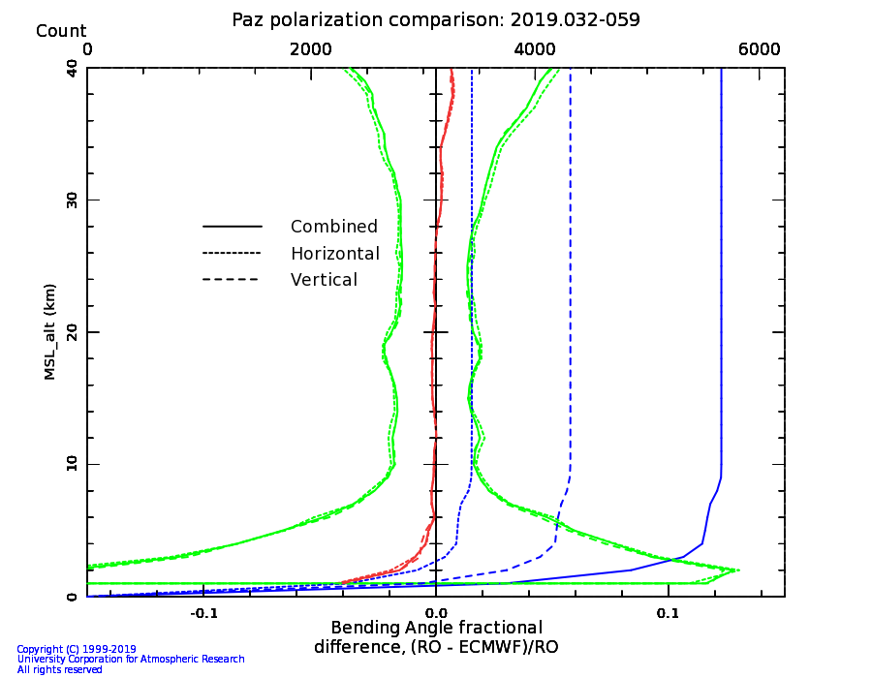
V/H Combination Results
Combined processing results in good statistics compared with ECMWF.
The combination results in much higher occultation counts compared with processing H or V polarization separately.
Polarization | Good occultation count
Vertical | 4390
Horizontal | 3493
Combined | 5750
Notes:
As Josep Aparico noted, ‘careful execution’ is important,

Slide 8
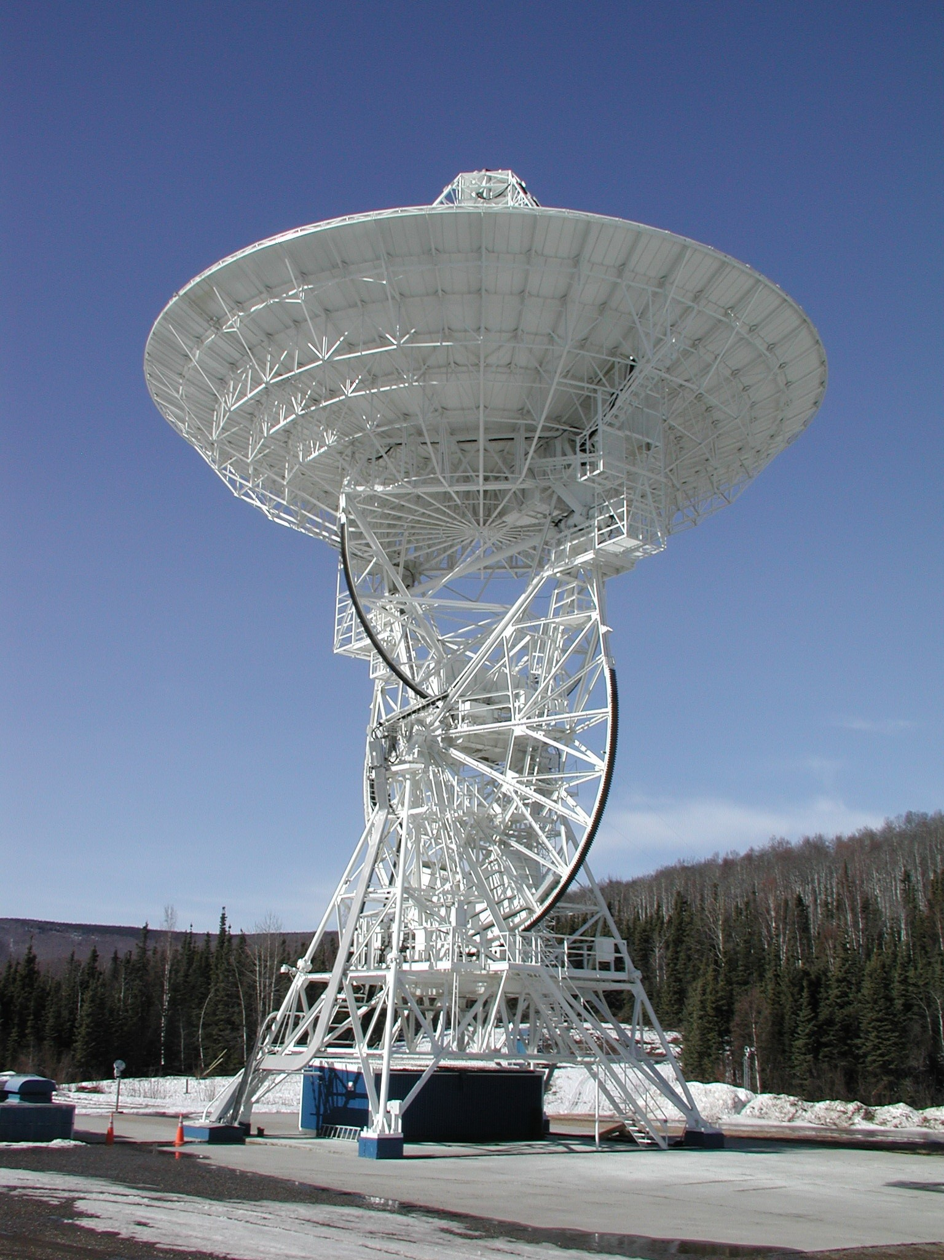
Operational PAZ Processing
Fairbanks data for PAZ downlinked and processed at CDAAC since March 2019
Near real-time processing implemented
Leveraging COSMIC-2 data processing center infrastructure
UCAR/CDAAC PAZ products are being provided to the NOAA Product Distribution and Access (PDA) system since July 2019
PAZ products also sent to weather centers worldwide via WMO GTS
Notes:
As Josep Aparico noted, ‘careful execution’ is important,

Slide 9
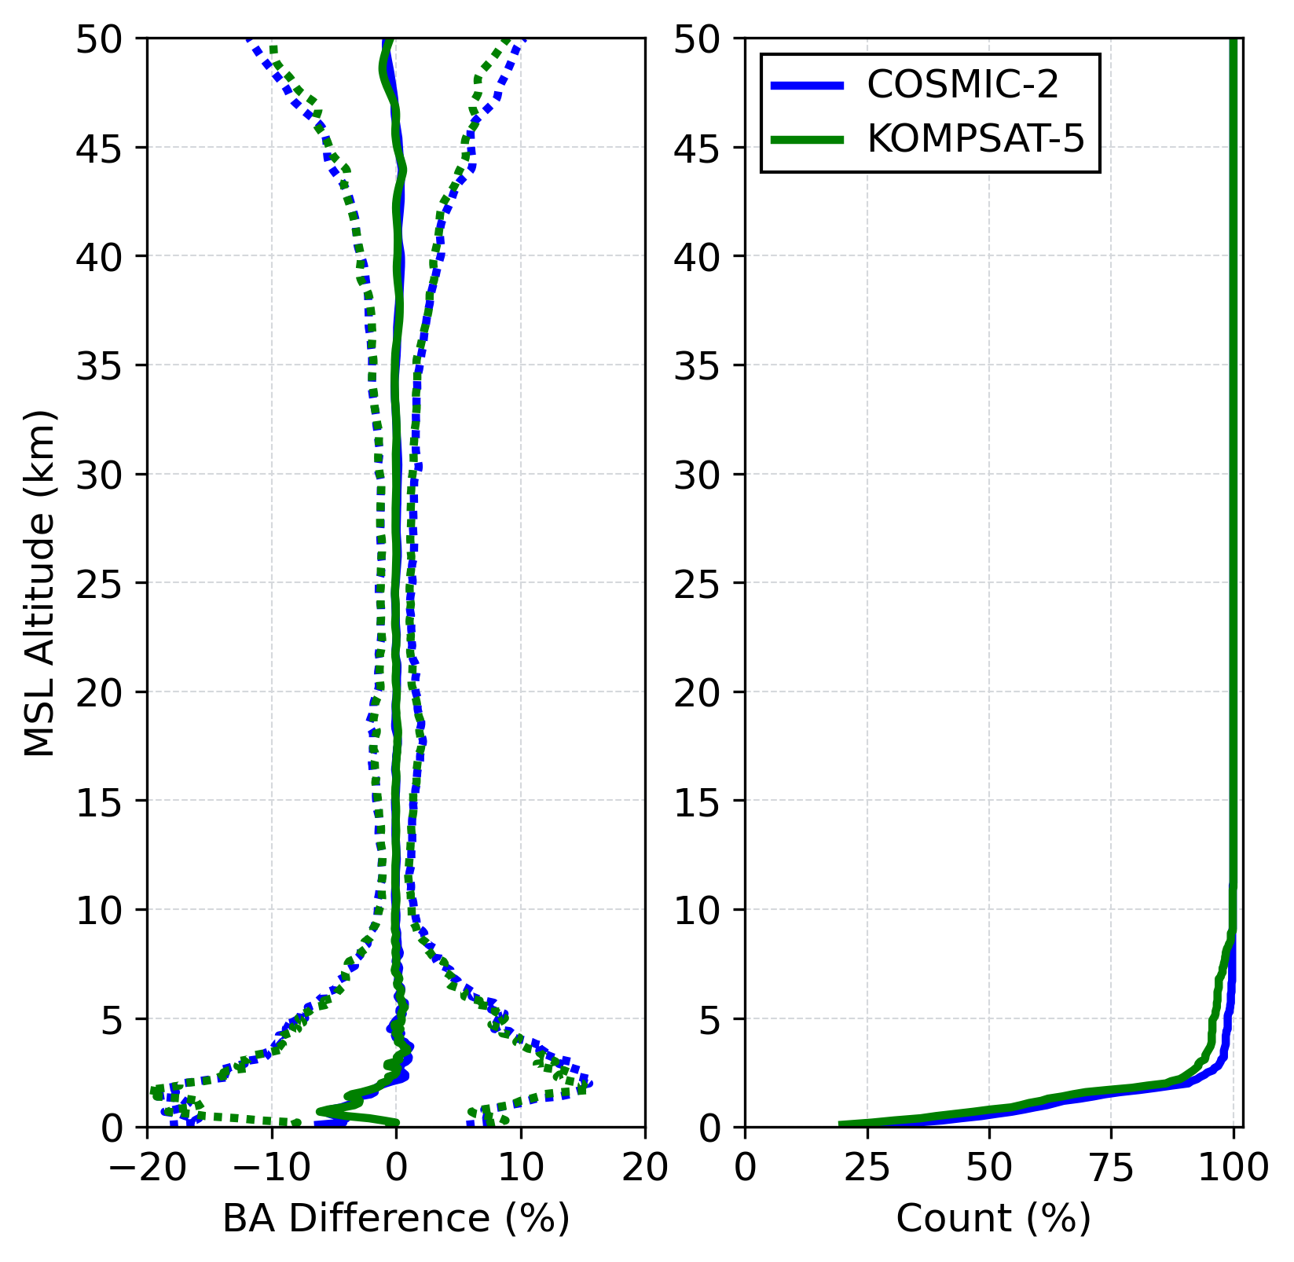
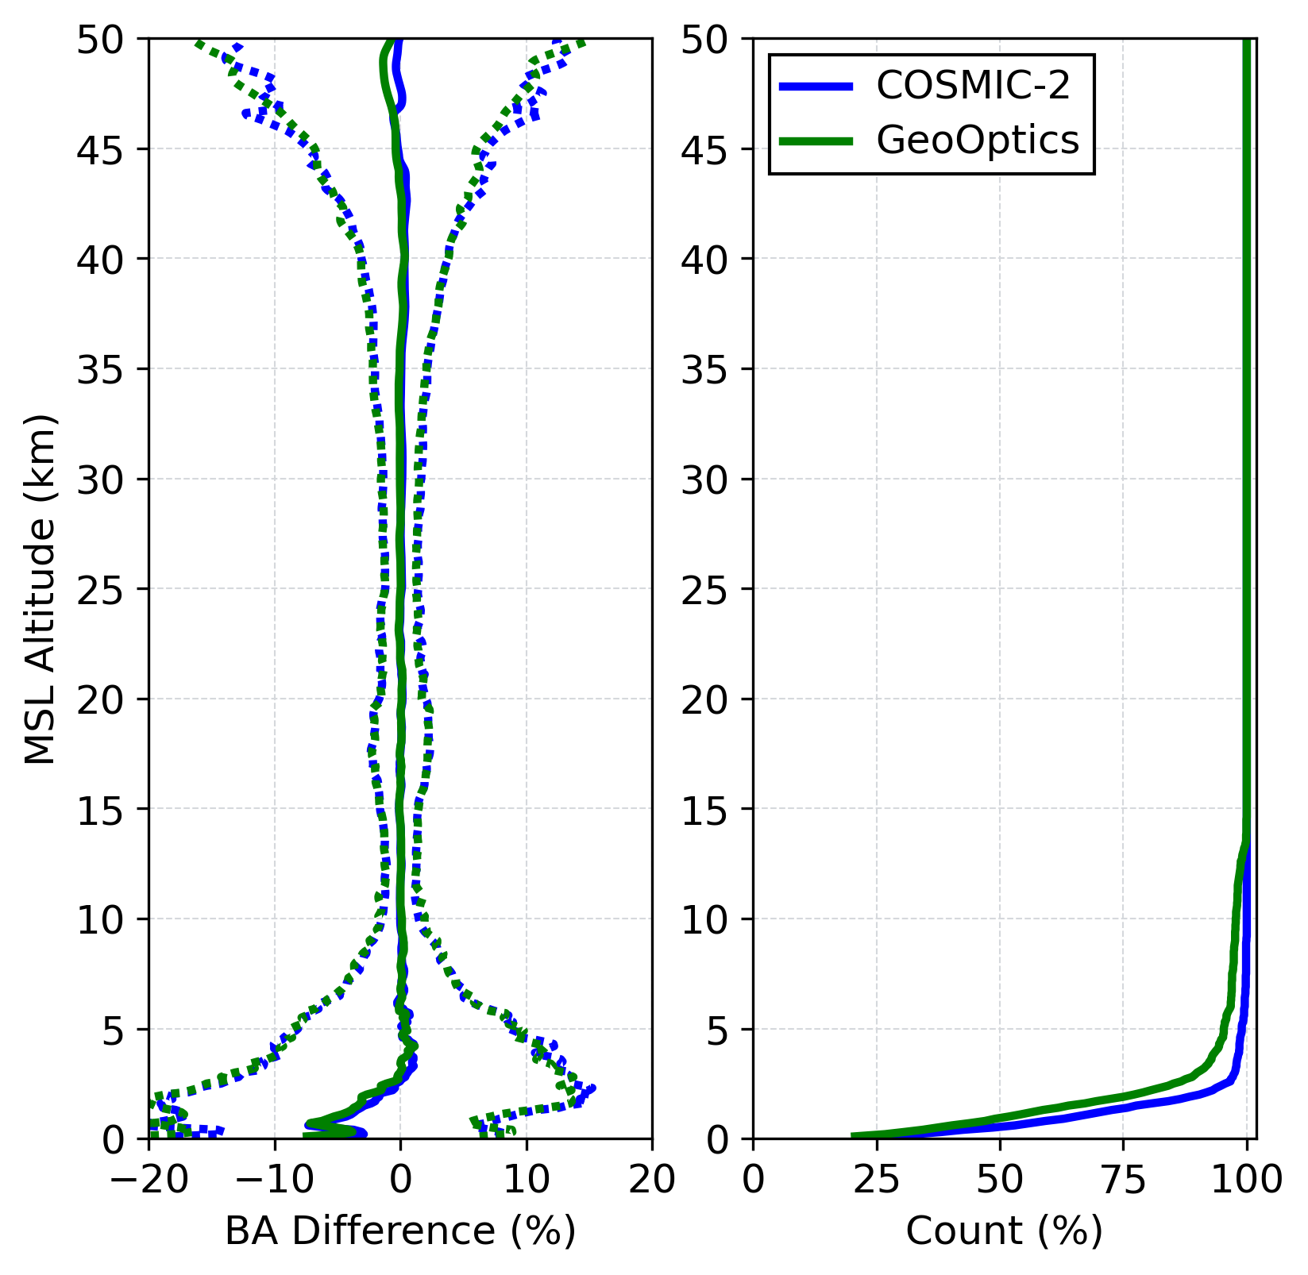
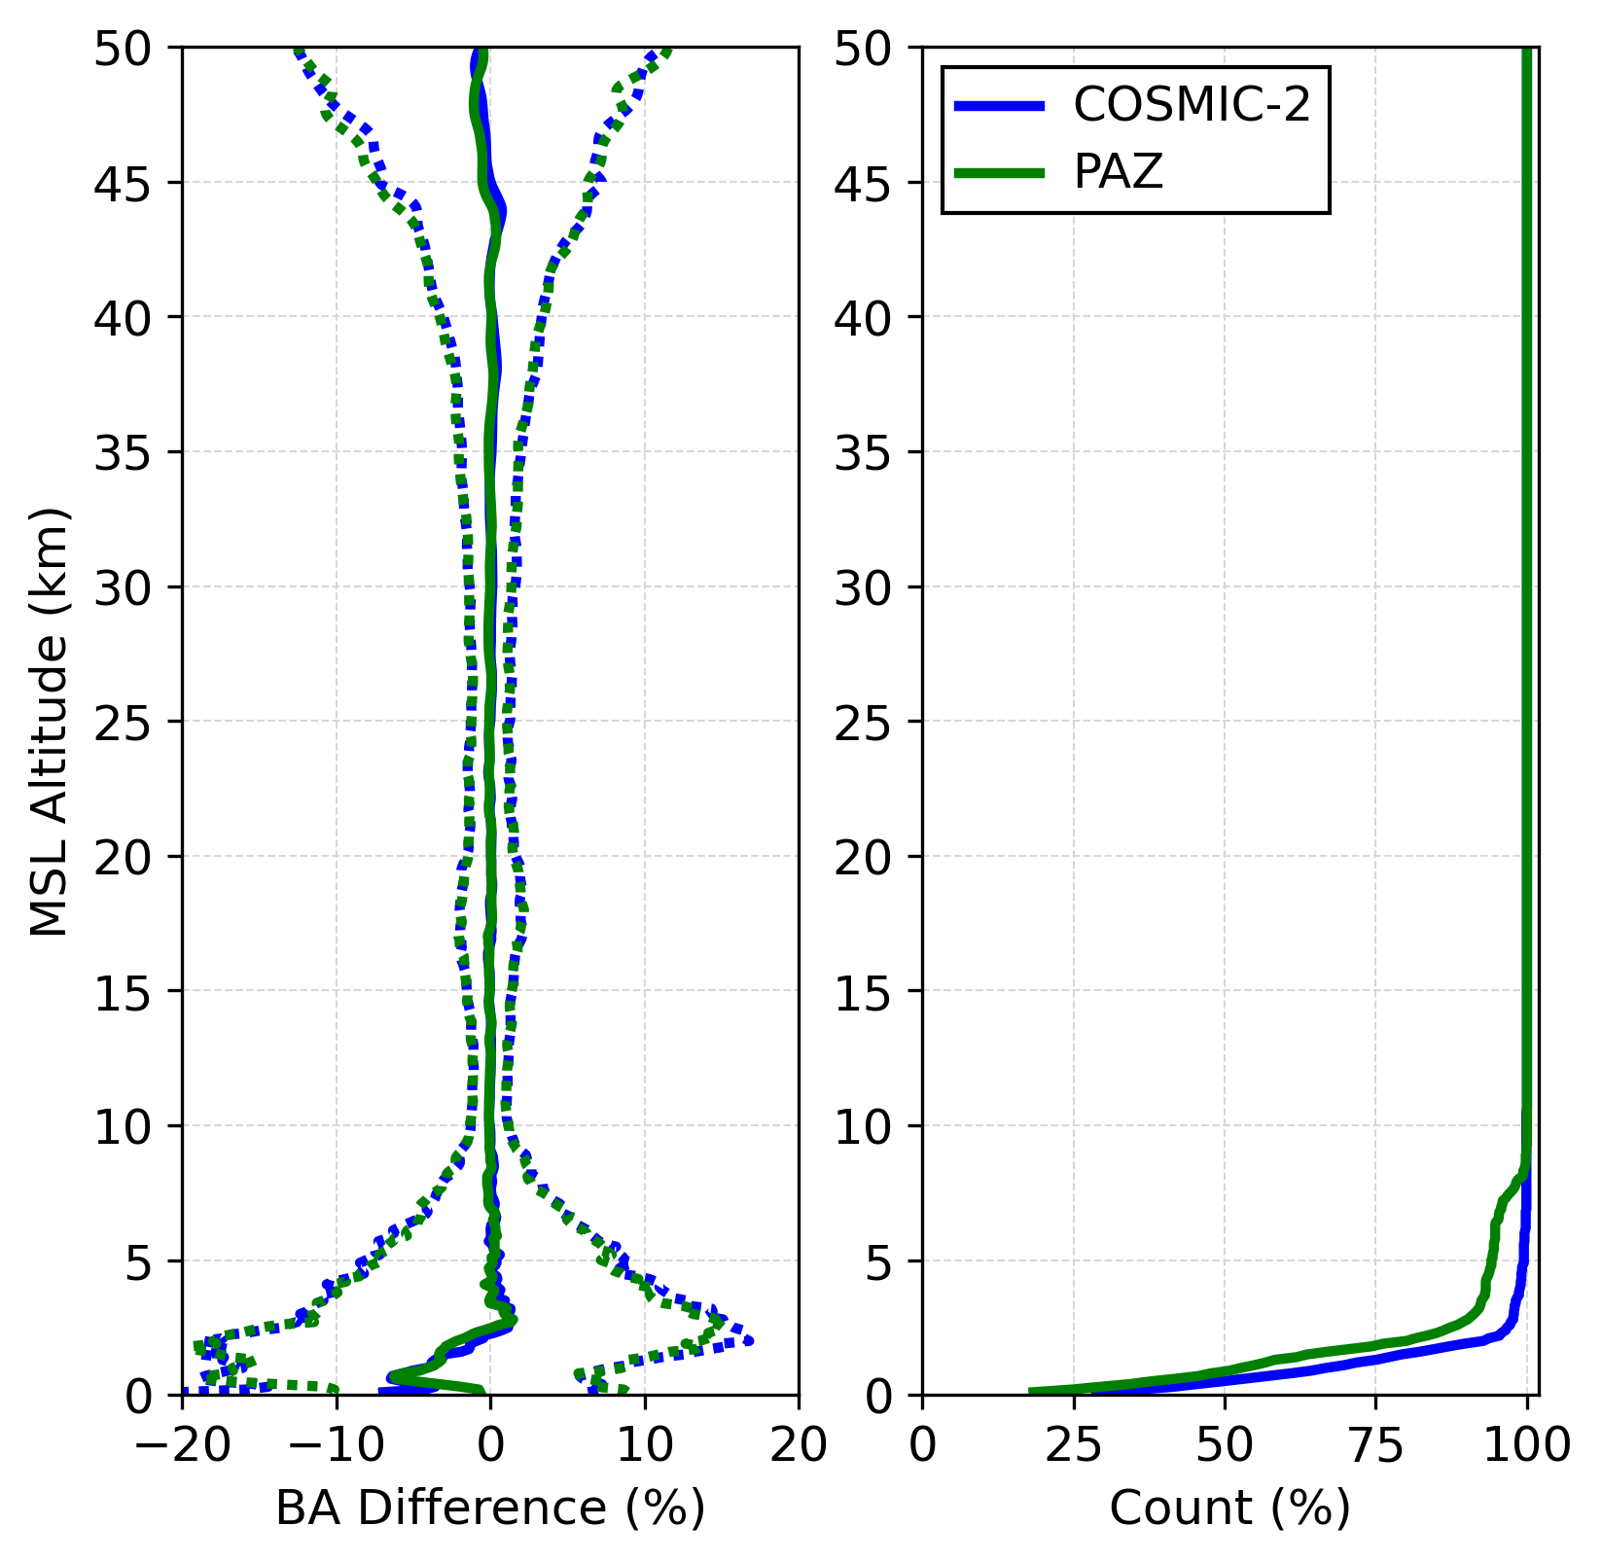
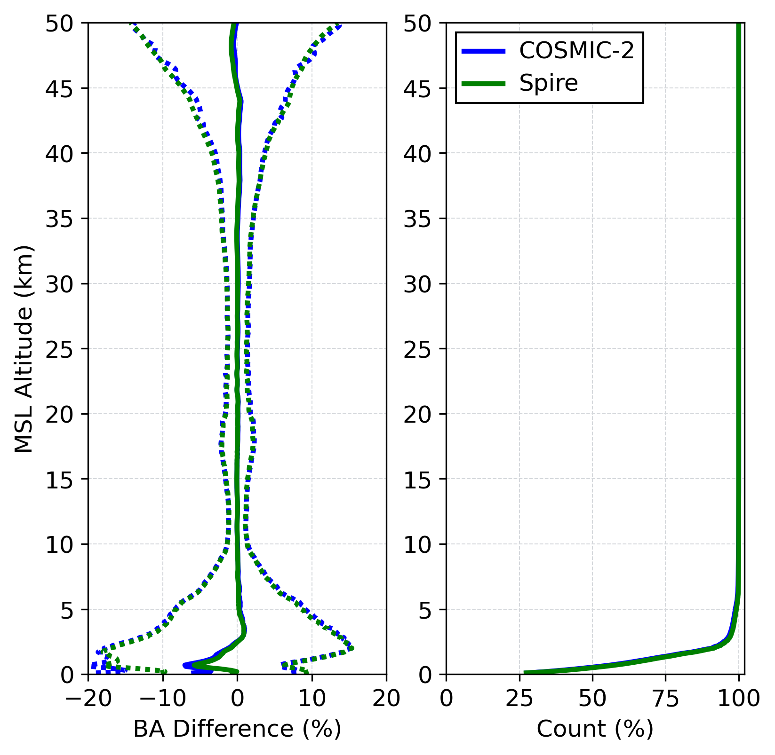
PAZ compared with other RO missions
Showing CDAAC near real-time bending angle (BA) vs. ECMWF short term forecast statistics
Collocated profiles (3 hr, 300 km) during Aug. 2022
Generally very similar results across missions
767 pairs
Reaching 1 km:
C2 63%
K5 58%
1482 pairs
Reaching 1 km:
C2 68%
GeoOpt 54%
Spire from NOAA CDP
968 pairs
Reaching 1 km:
C2 70%
PAZ 55%
44583 pairs
Reaching 1 km:
C2 68%
Spire 69%
Courtesy Z. Zeng, UCAR

Slide 10
Spire PRO Processing
Working to process Spire PRO data sample received via NOAA Commercial Data Program
Dates: June 20-July 8, 2023 (2023.171-189)
Three satellites: 166, 167, and 170
New Spire level 0 filetype: proObs
So far we processed one day (2023.171) using modified PAZ processing software to generate RO profiles using the H and V channels separately and in combination
We also developed code to produce $∆φ$ according to the recipe given in Cardellac, et al: Tutorial on GNSS Polarimetric Radio Occultations, given at the first PAZ Polarimetric RO workshop, April 23, 2020

Slide 11
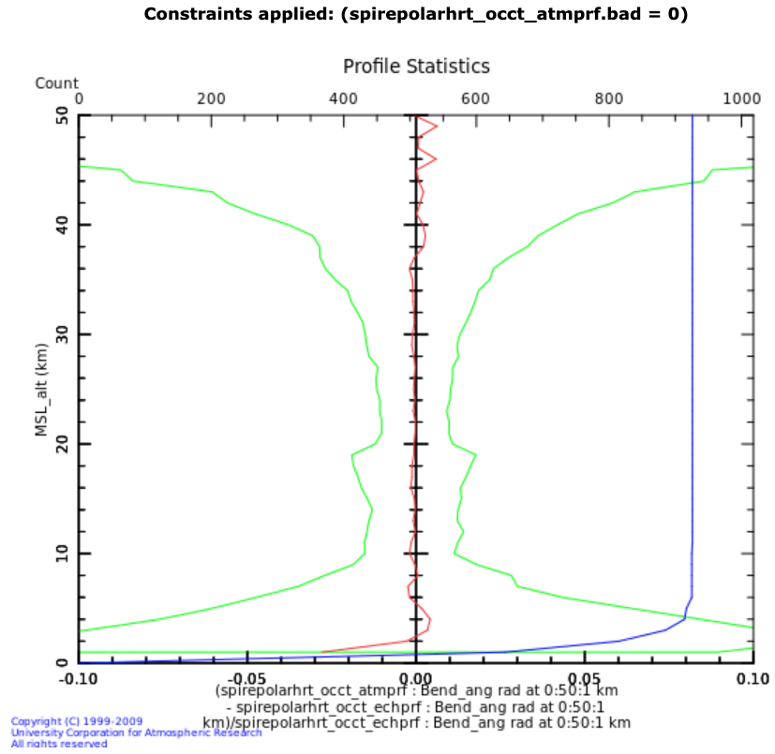
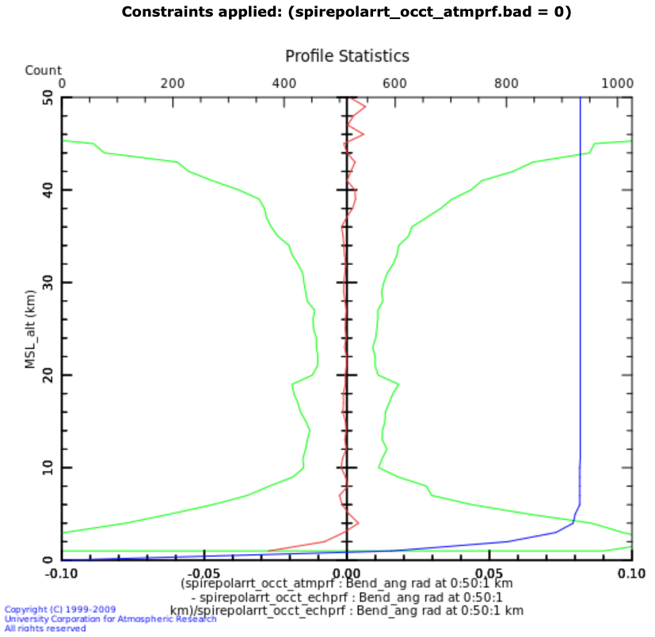
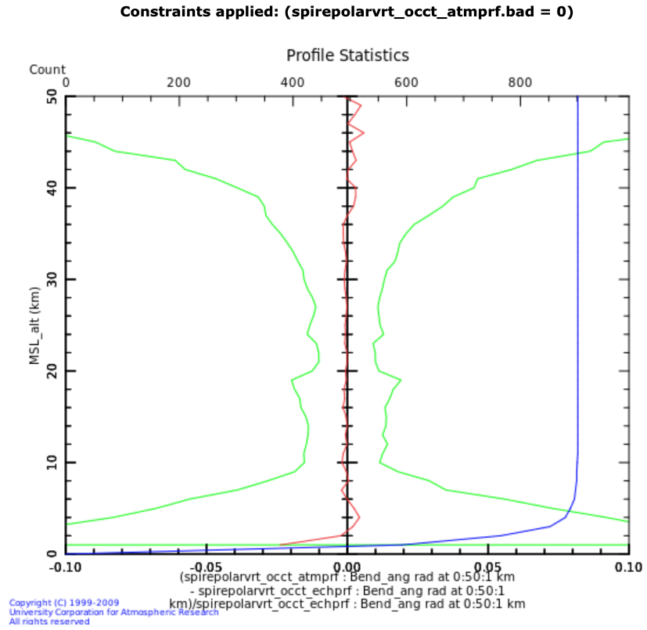
Standard RO processing
H
H+V
V

Slide 12
Standard Spire RO Processing
Initial processing looks reasonable
A modest increase in occultation count resulted from combining H and V
A modest reduction of bending angle noise resulted from the combination
Comparisons with ECMWF for H, V and H+V are very similar
Polarization | Good occultation count | 60-80km bending angle noise (rad)
Vertical | 901 | 4.637e-6
Horizontal | 926 | 4.491e-6
Combined | 933 | 4.355e-6

Slide 13
Differences Between Spire and PAZ PRO Processing
PAZ is GPS-only. Spire tracks GPS, GLONASS, and Galileo, and Beidou.
Only GPS, GLONASS, and Galileo results are shown here—we need special clock data to process Beidou, which I did not have time to fetch.
PAZ only tracks setting occultations. Spire tracks rising and setting.
This necessitated many modifications in the H/V combination code!
PAZ tracks closed loop, then open loop data. Spire tracks all open loop data.
PAZ data requires ½ cycle slip fixing before H/V combination, Spire does not.
PAZ has uses separate receiver channels with separate time stamps for H and V tracking. Spire tracks H and V with a shared time stamp.
No interpolation of time stamps is needed for Spire. No phase alignment is required between H and V channels for Spire.

Slide 14
Spire ∆𝜙 Processing
Initial experiments in generating the $∆φ$ parameter associated with heavy rain/snowfall were done.
The process outlined in the PAZ PRO tutorial were followed, with much experimentation.
The results shown on the next slides include the following steps:
Down-sample H and V phases with a climatological Doppler model. Compute I and Q for each.
Connect H and V phases given I and Q.
Truncate data below an average SNR threshold: Combining signals that are mostly noise just increases the noise.
∆𝜙 = H - V
Compute I and Q from this difference, then phase-connect again: This fixes full cycle slips in $∆φ.$
Apply a spike filter to the derivative of $∆φ$ and re-integrate. This helps with remaining jumps.
Truncate $∆φ$ based on a rolling window stdv threshold. This gets rid of wildness at the bottom as the signals pass into noise.
Apply a 6th order Butterworth low-pass filter with a cutoff frequency of 1 Hz. This cleans the signal up, getting rid of high frequency clutter.
No linear detrending was done as is described in the PAZ tutorial. Many $∆φ$ profiles have a linear trend, but not all.

Slide 15
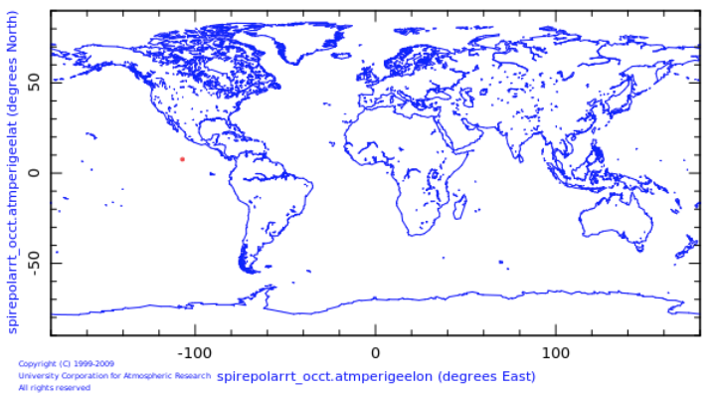
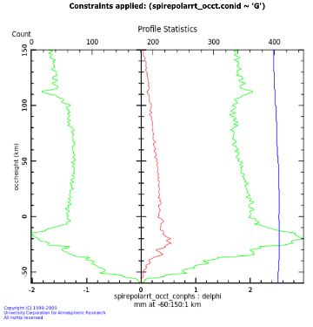
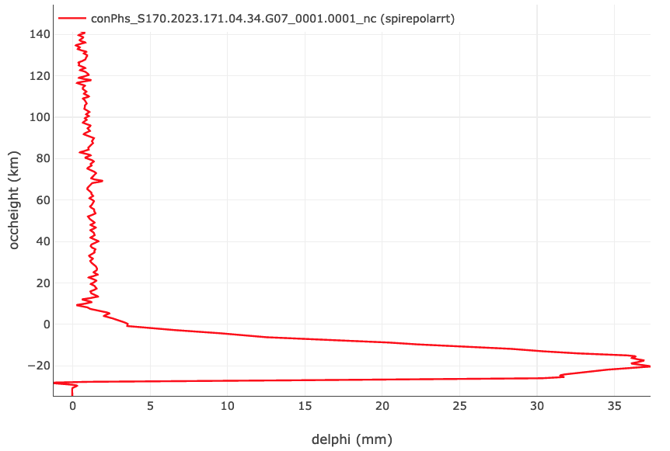
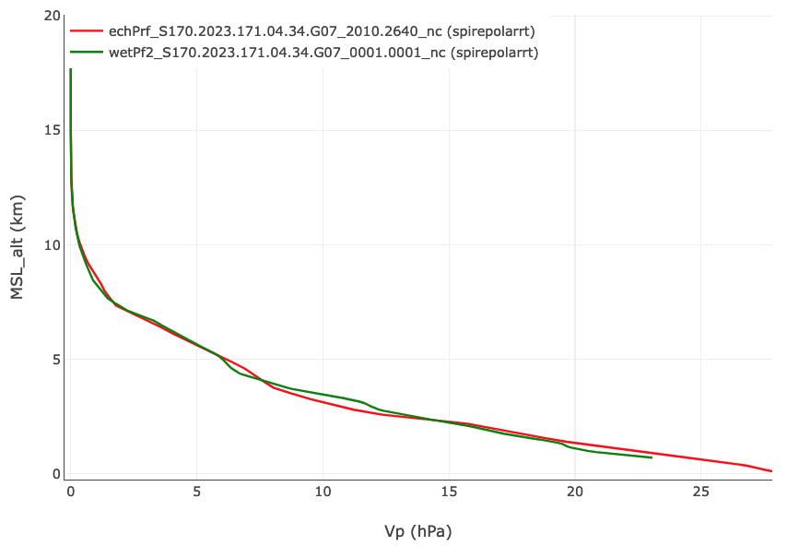
Delta Phi: GPS
Average of all $∆φ$ for one day for GPS. Note ‘occheight’ is straight line height!
water vapor pressure
∆𝜙
25 hPa
35 mm

Slide 16
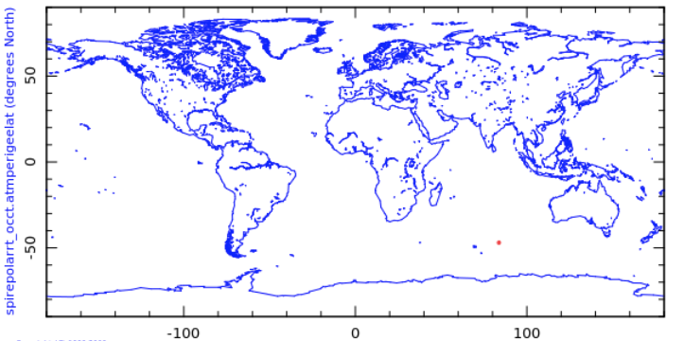
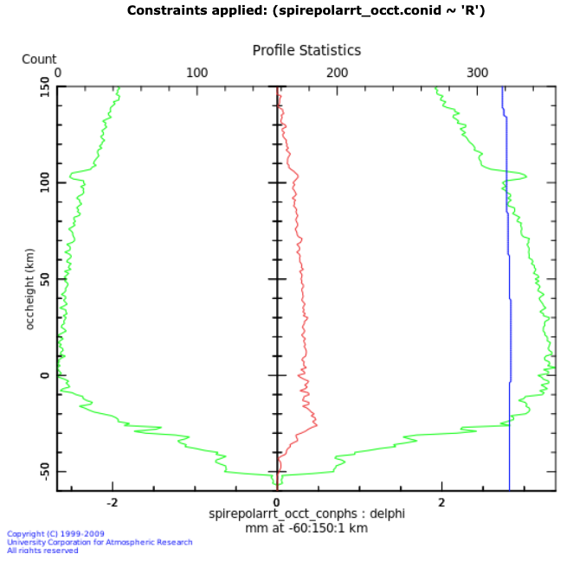
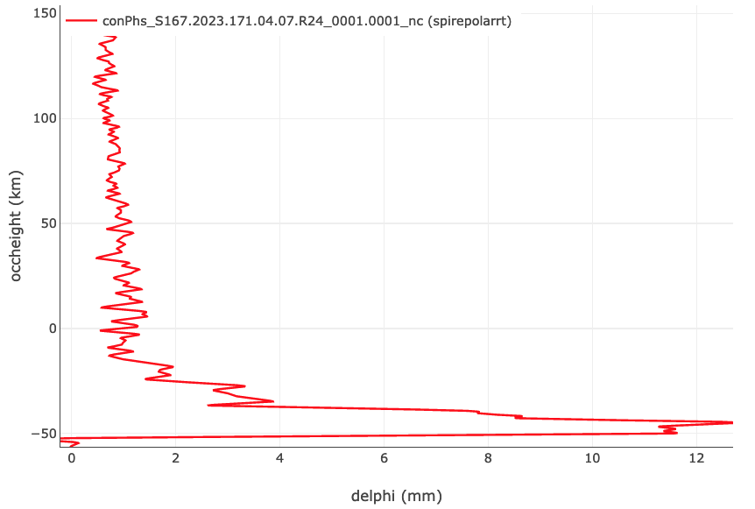
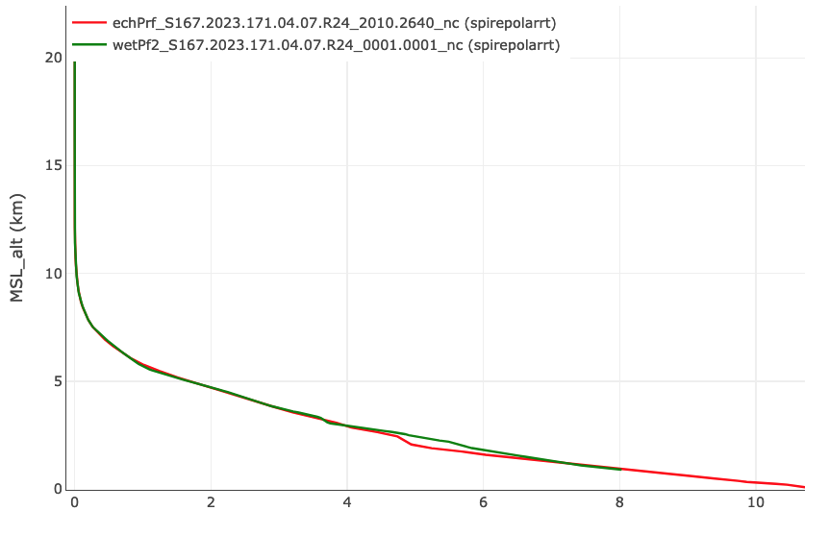
Delta Phi: GLONASS
Average of all $∆φ$ for one day for GLONASS.
water vapor pressure
∆𝜙
10 hPa
12 mm

Slide 17
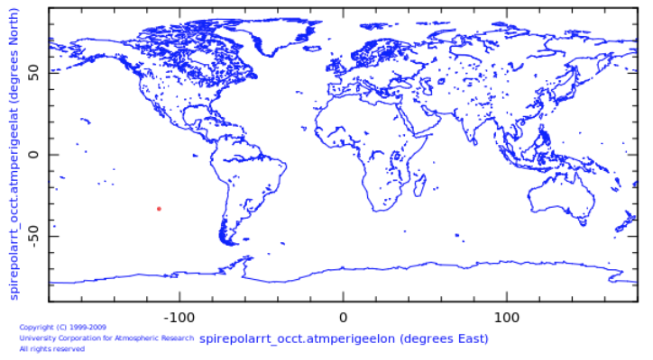
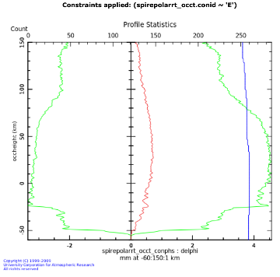
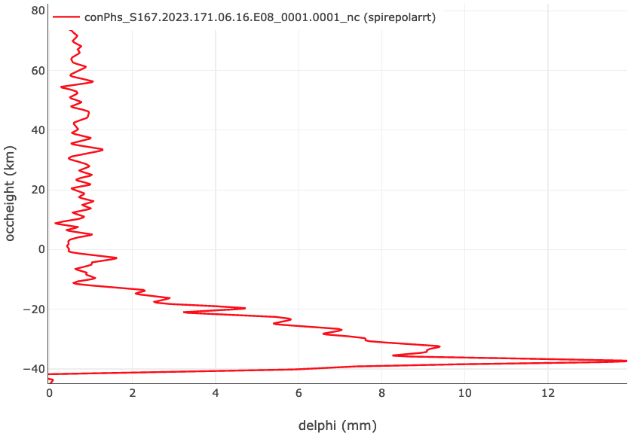
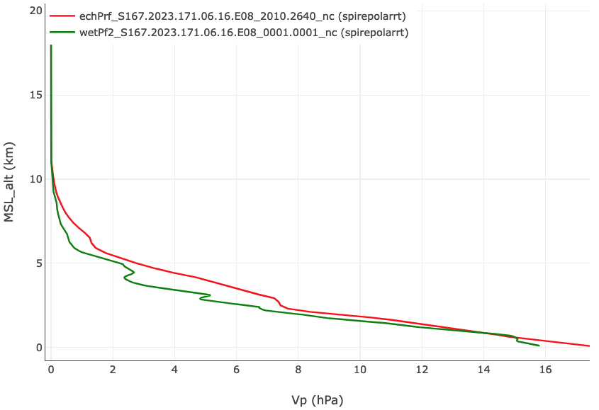
Delta Phi: Galileo
Average of all $∆φ$ for one day for Galileo.
water vapor pressure
∆𝜙
16 hPa
12 mm

Slide 18
Discussion of ∆𝜙 Results
Results are very preliminary!
Three cases are shown that seem consistent with heavy rainfall, given:
The shape and altitude of the ∆𝜙 curve
The location of the profile
Relatively moist RO and ECMWF model profiles
These 3 were picked from almost 1000 profiles. The average profile for each constellation looks reasonable, showing a linear trend high up as is seen for PAZ.
There are numerous strange looking ∆𝜙 profiles. These need to be looked into!
Rising vs. setting occultations give similar ∆𝜙 profiles for each constellation (G, R, and E).
The average shape of Galileo profiles seems different from GPS and GLONASS—less linear. This also bears looking into!

Slide 19
Conclusion
PAZ data processed at UCAR since May 2018
H and V processed separately for sanity check
Several approaches tried for combining H and V
Current approach yields similar statistics to independent H or V processing, but results in much higher quality checked data counts
Results from PAZ compare favorably with other real-time RO missions processed at UCAR/CDAAC.
PAZ data on PDA and on GTS
Initial processing of Spire PRO data has been done.
RO results look reasonable.
∆𝜙 profiles have been computed and cleaned up. Many look reasonable.

Slide 20
Backup slides

Slide 21
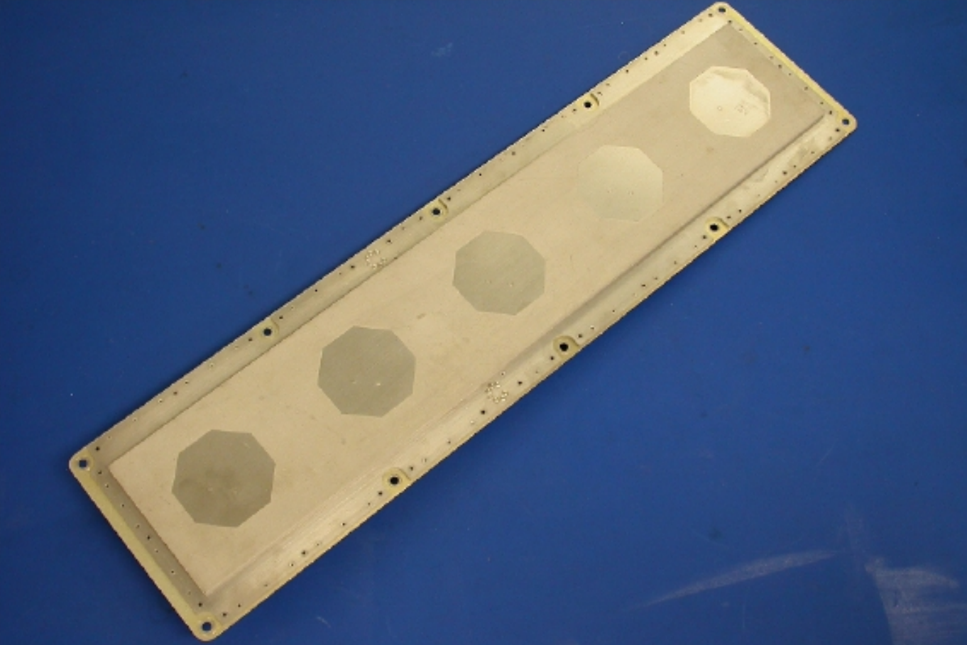
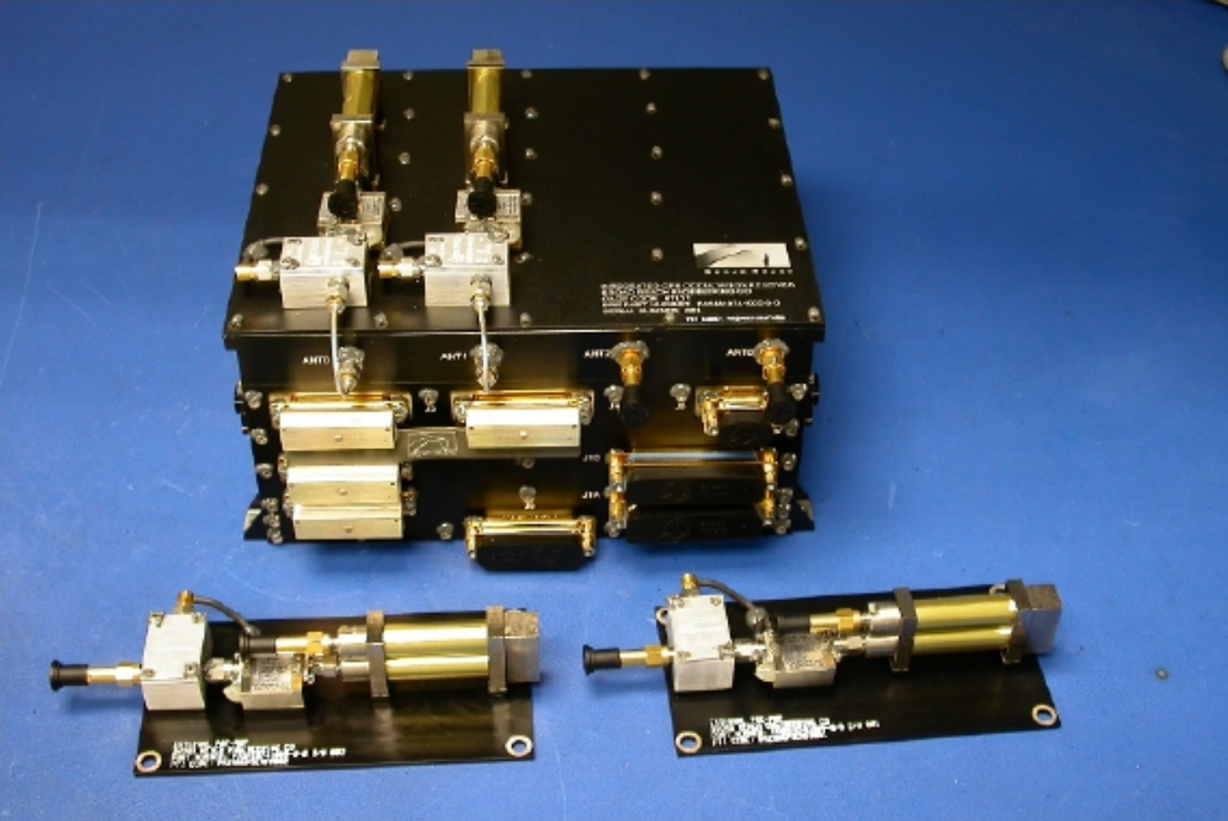
PAZ Background
Launched Feb 22 2018
Spanish SAR satellite based on TerraSAR-X
Radio Occultation Heavy Precipitation (ROHP) IGOR instrument a secondary payload
JPL heritage instrument
Special purpose multiple patch antenna has separate outputs for Horizontal and Vertical polarizations
These outputs are processed by the IGOR as separate antenna inputs, similar to fore and aft antennas on other spacecraft
This approach is a simple change to IGOR firmware, but adds complexity to ground data processing due to separate time stamps for each polarization
The separate H and V channels are intended for rain detection, but can use this extra information to enhance normal radio occultation (RO) processing.
Dual polarization antenna
IGOR GPS receiver
Photo credit: Estel Cardellach, ICE CSIC
Notes:
As Josep Aparico noted, ‘careful execution’ is important,

Slide 22
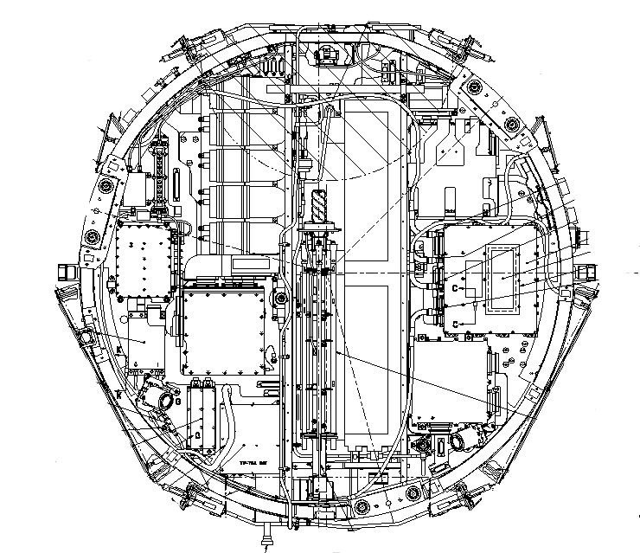
Multi-Antenna High Rate Data Packaging
COSMIC-1
Antenna 3 (Occultation)‏
Antenna 2 (Occultation)‏
High rate data, antenna 3
Time | 1233014435.0000254
PRN | 23
Phase | ...
SNR | ...
High rate data, antenna 2
Time | 1233014435.0000255
PRN | 24
Phase | ...
SNR | ...
Separate data packets per antenna
Different times
Different PRNs

Slide 23
PAZ High Rate Data Packaging
PAZ
H polarization antenna input‏
V polarization antenna input‏
High rate data, antenna 2
Time | 1233014435.0000254
PRN | 23
Phase | ...
SNR | ...
Separate data packets per polarization, same antenna
High rate data, antenna 3
Time | 1233014435.0000255
PRN | 23
Phase | ...
SNR | ...
Different times
Same PRN

Slide 24
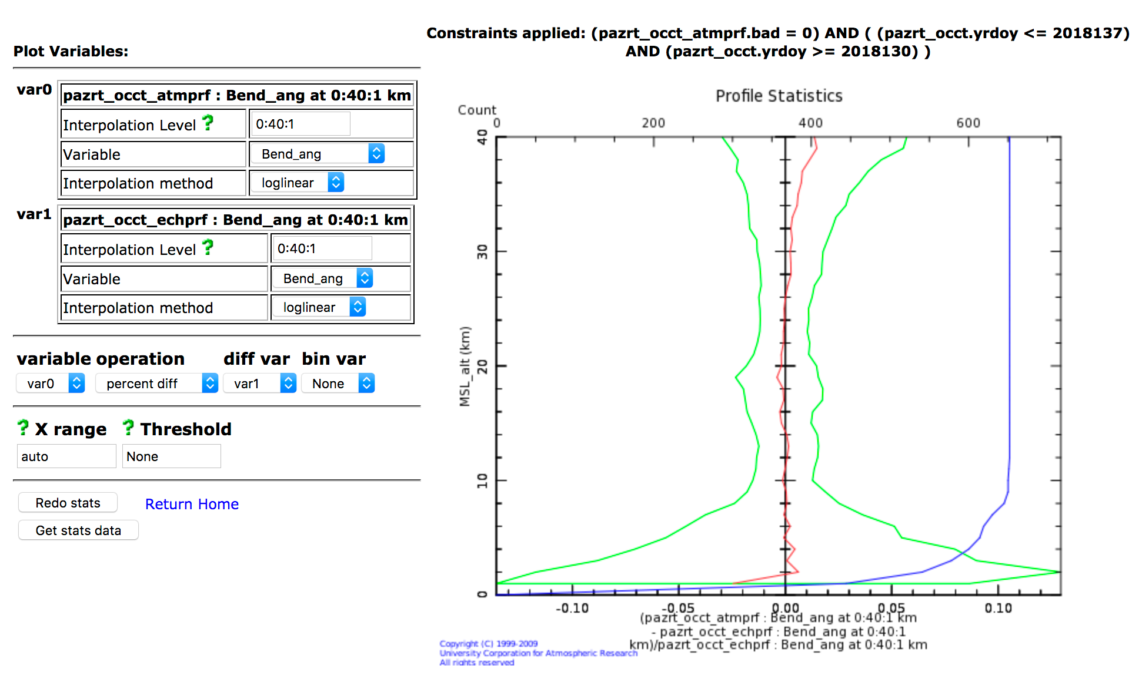
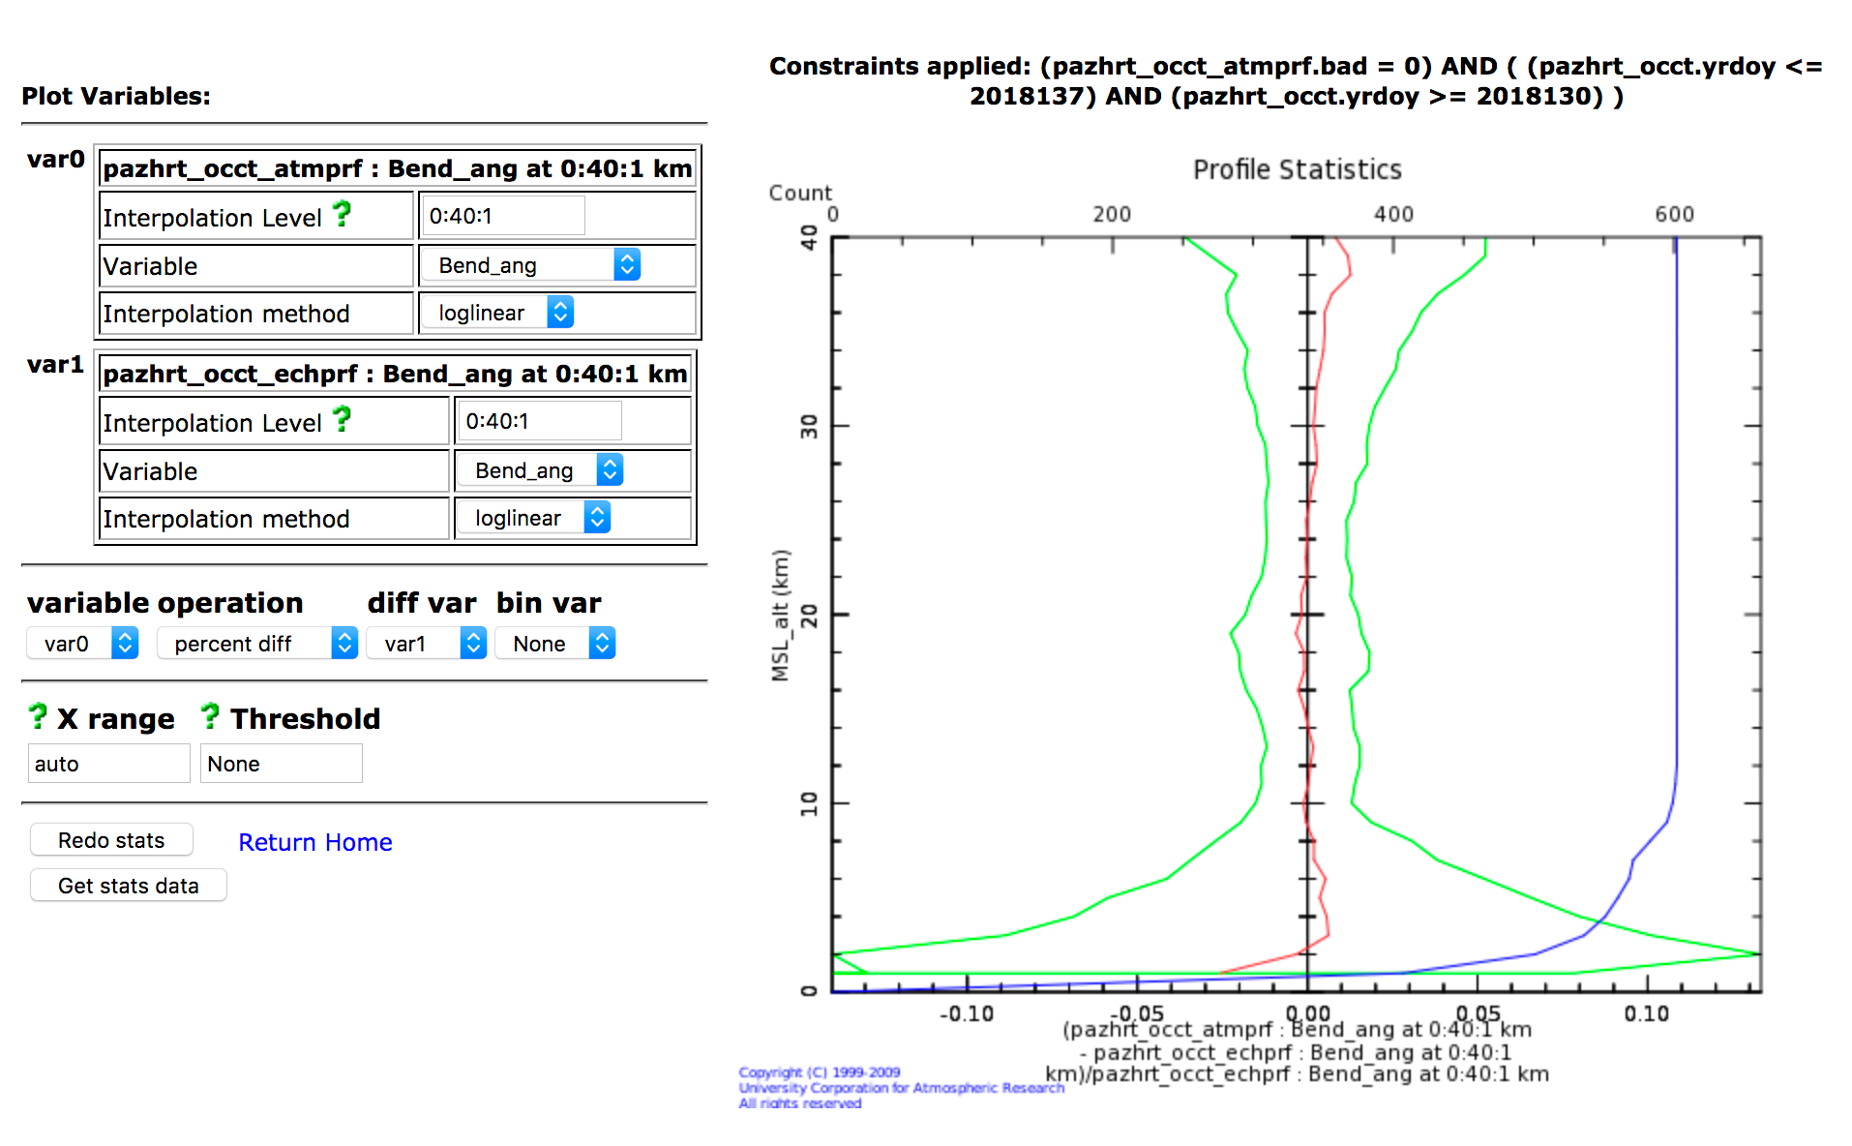
V and H Compared
Single-polarization statistics similar
Vertical
Horizontal

Slide 25
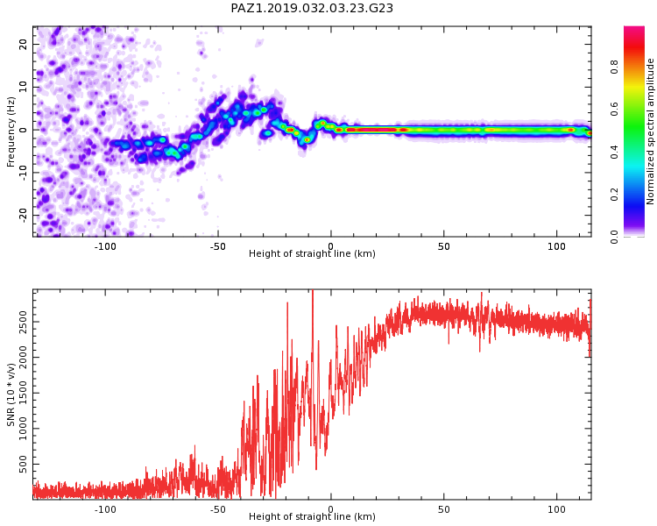
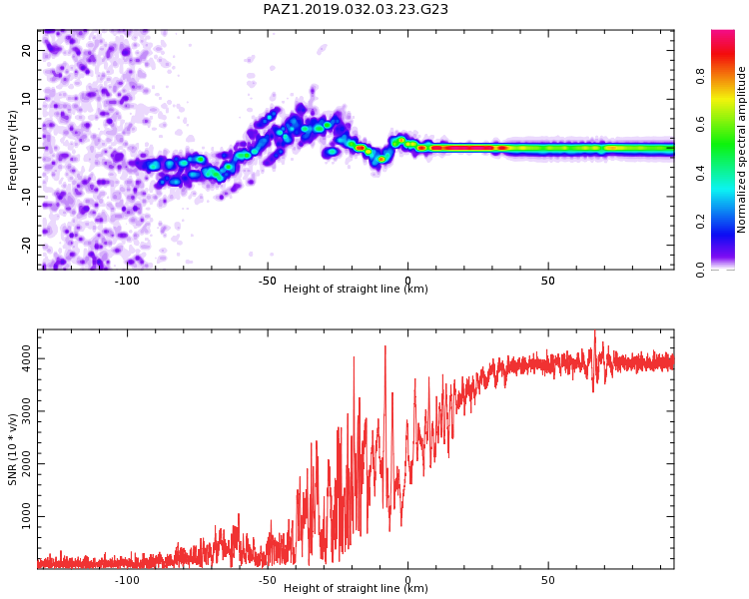
Spectrogram Comparison
Note the larger SNR for the horizontal polarization case. In other cases, vertical polarization has higher SNR. Both can be combined to yield higher SNR.
Vertical polarization
Horizontal polarization
250 v/v
400 v/v

Slide 26
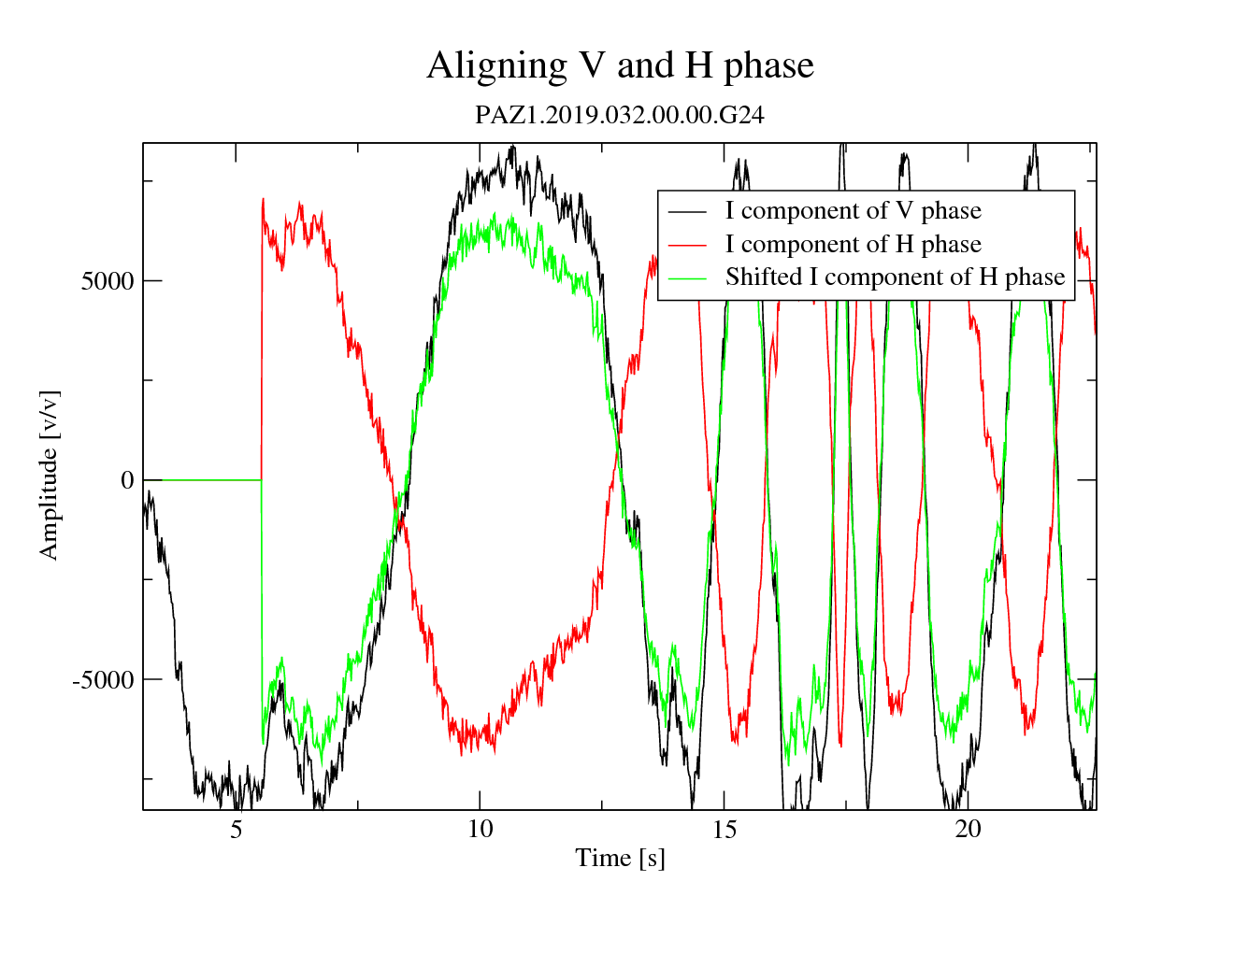
Aligning V and H polarization phases
H phase is shifted 2.9 radians to align with V phase
Now I and Q components of H and V can be added constructively

Slide 27
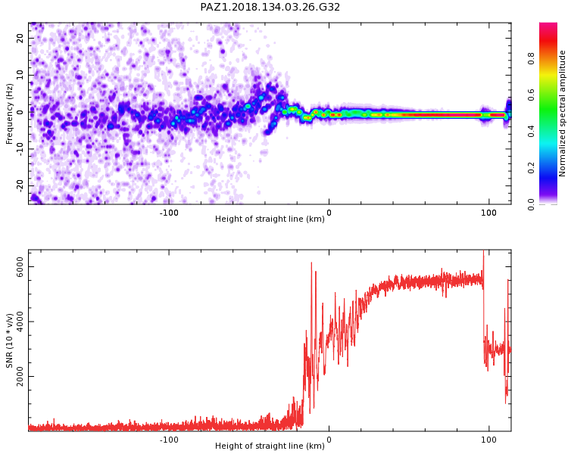
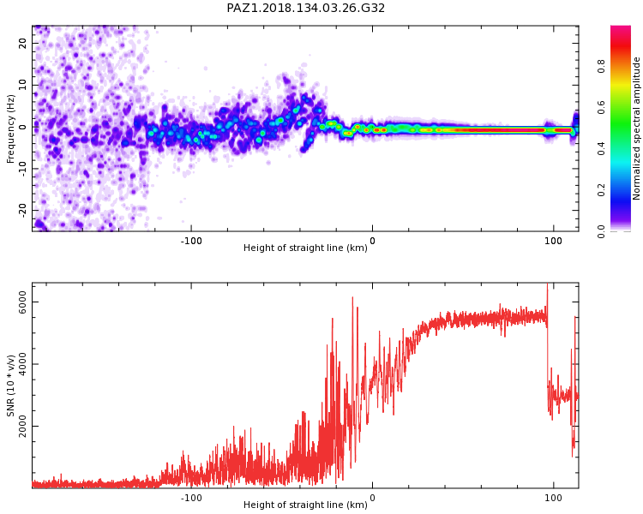
Fixing ½ cycle slips in the slave by comparison with the master
Vector sum without fix
Vector sum with fix
If ½ cycle slips are not fixed in the slave polarization, then there is substantial cancellation when the two are added, as shown at left.

Slide 28
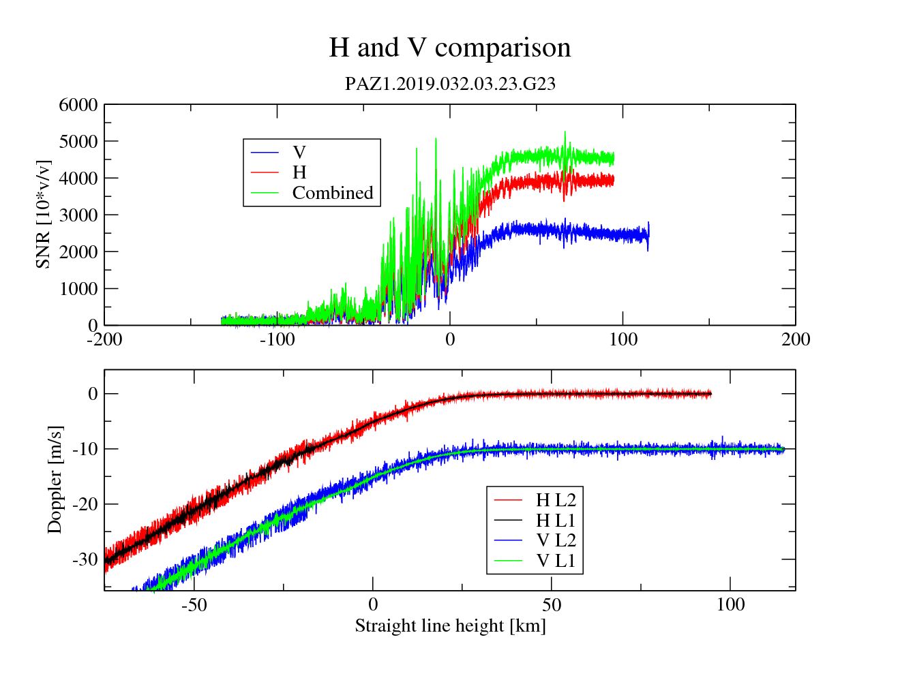
Choosing V or H for master polarization
Originally I always chose V for the ‘master’ polarization, but found that in many cases H worked better
In this occultation, the single-polarization H processing passed QC, whereas the V processing did not.
Note the higher L2 Doppler noise for V
Master polarization is chosen by higher average SNR, so for this occultation H is chosen over V
Phases offset by 10 Hz for visibility

Slide 29
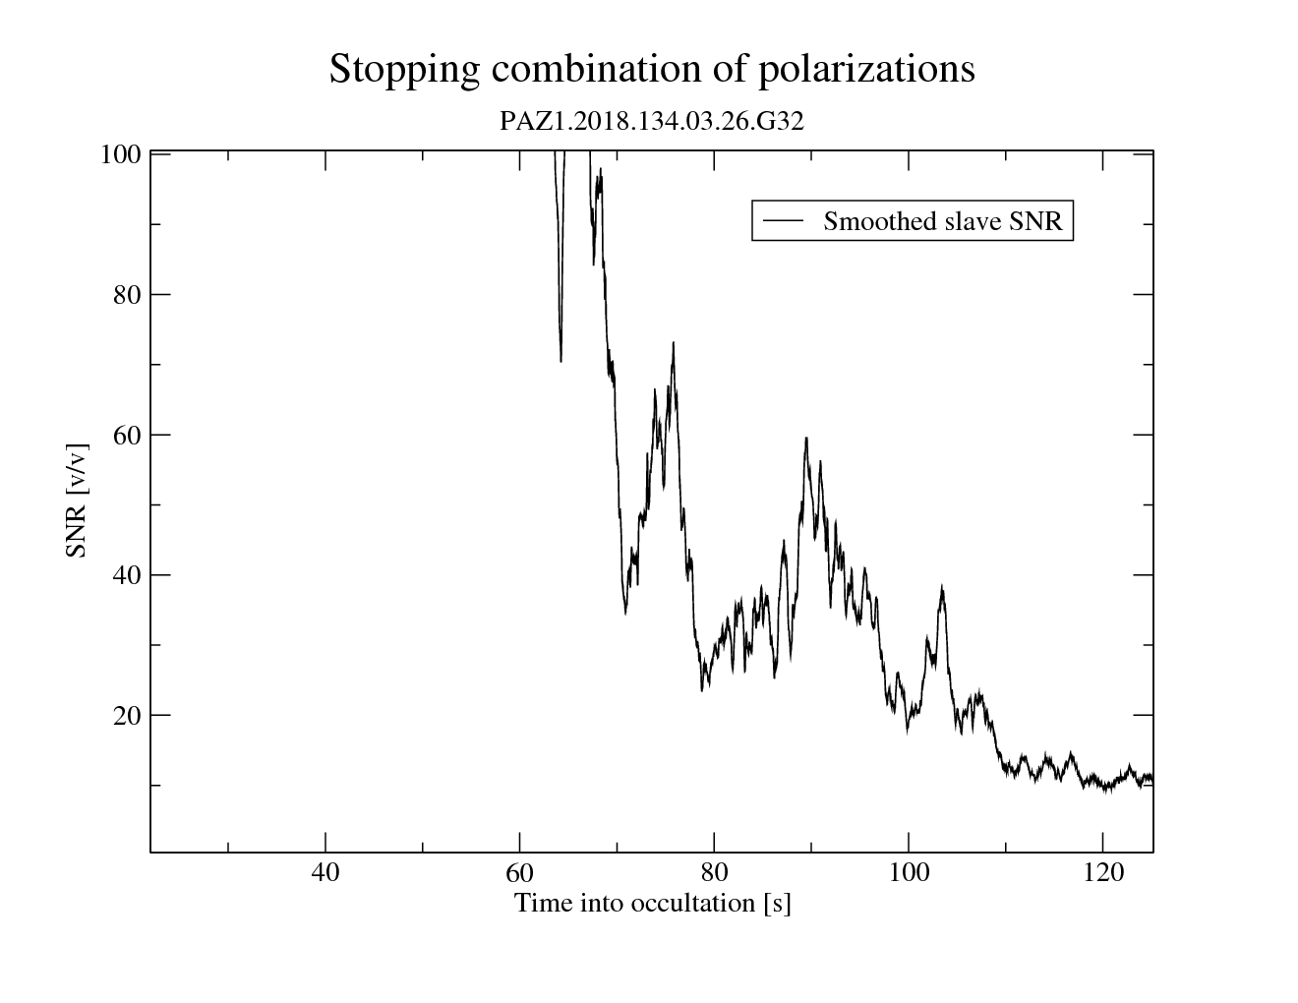
Determining when to stop combination
The combination of polarizations no longer makes sense when the SNR gets too low—this can result in an amplification of noise.
We cut the combination off when the boxcar-smoothed slave SNR descends below 15 v/v
15 v/v
Cutoff point

