Slide 1



WRF Simulations of tropical cyclones
Shu-Ya Chen¹, Ying-Hwa Kuo², Hsiu-Wei Li¹
¹ GPS Science and Application Research Center, National Central University, Taiwan
² UCAR Community Programs, University Corporation for Atmospheric Research, U.S.A.

Slide 2
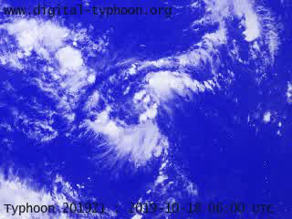
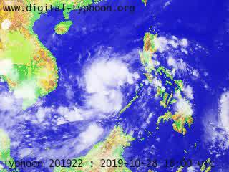
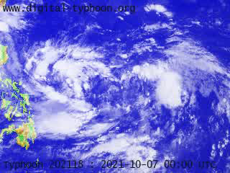
Three Tropical Cyclones (Satellite Imagery)
Typhoon Bualoi (2019)
Typhoon Matmo (2019)
Typhoon Kompasu (2021)
www.digital-typhoon.org
Bualoi formed on Oct. 19, 2019.
Under a favorable condition of low vertical wind shear and warm sea surface temperature, it rapidly intensified to be a typhoon on Oct. 20, and became a Category-5 typhoon on October 22.
Matmo formed on Oct. 28 in the South China Sea and became weakened due to landfall in central Vietnam.
The remnants of Matmo emerged into the Bay of Bengal, it redeveloped into a depression on Nov. 5. Then, the cyclone was renamed Bulbul.
There were two tropical depressions (Maring and Nando) in the same monsoonal circulation.
Maring merged with the Nando, that formed a very broad and large circulation.
JMA reclassified it to a tropical storm, and named Kompasu.

Slide 3
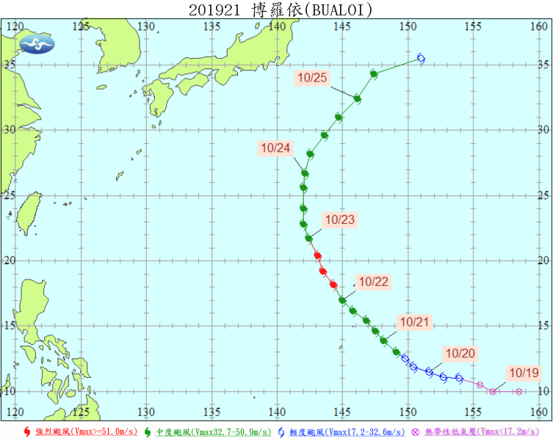
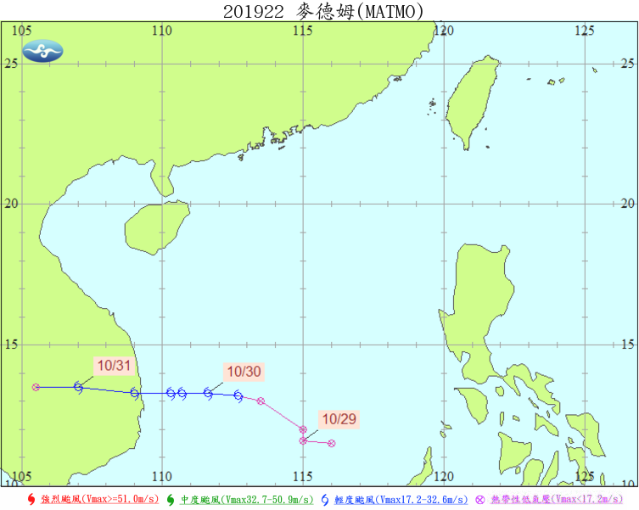
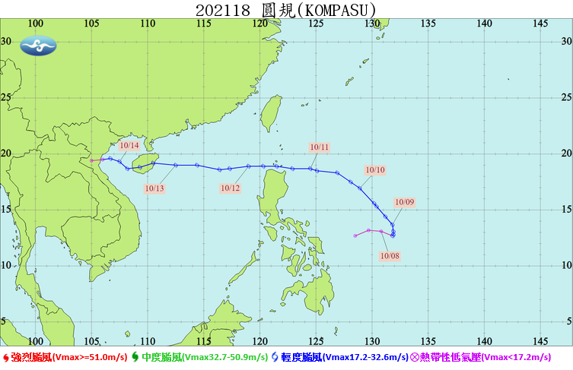
Three Tropical Cyclones
Typhoon Bualoi (2019)
Typhoon Matmo (2019)
Typhoon Kompasu (2021)
Despite Bualoi did not make landfall in Japan, the heavy rainfall caused floods and landslides and resulted in casualties and substantial property damage.
Matmo made landfall in Vietnam on Oct. 30, bringing strong winds and heavy rainfall, causing flooding and road closures.
Matmo destroyed 2.7 thousand houses causing more than 165 million USD in damage in Vietnam.
The typhoon affected many areas, including the Philippines, Taiwan, southeast China, and Vietnam.
It caused significant damage to the Philippines, thus “Kompasu” was removed from the naming list.

Slide 4
WRF Model Configuration
WRF model v4.2
Two model domains
Horizontal resolution: 15 km and 3 km
Grid pints: 662x386, 751x751
Vertical level: 52
Model top: 20 hPa
Kain-Fritsch cumulus convection scheme applied only for the D01
RRTMG radiation physics scheme
YSU PBL scheme
No bogus vortex implementation
D01
D02
D02
D02
Notes:
to assess the sensitivity of PAZ
observations to differences in the microphysics, either inter-model or
from the same model with different parameterizations.

Slide 5
Microphysics
Microphysics provides atmospheric heat and moisture tendencies, microphysical rates, and sureface resolved-scale rainfall
Laten heat release from: condensation, evaporation, deposition, sublimation, freezing, melting
Particle types: cloud water, rain drops, ice crystals, snow, graupel, and hail
Processes: aggregation, accretion, growth, fall-out
Single moment scheme: one prediction equation for mass (kg/kg) per species (Qr, Qs, etc.) with particle size distribution being derived from fixed parameters.
Double-moment (DM) scheme: add a prediction equation for number concentration (#/kg) per DM species (Nr, Ns, etc.). DM schemes allow for additional processes such as size-sorting during fall-out and sometimes aerosol (cloud condensation nuclei, CCN) effects.
From Dr. Dudhia (NCAR WRF tutorial)

Slide 6
Microphysics in WRF
Qv: water vapor
Qc : cloud water
Qr : rain
Qi : ice
Qs : snow
Qg : graupel
Qh : hail
Nn : CCN number
Opt | Cloud microphysics scheme | Variables | Description
2 | Purdue Lin Chen and Sun (2002) | Qv Qc Qr Qi Qs Qg | A sophisticated scheme that has ice, snow and graupel processes, suitable for real-data high-resolution simulations.
6 | WSM6 Hong and Lim (2006) | Qv Qc Qr Qi Qs Qg | Single moment scheme. A scheme with ice, snow and graupel processes suitable for high-resolution simulations.
7 | Goddard 4-ice Tao et al. (1989, 2016) | Qv Qc Qr Qi Qs Qg Qh | It predicts hail and graupel separately, provides effective radii for radiation.
8 | New Thompson Thompson et al. (2008) | Qc Qr Qi Qs Qg Ni Nr | A new scheme with ice, snow and graupel processes suitable for high-resolution simulations. Double moment scheme.
10 | Morrison 2-mom Morrison et al. (2009) | Qc Qr Qi Qs Qg Nr Ni Ns Ng | Double-moment ice, snow, rain and graupel for cloud-resolving simulations.
From WRF User’s Guide

Slide 7
Experiments
PAZ1.2019.296.21.41.G14 | PAZ1.2019.303.09.35.G16 | PAZ1.2021.285.23.27.G04
2019-10-23 21:41:19 | 2019-10-30 09:35:10 | 2021-10-12 23:27:16
Two Initial conditions:
GDAS FNL 0.25º (6-h interval)
ERA5 0.25º (1-h interval)
Bualoi
Matmo
Kompasu
Model parameterizations:
RRTMG for radiation physics, YSU scheme for PBL, and Kain-Fritsch for cumulus scheme (Not applied on D02)
X : PRO
O : RO
+ : RAOB
Thirty WRF simulations:
Two global analyses for initial conditions
Three typhoon cases
Five microphysics schemes
forecast
18h
18h
18h
2019/10/23
06 UTC
2019/10/24
00 UTC
2019/10/29
18 UTC
2019/10/30
12 UTC
2021/10/12
06 UTC
2021/10/13
00 UTC

Slide 8
Effect from Initial Conditions
Bualoi
Matmo
Kompasu
Total Precipitable Water
(vapor plus all hydrometeors)
Sea Level Pressure
10-m Wind
ERA5
weaker
GDAS

Slide 9
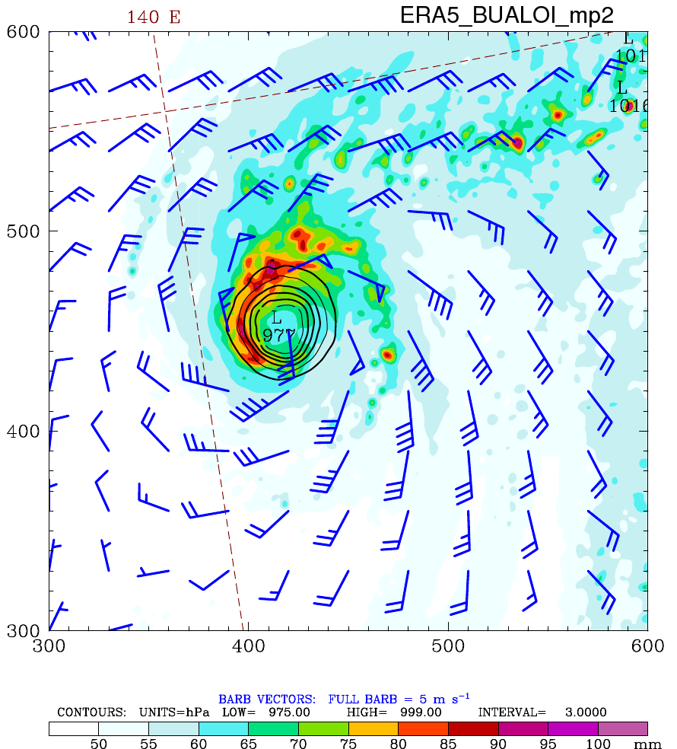
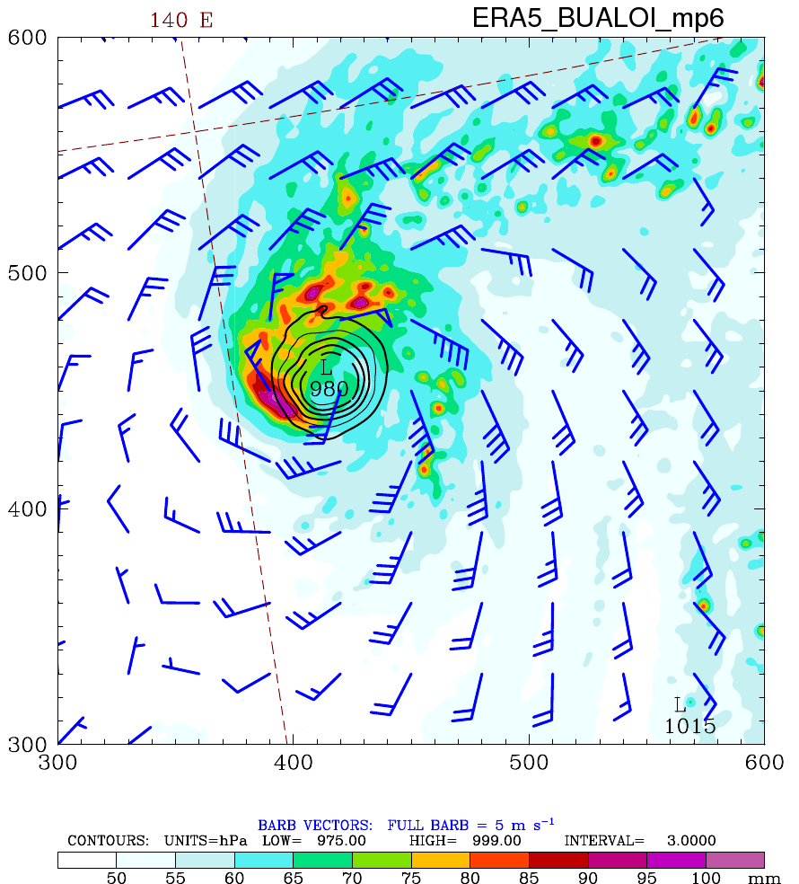
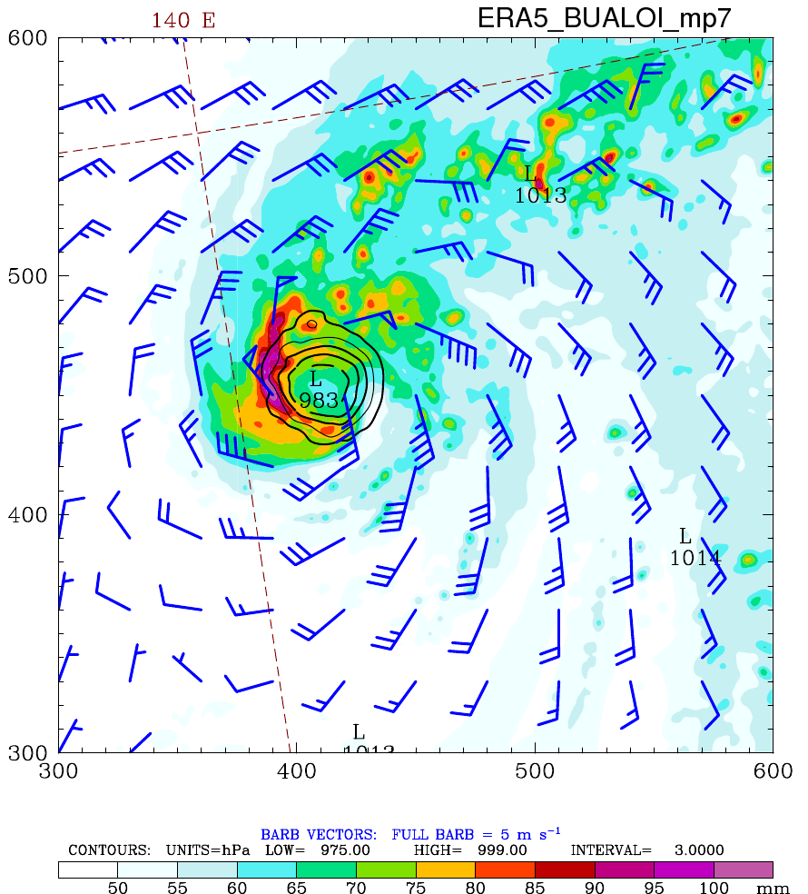
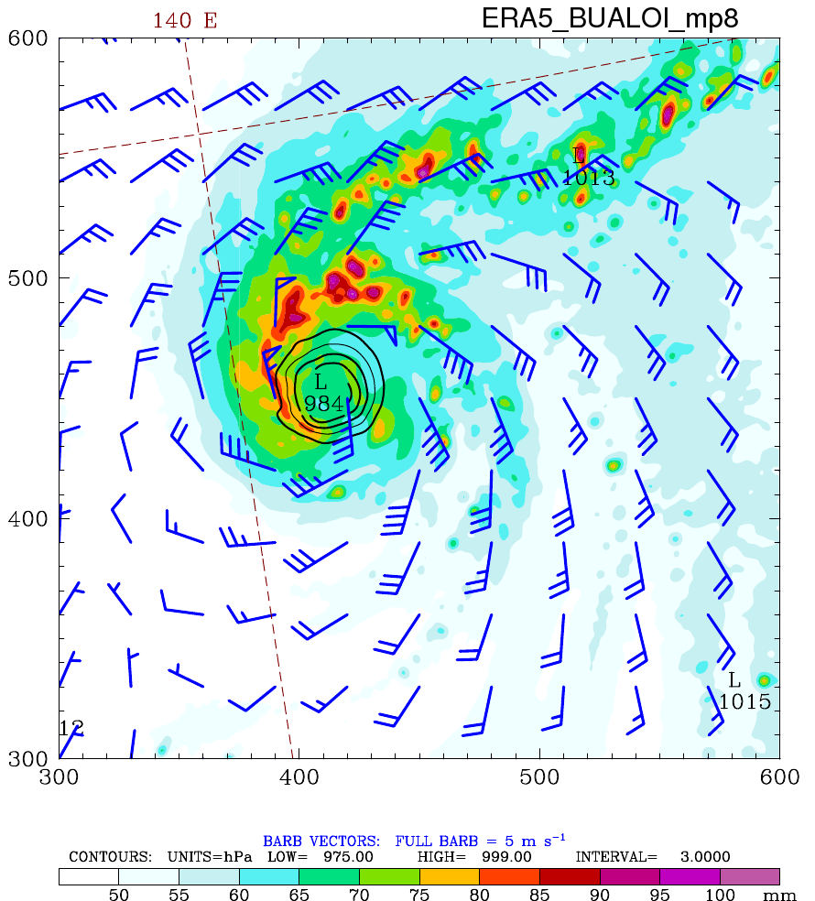
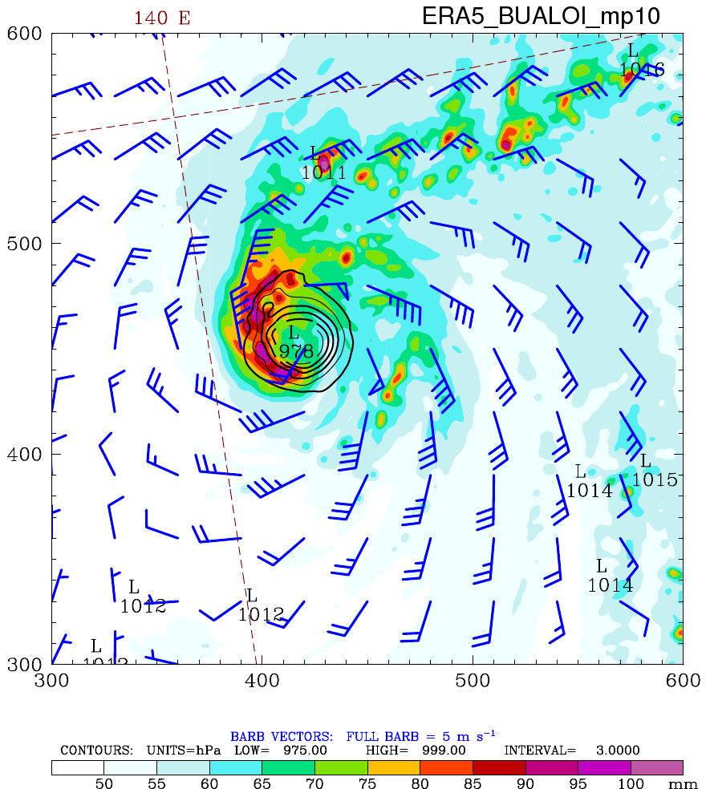
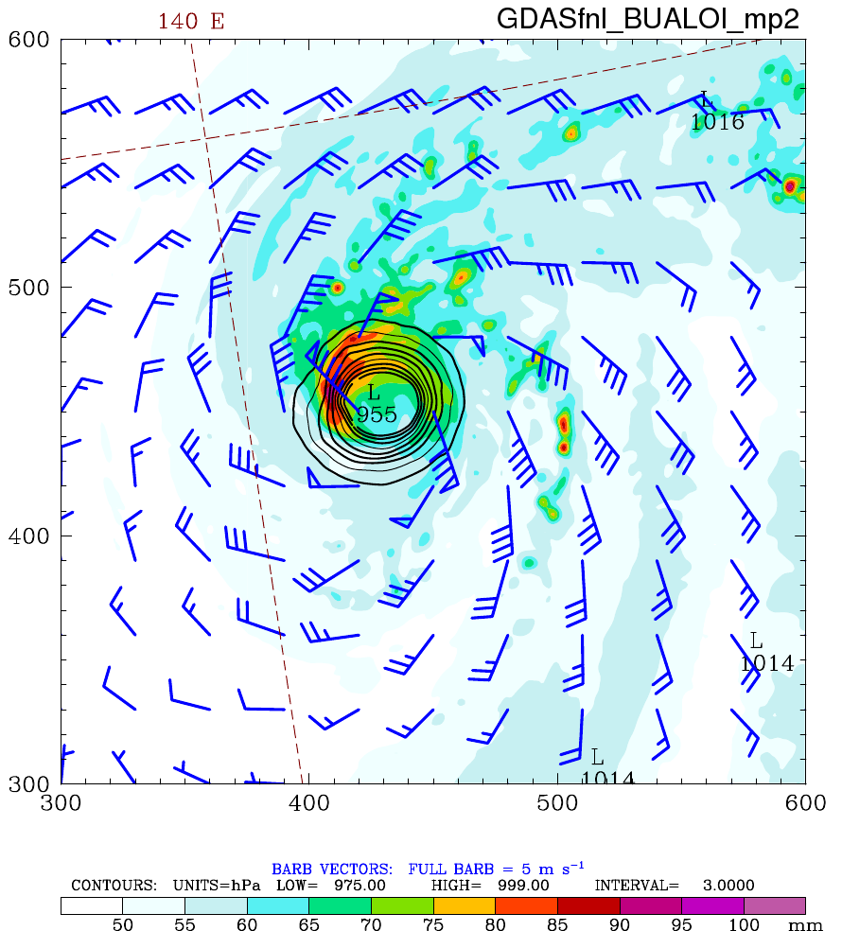
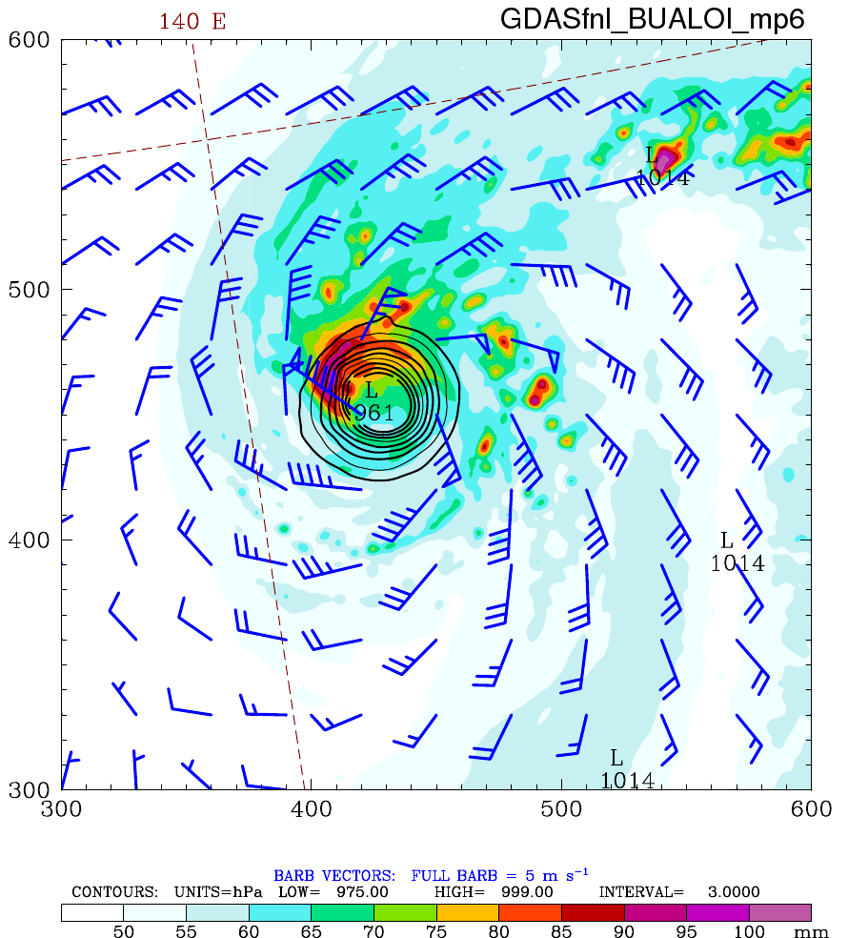
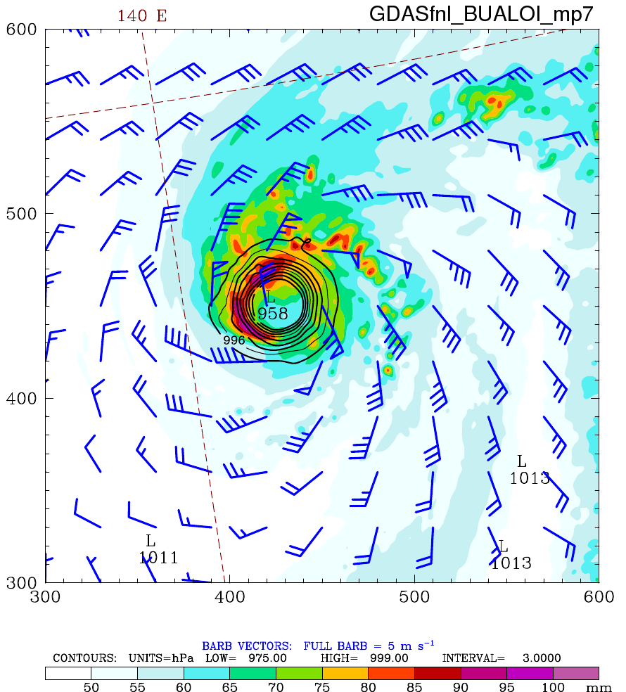
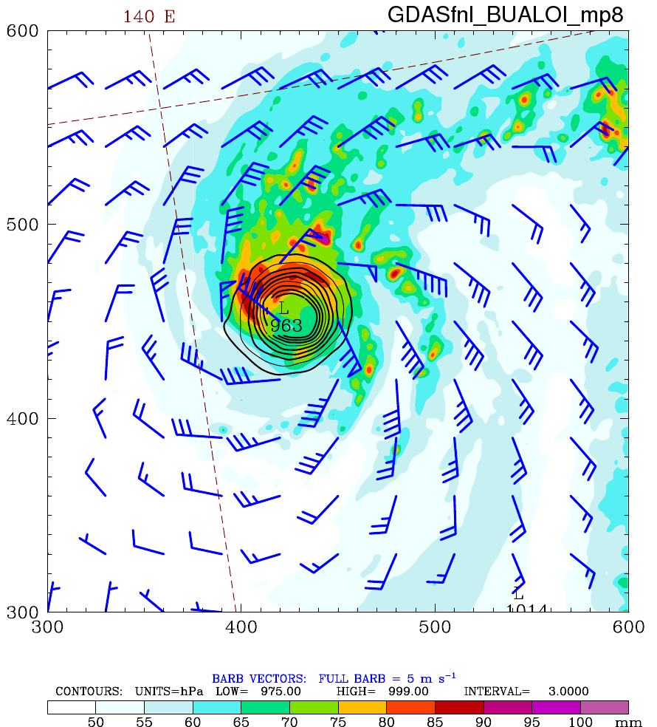
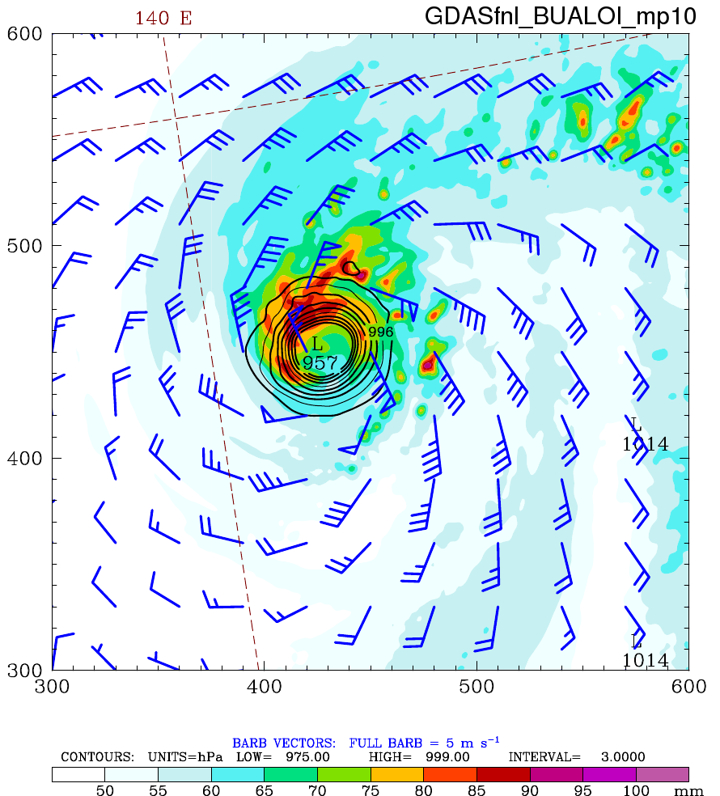
18-h Forecasted TPW+SLP+10m Wind (Bualoi)
Purdue Lin
WSM6
Goddard
Thompson
Morrison
ERA5
GDAS

Slide 10
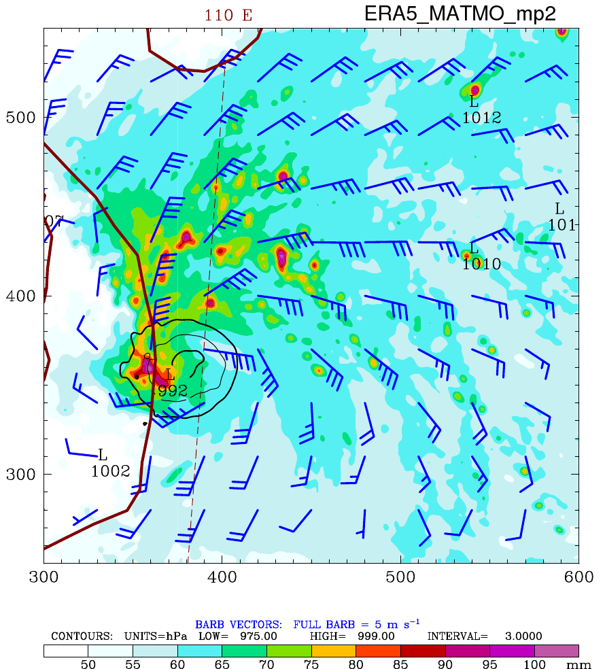
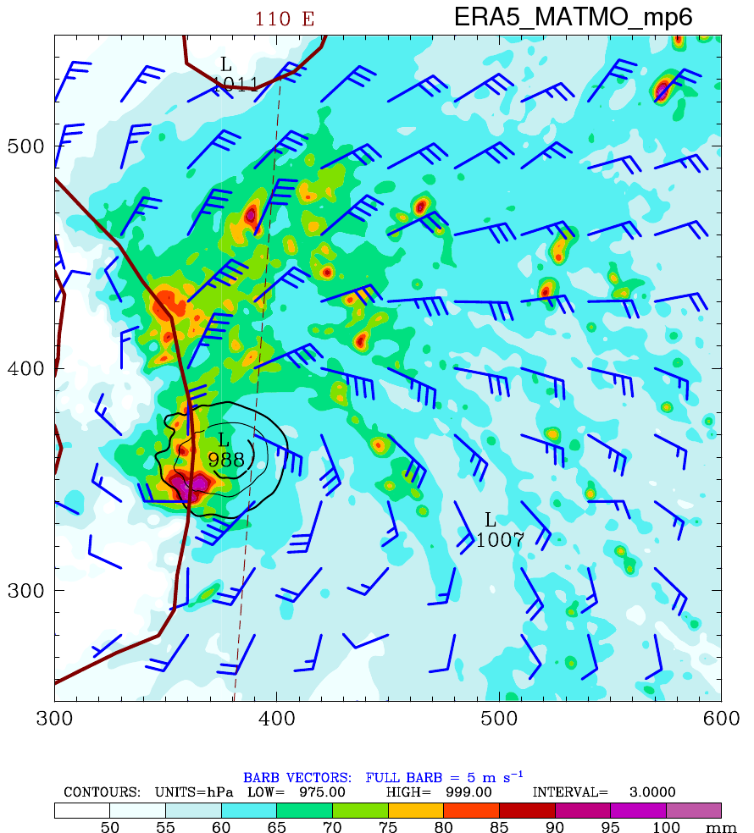
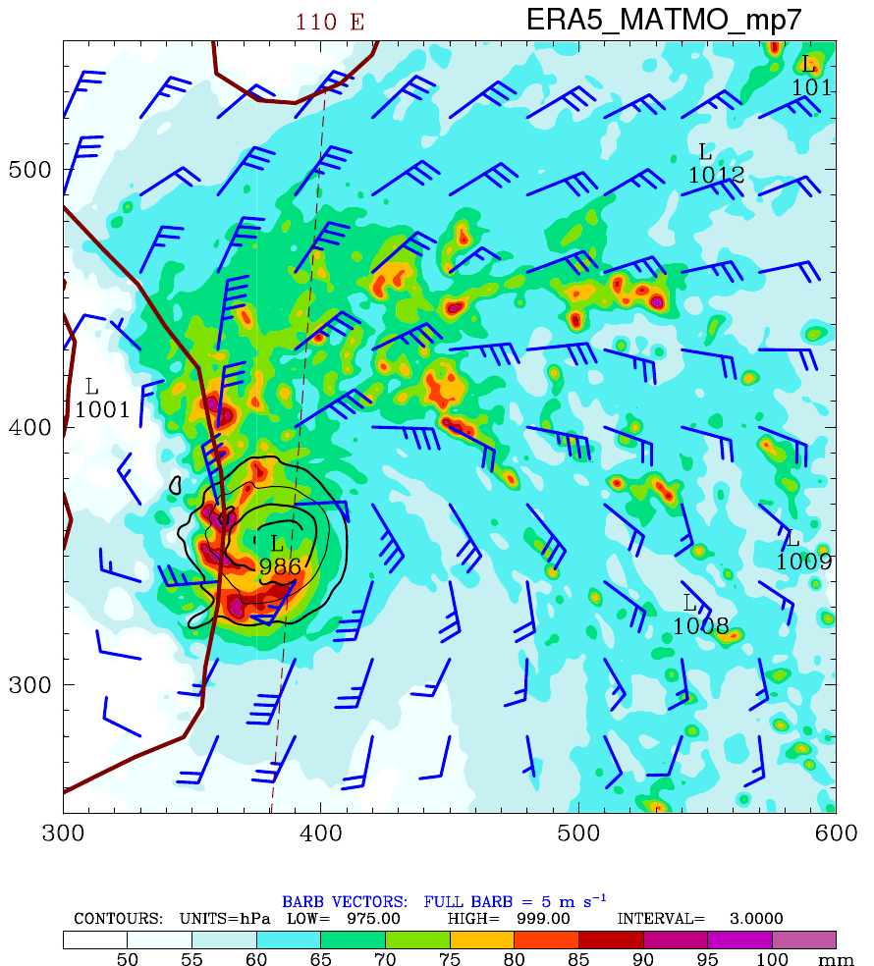
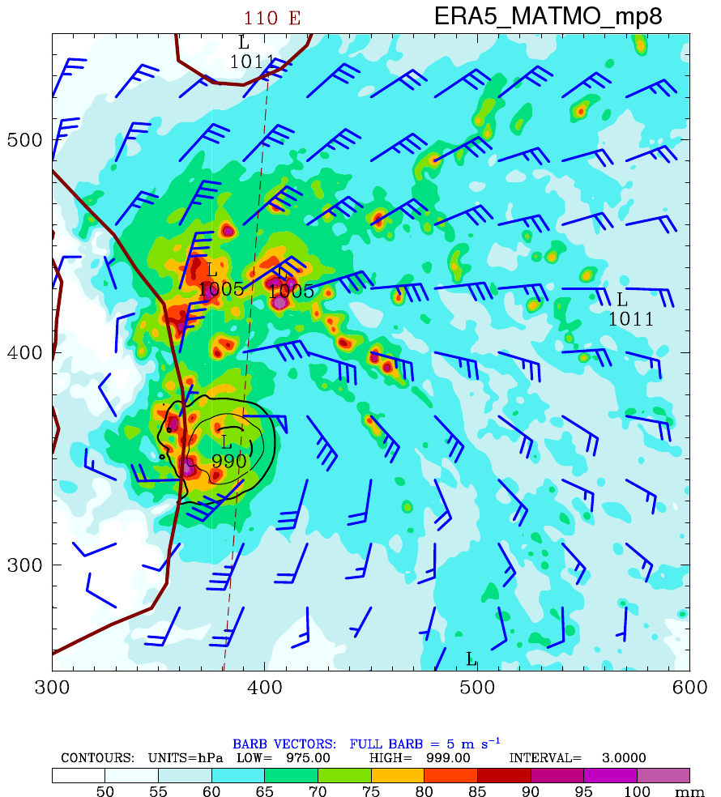
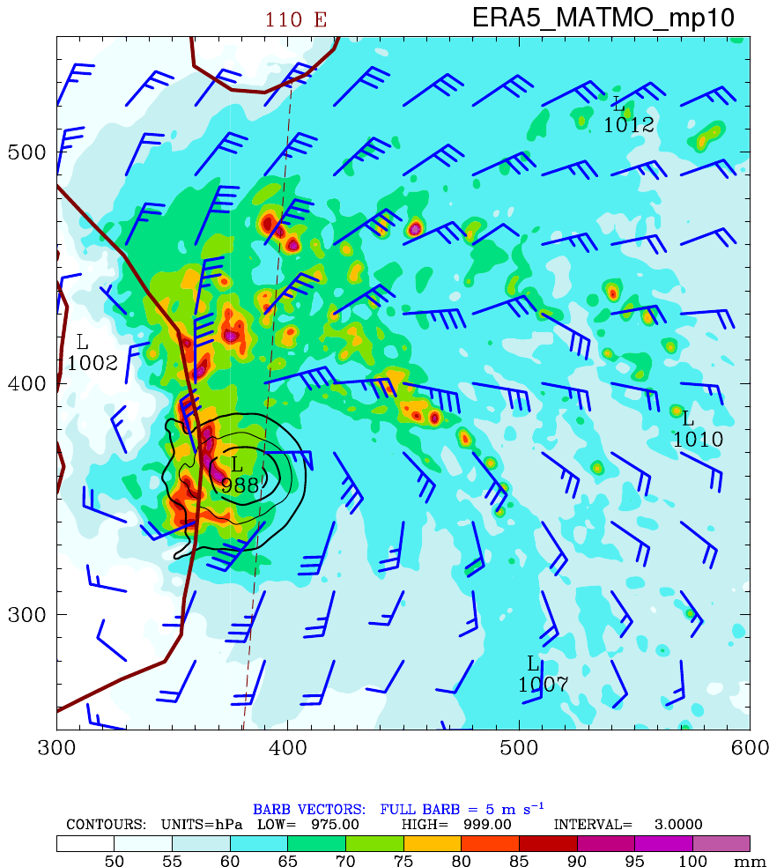
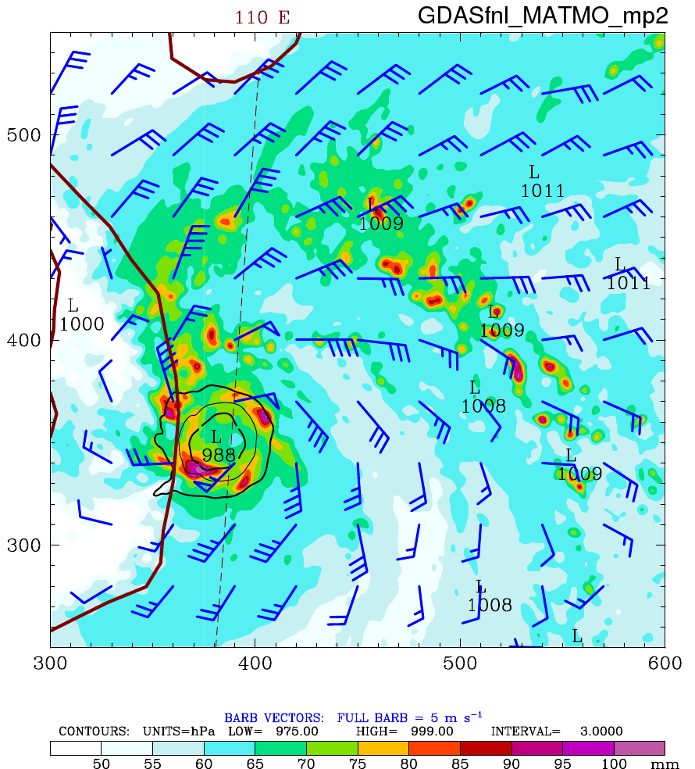
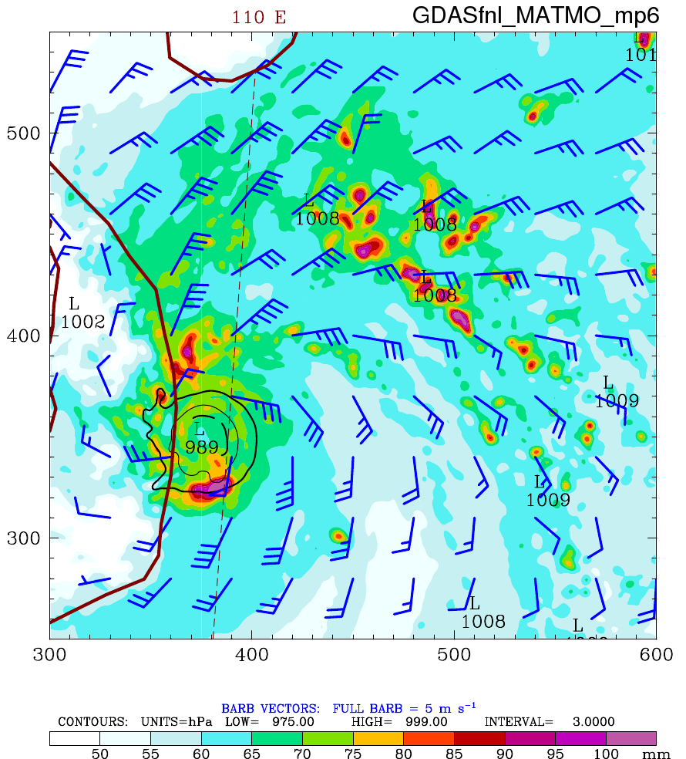
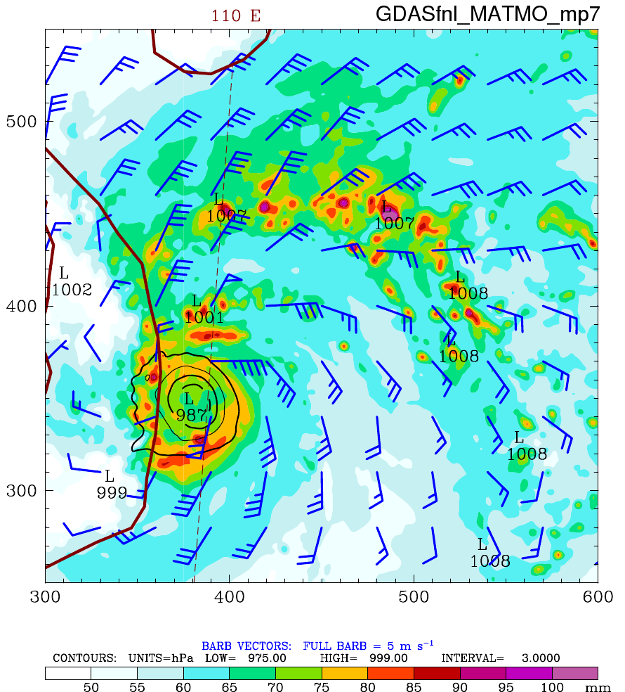
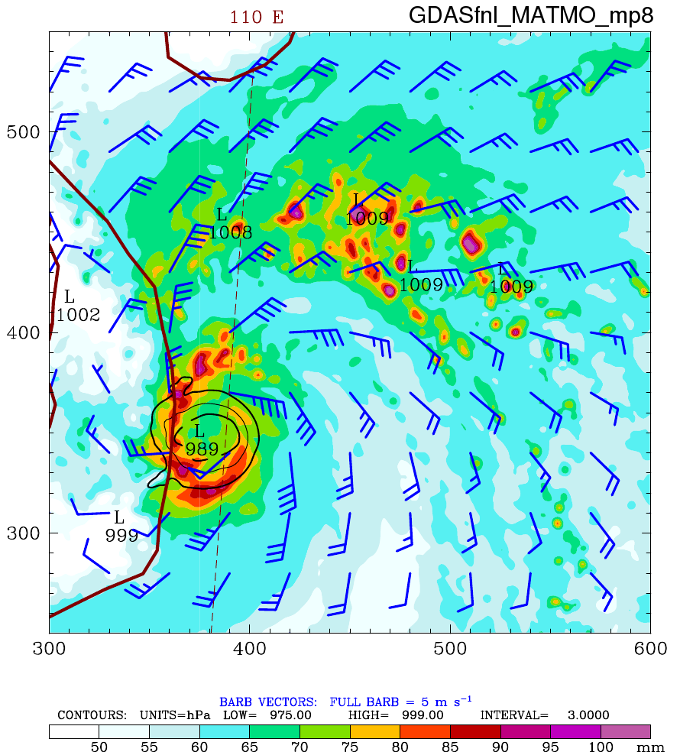
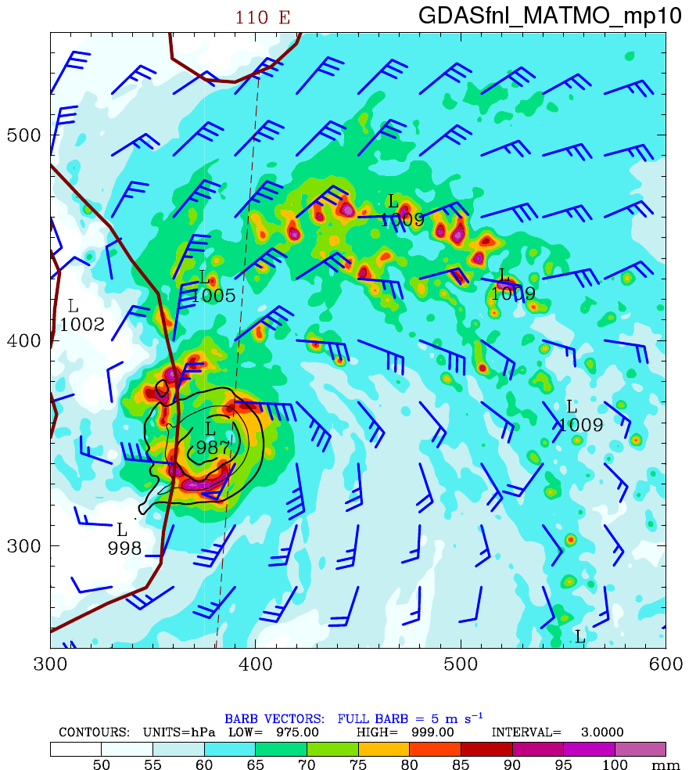
18-h Forecasted TPW+SLP+10m Wind (MATMO)
Purdue Lin
WSM6
Goddard
Thompson
Morrison
ERA5
GDAS

Slide 11
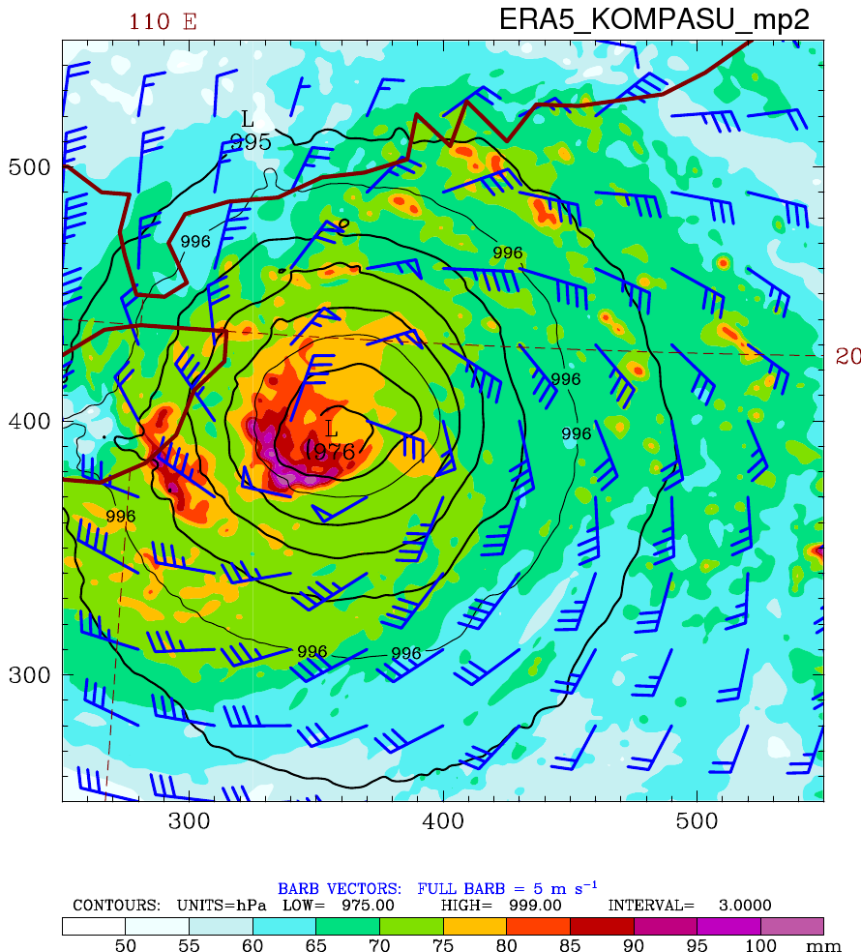
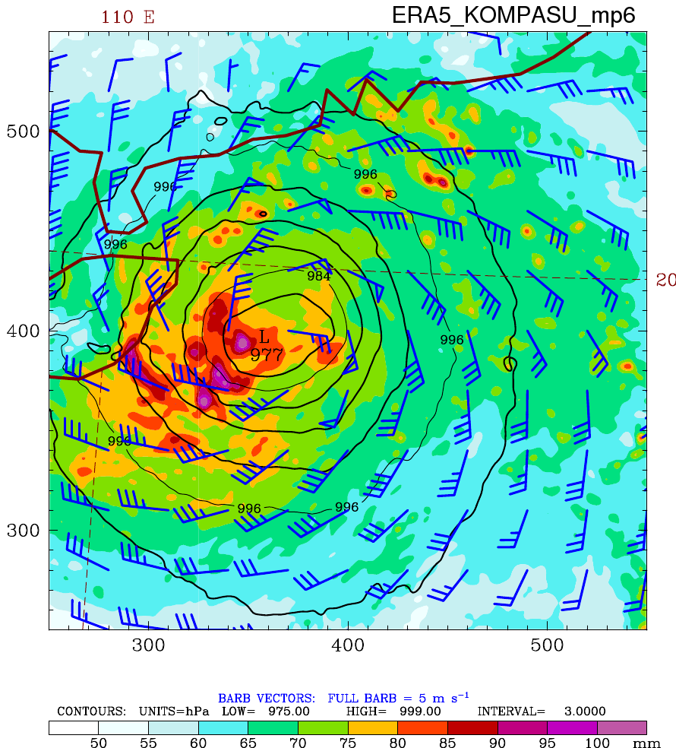
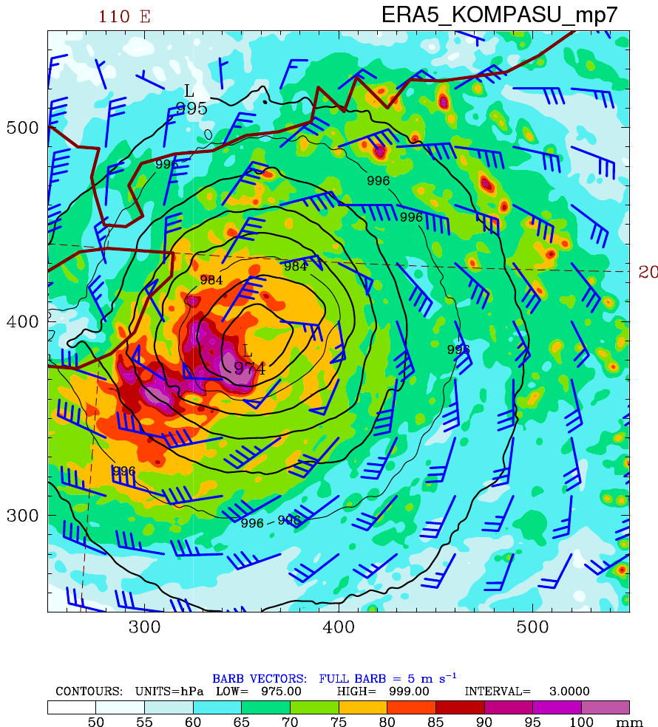
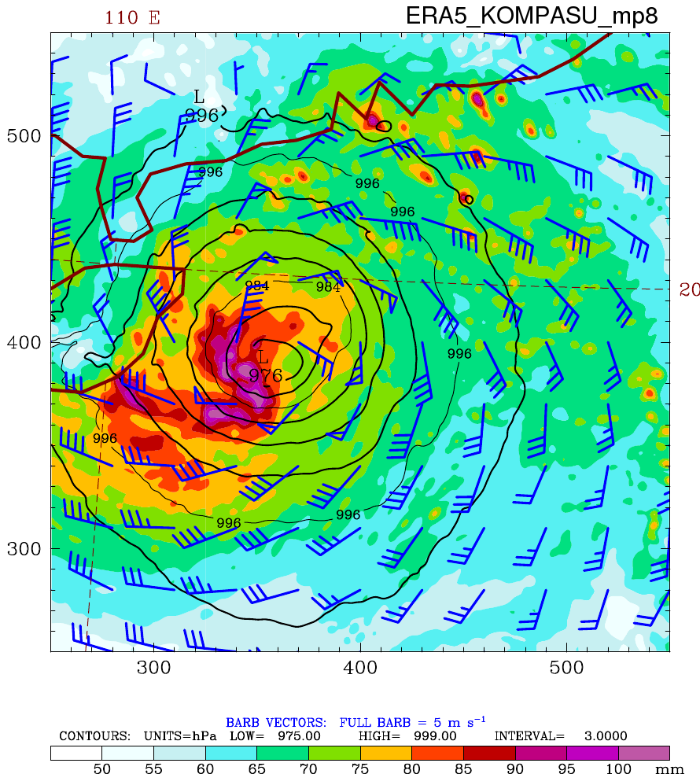
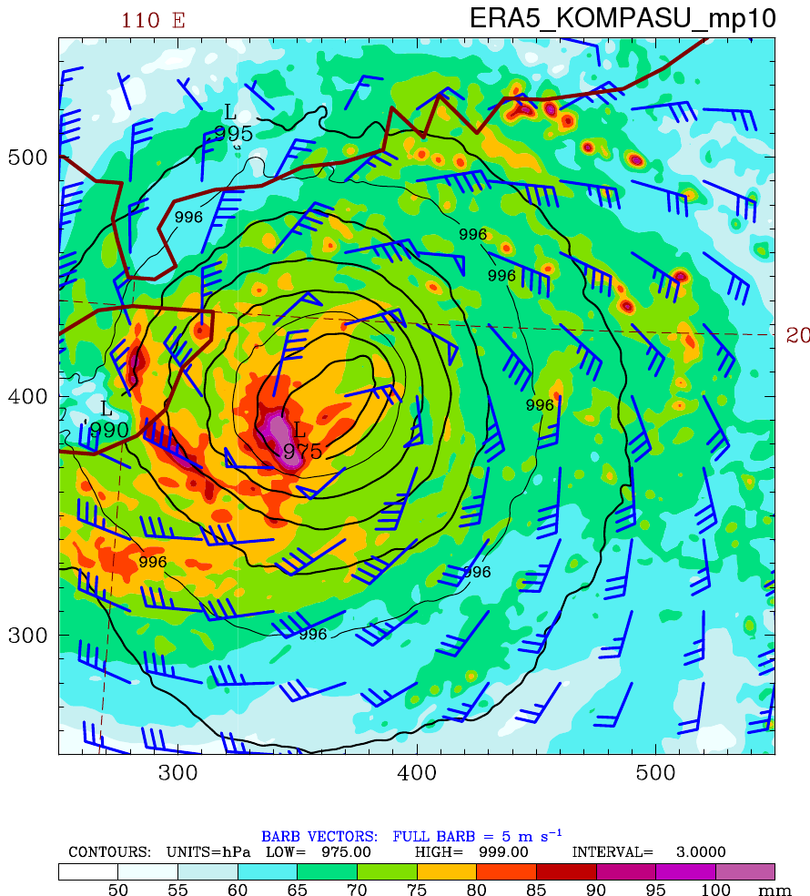
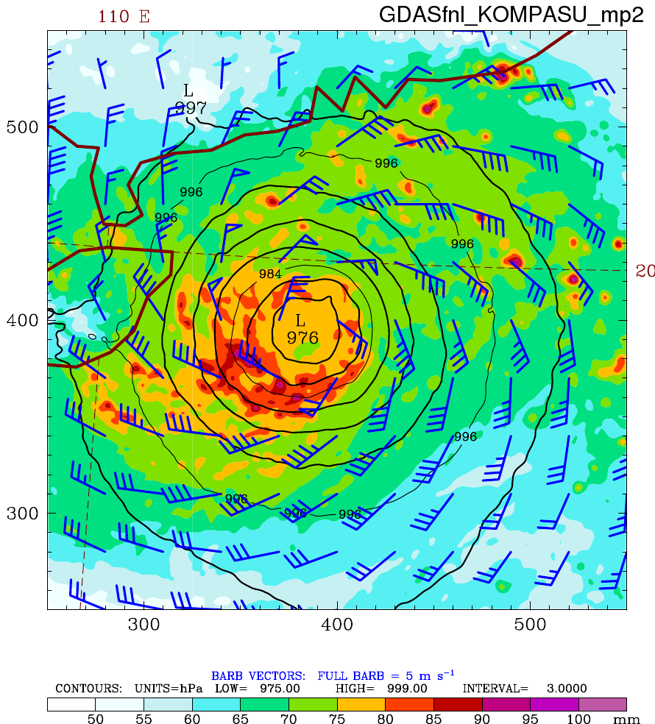
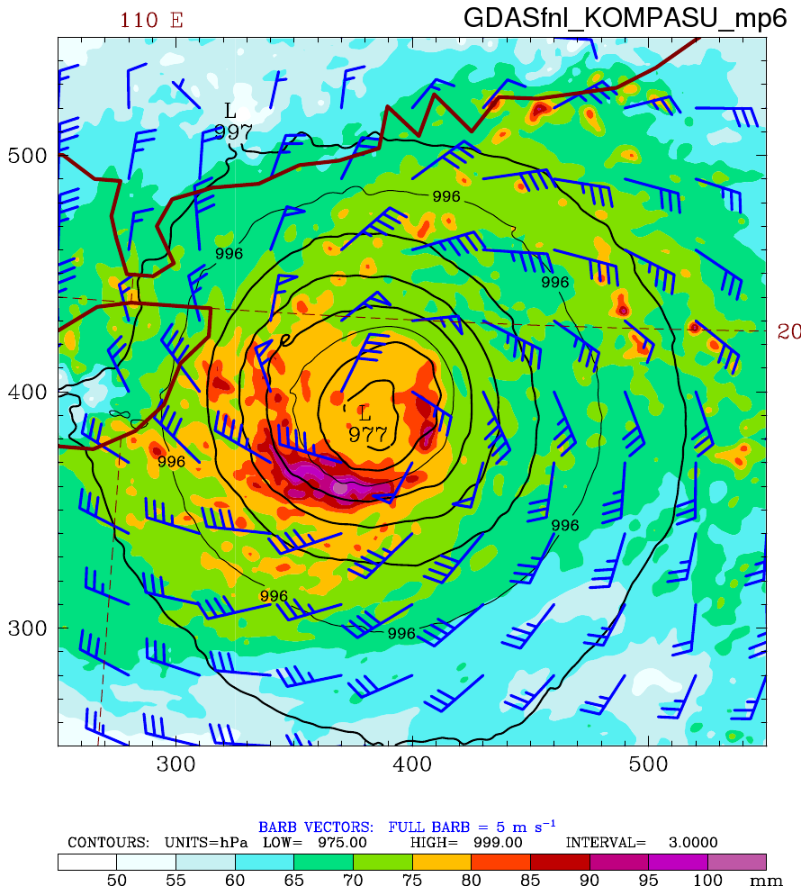
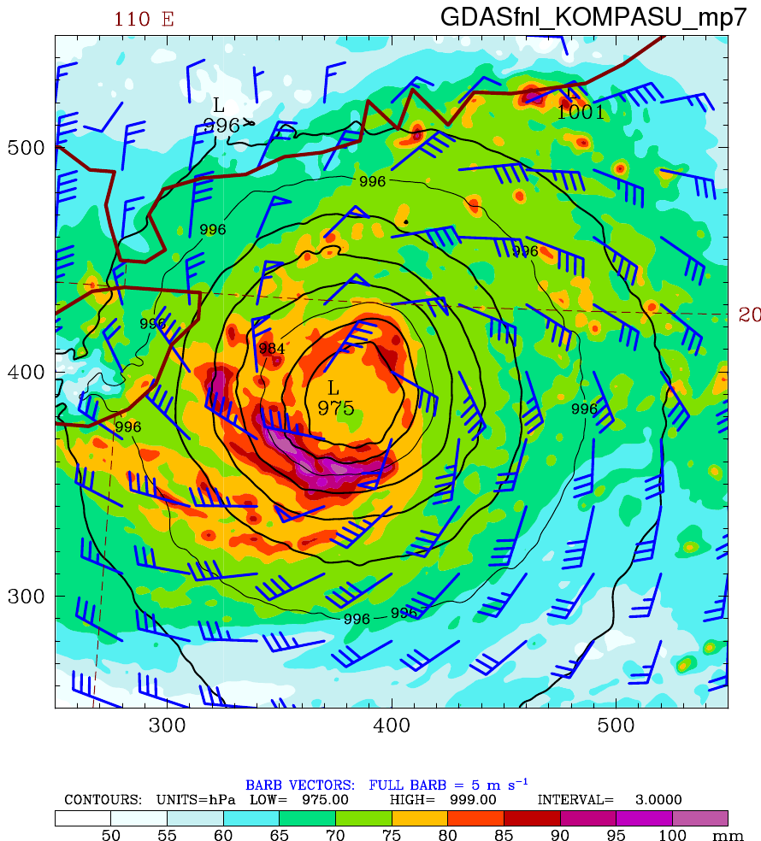
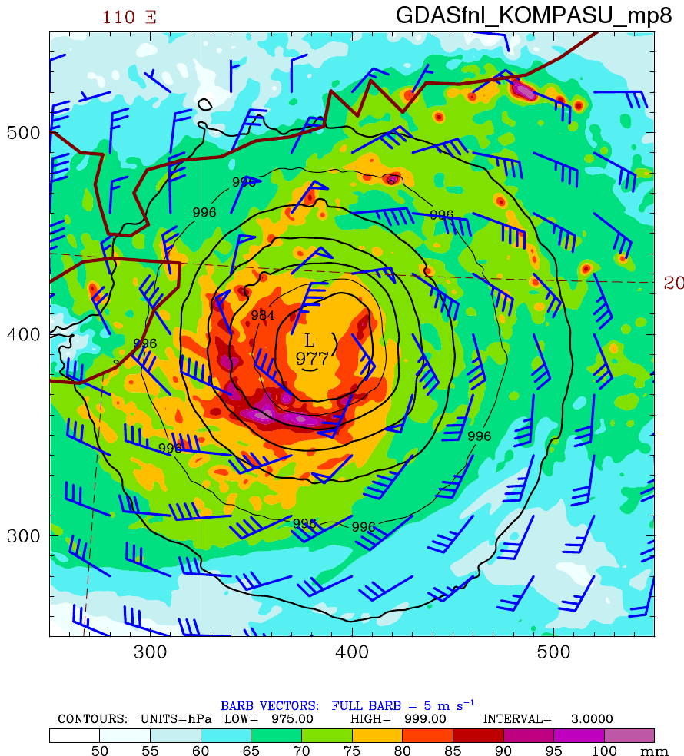
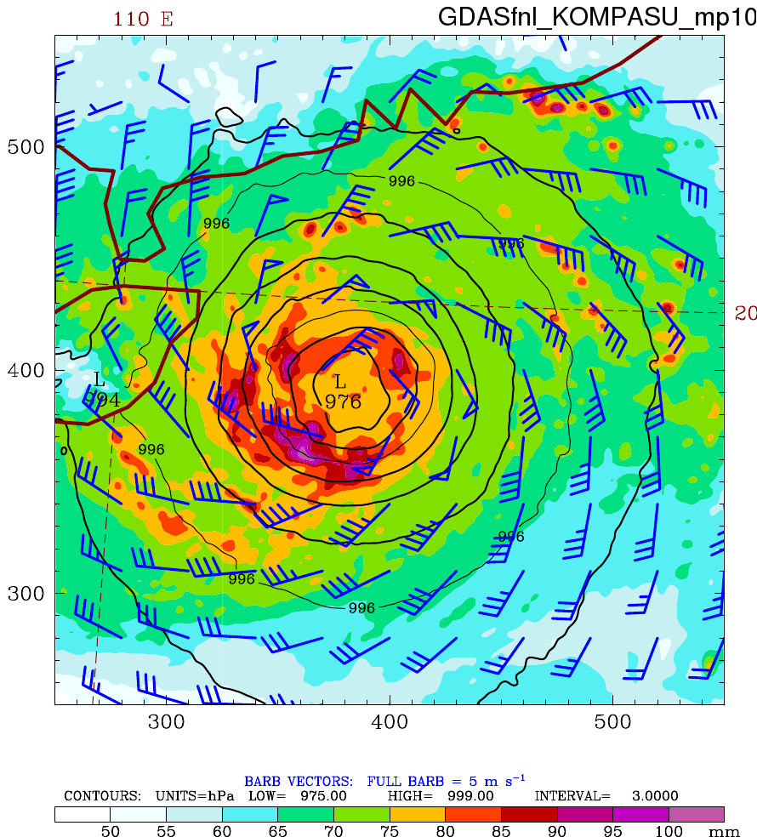
18-h Forecasted TPW+SLP+10m Wind (KOMPASU)
Purdue Lin
WSM6
Goddard
Thompson
Morrison
ERA5
GDAS

Slide 12
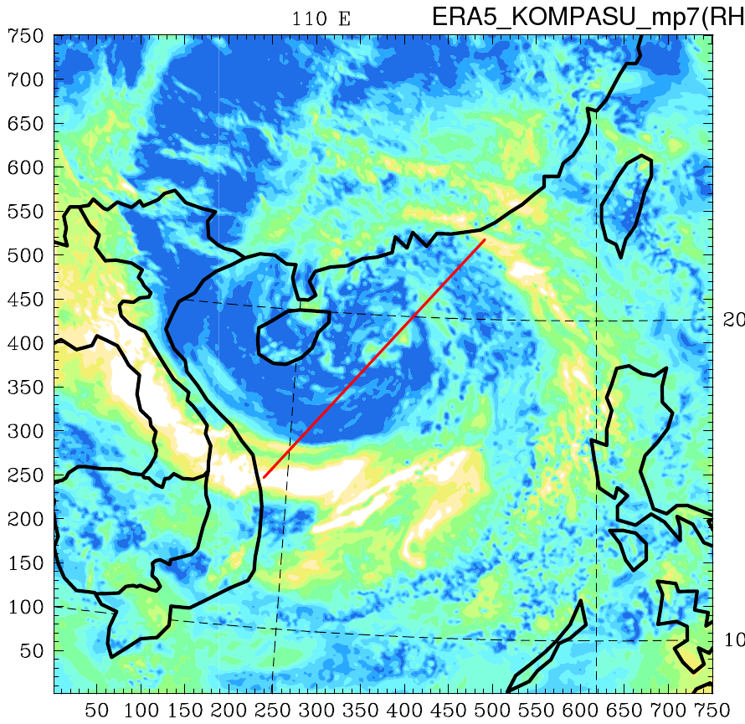
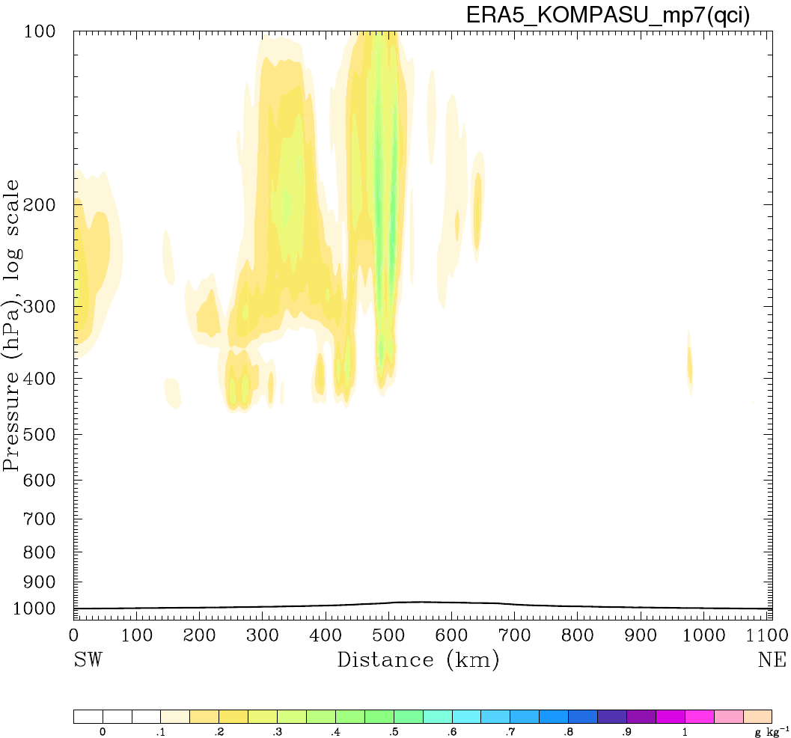
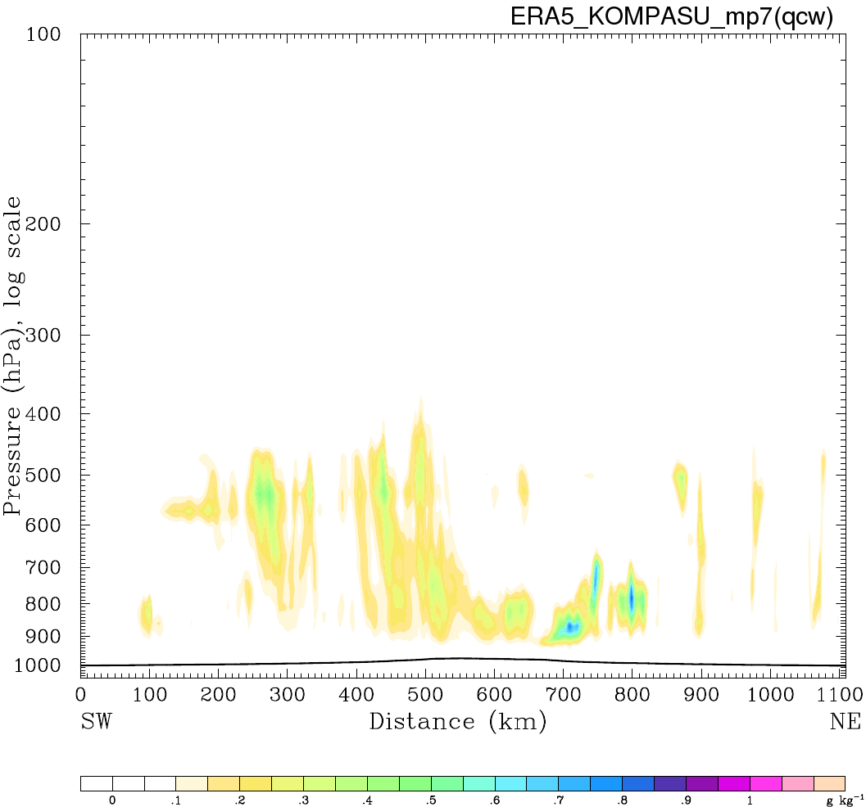
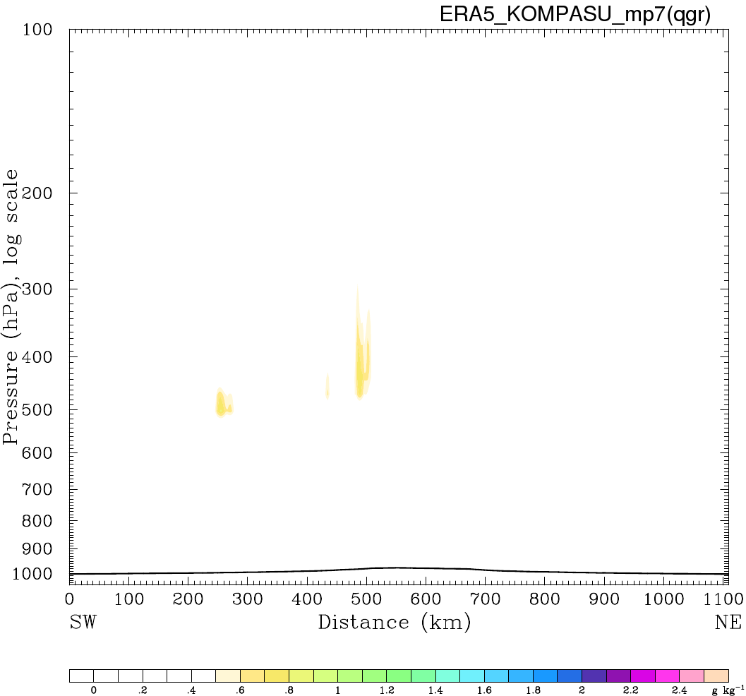
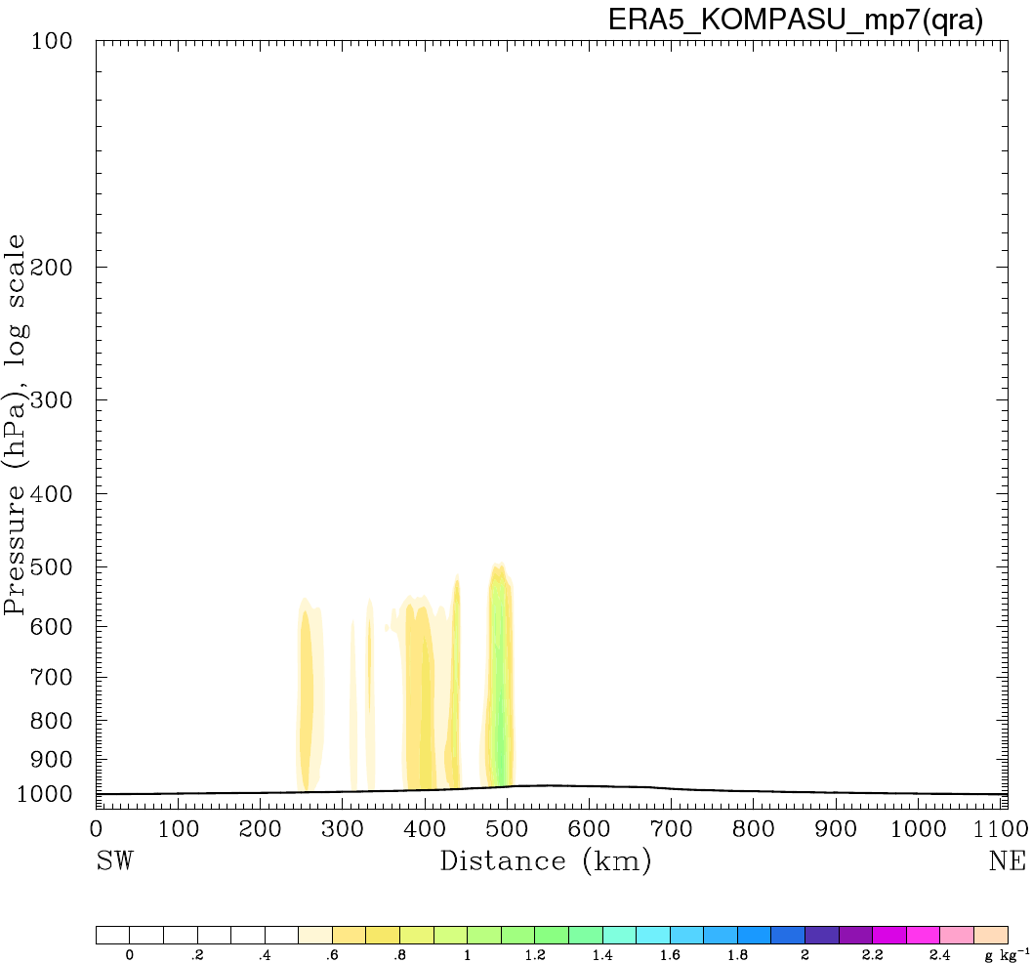
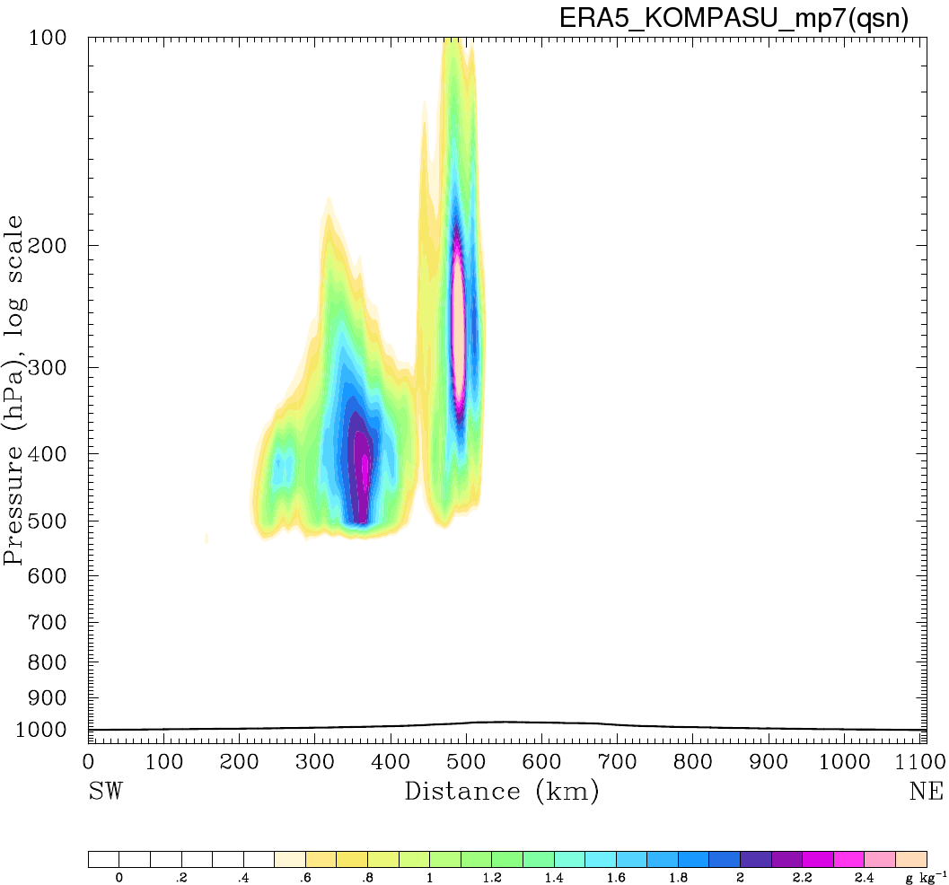
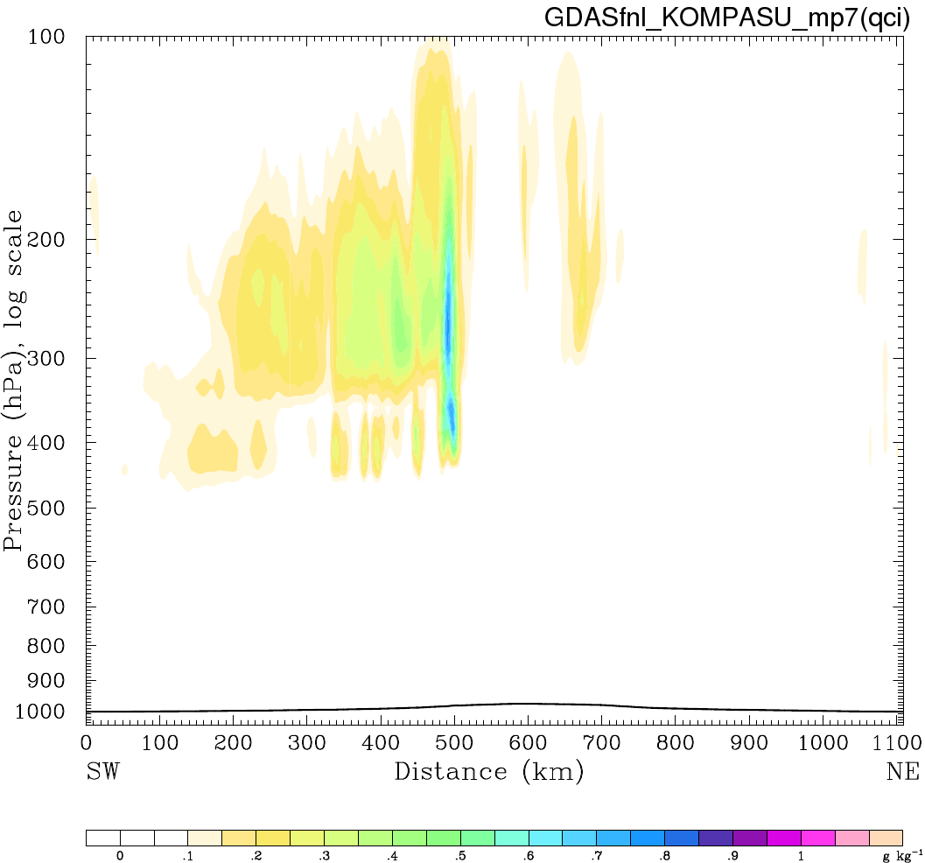
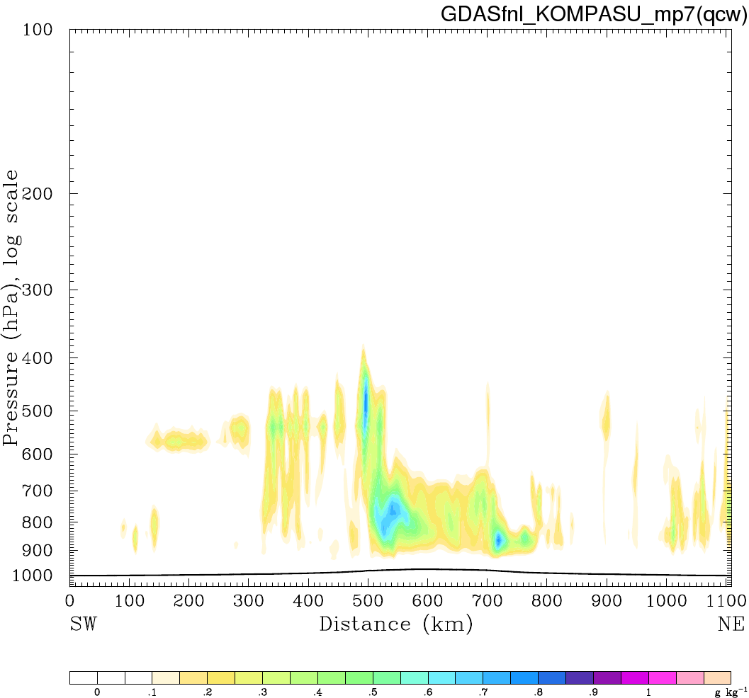
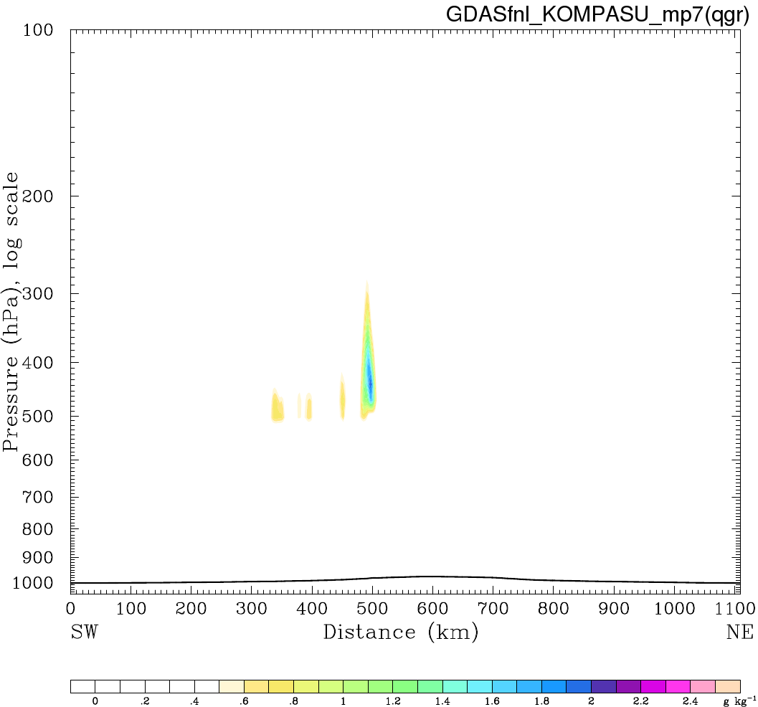
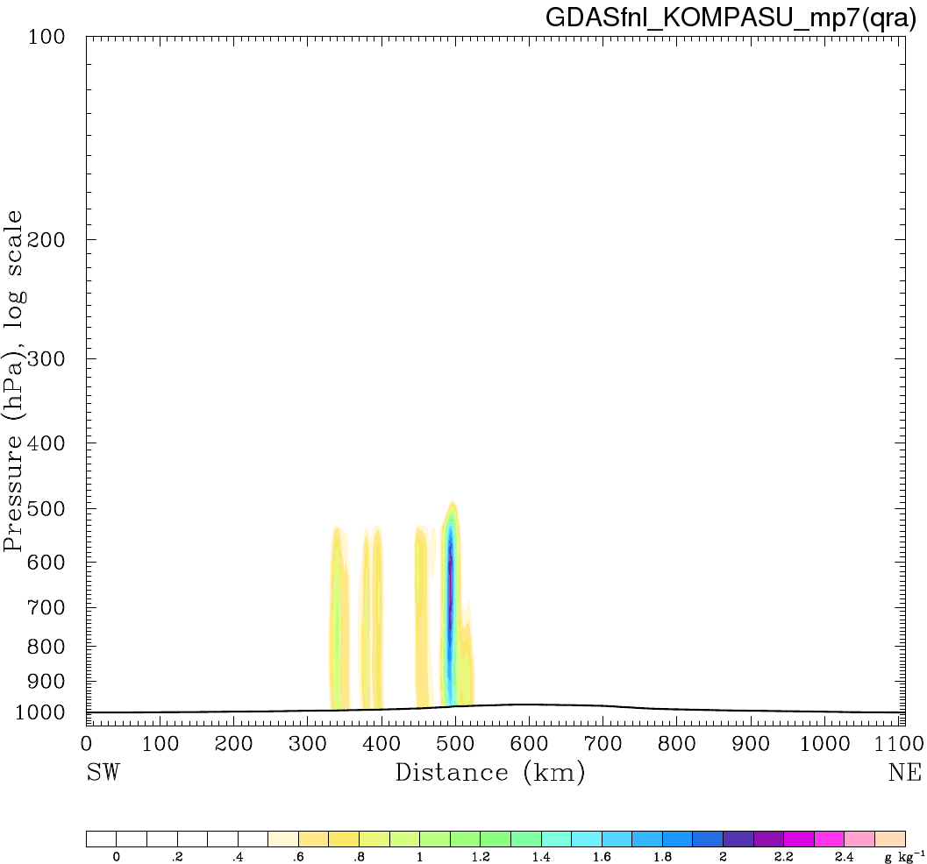
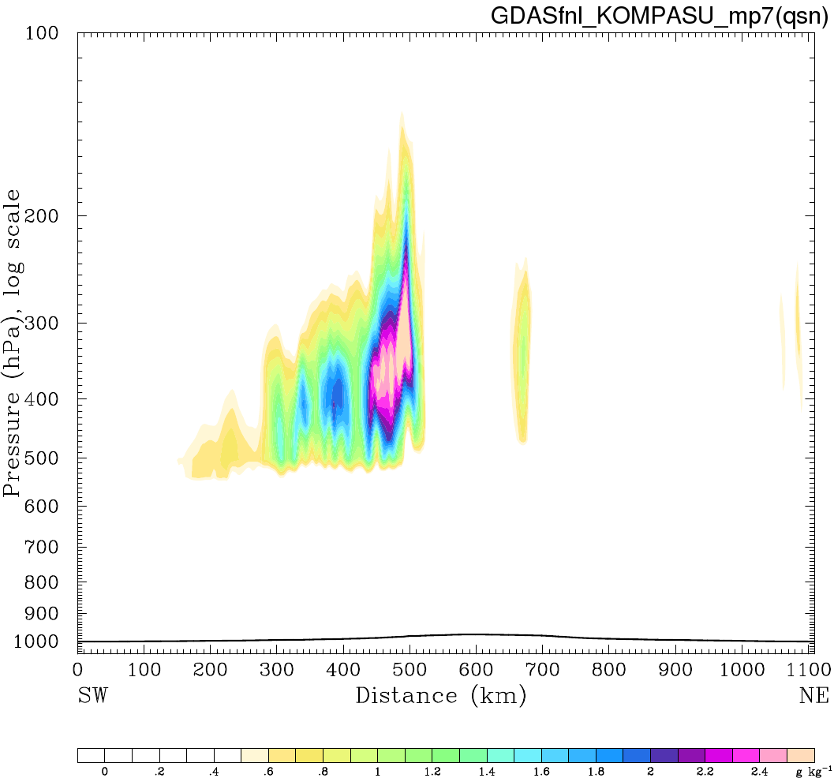
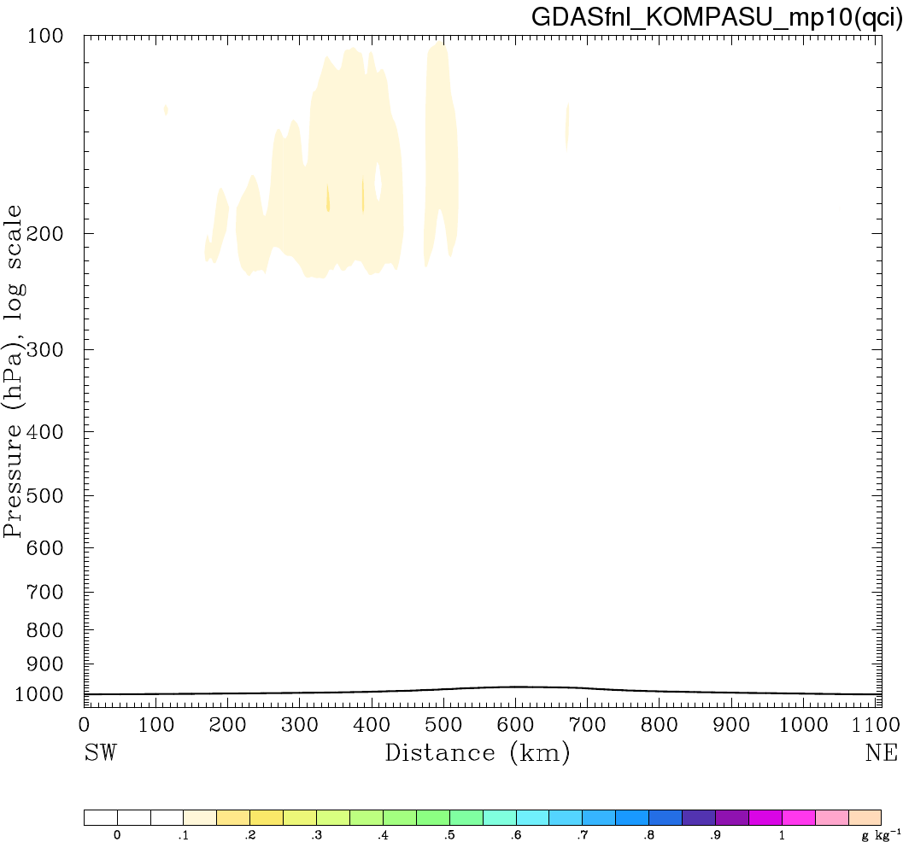
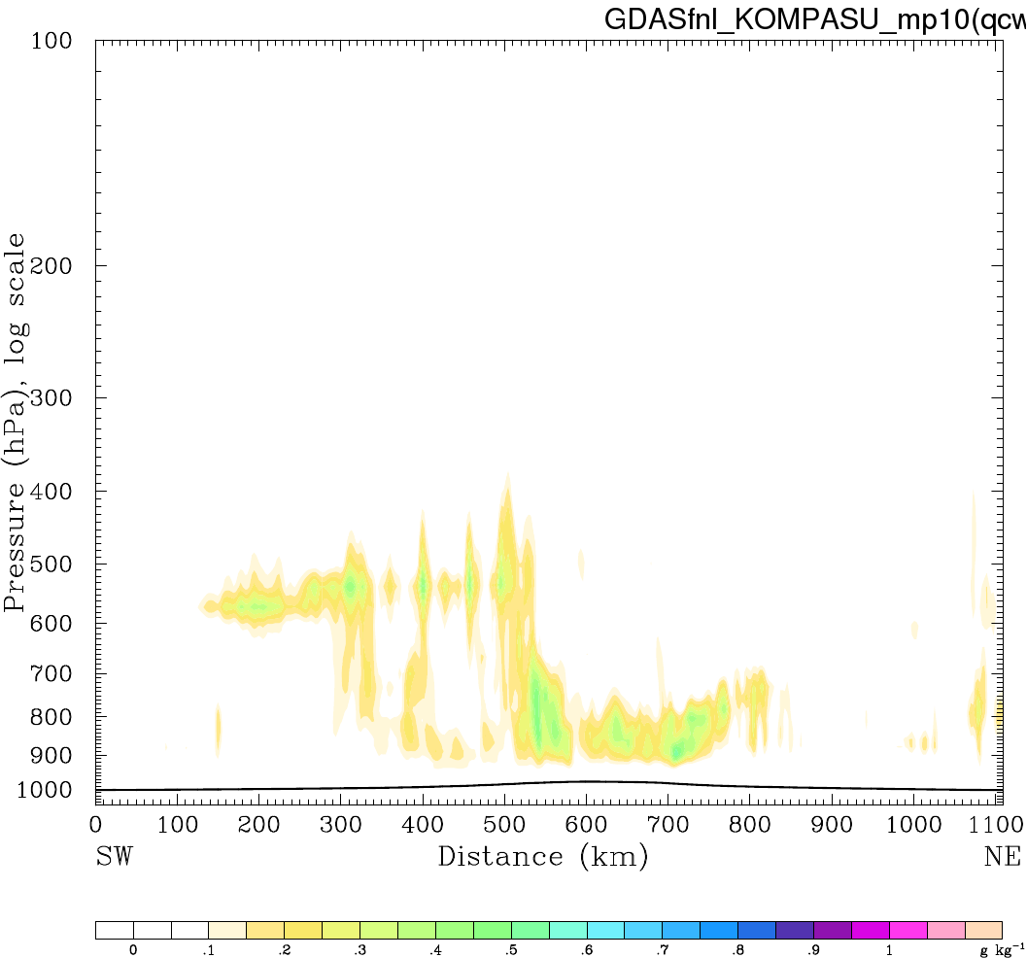
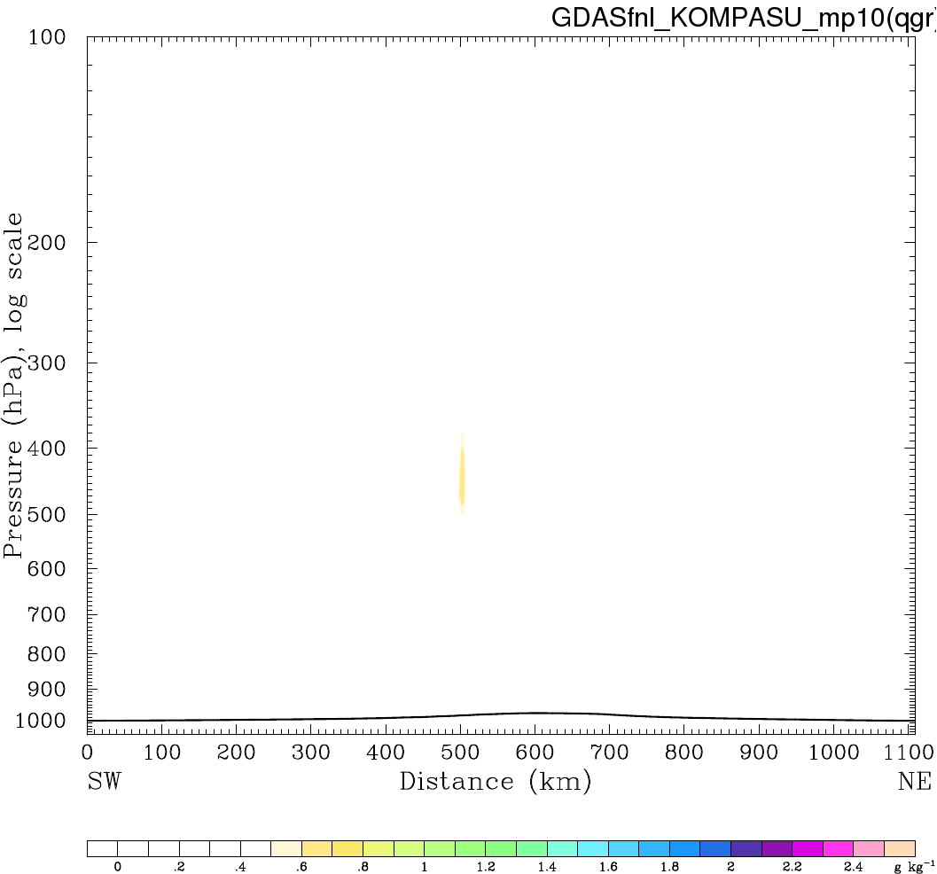


Hydrometeors (mixing ratio) for KOMPASU
Cloud Ice Cloud Water Graupel Rain Water Snow
ERA5 Goddard
GDAS Goddard
GDAS Morrison
Notes:
Only a few or none snow in WSM6 and Purdue Lin

Slide 13



12-h Accumulated Rainfall from GPM IMERG
Bualoi
Matmo
Kompasu

Slide 14










12-h Accumulated Rainfall (f6-18h) (Bualoi)
GPM
ERA5
GDAS
Purdue Lin
WSM6
Goddard
Thompson
Morrison

Slide 15










12-h Accumulated Rainfall (f6-18h) (Matmo)
GPM
ERA5
GDAS
Purdue Lin
WSM6
Goddard
Thompson
Morrison

Slide 16










12-h Accumulated Rainfall (f6-18h) (Kompasu)
GPM
ERA5
GDAS
Purdue Lin
WSM6
Goddard
Thompson
Morrison

Slide 17
Typhoon Tracks
BestTrack
Purdue Lin
WSM6
Goddard
Thompson
Morrison
Bualoi
Matmo
Kompasu
ERA5
No typhoon at the first output
GDAS

Slide 18



Track Errors
ERA5 (solid)
GDAS (dash)

Slide 19



Intensity
ERA5 (solid)
GDAS (dash)

Slide 20




Verification against ERA5
RMSE during the 18 h forecasts for 3 Cases
Temperature (ºC)
Water Vapor Mixing Ratio (g kg⁻¹)
ERA5
GDAS
ERA5
GDAS
Purdue_Lin
WSM6
Goddard
Thompson
Morrison
Purdue_Lin
WSM6
Goddard
Thompson
Morrison

Slide 21






QVAPOR Verification against ERA5 (RMSE for Bualoi)
ERA5
6-h forecast
12-h forecast
18-h forecast
Purdue_Lin
WSM6
Goddard
Thompson
Morrison
GDAS

Slide 22












Individual Verification against Soundings (QVAPOR)
(15 RO, 1 RAOB)
F
E
A
B
D
TY center
GNSS RO
Radiosonde
No consistent mode
C
Sounding A B C D E F
ERA5
GDAS

Slide 23


Verification against Soundings
Mean Differences in QVAPOR for 3 Cases
(15 RO, 1 RAOB)
TY center
GNSS RO
Radiosonde
Purdue_Lin
WSM6
Goddard
Thompson
Morrison
ERA5
Purdue_Lin
WSM6
Goddard
Thompson
Morrison
GDAS
WRF model has a underestimate QVAPOR in most the troposphere
WRF model has a underestimate QVAPOR in the lower troposphere

Slide 24


Verification against Soundings (15 RO, 1 RAOB)
Mean Differences (Temperature)
Purdue_Lin
WSM6
Goddard
Thompson
Morrison
Purdue_Lin
WSM6
Goddard
Thompson
Morrison

Slide 25
Summary
The results show a significant variability in hydrometeor distributions, which depend on the initial conditions and microphysics.
In general, all the simulations in this study show an underestimation of precipitation compared to the GPM. An underestimated QVAPOR is also found in the verification against sounding observations.
Comparing the WRF simulation, the accumulated rainfall is relatively higher for the cases with initial conditions from GDAS.
In addition, the Goddard scheme shows the best performance in the water vapor mixing ratio for the verification against ERA5.

