Slide 1
GNSS PRO Forward operator
Daisuke Hotta, Katrin Lonitz and Sean Healy
Thanks also to: Ramon Padullés, Peter Bechtold, Alan Geer, Robin Hogan, Patrick Erikson

Slide 2
Introduction
Forward operator
Tangent linear
Adjoint
Observation error model
PRO observed
Assimilation
Updated model state
Model state
PRO simulated
Forward operator
Forecast
Notes:
A “first-principle” scattering calculation of KDP from NWP variables would require assumptions about details of cloud microphysics and precipitation that are not currently represented in the forecast model. In IFS, the only prognostic variables related to hydrometeors are their water content (or vertical mass-flux; see next subsection), so KDP needs to estimated from the water content variables from each type of hydrometeors

Slide 3
Components of PRO forward operator
Computing ray-path position
Exploit ray-tracing of the operational 2D operator for RO (Healy et al. 2007)
Modelling K_{DP} from hydrometeors represented in the forecast model
Rigorous modelling requiring scattering calculation with many assumptions about hydrometeor characteristics - more complex, but possible
Start by assuming linear relationship between K_{DP} and hydrometeor water content (Padullés et al. 2021)
(IFS specific) Converting vertical mass fluxes into water content
Follow RTTOV-SCATT’s approach (Geer 2007, ECMWF tech memo 535)
Notes:
A “first-principle” scattering calculation of KDP from NWP variables would require assumptions about details of cloud microphysics and precipitation that are not currently represented in the forecast model. In IFS, the only prognostic variables related to hydrometeors are their water content (or vertical mass-flux; see next subsection), so KDP needs to estimated from the water content variables from each type of hydrometeors

Slide 4
Analogy between PRO and RO observable
PRO | RO
Differential phase shift Φ_{DP} | Bending angle
Integral of K_{DP} along the ray path | Integral of infinetsimal bending along the ray path
$$Φ_{DP}=\int_{GNSS}^{LEO}{K_{DP}\left(s\right)ds}$$ | $$⍺=\int_{GNSS}^{LEO}{\frac{d⍺}{ds}ds}$$
This allows to use the existing operator for RO bending angle for PRO

Slide 5
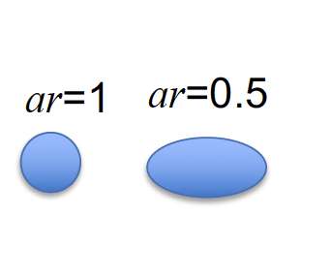
linear relationship between K_{DP} and hydrometeor content
PRO observable = integral of K_{DP} along the ray path:
$$Φ_{DP}=\int_{GNSS}^{LEO}{K_{DP}\left(s\right)ds}$$
$$KDP= \frac{1}{2}C⍴ × WC × (1−ar)$$
with parameters ρ (density) and ar (axis ratio) fixed
Assumptions:
pure Rayleigh scattering
hydrometeors approximated as spheroids with axis ratio ar
ar and ⍴ are independent of particle size
Gamma distribution of particle size distribution (conv. WCs)
Notes:
WC means any of IWC, SWC, LWC, RWC, RWCconv and SWCconv, in units of g m−3, KDP(WC), in units of mm km−1, denotes the KDP contribution from the hydrometeor whose water content is denoted WC
ρ is the particle density in units of g cm−3
ar (non-dimensional) is the assumed axis ratio of the ice particles.
C is a proportionality constant which is derived from theory of scattering by spheroid objects which is set as C = 1.6 g cm−3−2 in this study.
For ar and ρ, we assume them to be constant and arbitrarily chose their values as ar = 0.5 and ρ = 0.2 g cm−3

Slide 6
Experimental setup
Input data:
IFS Cy47R3b at operational Tco1279L137 resolution (Δx=9km) interpolated to 0.125x0.215 lat-lon grid.
Tailor-made to archive convective mass fluxes which are not stored by default (thanks to Peter Bechtold)
Observations:
PAZ Polarimetric V06 data provided by IEEC, and regular RO Level-2 data from UCAR post-processing
Examined cases:
5 Atmospheric River (AR) cases, all in the North Pacific extratropics.
6 Tropical Cyclone (TC) cases.
Selected by Dr. Ramon Padullés of IEEC for their PRO model intercomparison exercise.

Slide 7
Results
5 Atmospheric River (AR) cases, all in the North Pacific extratropics.
6 Tropical Cyclone (TC) cases.
Selected by Dr. Ramon Padullés of IEEC for their PRO model intercomparison exercise.
PAZ observations

Slide 8
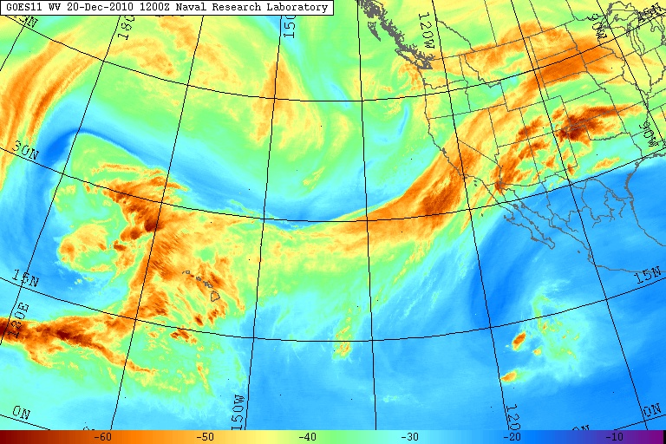
Results – example atmospheric river (AR) case
Very good agreement between simulated total (purple) and observed (blue) profiles.
Resolved-scale snow (yellow solid) is the dominant contribution
which is a surprise, to be discussed later
Notes:
Atmospheric rivers are relatively long, narrow regions in the atmosphere – like rivers in the sky – that transport most of the water vapor outside of the tropics. While atmospheric rivers can vary greatly in size and strength, the average atmospheric river carries an amount of water vapor roughly equivalent to the average flow of water at the mouth of the Mississippi River. Exceptionally strong atmospheric rivers can transport up to 15 times that amount. When the atmospheric rivers make landfall, they often release this water vapor in the form of rain or snow.
Water vapor imagery of the eastern Pacific Ocean from the GOES 11 satellite, showing a large atmospheric river aimed across California in December 2010. This particularly intense storm system produced as much as 26 in (660 mm) of precipitation in California and up to 17 ft (5.2 m) of snowfall in the Sierra Nevada during December 17–22, 2010.

Slide 9
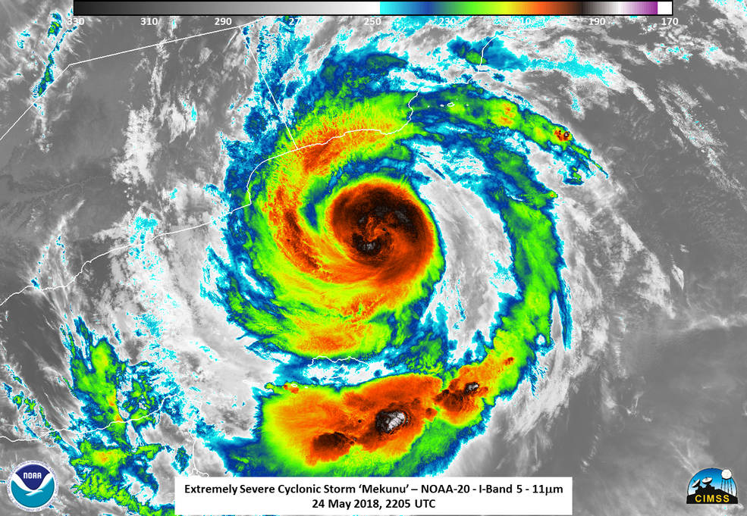
Results – example Tropical cyclone (TC) case
Results for all TC cases show poor agreement between simulation and observation
“Shape” of the profiles do not match
Amplitude also systematically overestimated
Notes:
The NOAA-20 satellite captured an infrared image of Mekunu on May 25 that showed temperature data of the cloud tops. Powerful thunderstorms surrounding the low-level center and in a band south of the center had temperatures as cold as or colder than minus 99.6 degrees Fahrenheit (200 kelvin/minus 73.1 degrees Celsius).
Credits: NOAA/UWM/SSEC/CIMSS, William Straka III
Indic ocean off saudi arabia

Slide 10
Why does snow dominate the signal?
Φ_{DP} signals are mostly dominated by contribution from snow.
In weather radar community, it is accepted that K_{DP} for snow is negligibly smaller than for rain (e.g., review by Kumjian 2013)
Possible explanation:
geometry of GNSS-RO
different carrier-wave wavelength
GNSS: L-band, ~ 1.5GHz, λ ≈ 20 cm (to avoid attenuation by rain/snow)
Radar: C- to X-band, 6GHz ~ 10GHz, λ = 3 ~ 5 cm (to maximize backscatter by rain/snow)
Longer wavelength of GNSS carrier waves makes phase measurement sensitive more to the bulk properties (Turk et al. 2021, JAOT)
while shorter wavelength of radar waves makes phase measurement sensitive to details of the particle shape

Slide 11
Sensitivity experiments

Slide 12
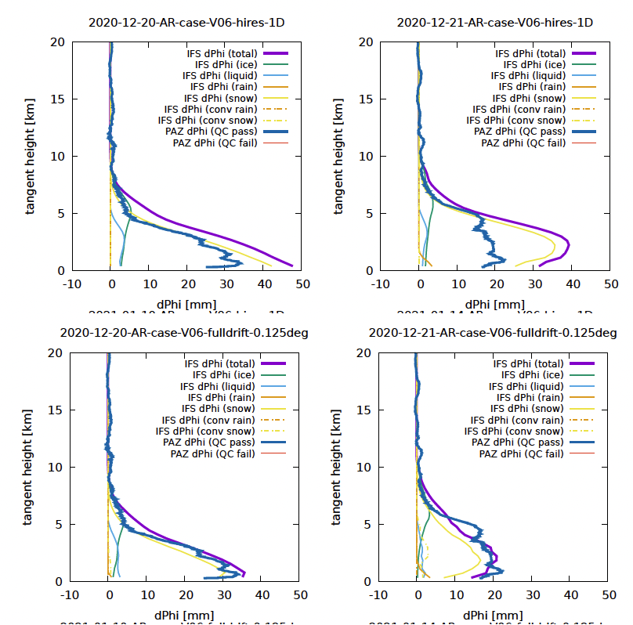
How would our results look like with using 1D calculation (i.e., assuming the atmospheric condition is horizontally uniform around the tangent point)?
1D
Poor agreement between 1D simulation vs obs, even for relatively “easy” AR cases
2-D ray-tracing is essential for good PRO simulations
2D
Notes:
Our 2D operator can easily operate in “1D mode” to emulate a 1D operator. To do this, we just set the derivative of the horizontal ray position to zero when integrating the ray equation (which is equivalent to assuming zero horizontal gradient of refractivity within the 2D slice). For simplicity, the tangent-point drift is ignored in our 1D computation.

Slide 13
Summary
Development of first version of GNSS-PRO forward operator
extending the operational 2D operator for GNSS-RO
2D ray-tracing is essential (1D operator fails)
Snow is the dominant contribution to Φ_{DP}
Most likely because of geometry of measurement
Very good fit between simulation and observation for Atmospheric River cases (=synoptic-scale systems)
Poor fit for Tropical Cyclone cases, due to Φ_{DP}’s high sensitivity to position errors
DA method would need to be able to correct position error in the background field
Preprint, Hotta et al 2023 https://amt.copernicus.org/preprints/amt-2023-132/

Slide 14
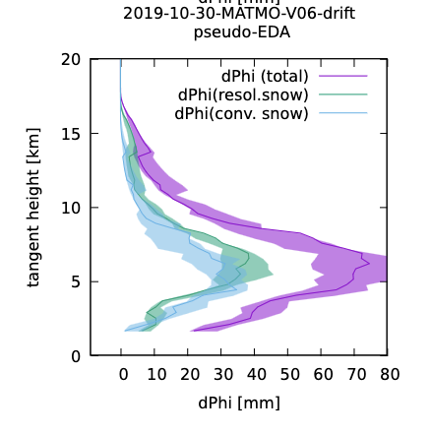
How import is the exact position of the rays?
Shift lat/lon of the tangent positions by ±0.1deg (~10km) and simulate Φ_{DP} to produce 3x3=9 profiles
Plot min/max of such profiles with shading.
AR not as sensitive but TC cases are
PRO observations can tell the model that the TC position is wrong.
Challenge: Would 4DVar be able to correct the background correctly?
Locally increasing snow along the ray
Shifting position of TC in background
AR
TC
Notes:
Suppose a situation where the observed Φ_{DP} is greater than background ΦDP due to misplaced TC.
– The positive O-B can be “corrected” in many different ways:
• Locally increasing snow along the ray (wrong correction)
• Changing the refractivity (or temperature) so that the ray passes through areas of intense snow (wrong
correction)
• Shifting the position of TC in the background fields (“correct” correction), ...etc.
– Given that GNSS-PRO observations are sparse, would they be informative enough to constrain the correction in
the right direction?
Tangent point drift

Slide 15
Future work
Test for more cases/data
Refine K_{DP}/WC relation
Fine-tune parameters
introduce K_{DP}/WC-relation derived from RTTOV-SCATT (more challenging but with more promise)
Write TL/Adjoint
Incorporate into ROPP 13
Notes:
Patrick Eriksson: Kdp for snow should be smaller if Temp are warmer
Wang et al. (2021) introduced polarimetric bending angle as an alternative observable quantity, and showed that polarimetric bending angle can be less prone to issues with multi-path, which may be beneficial especially for measurements at low altitude.

Slide 16
Backup

Slide 17
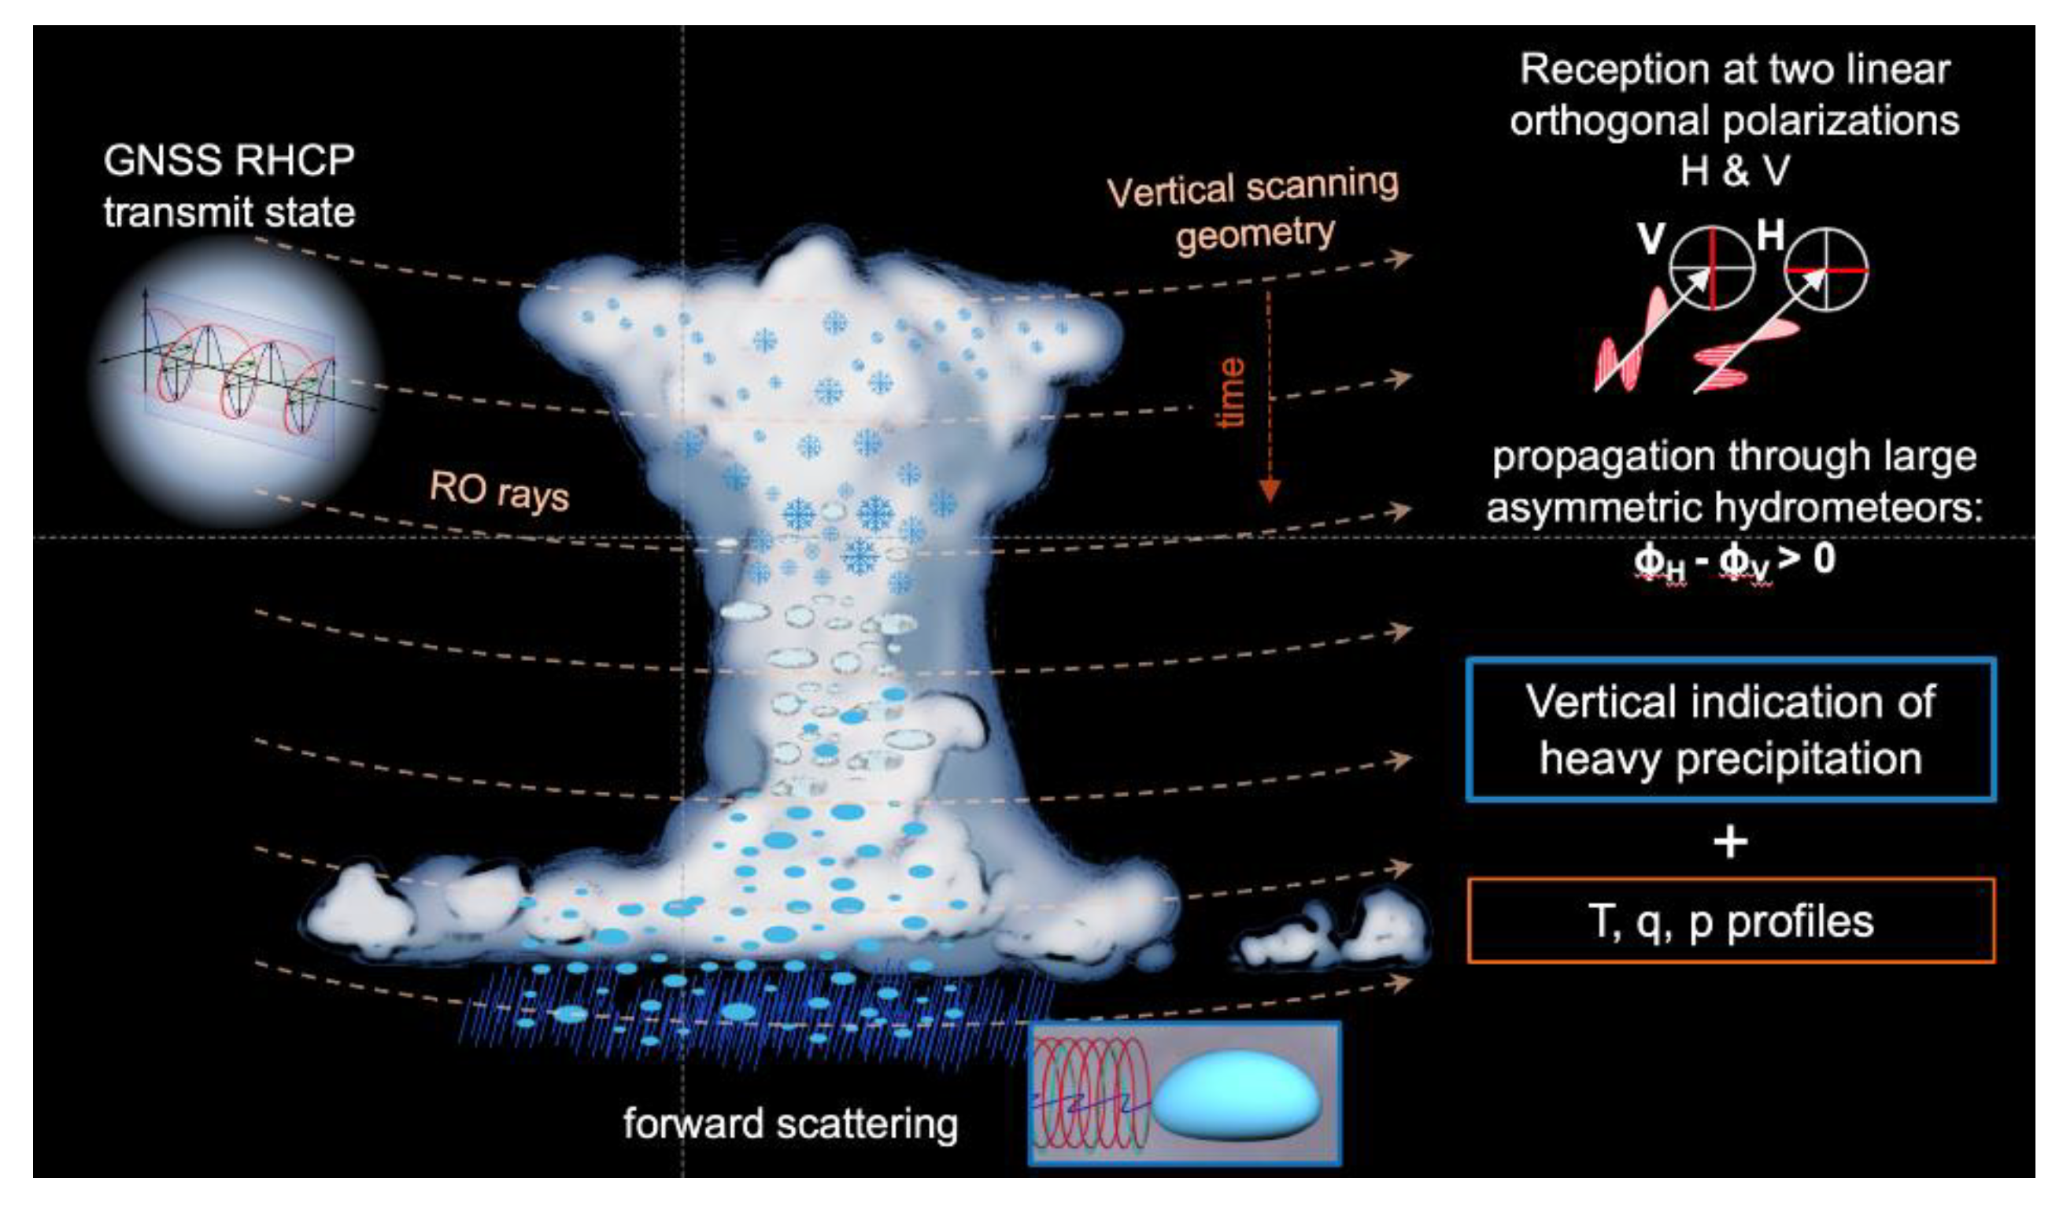
GNSS-PRO measurement principle
Large rain drops are oblate
H-pol more delated than V-pol
Inducing a phase shift ~ size and density
Fig. taken from Turk et al 2019
Notes:
The co- and cross-polarized radio signals propagating through heavy precipitation media will experience different phase delays (phase delay is denoted by 𝜙), measurable by the receiver’s polarimetric antenna.
The carrier waves employed in GNSS are circularly polarised to minimise the impact of receivers’ antenna alignment on the accuracy and stability of positioning.

Slide 19
Systematic overestimation of Φ_{DP} for TC cases
simple linear relation between K_{DP} and hydrometeor water content:
$$KDP= \frac{1}{2}C⍴ × WC × (1−ar)$$
with parameters ρ (density) and ar (axis ratio) fixed
good simulations for AR cases
systematically overestimated simulations for TC cases
Why?
There are some observational evidence that ar should be larger (snow particles less horizontally oriented) in deep convections (e.g., Gong and Wu 2017, ACP) (thanks to Ramon Padullés)
In TC cases, areas of intense SWC were warmer than in AR cases.
“First principle” scattering computation suggests that K_{DP}/WC should be smaller if warmer (Patrick Eriksson, private comm.)
Notes:
depending on the strength of mixing or vertical velocity of the background field (Ramon)

Slide 23
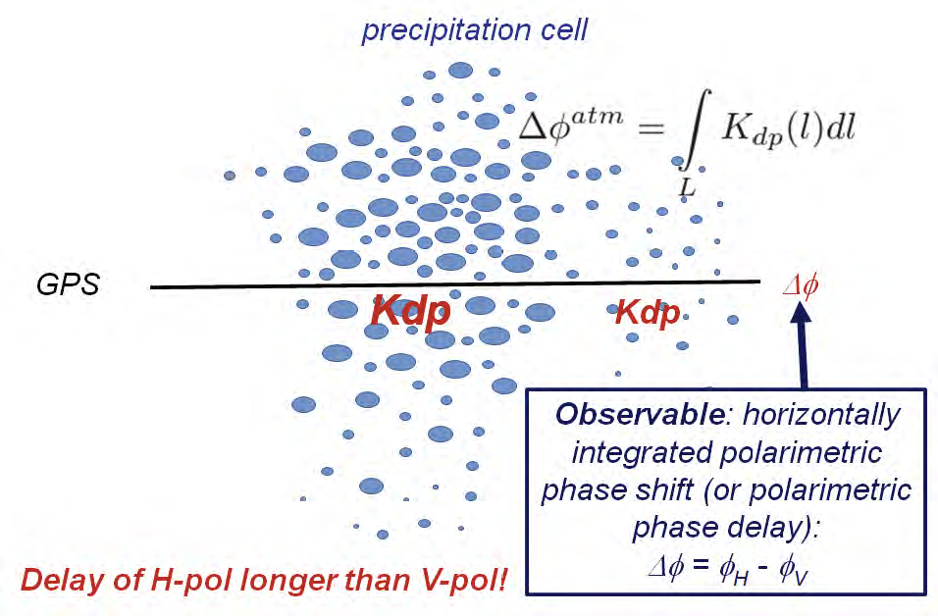
What is GNSS-PRO?
Polarimetric Radio-Occultation measurements can sense precipitation along their path
Measures excess phase in horizontal and vertical polarisations
Oblate objects induce larger phase delay in H-pol than in V-pol
senses rain/snow particles along the ray path
similar to K_{DP} obs of ground-based weather radar
Spanish PAZ satellite provides observations since 2018 (Cardellach et al., 2019)
Also, Spire launched satellites with PRO capability
Notes:
Phi_DP polarimetric differential phase shift
specific differential phase shift K_{DP}
Polarimetric radar observations exploit the fact that, when polarised radio waves travel through oblate objects like large rain droplets, the phase is delayed more in the horizontally polarised waves than in their vertically polarised counterpart due to the directionally differential cross-section of the oblate objects

