Slide 1
Produits radar en Outre Mer
Bernard Urban
7 juin 2016
Use of polarimetric observations at Météo France
State of the art and perspectives
Nicolas Gaussiat, Head of Météo France Radar Centre with contributions from MF NWP research division.
RO-PAZ second workshop – 29 november 2023

Slide 2
Summary
1 NWP models & MF observations
2 Current use of polarimetric data
3 Perspectives of use of GNSS Polarimetric data
4 Conclusion

Slide 3
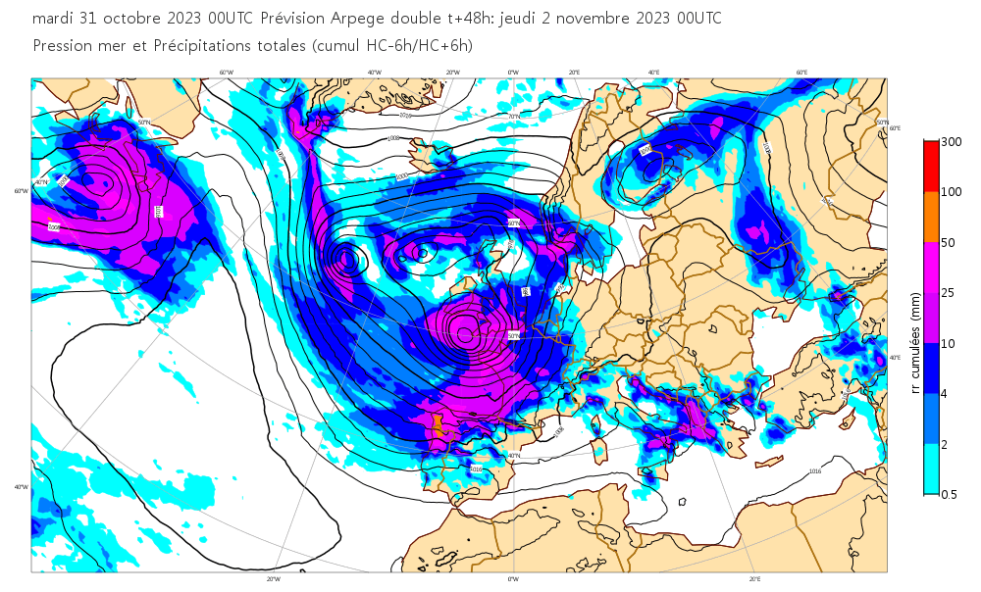
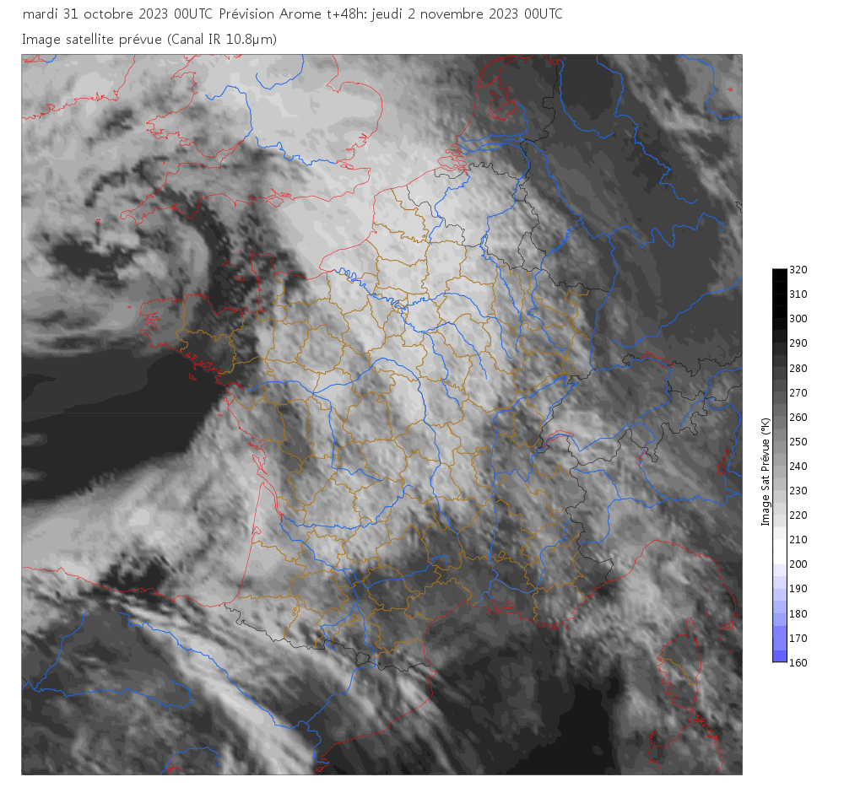
ARPEGE global model and AROME limited area model
For issuing weather forecasts, Météo-France operates both a global model named ARPEGE and a regional model named AROME.
ARPEGE forecast of pressure and precipitation
ARPEGE issues forecasts up to 4 days ahead over the globe.
Horizontal resolution varying between 5 km and 25 km
6h window 4D-Var assimilation with background errors
from EDA (50 members, TL499C1L105)
10⁹ observations assimilated per month (90 % satellite data)
AROME issues forecasts up to 2 days ahead over
Western Europe.
Horizontal resolution of 1.3 km.
1h cycle 3D-Var assimilation => 1h cycle 3D-EnVar
in the parallel suite with background errors from
EDA (25 members, 3.25 km resolution).
10⁷ observations per month (10 % are satellite data).
Storm Ciarán forecasts initialized on Oct. 31st 00h UTC, valid on Nov. 2nd 00h UTC
AROME forecast simulated
satellite imagery

Slide 4
ARPEGE global model and AROME limited area model
Both the global model and the regional model have their own Ensemble Data Assimilation system and Ensemble Prediction System.
ARPEGE issues forecasts up to 4 days ahead over the globe.
Horizontal resolution varying between 5 km and 25 km
6h window 4D-Var assimilation with background errors
from EDA (50 members, TL499C1L105)
10⁹ observations assimilated per month (90 % satellite data)
=> EPS 34+1 members
AROME issues forecasts up to 2 days ahead over
Western Europe.
Horizontal resolution of 1.3 km.
1h cycle 3D-Var assimilation => 1h cycle 3D-EnVar
in the parallel suite with background errors from
EDA (25 members, 3.25 km resolution).
10⁷ observations per month (10 % are satellite data)
=> EPS 16+1 members
Storm Ciarán forecasts initialized on Oct. 31st 00h UTC, valid on Nov. 2nd 00h UTC

Slide 5
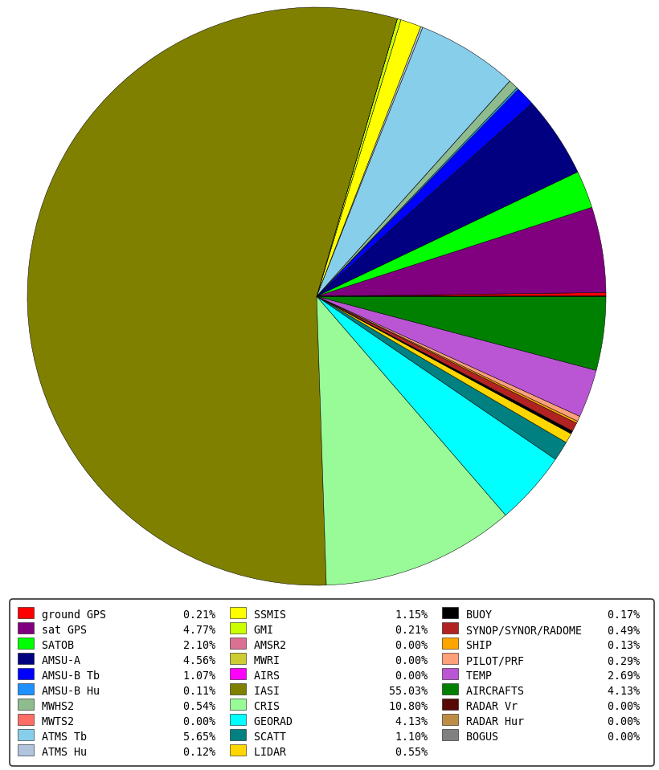
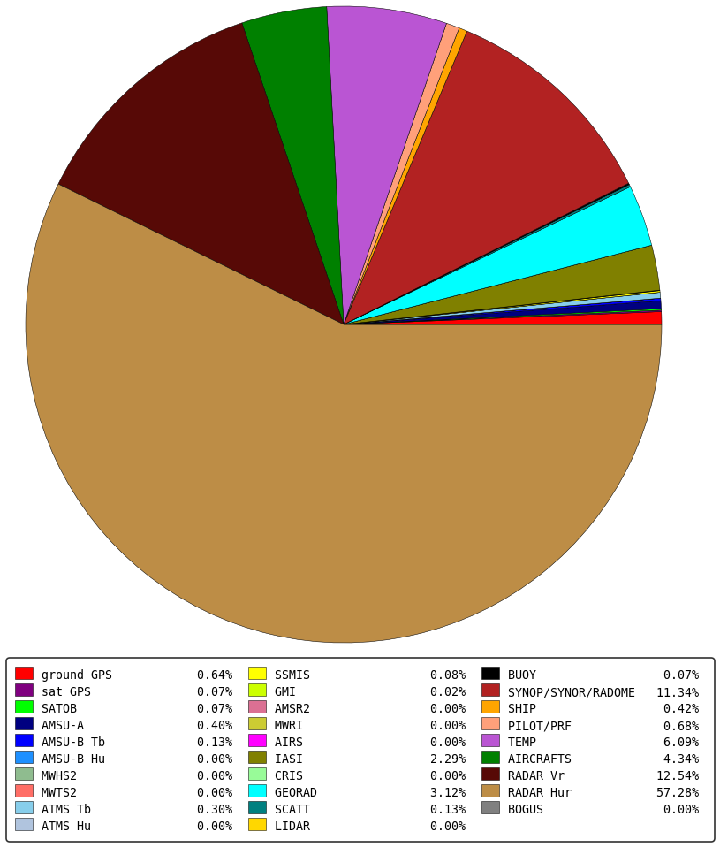
Observations assimilated in NWP models
In the global model, mostly satellite data (90 %)
Hyperspectral sounder IASI represent 55 % of the
total number of the observations assimilated in ARPEGE
In the regional model, mostly ground-based data (90 %)
Radar data clearly dominate on rainy days (more than 55 %)

Slide 6
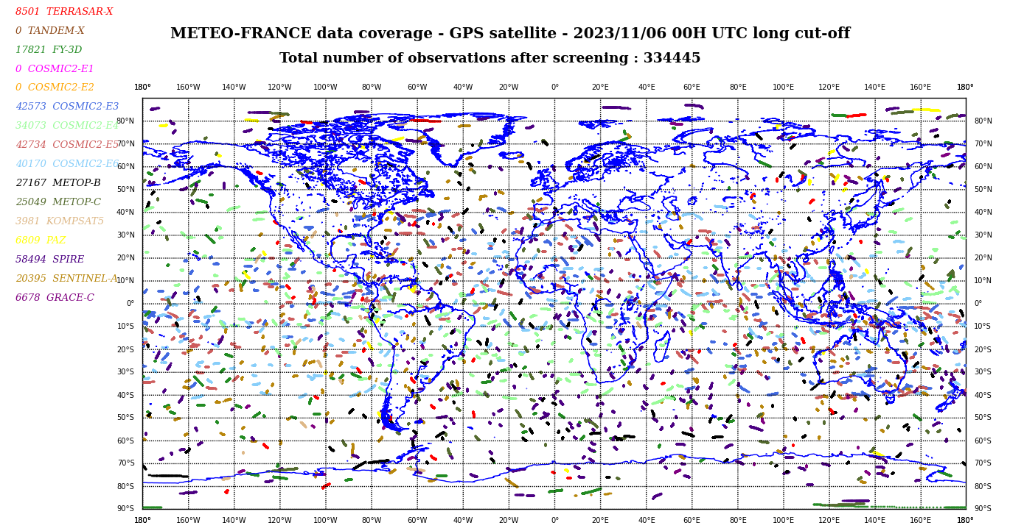
GNSS RO and GNSS PRO in NWP at Météo-France
Operational use of « traditional » GNSS radio-occultation observations in our NWP :
global (ARPEGE) + regional (AROME) models
    Assimilation of bending angles with a 2D observation operator
    Importance of GNSS-RO observations for the analysis:
    GNSS-RO in our global model : less than 5 % of the total amount of the assimilated
    observations but 16 % of the information content for the analysis

Slide 7
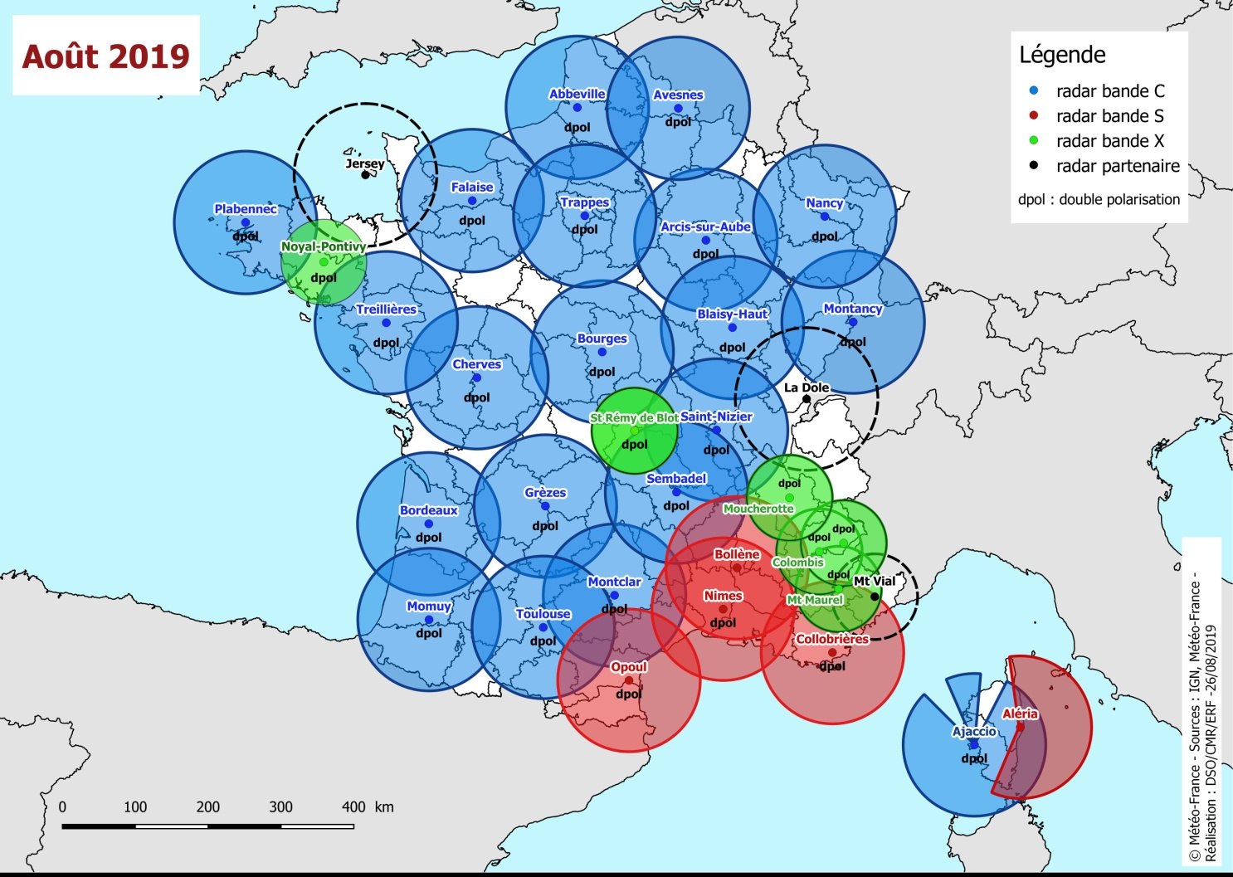
French radar network (Mainland France)
French radar network - August 2019
32 radars
All Doppler (Triple-PRT)
20 C band (all DPOL)
5 S band (3 DPOL)
6 X band (all DPOL)
2 airport X band (all DPOL)
+ 7 radars overseas

Slide 8
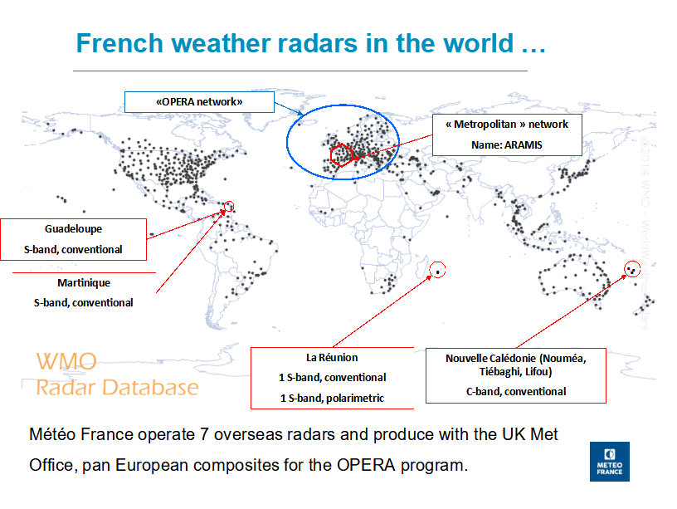

Slide 9
Summary
1 NWP models & MF observations
2 Current use of polarimetric data
3 Perspectives of use of GNSS Polarimetric data
4 Conclusion

Slide 10
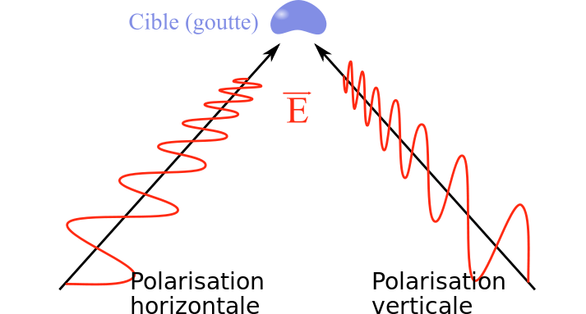
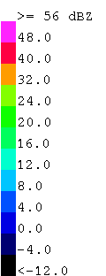
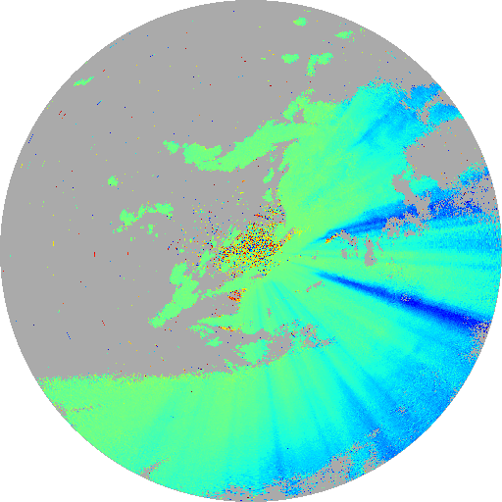
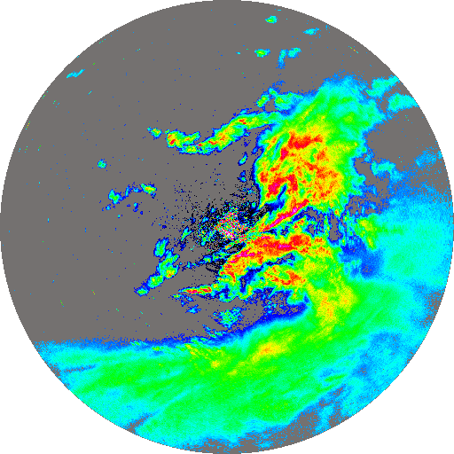
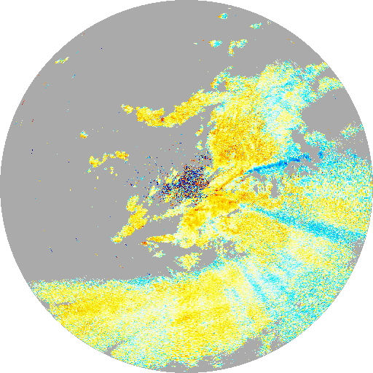
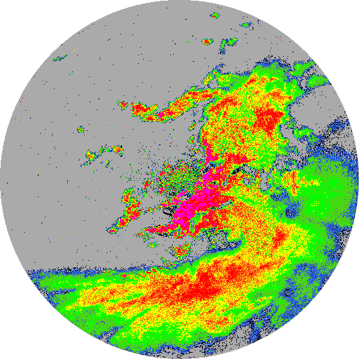
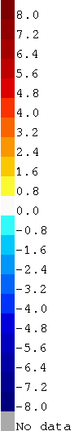
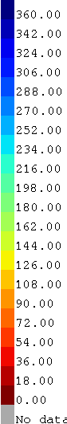
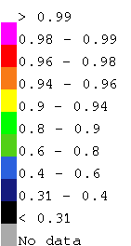
Dual-Pol weather radar principles
Pulse to pulse transmission of horizontaly and verticaly polarised waves (either simulatenously or alternanively)
Differential information is sensitive to target shape and properties
4 parameters Z_{H}, Z_{DR}, Φ_{DP}, ρ_{HV}
Réflectivity
Differential reflectivity
Differential phase
Correlation coefficient
Avesnes 22/06/15 18:00 UTC
Météo France = pioneer among NMSs on the topic

Slide 11
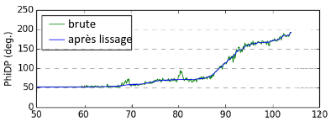
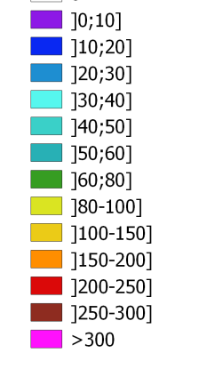
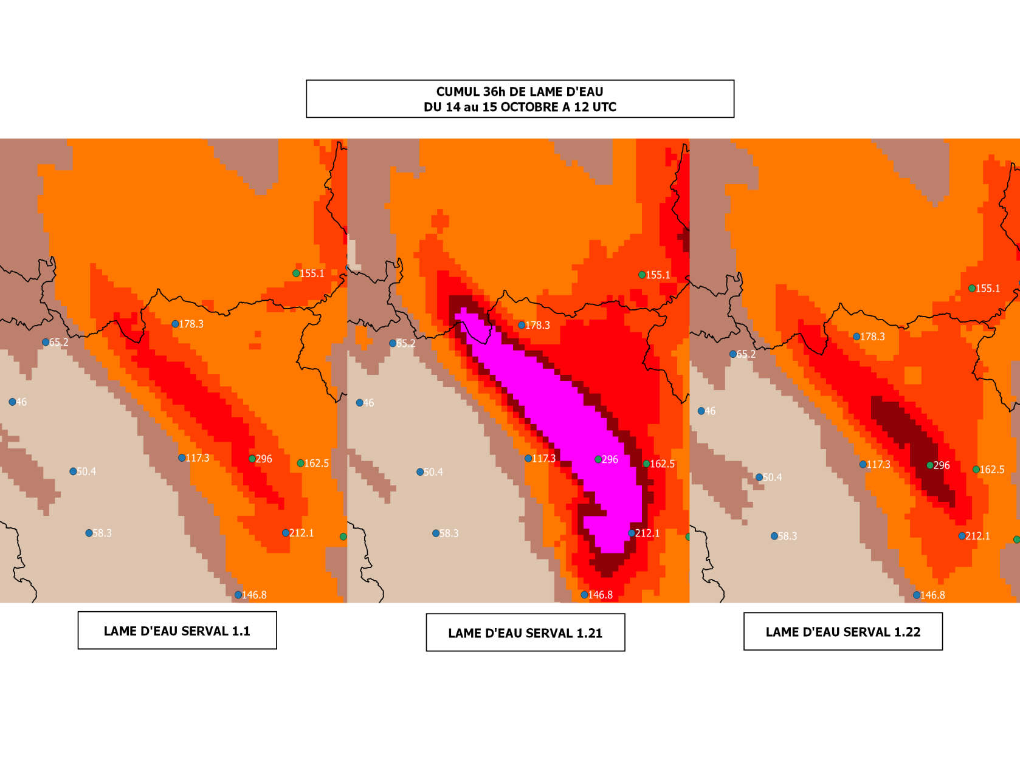
DPOL research at CMR : Quantitative Precip Estimation
Moderate rain
The differential phase (Phidp in °)
is good indicator of the
attenuation.
Current challenges :
KDP (derivative of Phidp ) ↔ Rainrate link
How to deal with noise, low SNR
Mie-scattering effect on Phidp (Delta)
Interpret/use KDP from frozen precipitation
How to deal with the melting layer
Heavy rain

Slide 12
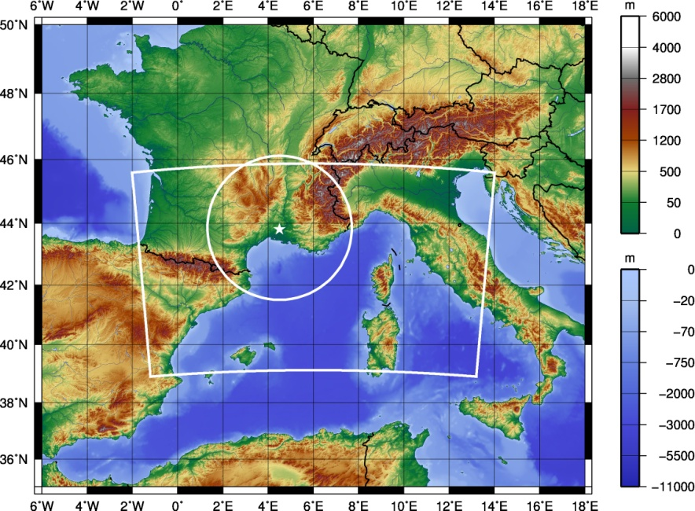
DPOL research at CNRM : data assimilation
Meso-NH model
  Convective-scale atmospheric model developed by CNRM-GAME and LA
  Nonhydrostatic dynamical model core, detailed moist physics, including a 1-moment bulk microphysics scheme (ICE 3)
  6 water species :
    water vapor
    rain
    (dry) snow
    graupel
    cloud droplets
    ice crystals
No representation of hail / melting snow currently …
Version MesoNH: 4-9-0
Simulation domain
Nîmes radar (S-band)
256 km range circle

Slide 13
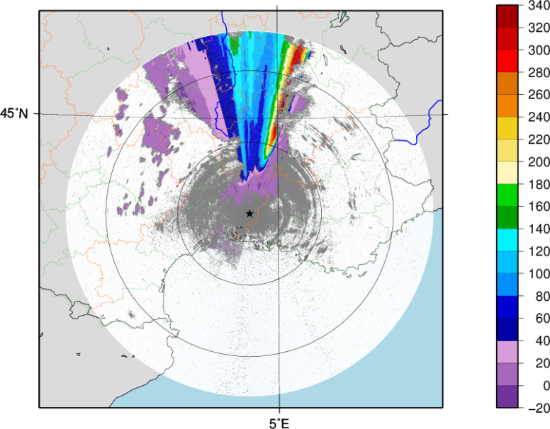
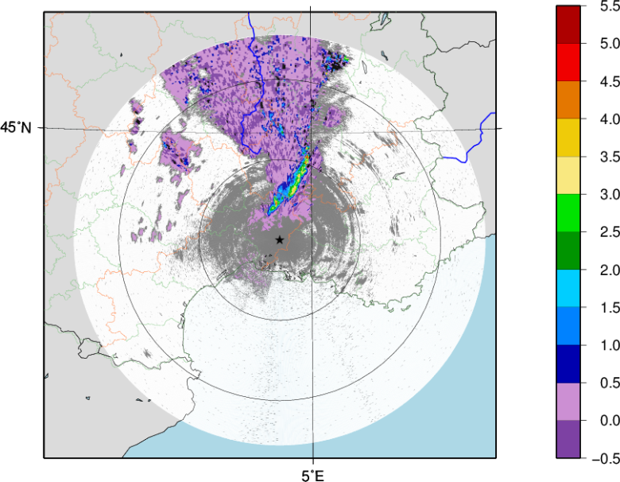
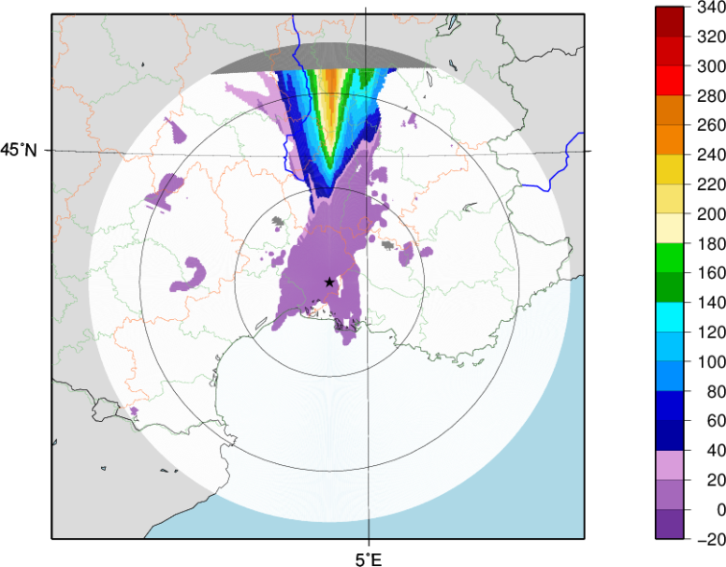
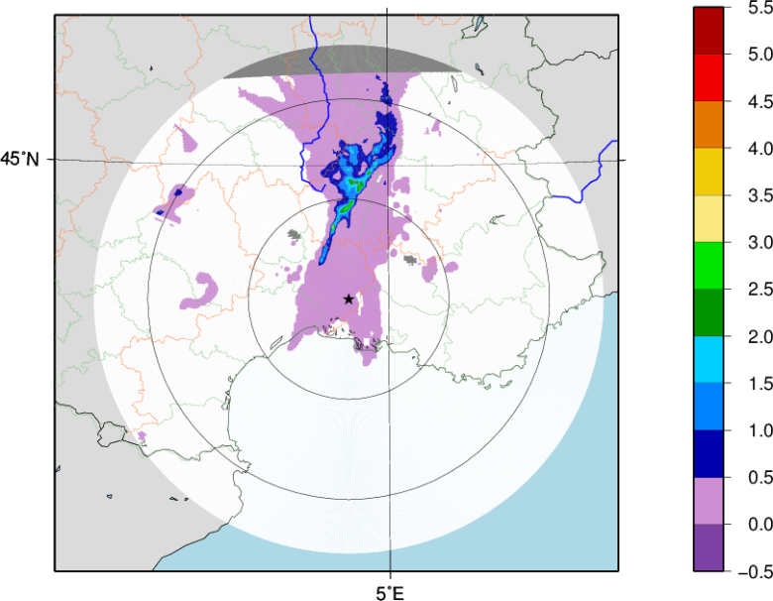
DPOL research at CNRM : data assimilation
Differential phase and specific differential phase (from C. Augros PhD thesis)
Observed variables (corrected from attenuation)
Nîmes radar
(S-band)
Elevation=0.6°
24/09/2012
0300 UTC
Phi_{DP} (°)
K_{DP} (° km⁻¹)
Simulated variables
100 km
Phi_{DP} (°)
K_{DP} (° km⁻¹)

Slide 14
Summary
1 NWP models & MF observations
2 Current use of polarimetric data
3 Perspectives of use of GNSS Polarimetric data
4 Conclusion

Slide 15
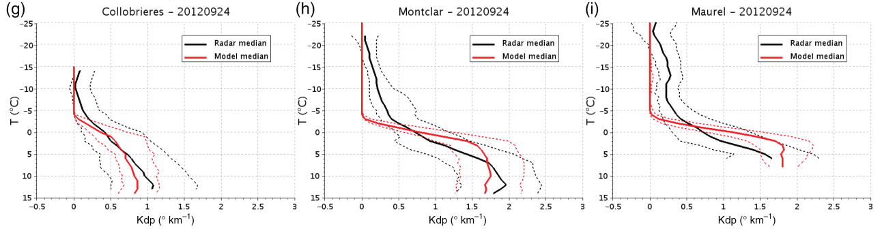

Perspectives for a use of polarimetric information
  Main interest : assimilation for global modele ARPEGE
  Need to develop an observation operator for ΔΦpol to get information on hydrometeors (by extending
  the existing 2D observation operator for GNSS RO bending angles)
  Possible option : combine the dual-pol radar forward operator from Augros et al (2016) with the
  existing 2D observation operator for GNSS RO bending angles
  Tests on case studies (high precipitation events, tropical cyclones,...)
Exemple of mean observed / modelled Kdp profiles in convective regions (from Augros et al 2016)
S- band
C- band
X- band
Need to change/improve model density
options / forward op options in
snow/graupel/ice (simulated Kdp is too low) !
https://doi.org/10.1002/qj.2572 ; https://github.com/UMR-CNRM/operadar/

Slide 16
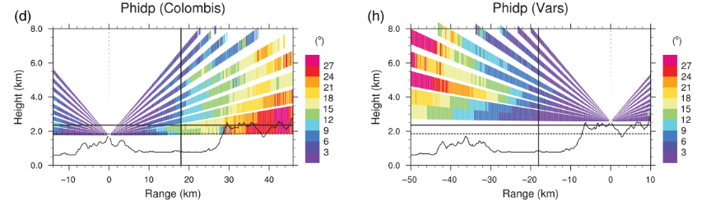
Comparison of the differential phase measured by GNSS RO and surface radars
Météo-France provides the mosaic of KDP measured by multiple surface radars, allowing a comparison with the measurement of GNSS. This comparison may help us to better understand the micro-physical processes (accretion and aggregation) above the melting layer and their impact on rain intensity on surface.
The challenge is to well adjuster the KDP of surface radars according to their elevation angle and the path of GNSS measurements. And the sampling size of the two observations are very different.

Slide 17
Towards a hybrid approach to measure rain on surface with the two mesurements together
The auto-consistent relationship between the reflectivity (Zh) and KDP is widely used to estimate the KDP from Phidp measured .
A hybrid approach using the Phidp measured at low level of atmosphere by GNSS and the surface-radar reflectivity is potentially useful to estimate KDP and rain intensity.
This approach is particularly interesting over the regions where only simple polarization radar observation is available.

Slide 18
Summary
1 NWP models & MF observations
2 Current use of polarimetric data
3 Perspectives of use of GNSS Polarimetric data
4 Conclusion

Slide 19
Discussion
Can we learn from each other experience of using KDP for estimating precipitation ?
How do we interpret KDP in forward scattering with respect to KDP from backscattering ?
Could we compare observations of precipitation/ KDP from RO-PAZ and ground base radars.
Can information from ground base radar (including overseas french territories) better inform RO-PAZ retrievals and vice versa.
Can GNSS polarimetric data be potentialy usefull in NWP assimilation ?

