Slide 1
Remote Sensing of Cloud Ice with mm and submm-wave Radiometry/Polarimetry and Possible Connections with PRO
Dong L. Wu
Climate and Radiation Lab (Code 613)
NASA Goddard Space Flight Center

Slide 2
Outline
Polarimetric Cloud Ice Measurements with Passive MW
Aura/MLS 122 GHz
ER-2/CoSSIR 170, 325, 684 GHz
Current Concepts in Development
IIP/SWIRP 220, 680 GHz
Discussions and Thoughts for Polarimetric RO
GMI 89, 166 GHz
EV6/PolSIR 325, 680 GHz
Circular vs Linear Polarizations: Ionospheric Effects?
Conceptual Radxfer Model
Multi-Path Effects?

Slide 3
A Conceptual Model for Polarimetric Passive Microwave Observations of Ice Clouds
T_{V}=T_{1V}e^{-τ2V}+T_{J}(1-e^{-τ2V})
T_{H}=T_{1H}e^{-τ2H}+T_{J}(1-e^{-τ2H})
T_{J}=T_{scat}ω₀+T₂(1-ω₀)
Cloud Source Function
Cloud Temperature
τ₂=τ_{IWP}
T₂
T_{J}
PD = T_{V} – T_{H}
= T_{1V}e^{-τ2V} - T_{1H}e^{-τ2H} +T_{J}(e^{-τ2H}-e^{-τ2V})
Water vapor
Passive Sensor
Active Sensor
τ_{LWP}
τ₁=τ_{LWP}+τ_{R}
τ_{R}
T₁
P_{t}
T_{H} = H-pol Brightness Temperature
T_{V} = V-pol Brightness Temperature
PD= Polarization Difference
Gong and Wu (2017)

Slide 4
Aura Microwave Limb Sounder (MLS)
A NASA-JAXA Mission (2014-present)

Slide 5
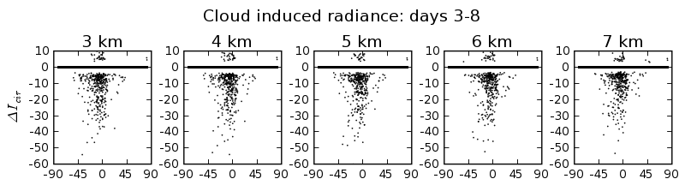
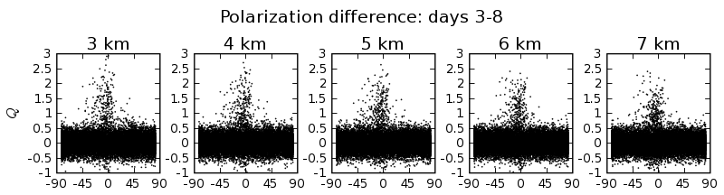
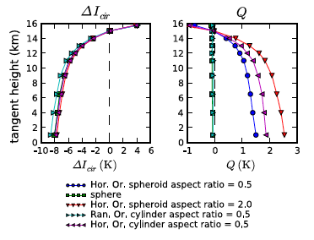
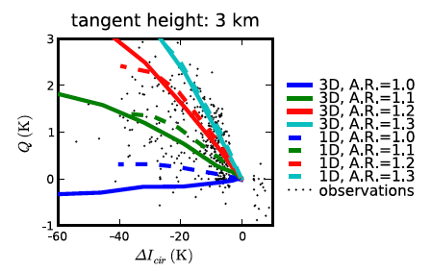
Polarimetric Measurements from MLS 122 GHz
Significant polarization signals in MLS due to horizontally aligned ice crystals in cirrus clouds
Simulations show qualitative agreement with the observations
122 GHz is not ideal for cloud measurements due to strong O2 absorption
Partial vertical polarization can be replicated in simulations by considering oblate spheroids with different aspect ratios
Latitude
Davis et al. (2005)

Slide 6
Global Precipitation Measurement (GPM)
Microwave Imager (GMI)
A NASA-JAXA Mission (2014-present)

Slide 7
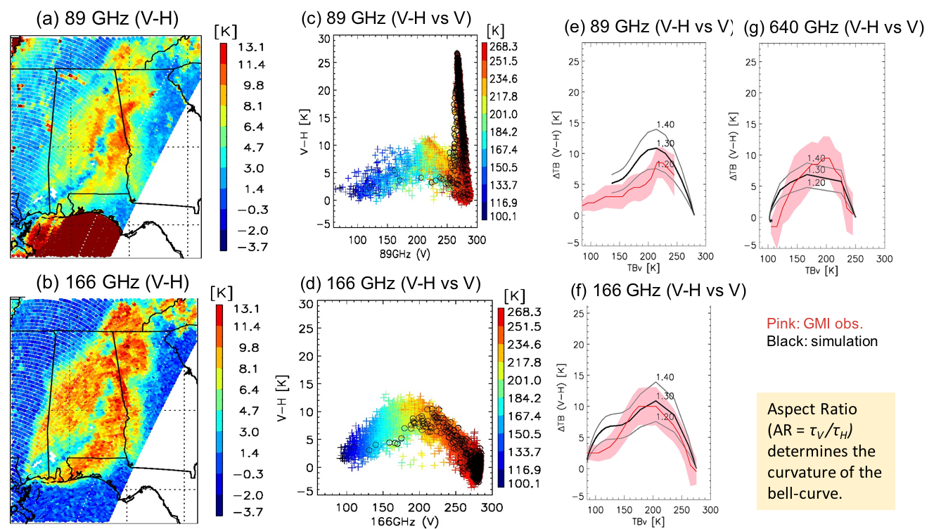
GMI 89 and 166 GHz Polarized Radiances
ER-2 CoSSIR
640 GHz
Gong and Wu (2017)

Slide 8
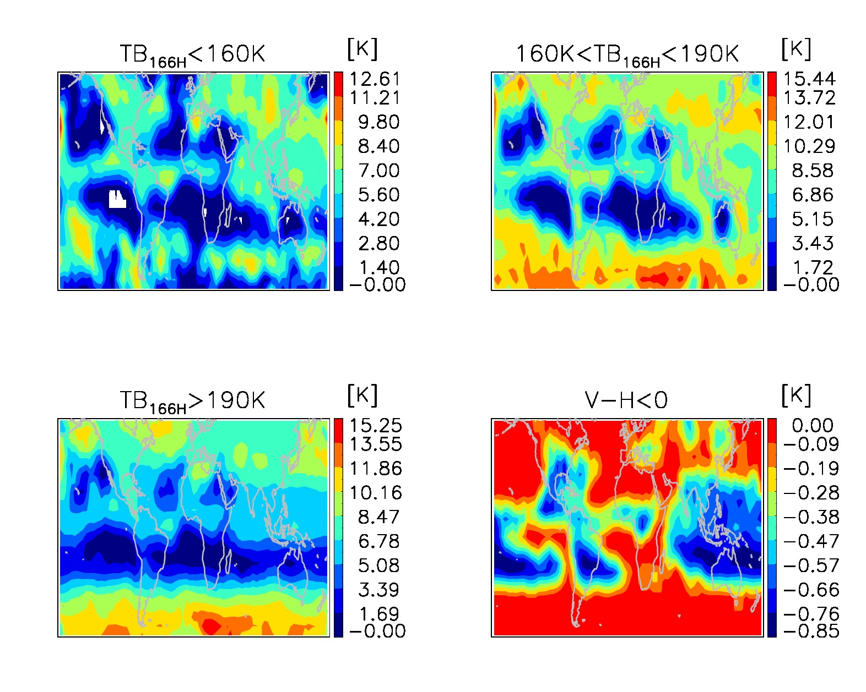
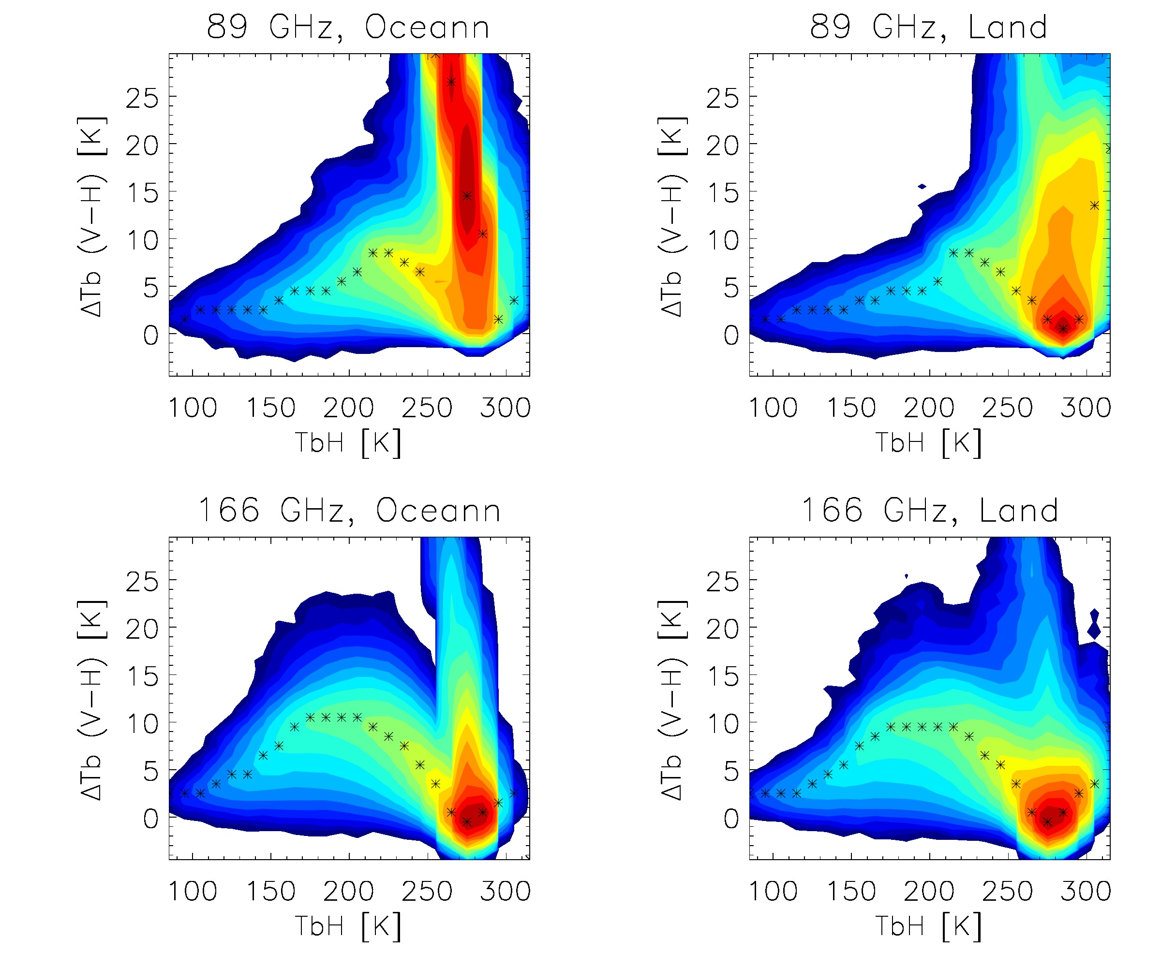
Global Statistics from GMI
GMI 166 GHz
Land vs Ocean
GMI 89 and 166 GHz
Gong and Wu (2017)

Slide 9
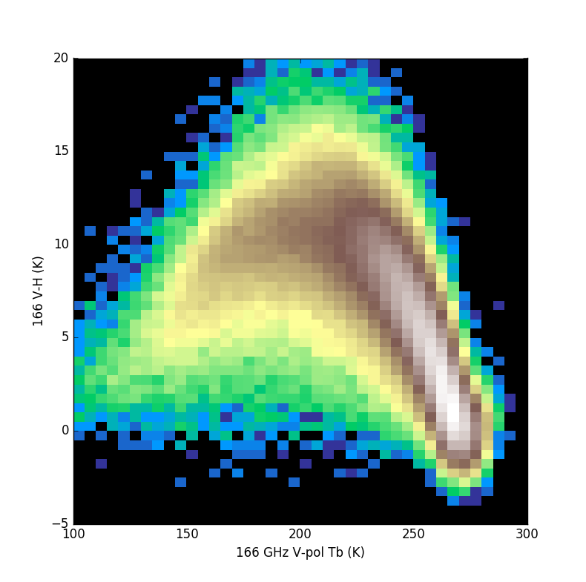
Insights from W and Ka Radars
1
2
3
4
CloudSat
W-Band
1
GMI
2
4
166 GHz (V-H) /K
3
GPM
Ka-Band
3,4
1,2
Melting layer
166 GHz V-pol /K
Gong et al. (2020)

Slide 10
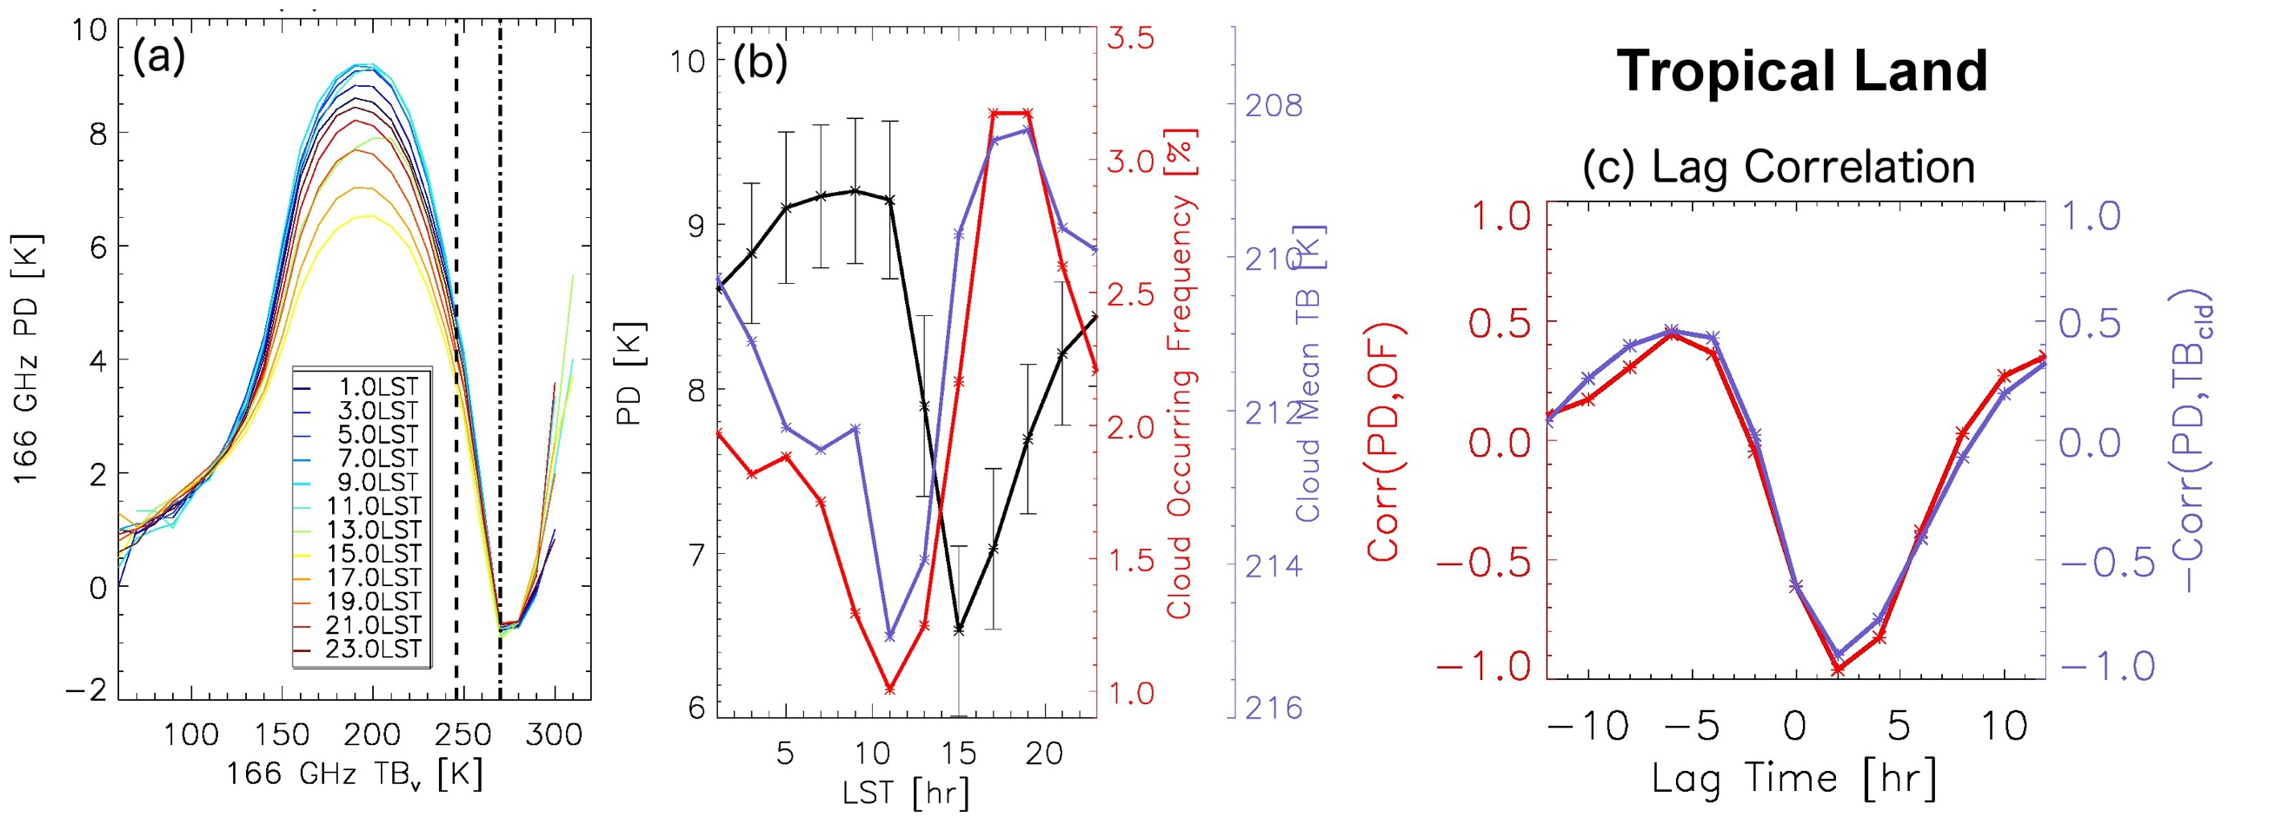
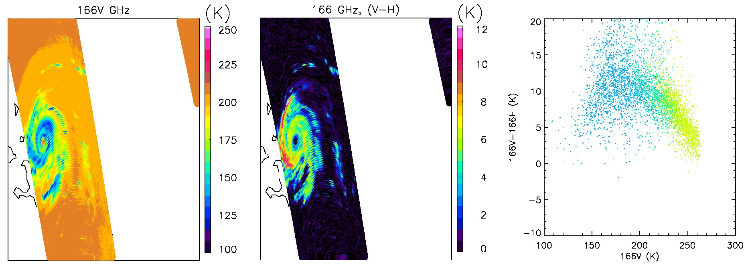
Diurnal Cycle of Fast Processes
Peak of PD has a strong diurnal cycle over tropical land (black line), suggesting a diurnal variation of ice microphysical properties
The PD diurnal cycle leads ice cloud bulk properties (thickness, occurrence frequency) by ~2 hours
Elevated PD values found in an arm of Hurricane Irma (on the left side of traveling) during its intensified period.
(Courtesy of J. Gong)

Slide 11
Compact Sub-mm and LWIR Polarimeters for Cirrus Ice Properties
(SWIRP)
An ESTO IIP Project (2018-2022)

Slide 12
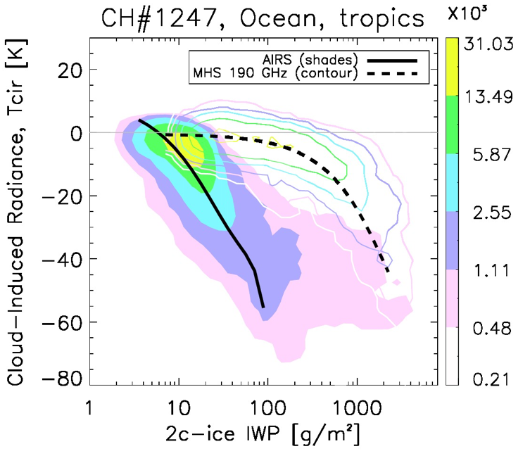
Motivations for Submm+IR Polarimeters
T_{cir} = T_{b} – T_{b_clear}
Clouds, ice clouds in particular, as a major source of uncertainty in climate prediction.
Some cloud ice is not observed by microwave (MW) and infrared (IR) sensors, and need submm cloud radiometers.
Cloud microphysical properties (particle size and shape) account for ~200% and ~40% of measurement uncertainty, respectively.
Combined submm and LWIR polarimeters to provide the sensitivities needed for cloud ice and microphysical property (particle size and shape) measurements over a large dynamic range.
190 GHz
Submm
(Courtesy of J. Gong)
Ice Water Path (IWP) from CloudSat/CALIOP

Slide 13
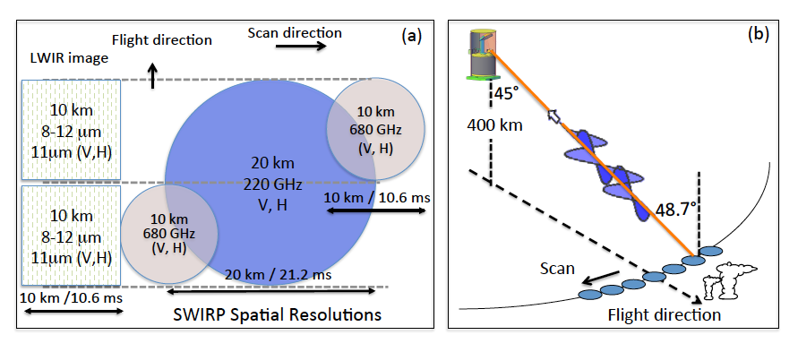
SWIRP: Compact Submm-Wave and LWIR Polarimeters for Cirrus Ice Properties
Objectives
PI: Dong L Wu, NASA GSFC
Design and develop a miniaturized conical-scanning mm/submm-wave and LWIR cloud polarimeters for measuring ice microphysical properties from space.
Mature the 220 and 680-GHz direct detection technology with narrow band filters.
Design and develop a compact, multi-channel (8.6, 11, 12 mm) LWIR spectro-polarimeter.
Substantiate size, mass, and power of the combined mm/submm-wave, LWIR polarimetric-radiometer systems, scan and calibration mechanism.
Build and test a prototype SWIRP instrument.
SWIRP will measure cloud ice (IWP), bulk particle size (Deff) and shape (AR) with conical scanning dual-pol radiometers at (220, 680) GHz and 11 mm bands to provide the needed sensitivity
Approaches
Milestones
Design and miniaturize conical-scanning radiometer/polarimeter system with on-board calibration.
Develop one 220 and two 680 GHz polarimetric receivers using direct detection with matched FOVs.
Develop 3-band LWIR polarimeters with matched FOV to mm/submm-wave receivers.
Miniaturize the Bearing And Power Transmission Assembly scan system from previous successful designs for optimal power/data outputs.
Verify the design requirements by testing the prototype instrument
System Requirements Review (SRR) 10/17
Preliminary Design Review (PDR) 01/18
Critical Design Review (CDR) 03/18
Polarimeters Delivery 08/21
Cal and Mechanical System Delivery 09/21
Instrument Integration and Test -
Pre-Environmental test Review (PER) -
Instrument Testing and Verification Report -
Project closeout and final report 3/22
Co-Is/Partners: G. De Amici, GSFC; W. Deal, W. Gaines, Northrup Grumman Aerospace Systems; R. Chipman, UofA; P. Yang, Texas A&M University
TRL_{in} = 3
TRL_{exit} = 4

Slide 14
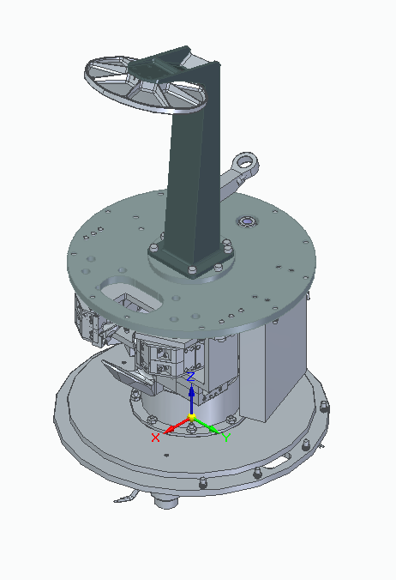
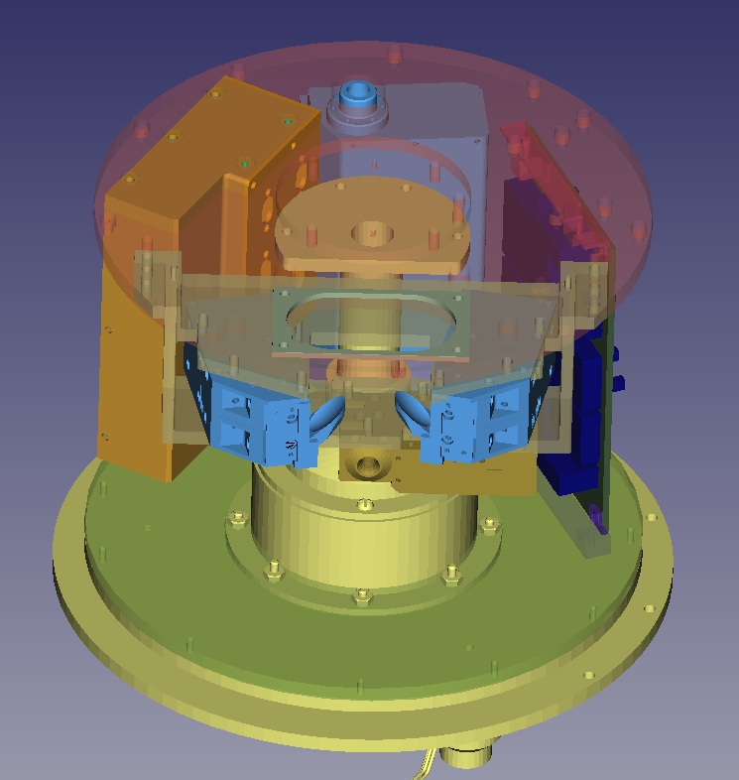
SWIRP Instrument Overview
C&DH (Final)
Unprotected Gold Zerodur IR Mirrors
IRCSP
(delivered)
Drum Lid
8-12μm
680GHz
Submm
Cover
PDU
(Built)
220GHz
680GHz
680-GHz
(in repair)
BAPTA
(delivered)
220-GHz
(delivered)
Courtesy of P. Pantina)

Slide 15
Configurable Scanning Submillimeter-wave Instrument/Radiometer (CoSSIR)
An ER-2 Airborne Simulator for Submm-Wave Remote Sensing

Slide 16


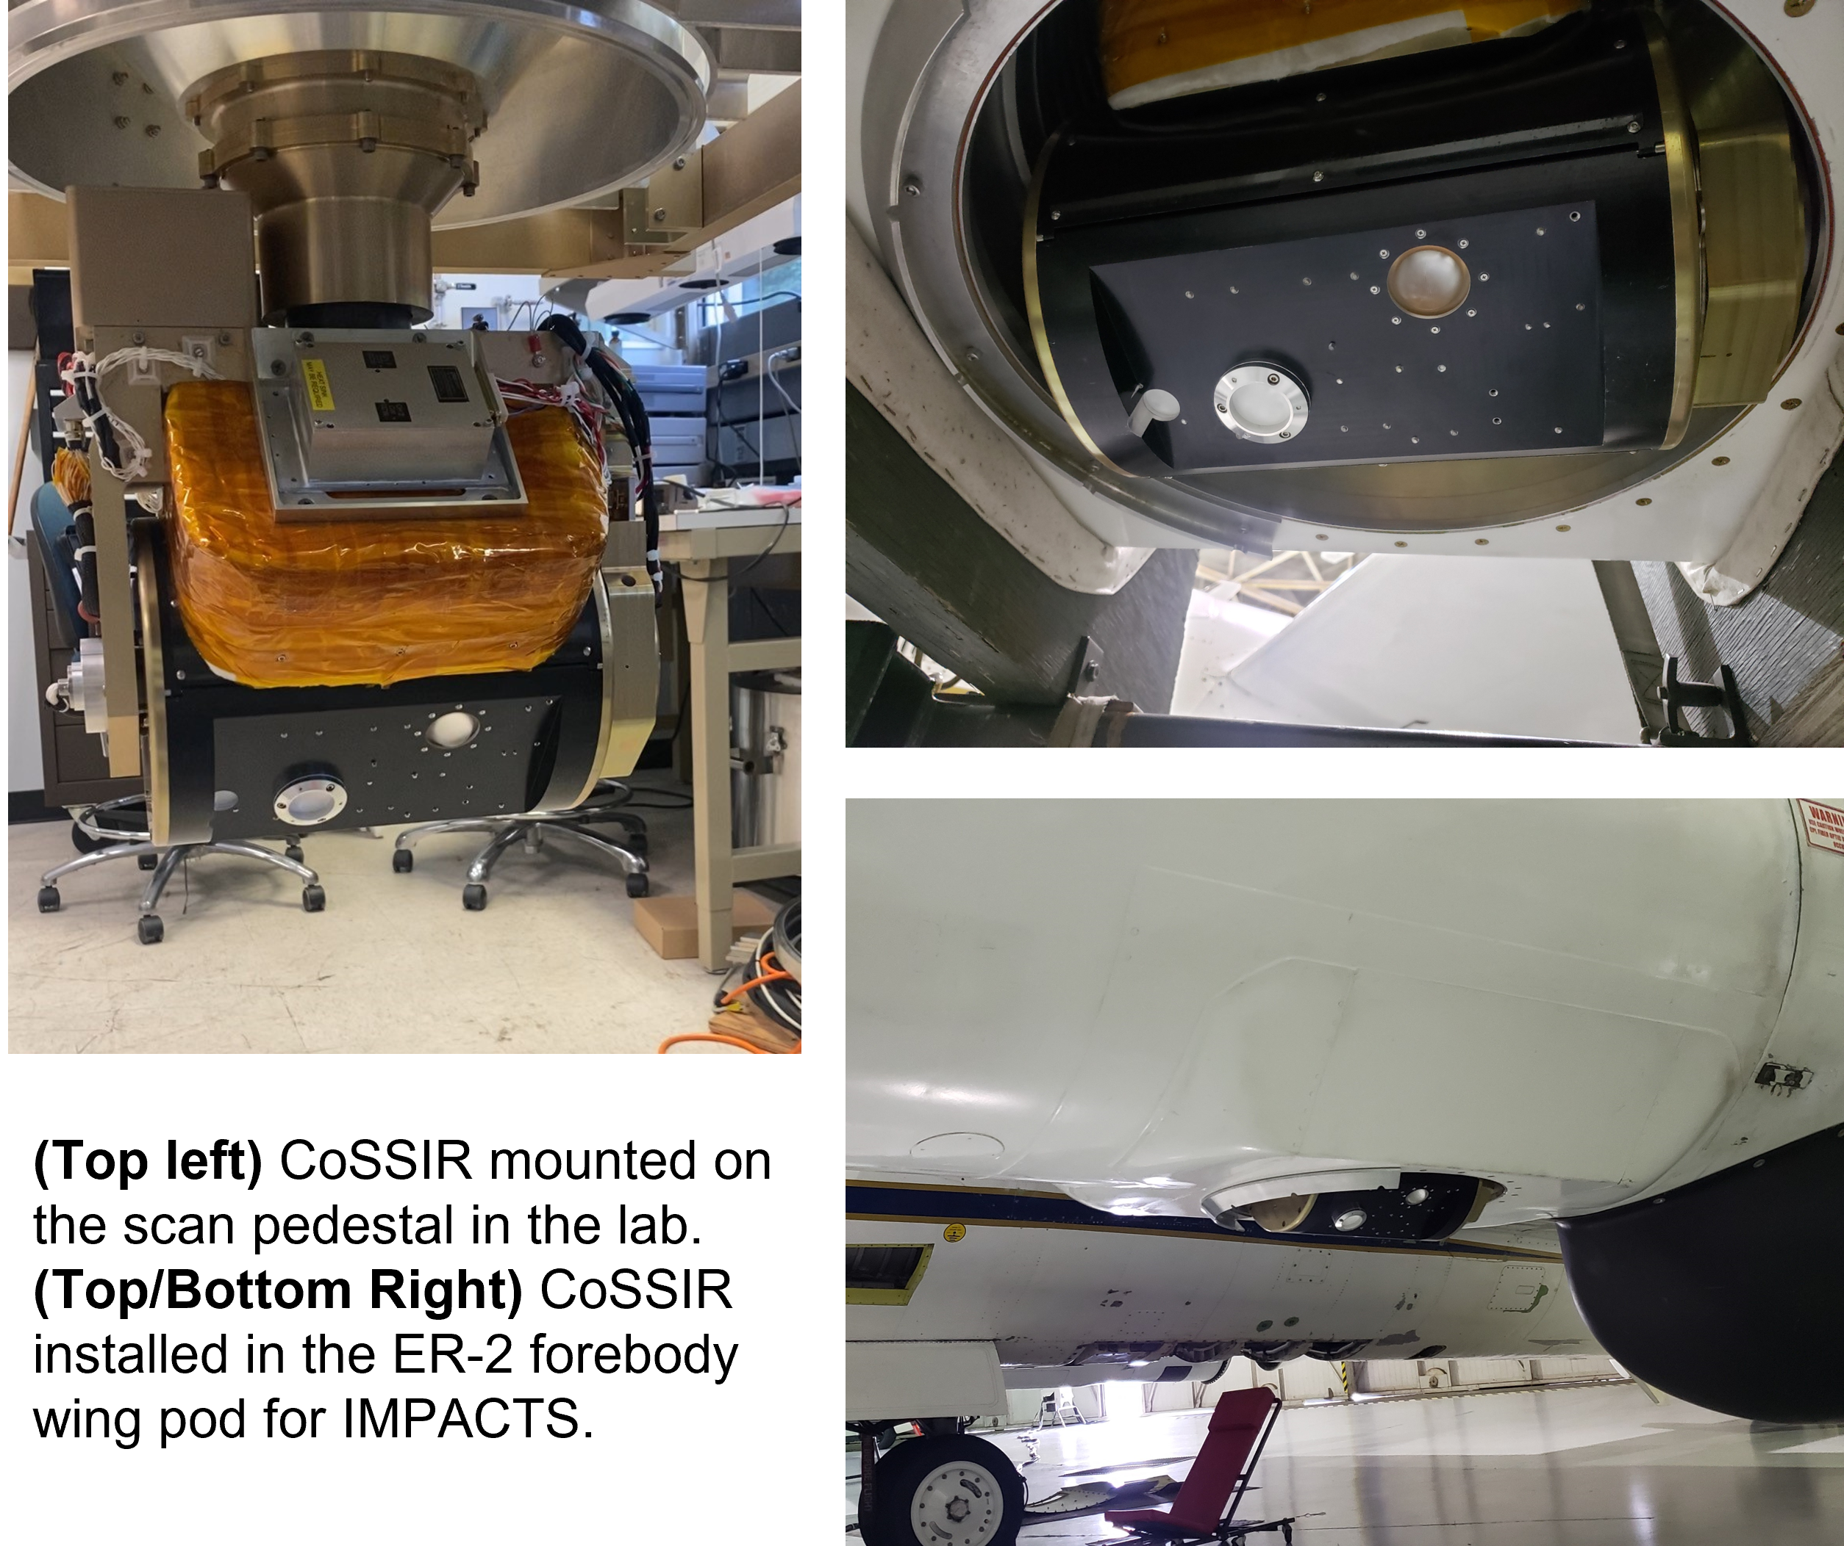
CoSSIR Operation Summary
Two campaigns: IMPACTS (Jan-Feb 2023) and ALOFT (July 2023)
Aircraft: NASA ER-2, ~65k feet altitude
Number of flights: 28 (15 IMPACTS, 13 ALOFT)
Total hours operation: ~170 hrs (97 hrs IMPACTS, 73 hrs ALOFT)
Channel | Center Frequency (GHz) | Bandwidth (GHz) | NEDT (K)
170v/h | 170.5 | 1.0 | 0.2/0.3
177v/h | 177.3 | 1.0 | 0.4/0.5
180v/h | 180.3 | 1.0 | 0.4/0.4
182v/h | 182.3 | 1.0 | 0.4/0.5
325±11v/h | 325.0±11.3 | 3.6 (x2) | 0.5/0.7
325±3v/h | 325.0±3.55 | 2.85 (x2) | 0.5/0.5
325±1v/h | 325.0±0.9 | 0.9 (x2) | 1.5/1.5
684v/h | 684.0±4.0 | 6.0 (x2) | 0.9/0.6
Courtesy of R. Kroodsma, M. Fritts, I. Adams, P. Racette, and J. Gong

Slide 17
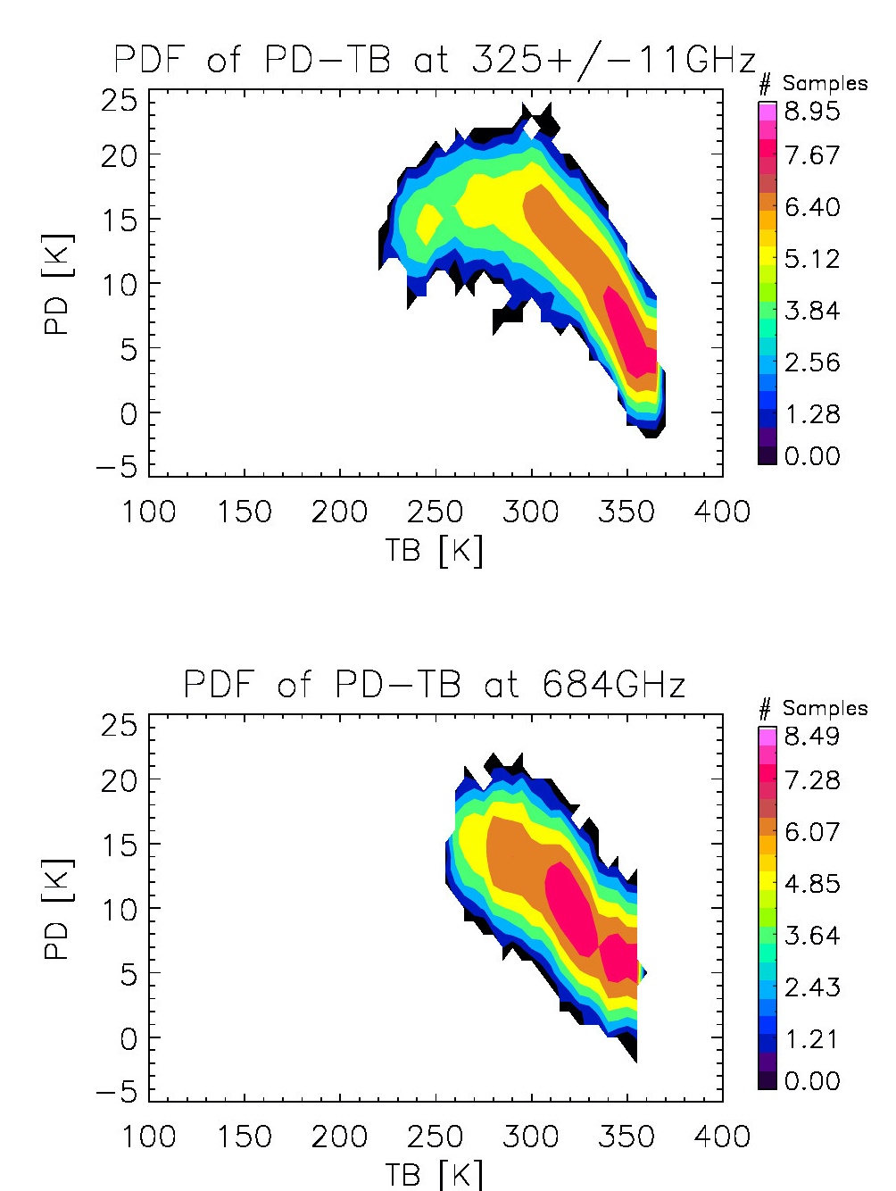
CoSSIR Science Data During 7/5/23 Science Flight
Observed PD-TB relationships are consistent with ice cloud scattering from different particle orientations
Real-time quick-look brightness temperature (TB) for all 16 CoSSIR channels as well as polarization differences (PD) during 7/5/23 ALOFT science flight over Yucatan Peninsula.
Courtesy of R. Kroodsma, M. Fritts, I. Adams, P. Racette, and J. Gong

Slide 18
Polarized Submillimeter Ice-cloud Radiometer
(PolSIR)
A NASA EV6 Mission to Study Diurnal Variations of Ice Clouds

Slide 19
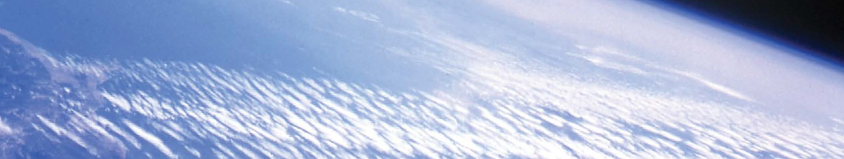
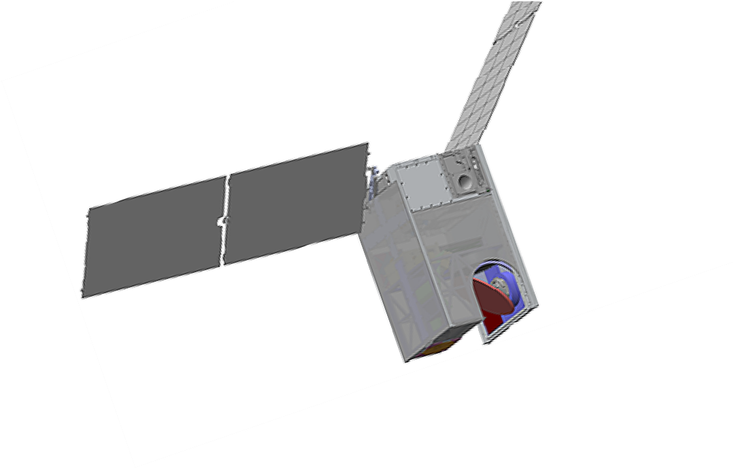

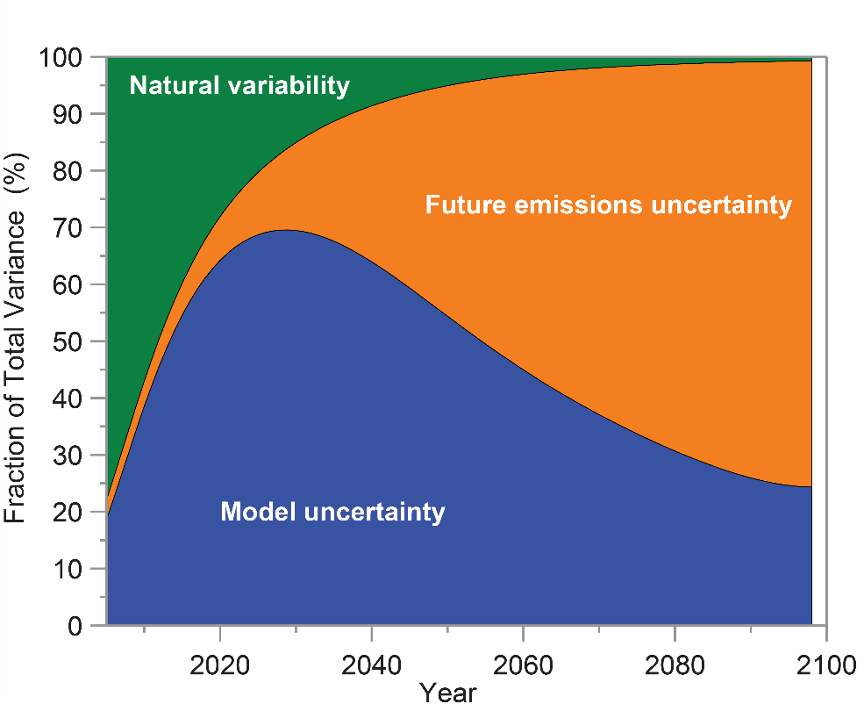
The climate model challenge: Predicting climate change on decadal time scales
Polarized Submillimeter Ice-cloud Radiometer
Motivations:
At prediction timescales of 10 – 40 years, model uncertainty dominates
  Different climate models give different answers …
  We lack full understanding of key processes …
  Different assumptions are made about those processes in models
Science Objectives:
O1: Constrain diurnal cycle amplitude, form, and timing of the ice water path (IWP) in tropical and sub-tropical ice clouds
O2: Determine the diurnal variability of ice clouds in the convective outflow areas and understand relation to deep convection
O3: Determine the relationship between shortwave and longwave radiative fluxes and the diurnal variability of ice clouds
A1: Enable improvement of climate models by providing novel observations of the diurnal cycle of ice clouds
US 2018 National Climate Assessment
PI: Ralf Bennartz (Vanderbilt U)

Slide 20
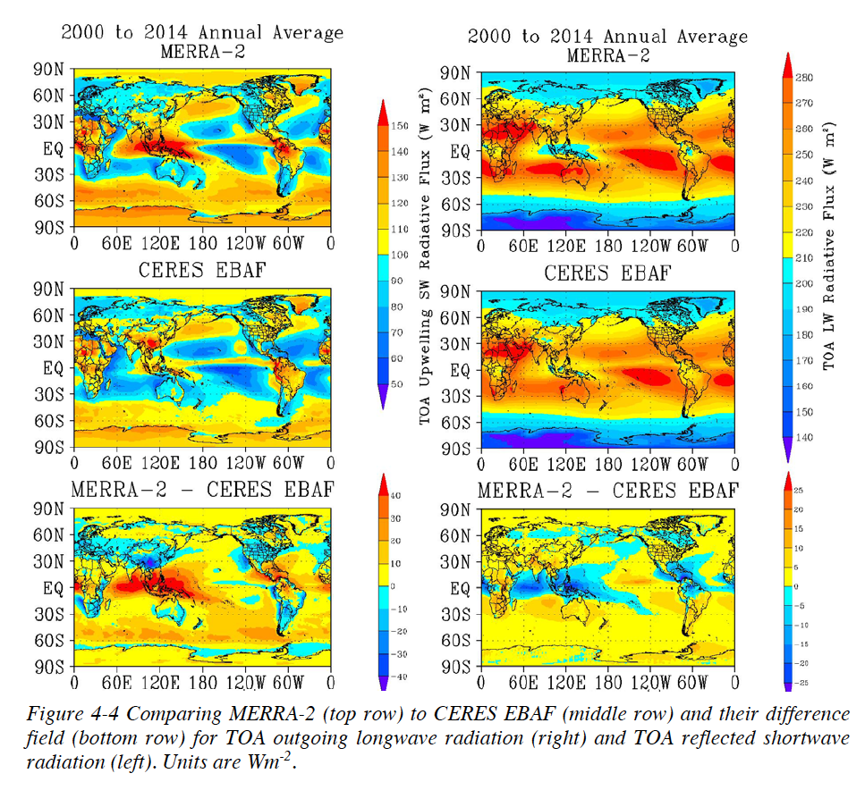
Long-Standing Radiation Problem from Tuning Ice Clouds
Shortwave (SW)
Longwave (LW)
  Cloud ice is used as a tuning parameter to balance radiation at top of the atmosphere (TOA) and precipitation at the surface
  Net TOA radiation (SW+LW) errors are canceled by tuning cloud ice.
  ‘Cancellation of errors’ rather than physically correct description
    Diurnal cycle wrong
    Tropics are the main area of concern
150
280
MERRA
CERES
50
150
40
25
MERRA-CERES
Difference
-40
-25
Bosilovich et al. (2015)
Model overestimates LW
Model underestimates SW

Slide 21
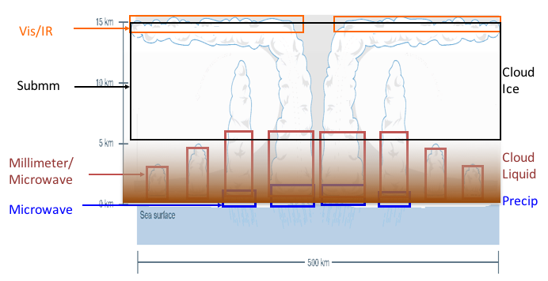
PolSIR Measurements
PolSIR
325 GHz
680 GHz
  Focus on upper-tropospheric ice clouds with sounding from 325 and 680 GHz bands
  Particle size from two frequencies
  Particle shape/orientation from dual (V and H) pol from two bands
  H2O sounding at 325 GHz
H₂O
O₂
H₂O
H₂O
O₂

Slide 22
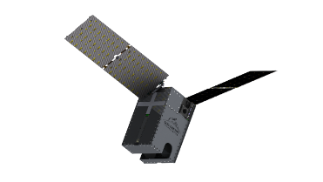
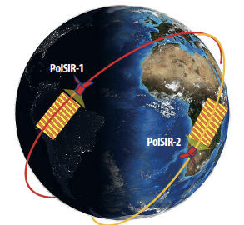

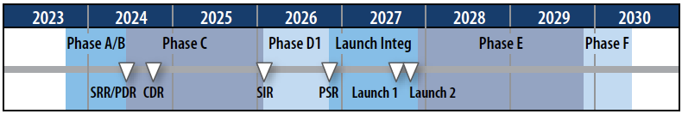
EVI-6: Polarized Submillimeter Ice-cloud Radiometer (PolSIR)
Science Objectives
Constrain seasonally influenced diurnal cycle of tropical ice water path (IWP) and particle diameter
Determine the diurnal variability of ice clouds in the convective outflow areas
Determine the relationship between shortwave and longwave radiative fluxes and the diurnal variability of ice clouds
Benefits
Enable development of better cloud parameterizations
Reduce uncertainty in 20-30 year climate model predictions
Team
PI: Ralf Bennartz (Vanderbilt U)
Deputy-PI: Dong Wu (GSFC)
Co-Is: Helene Brogniez (France), Negar Ehsan (GSFC), Gregory Elsaesser (Columbia U), Jie Gong (GSFC), Rachael Kroodsma (GSFC), Claire Pettersen (UMich), Anita Rapp (TAMU)
Team Members: Emily Berndt (MSFC), Benjamin Johnson (UCAR), Bryan Karpowicz (GSFC), Kevin Garrett (NOAA), Min-Jeong Kim (GSFC), Daryl Kleist (NOAA), Ian Adams (GSFC), Arrone Merelli (U Mich), Donifan Barahona (GSFC)
Mission Overview
$37M (FY24) Class-D mission selected for EVI-6
Two identical 12 U CubeSats, each with dual-band radiometers: 683-GHz (QV & QH), 325/1.5-GHz (QV), 325/3.5-GHz (QV), 325/9.5-GHz (QV & QH)
Low earth orbit between 35°and 51°inclination separated by 3-8 hrs
Launch provided by NASA LSP, outside cost cap
Mission Roles, Partnerships, Contributions
Vanderbilt U: Mission science, cloud ice retrieval
GSFC: Mission management, instrument development/calibration, data distribution
U Wisconsin: Science data processing
Blue Canyon Technologies (BCT): Spacecraft
Virginia Diodes Inc (VDI): Submm-wave receivers
NOAA: Operational enhancement options
U Paris Saclay (Franch Contribution): cloud retrievals
Science Enhancement Options
GSFC, UMBC, MSFC, Columbia U, UCAR/JCSDA, NOAA, GMAO, UMich, TAMU

Slide 23
Discussions and Thoughts on GNSS-RO Polarization
1. Circular vs Linear Polarizations: Error from Faraday Rotation?
2. Multiple Scattering Effects?

Slide 24

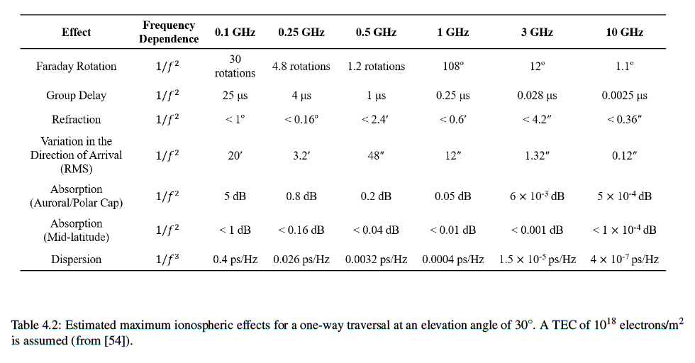
Far Side
Near Side
Ellipse
(RHCP + LP)
RHCP
LEO
Receiver
GNSS
Transmitter
Ionospheric Effects?
  RHCP is designed to overcome Faraday rotation at L band
  Cloud-induced linear polarization (LP) components would subject to different rotations and absorptions
  Caution needed for ionospheric correction
(Davies, 1965; Kindervatter and Teixeira, 2022)

Slide 25
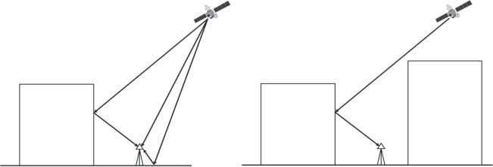
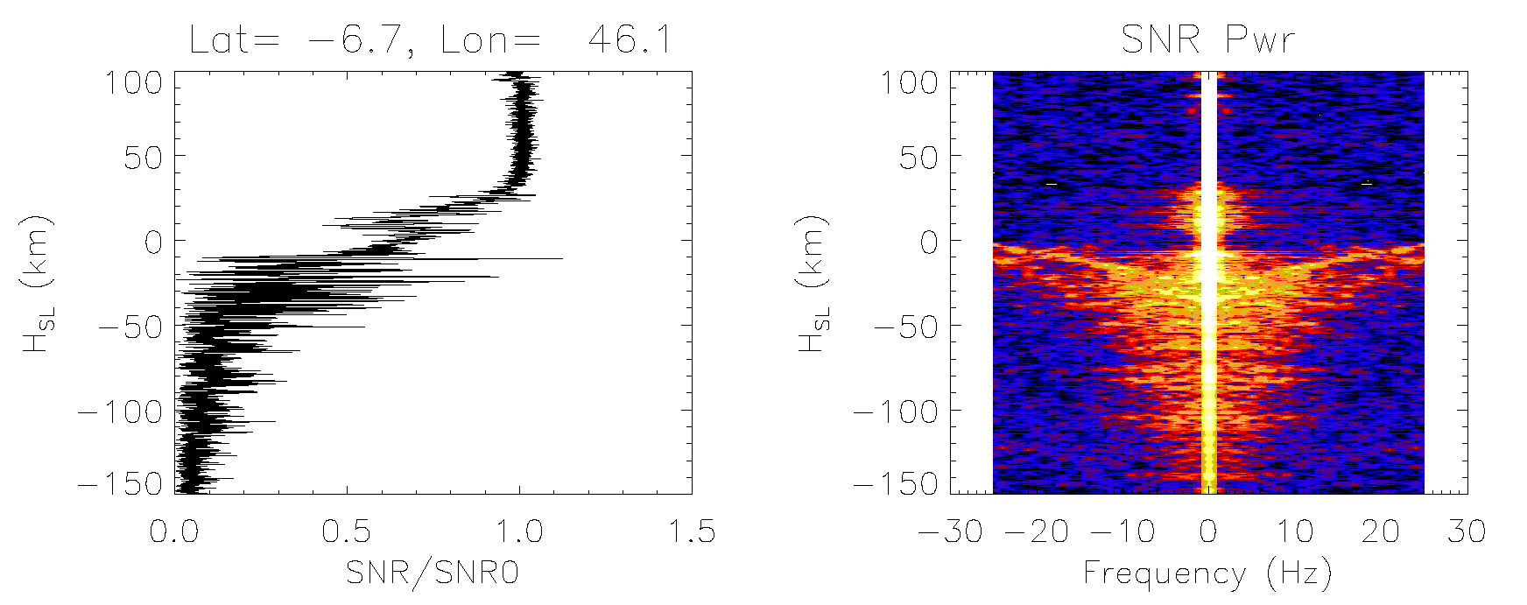
RHCP + ΔLHCP
RHCP
LEO
Receiver
GNSS
Transmitter
Multi-Path Issue?
  Grazing-angle reflection can create a LHCP component at the receiver end, similar to ground-based receivers in the city
  Interference of multi-path signals from PBL and cloud layers are evident in L1 SNR profiles
  Multi-path propagations can be caused by surface and elevated atmospheric layers [Sokolovshiy et al., 2014; Wu et al., 2022]

Slide 26
NASA’s Commercial Smallsat Data Acquisition (CSDA)
Program
Acknowledgment
https://www.earthdata.nasa.gov/esds/csda
CSDA-acquired data available for scientific use
Open to U.S. Government-funded researchers

