Slide 1
An assessment of entrainment and precipitation onset over the tropical pacific in observations and CMIP6 models
Todd Emmenegger
GNSS PRO workshop
November 29, 2023
Notes:
My talk today is titled The physics behind precipitation onset bias in CMIP6 models.
And I’m going to go ahead and clear up this title now. CMIP6 stands for coupled model intercomparison project phase 6, and these are the global climate models that are used by the IPCC to assess future warming scenarios.
When I say precipitation onset bias, I’m referring to the sensitivity of climate model precipitation relative to observations.

Slide 2
Contents
The ‘Pickup’ diagnostic - HOW CMIP6 models get precipitation wrong
Pseudo-entrainment diagnostic - WHY CMIP6 models get precipitation wrong
Bulk plume formulation of buoyancy and its factors
The Tradeoff : If a model entrains too heavily (little), it will need to compensate with higher (lower) climatological moisture to produce a realistic environmental temperature lapse rate

Slide 3
Significance
Convection affects global energy balance through vertical transport of heat, moisture and momentum
In tropics, deep cumulus clouds primary mechanism
Ill-constrained representations of deep cloud and precipitation are major contributor to uncertainty in climate projections, including precip extremes
Model diagnostics of tropical convection play integral role in understanding limitations of model behavior in future warming scenarios
E.g. Riehl and Markus, 1958; Neelin and Held, 1987; Meehl et al. 2000; Allen and Ingram 2002; Trenberth et al. 2003; Chou et al. 2012; O’Gorman 2012; Sillmann et al. 2013; Pendergrass and Hartmann 2014; Neelin et al. 2022
Notes:
Convection plays a major role in the global energy balance
And poorly constrained representation of topical moist convection and precipitation are shown to be major contributors to uncertainties in climate projections including precipitation extremes
Model diagnostics of tropical convection play integral role in understanding limitations of model behavior in future warming scenarios

Slide 4
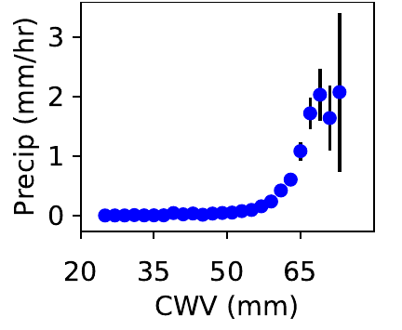
The Pickup
Robust relationship between humidity and precip: conditional-average precipitation rate picks up once a critical humidity value has been reached
Humidity (CWV) from microwave radiometer and precip from optical rain gauge at Atmospheric Radiation Measurement (ARM) Campaign at Nauru Island in the Tropical Western Pacific
Conditional-average precipitation rate from measurements taken at Nauru Island

Slide 5
The Pickup
Pickup represents the transition to deep convection
Linear fit provides estimation of critical value
‘Pickup’
~60 mm
Conditional-average precipitation rate from measurements taken at Nauru Island

Slide 6
CMIP6 Models
CMIP6 models show improvement over low-CRH biased pickup in CMIP5 models shown in Rushley et al. 2018
Sorted by critical value
Convective transition statistics for CMIP6 model cohort. Emmenegger et al. 2022 (in press)
Notes:
CMIP6 models show improvement over low-CRH biased pickup in CMIP5 models shown in Rushley et al. 2018

Slide 7
CMIP6 Models
CMIP6 models show improvement over low-CRH biased pickup in CMIP5 models shown in Rushley et al. 2018
Some pickup slightly late
What errors persist?
Convective transition statistics for CMIP6 model cohort. Emmenegger et al. 2022 (in press)
Notes:
CMIP6 models show improvement over low-CRH biased pickup in CMIP5 models shown in Rushley et al. 2018

Slide 8
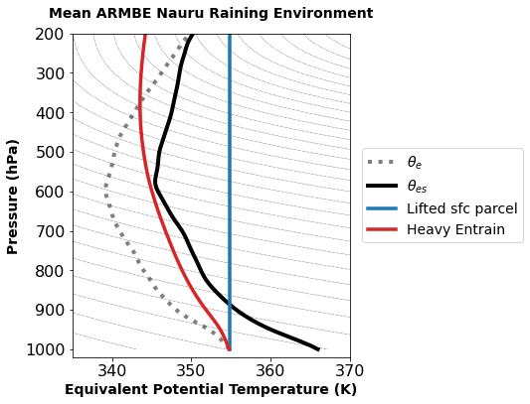
More entrainment⇒later CWV pickup
Buoyancy of Plumes drives convection hence precipitation
Most models use bulk plume
Convection if boundary layer air would be warmer than its environment after lifting and mixing

Slide 9
More entrainment⇒later CWV pickup
Heavy entrain -
Buoyancy depends on lower free troposphere moisture
No entrainment: plume buoyancy dependent on boundary layer moisture
Environment and different mixing assumptions for a conserved variable (𝜽_{e} )
Notes:
So before we were just looking at a cartoon. Here I’ve done some simple plume mixing calculations on a lifted surface parcel.
Both plumes have dependencies on the surface moisture the entraining case as before, this red line, has dependency on the moisture content of the lower free troposphere.
The entraining plume isn’t buoyant in this case

Slide 10
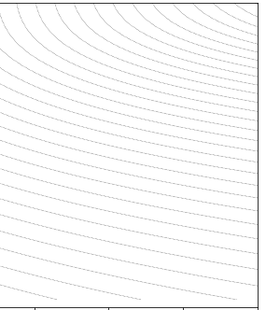
More entrainment⇒later CWV pickup
Environment needs to moisten so that this entrainment assumption has positive buoyancy
Environment and different mixing assumptions for a conserved variable (𝜽_{e} )
Notes:
And this explains how entrainment and moisture content play a role in determining the pickup.
If a model is using a heavy entrainment, it needs the column to be moisture to dilute the plume less so that there’s some measure of positive buoyancy.
And I’ve shown this by shifting the theta_e of the environment so that its close to saturation.

Slide 11
More entrainment⇒later CWV pickup
Holloway and Neelin (2009): CWV serves as proxy for role of free tropospheric humidity on entraining plumes
Xie at al. 2019: Too strong coupling to surface → convection triggered too easily
Environment and different mixing assumptions for a conserved variable (𝜽_{e} )
Notes:
And just to reiterate these points we made earlier, we’ve shown how the critical value of the CWV pickup serves as a proxy for role of free tropospheric humidity on entraining plumes
And If your plume doesn't mix, its behavior is being governed by the boundary layer

Slide 12
More entrainment⇒later CWV pickup
Holloway and Neelin (2009): CWV serves as proxy for role of free tropospheric humidity on entraining plumes
Xie at al. 2019: Too strong coupling to surface → convection triggered too easily
‘ Not enough (too much) mixing causes early (late) pickup’
Notes:
And just to reiterate these points we made earlier, we’ve shown how the critical value of the CWV pickup serves as a proxy for role of free tropospheric humidity on entraining plumes
And If your plume doesn't mix, its behavior is being governed by the boundary layer

Slide 13
Emenegger et al 2023 (in review) used bulk plume approach to develop a model diagnostic to estimate mixing rates among the CMIP6 cohort
(Entrainment rate)

Slide 14
Emenegger et al 2023 (in review) used bulk plume approach to develop a model diagnostic to estimate mixing rates among the CMIP6 cohort
CAPE-like measure, temperature difference between 600 hPa and boundary layer
(Entrainment rate)
Subsaturation of lower free troposphere ~ relative humidity

Slide 15
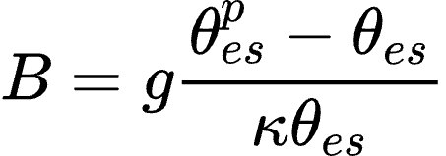
Emenegger et al 2023 (in review) used bulk plume approach to develop a model diagnostic to estimate mixing rates among the CMIP6 cohort
CAPE-like measure, temperature difference between 600 hPa and boundary layer
Fast timescale in which buoyancy dissipated (QE; Arakawa and Schubert, 1974) →
(2)
Bulk plume sets the env
𝜃_{es}
Subsaturation of lower free troposphere ~ relative humidity
Larger entrainment tend to give larger lapse rates

Slide 16
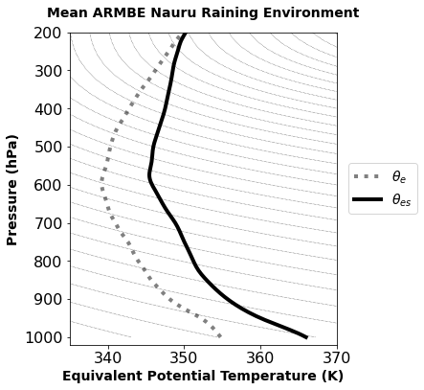
Emenegger et al 2023 (in review) used bulk plume approach to develop a model diagnostic to estimate mixing rates among the CMIP6 cohort
Fast timescale in which buoyancy dissipated (QE; Arakawa and Schubert, 1974) →
(2)
Bulk plume sets the env
𝜃_{es}
Larger entrainment tend to give larger lapse rates

Slide 17
Emenegger et al 2023 (in review) used bulk plume approach to develop a model diagnostic to estimate mixing rates among the CMIP6 cohort
Fast timescale in which buoyancy dissipated (QE; Arakawa and Schubert, 1974) →
(2)
Bulk plume sets the env
𝜃_{es}
Larger entrainment tend to give larger lapse rates

Slide 18
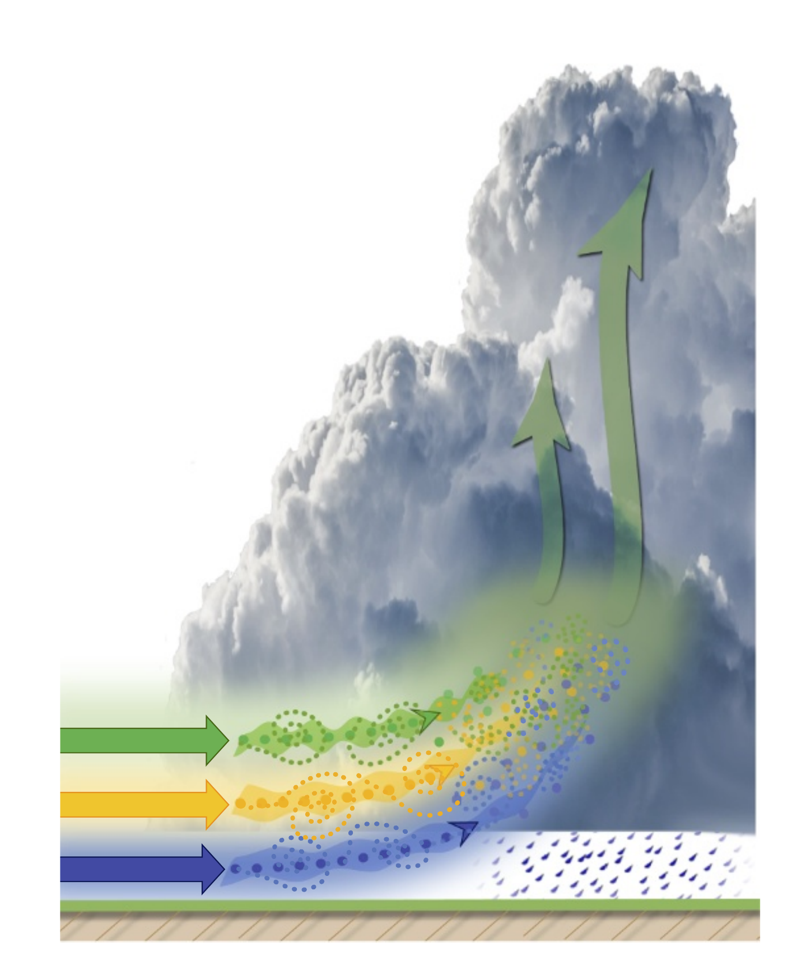
Putting it together: Entrainment Estimator
Parcel leaves with average properties of ABL

Slide 19
Putting it together: Entrainment Estimator
At 600 hPa, the bulk plume is equivalent to the env
Parcel leaves with average properties of ABL

Slide 20
Putting it together: Entrainment Estimator
At 600 hPa, the bulk plume is equivalent to the env
Incorporated some fraction, ε, of environmental air from this layer
Parcel leaves with average properties of ABL

Slide 21
Lapse Rates
Plume lapse rate
Boundary layer 𝜃_{e} and the 𝜃_{es} in upper free troposphere (here 600 hPa) estimate the plume lapse rate
Average 𝜃_{e} in the boundary layer vs 𝜃_{es} at 600 hPa of the average profiles during raining events. Ellipse is 95% confidence ellipse

Slide 22
Lapse Rates
Plume lapse rate
Boundary layer 𝜃_{e} and the 𝜃_{es} in upper free troposphere (here 600 hPa) estimate the plume lapse rate
5th to 95th percentiles of Western Pacific Ocean in ERA5
Average 𝜃_{e} in the boundary layer vs 𝜃_{es} at 600 hPa of the average profiles during raining events. Ellipse is 95% confidence ellipse

Slide 23
Lapse Rates
Plume lapse rate
Boundary layer 𝜃_{e} and the 𝜃_{es} in upper free troposphere (here 600 hPa) estimate the plume lapse rate
CAM5 perturbation experiment (colored x’s) show slightly cooler 𝜃_{es} and warmer boundary layer 𝜃_{e} with increasing entrainment
Average 𝜃_{e} in the boundary layer vs 𝜃_{es} at 600 hPa of the average profiles during raining events. Ellipse is 95% confidence ellipse

Slide 24
Lapse Rates
Near-zero entrainment
Boundary layer 𝜃_{e} and the 𝜃_{es} in upper free troposphere (here 600 hPa) estimate the plume lapse rate
Large entrainment
Average 𝜃_{e} in the boundary layer vs 𝜃_{es} at 600 hPa of the average profiles during raining events. Ellipse is 95% confidence ellipse

Slide 25
Plume Factors
Subsaturation reinforces the link between lapse rate and entrainment
If entrainment is large (large lapse rate) in model, column must be sufficiently saturated for convection to trigger

Slide 26
Plume Factors
Subsaturation reinforces the link between lapse rate and entrainment
If entrainment is large (large lapse rate) in model, column must be sufficiently saturated for convection to trigger

Slide 27
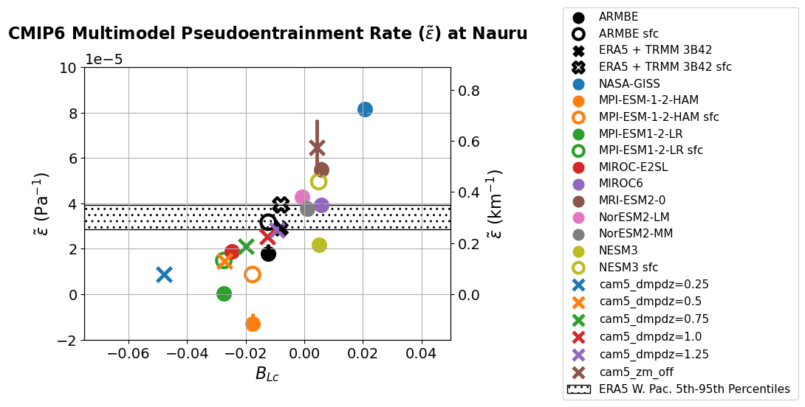
Pseudo-entrainment is a good predictor of onset of convection
(Critical value)
Notes:
We are going to estimate the pseudoentrainment of the bulk plume from the average profiles during raining events in obs and models
Plot critical value of the pickup on the previous slide against the pseduoentrainment
And we see that the pseudo entrainment is a good predictor of your convective onset
As you increase your pseduoentrainment, you’re going to convect at later values of buoyancy
In models with low entrainment, the threshold for convective instability is met in less buoyant environments

Slide 28
Pseudo-entrainment
Small subsat, big lapse rate
Big subsat, small lapse rate
Notes:
MPI models have low pseudo-entrainment , (large subsaturation, small lapse rate)
NASA-GISS stands out on the other end (subsaturation is small and its lapse rate is relatively large)
And in between, we see that the pseudoentrainment differentiates between the perturbed physics runs, these x’s.
And it looks like most models have too high entrainment.

Slide 29
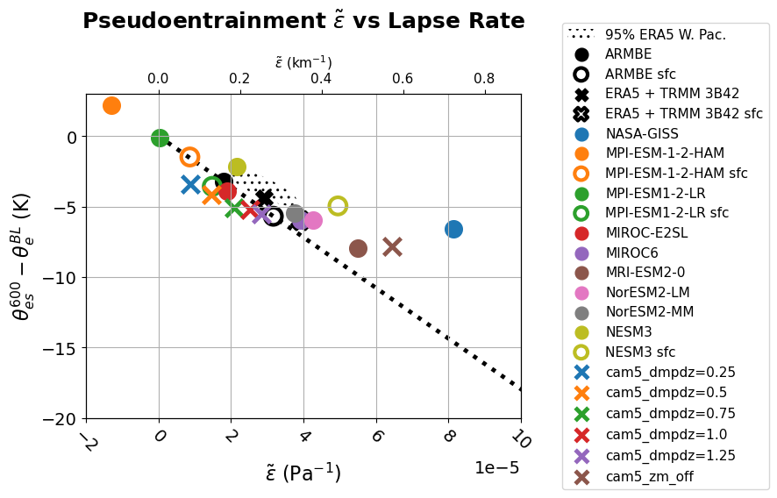
Wrong entrainment → Compensation between lapse rate and moisture
Altering entrainment rate in simulations changes mean state of climate (Kim et al. 2011, Mapes & Neale 2011)
Lapse rate / ARM subsat
Pseudo-entrainment vs lapse rate (Emmenegger et al. 2022 (in prep))
Notes:
In the plot here we have the pseudo-entrainment, plotted vs the lapse rate, the line here is a reference line to the ARM subsaturation.
And we’re trying to show the tradeoffs the models are making. So if a model lies to the right of the reference line, it has a lower subsaturation, to the left a higher subsaturation.
So if you’re model was behaving well in the CRH statistics we showed in the beginning but didnt have the right entrainment, it’d lie somewhere along this line and it’d have a lapse rate that was different from the obs

Slide 30
High entrainment → steep lapse rate…unless moisture compensates
Subsat does not have a large effect on the entrainment parameter…until the pseudo-entrainment becomes large and subsaturation begins to compensate for lapse rate differences
I.e. if moisture did not adjust, lapse rate would be very large for NASA-GISS
Lapse rate / ARM subsat
Pseudo-entrainment vs lapse rate (Emmenegger et al. 2022 (in prep))
Notes:
But since models have lapse rates within some reasonable range of ARM, if your model has really high entrainment, as is the case with NASA-GISS, it has to compensate with moisture
If it were doing well with creating the ARM statistics of moisture, itd have an absurd lapse rate

Slide 31
Wrong entrainment → wrong lapse rate if moisture is right
Subsat ~ CRH → models get entrainment wrong, but do relatively well in CRH since lapse rates adjust
Lapse rate / ARM subsat
Pseudo-entrainment vs lapse rate (Emmenegger et al. 2022 (in prep))
Notes:
And most of these models lie within a close vicinity to the ARM references line.
This is explaining why they’re doing relatively well in the CRH statistics at different entrainments, its because they’re getting the lapse rates wrong

Slide 32
Moisture adjustment explains pickup in CRH
Late pickup in CRH
Pseudo-entrainment vs lapse rate (Emmenegger et al. 2022 (in prep))
Notes:
Since models are getting the entrainment wrong, they’re going to compensate with their moisture
Smaller entrainment is leading to early pickup, whereas higher entrainment is leading the models to pickup late since they’re showing realistic lapse rates

Slide 33
Current and Future Work
Entrainment sets a ‘threshold’ of LFT moisture
Moisture in LFT must be sufficient such that dilution determined by entrainment rate doesn’t kill the plume
How does the LFT moisten?
Vertical advection, horizontal advection, etc…

Slide 34
ERA5 tendency leading up to event (Hours 0 is start of rain)
ΔK

Slide 35
ERA5 Tendency conditioned on event at Nauru (red star)
Moisture looks to move as a westward propagating wave
Higher entrainment → buoyancy (hence convection) has higher dependency on these patterns
(from event)

Slide 36
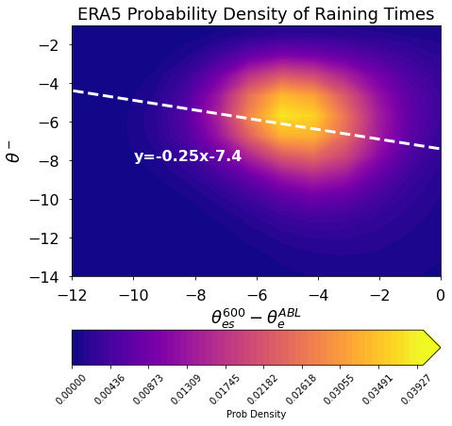
Entrainment across the pacific
Regression through raining event factors tell us entrainment rate that minimizes variance of buoyancy

Slide 37
Conclusion
Need more observational products to verify and evaluate spatial advection of moisture and buoyancy

