Slide 1
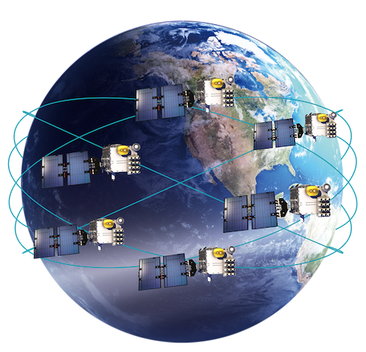
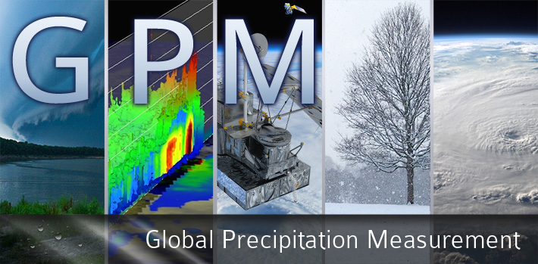
Moisture in the Lower Free Troposphere and Observational Strategies for Obtaining Vertical Profiles In and Near Convection
F. Joseph Turk¹, Todd Emmenegger²,
J. David Neelin²
¹Jet Propulsion Laboratory, California Institute of Technology, Pasadena CA
²Dept. of Atmos. and Ocean. Sci., University of California, Los Angeles
2nd GNSS Polarimetric RO User Workshop
Caltech, 28-29 November 2023
The work contained in this presentation was carried out at the Jet Propulsion Laboratory, California Institute of Technology, under a contract with NASA. © 2023 all rights reserved.

Slide 2
Precipitation-water vapor relation guiding model development
Convective transition statistics serve as diagnostics for the parameterization of convection in climate and weather forecast models by characterizing the dependence of convection on the humidity-temperature environment
The observed strong pickup of precipitation (P) as a function of layer-averaged water vapor (q) and temperature (T) is captured in models with varying accuracy (Kuo et al., 2018, 2020)
For independent assessment amongst models, observations of extreme (P, q, T) conditions are limited
In particular, global observations under the “high P, high q” domain: Conventional IR or MW satellite observations challenged by attenuation, clouds
Each curve shows the “pickup” from a different climate model
observed
Emmenegger et. al., 2023, in review
Neelin et al; 2022 AGU poster on “turbocharging”
Padulles et al, 2022: doi: 10.1175/JAS-D-21-0052.1

Slide 3
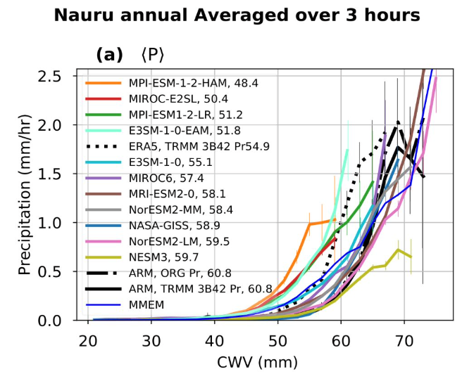
Precipitation-water vapor relation guiding model development
Many models “pick up” early (rain too frequently at too low of a rate)
Individual or multiple convective clouds are typically represented as plumes of buoyant air exchanging air through interactions with their environment (Todd Emmenegger’s previous presentation today)
Convection initiated if boundary layer air would be warmer than its environment after lifting and mixing:
Too strong coupling to to surface → convection triggered too easily
Insufficient sensitivity to moisture through entrainment
“high precipitation, high moisture” domain
Emmenegger et. al., 2023, in review

Slide 4
Using vertical profile information to assess convective conditions in CMIP6 models (courtesy Todd Emmenegger)
Equivalent potential temperature (e) (solid lines) and saturation equivalent potential temperature (e_{sat}) (dashed lines) at the Nauru island Atmospheric Radiation Mission (ARM) site
The orange shaded area gives a measure of conditional instability for a non-entraining parcel
The gray shaded area indicates the subsaturation in the lower free troposphere (LFT) (750–900 hPa)
Two models are shown for comparison with the ARM best estimate data
These same quantities can be computed from RO profiles (but conventional RO does not provide a direct measure of precipitation P)
e_{sat} (dashed)
e (solid)
Emmenegger et. al., 2023, in review

Slide 5
COSMIC-2 Radio Occultation (RO) Sampling Characteristics
COSMIC-2: 6-satellites, 24-deg orbit inclination, 500-km altitude
These RO observations sense through heavy precipitation, but cannot directly detect the presence/absence of precipitation
Once an RO finishes, the Earth rotates before the same COSMIC-2 receiving satellite can return for a second RO (viewing the same GNSS transmitting satellite)
On occasion, a second (or third) receiving satellite may occult the same GNSS transmitter, within a time offset relevant to the convective time scale (e.g., 10 mins or less)
NASA is increasingly obtaining more RO data through their Commercial Small Satellite Data Acquisition (CSDA) program
The COSMIC-2 satellites are arranged one-per orbit plane, resulting in RO soundings that are spaced far apart on the ground
Constellation Observing System for Meteorology, Ionosphere and Climate (COSMIC-2)
Notes:
The COSMIC and COSMIC-2 spacecraft are arrangedone-per-plane in circular orbits, with planes spaced evenly inRAAN around the Earth; as a result, they are typically thousandsof kilometers apart. This necessitates that any occultations ofa given GNSS satellite observed by separate RO satellites inthe constellation will result in soundings that are far apart onthe ground. The satellites of the GNSS constellations are alsotypically far apart in their orbits, implying that occultations ofseparate GNSS satellites observed in quick succession by a givenRO satellite will similarly result in widely spaced soundings.Moreover, the relative locations of the Earth surface and theGNSS constellations evolve significantly before any RO satellitecan return for a second occultation with this GNSS satellite.The period of the RO satellite orbits is approximately 90 min;over this time, the Earth rotates approximately 22.5◦, and theGlobal Positioning System (GPS) satellites (for example) travelapproximately 45◦in their orbits

Slide 6
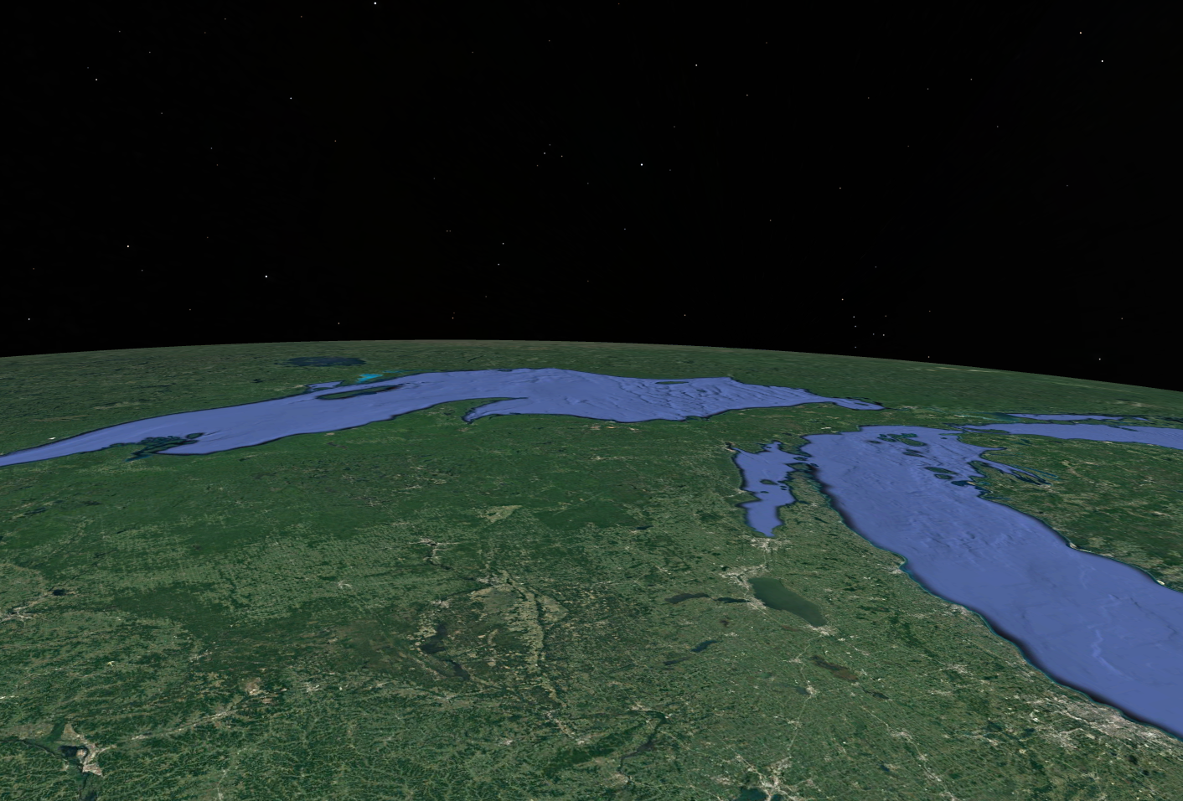
Dispelling the “Coarse Resolution” Myth: “Along-ray” Perspective
The resolution in the “along-ray” dimension is fairly coarse, ~200-km or more
The resolution in the vertical (~200 m) is much finer
than the vertical information contained in current passive MW sounders, e.g. ATMS
The resolution in the “across-ray” dimension is very fine (1-km), determined by the Fresnel zone volume along the propagation path
The RO measurement has very high resolution in 2 of the 3 spatial dimensions
(exaggerated depiction)
time
setting occultation
hundreds of km
1-km
200-m
upper rays
During each RO, the on-Earth tangent point “drifts” while the transmit and receive satellite occult each other
lower rays
Trace of tangent points on Earth surface

Slide 7
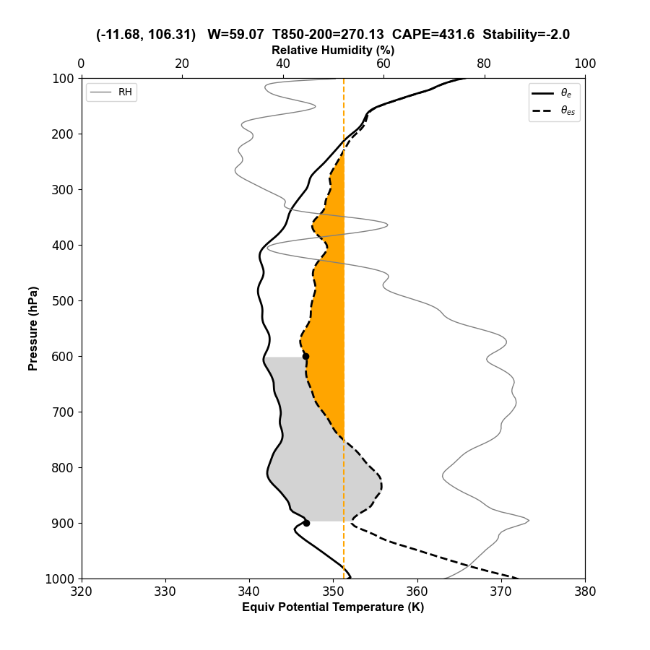
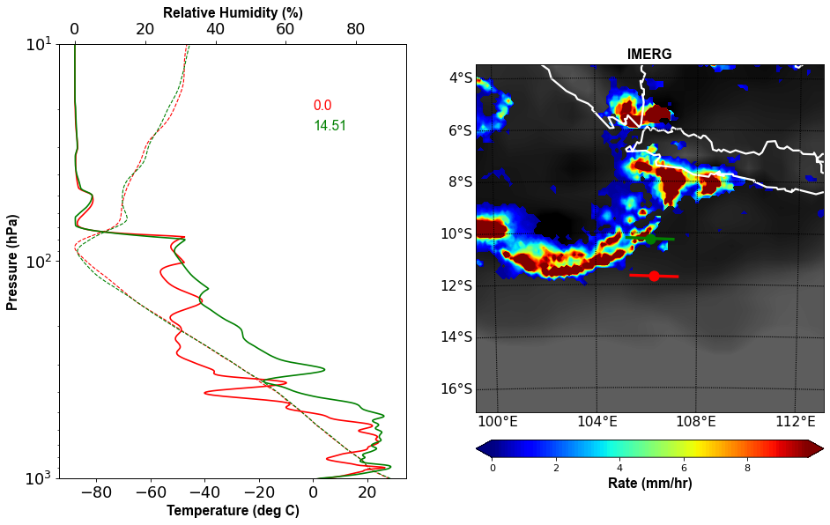
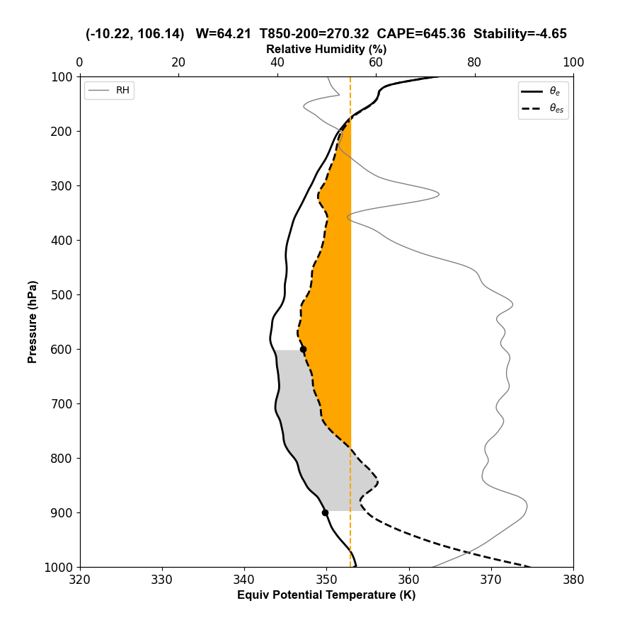
Stability from nearby COSMIC-2
outside
Background is the nearest 30-min IMERG (from NASA GPM)
S. Sumatra
Java
inside
outside
inside
IMERG provides no vertical precipitation information; look for cases where the RO encompasses the GPM-DPR radar swath

Slide 8
“Nearby” COSMIC-2 (Whenever GPM-IMERG > 0)
Red Points= Heaviest Precipitation (Upper 10% of the Precipitation Rate Distribution)
Column
Surface – 900 hPa
900-600 hPa
600-200 hPa
Column vapor higher inside precipitation relative to outside environment (not surprisingly)
No discernable difference below 900 hPa
Sensitivity is in the lower free tropospheric layers, above 900 hPa
2020-2022 Over-Ocean ±30-deg latitude

Slide 9
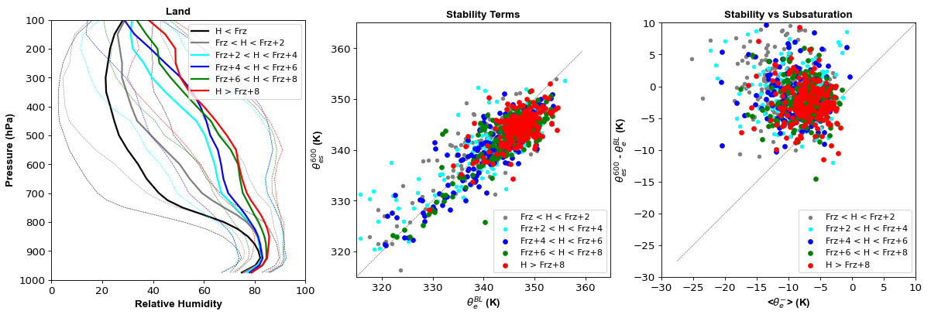
Instability from COSMIC-2 and GPM-DPR precipitation radar
Emmenegger et al (2023) estimated a mixing rate based on environmental factors (𝜀)
stability
$$ε=\frac{\left(θ_{es}^{600}−θ_{e}^{BL}\right) }{\left\langle θ_{e}^{−}\right\rangle }$$
vertically integrated subsaturation from 900-600 hPa
COSMIC-2 RO conditioned on the GPM-DPR radar profile top (up to 2-hr after RO):
more than 10-km above the freezing level (very deep convection)
8-10 km above the freezing level
4-8 km above the freezing level (less deep)
Notes:
redefined stability term

Slide 10
Instability from PAZ-ROHP (data through mid-2021)
With polarimetric RO, these terms can be computed from the same observation
ROHP is a single satellite, ~150 RO/day. How to obtain more observations?
From ROHP Pol-RO alone
Same as left, with ERA-I overlaid (black points)
ROHP RO where the associated $∆∅$profile top was located:
T=228K or colder (very deep convection)
Between 228-238K
Between 238-248K (less deep)

Slide 11
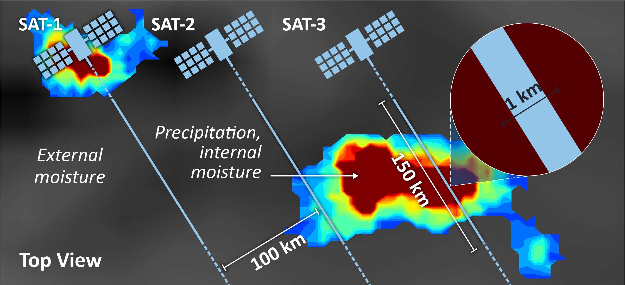
The STORM-PROBE¹ Concept
The STORM-PROBE concept consists of a low-Earth orbiting satellite constellation of GNSS polarimetric RO (PRO) measurements
The receiving satellites are spaced such that adjacent PRO would view the same GNSS transmitting satellite
Captures independent moisture profiles within and in the nearby environment surrounding convection
Turk et al., 2022, doi:10.3390/atmos13020259
1 Storm Thermodynamic Occultation for the Role of Moisture-Polarimetric Radio OBservations of the Environment

Slide 12
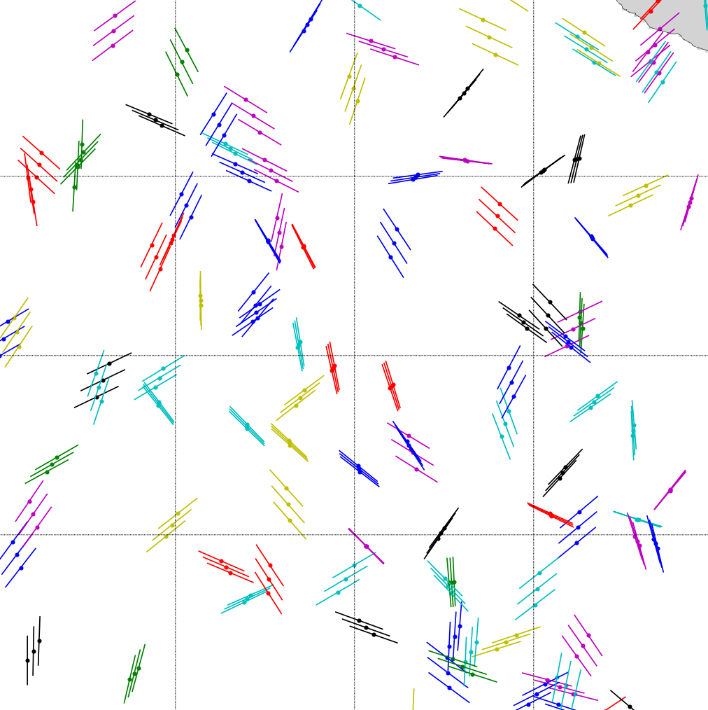
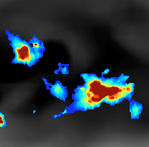
STORM-PROBE
Concept
1-km
Constellation of three closely-spaced PRO
45-deg inclination
475-km altitude
100-km
Captures moisture gradient in the “across-ray” direction
STORM-PROBE observation
2-days of STORM-PROBE observation locations
Each STORM-PROBE satellite has an identical dual-polarization GNSS receiver, capturing simultaneous PRO

Slide 13
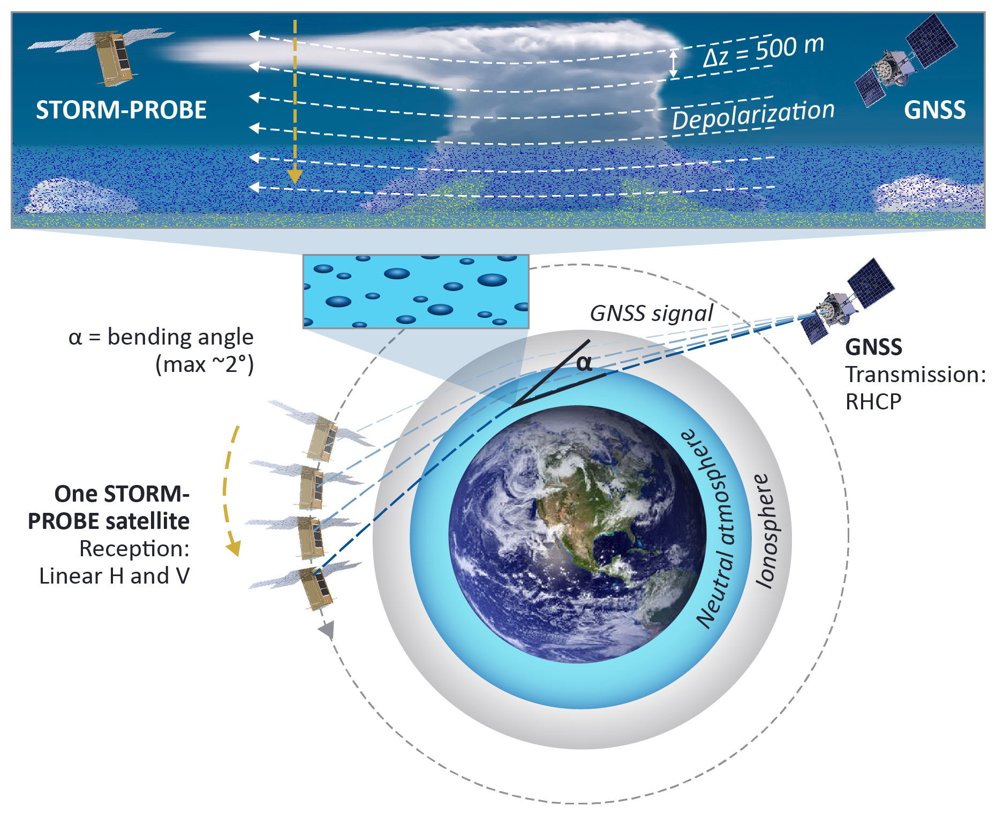
The STORM-PROBE¹ Concept: Polarimetric RO
Polarimetric RO (PRO) relies upon hydrometeor shape asymmetry, such that a differential phase time delay ($Δφ$) is induced between the H- and V-polarized GNSS signals propagating through heavy precipitation
The (T, q) profile and the precipitation detection profile are measured along the identical air mass
PRO concept flight-proven by the Spanish PAZ-ROHP satellite continuously since 2018 (Cardellach et al, 2019)
JPL-developed Cion GNSS receiver (CICERO, NTS-3, SunRISE, SNOOPI…)
1 Storm Thermodynamic Occultation for the Role of Moisture-Polarimetric Radio OBservations of the Environment

Slide 14
Interpreting the traditional RO and 𝛥𝜙 signal together
𝛥𝜙
Traditional MW radar and radiometer observations don’t provide a resolved q,T profile within/near heavy precipitation
Usually, synoptic-time NWP model or associated reanalysis fields are brought in – the user has to interpolate to “align” these to the radar pulse volume
For Pol-RO, the observation is naturally spatially averaged in the “along-ray” direction
The precipitation structure and moisture are directly sampled along the same air mass volume, at the same time
A
freezing level
B
surface
(exaggerated depiction)
Set of ROHP ray paths as the RO sets below 20-km
Set of tangent points. The “bending” mostly occurs near here
But the observed 𝛥𝜙 could have been induced from wherever precipitation was traversed along the ray path (figure above)
Turk et al., JTech, Oct. 2021, doi: 10.1175/JTECH-D-21-0044.1.

Slide 15
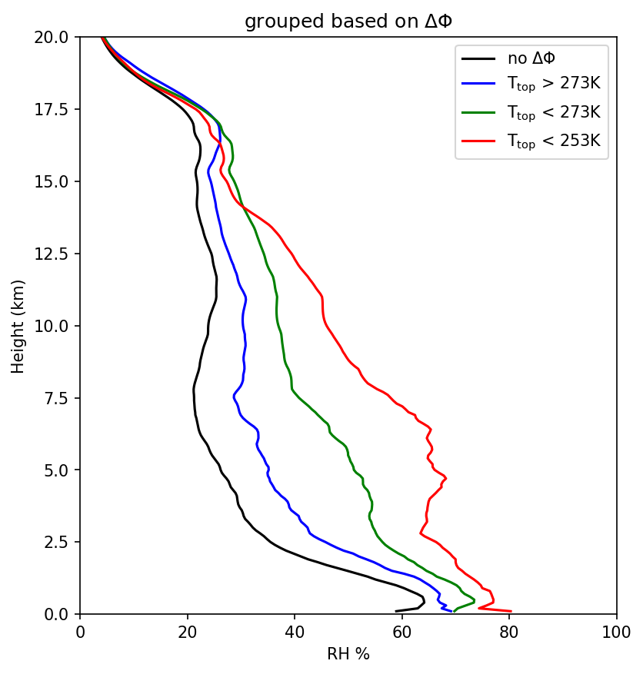
STORM-PROBE Concept: Moisture and “Depth” of Convection
All ROHP, Separated by Height of Top-Most Temperature Level where $∆φ$ > 3-mm
Use the top-most level where Δ$ϕ$exceeds a threshold value above the freezing level (proxy for “radar cloud top”)
Contrast stability from profiles ”inside” and “outside” regions of heavy precipitation
Would better pinpoint layer-sensitivity to the LFT water vapor structure, conditioned on the “depth” of convection
observations
Using $∆φ$ as a top-height proxy, indications of increased moistening in lower free troposphere
deep convection
shallow convection

Slide 16
RO Sampling with NASA’s CSDA Data Sources JJA 2022
Only COSMIC-2
After Quality Control: Including only those RO reaching to at least 920 hPa (ocean) or to within 500-m of terrain height (land)
COSMIC-2 plus Spire

Slide 17
3-month Totals (Using UCAR CDAAC Data) JJA 2022
Land and Ocean ±60-deg Latitudes
 | Total RO | Total RO After QC | Nearby | Nearby with Rain | Nearby with Rain and No-Rain | Percent ±20 deg latitude
COSMIC-2 (Excluding Spire) | 500319 | 293498 | 3935 | 286 | 21 | 48
All Data (Including Spire) | 895951 | 551283 | 23534 | 1407 | 141 | 63
The number of nearby rain RO profiles is limited, < 1000 events/year
These are conventional RO, not PRO, with no capability to directly detect the coincident presence of heavy precipitation

Slide 18
Summary
Dense RO global sampling, preferably with some near-coincident, provide unique diagnostics for the parameterization of convection in climate and weather forecast models
Using PRO, these observations provide a direct measure of the “height” reached by the convection, alongside the thermodynamical profile
The PRO signal is not (currently) assimilated in operational NWP models; provides an independent model assessment
Some S-P science objectives may be achievable with existing observations: COSMIC-2 with commercial RO (even better, polarimetric RO) data sources
For further information, ideas, collaborations: jturk@jpl.nasa.gov

