Slide 1
Relationships Between Deep Convection and Tropospheric Layers Using Polarimetric Radio Occultation Data
2nd PAZ Polarimetric Radio Occultations User Workshop
Terence Kubar^{2,1}
Manuel de la Torre Ju$\acute{a}$rez¹
Jonas Katona¹
F. Joseph Turk¹
Ramon Padull$\acute{e}$s^{3,4}
^{Photo by T. Kubar, 2005}
¹Jet Propulsion Laboratory, California Institute of Technology, Pasadena, CA
²Joint Institute for Regional Earth System Science & Engineering, University of California, Los Angeles
³Institute de Ciencias del Espacio (ICE-CSIC), Barcelona, Spain
⁴Institute of Space Studies of Catalonia (IEEC), Barcelona, Spain

Slide 2
Background on the Vertical Structure of the Atmosphere and Radio Occultation/Polarimetric RO (PRO)
●The lowest 1-2 km is the Planetary Boundary Layer has been well characterized by RO (von Engeln et al., 2005; Kalmus et al. 2022) and PBL top height variability versus low-level clouds from RO and MODIS/MISR (Kubar et al. 2020; Kubar et al. 2023 (latter manuscript under review))
●In the free troposphere where convective activity can dominate, the convective layer ends at the height that caps the top of convective clouds and, especially in the tropics, water vapor mixing ratios become low enough such that CO, CO₂ and O₃ dominate radiative heating
●This intermediate layer, called the Tropical Tropopause Layer (TTL), often is marked by detraining clouds near its base to the tropopause at the top – in the tropics this is usually the Cold Point Tropopause (CPT). However, when heating by O₃ is largely absent in the stratosphere in the winter high latitudes, the CPT may be discerned 20-30 km above the surface.
●PRO data, which provide concurrent information about hydrometeor profiles and thermodynamics, can provide new insights about vertical structure of clouds and stability

Slide 3
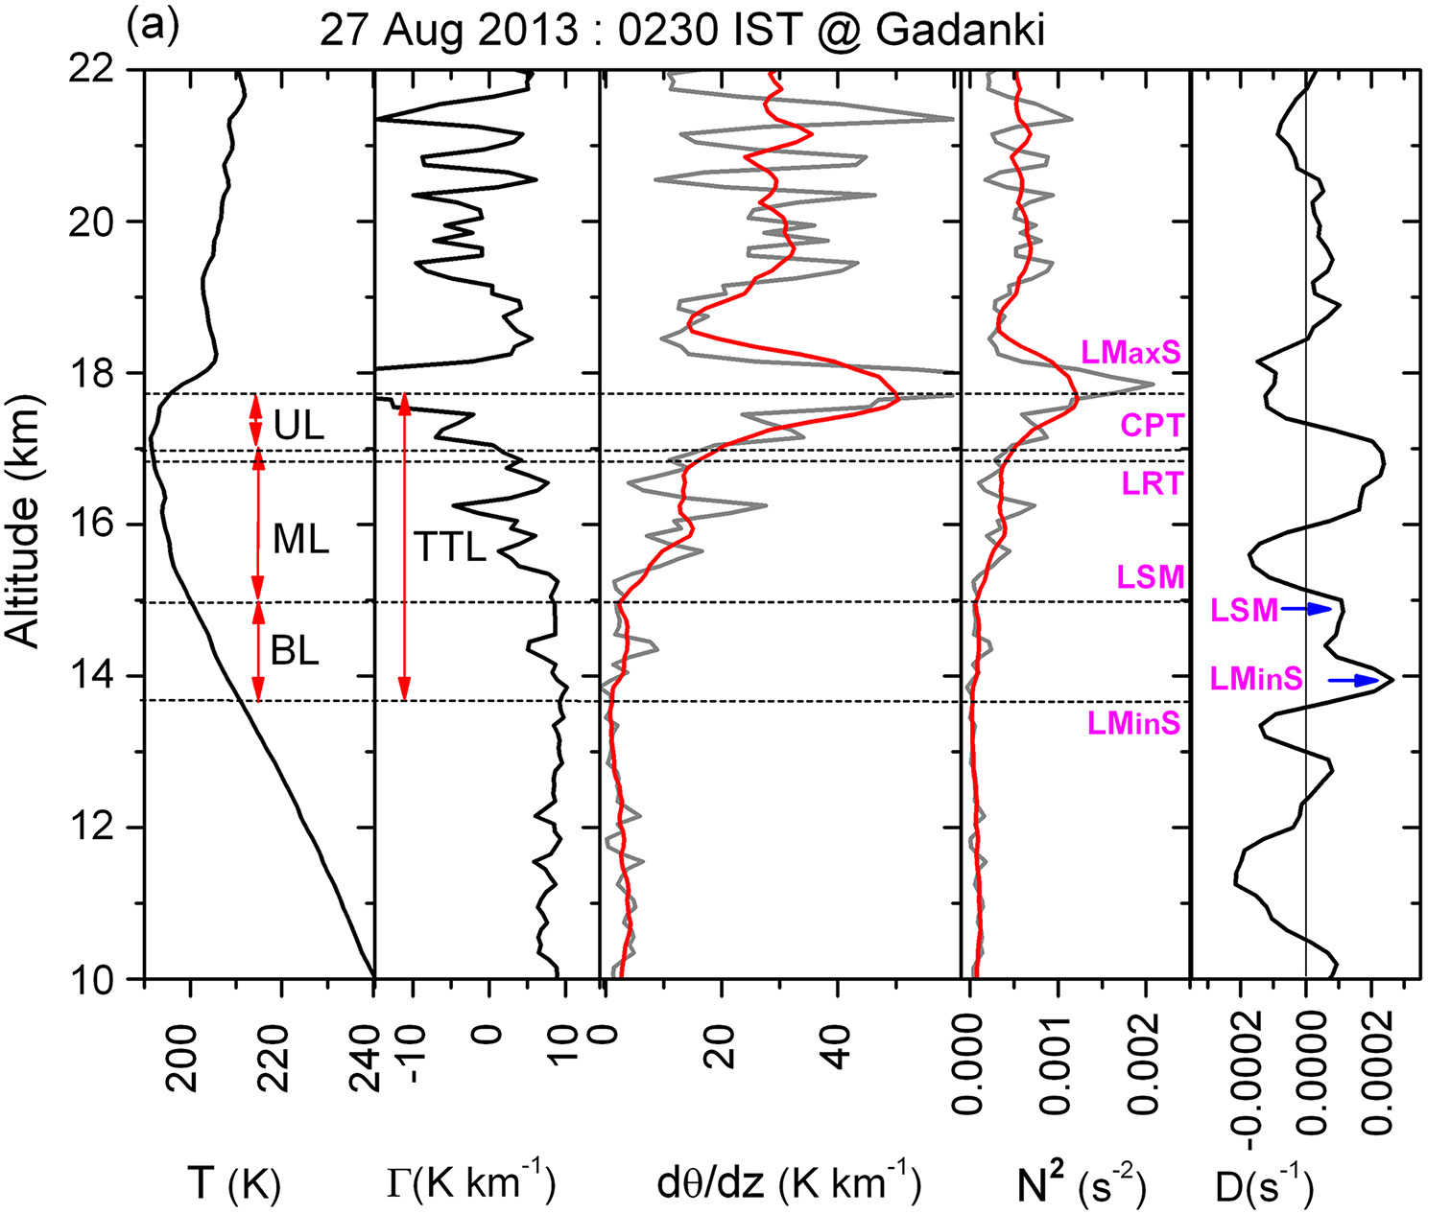
An Example of Different Sub-Layers of the TTL from Sunilkumar et al. (2017) over the Tropics (Gadanki, 13.5°N, 79.2°E on 27 Aug 2013):
Upper Layer (UL): Between CPT (lower) and Tropopause Inversion Layer (TIL), which we will refer to as LRMIN
Middle Layer (ML): Bounded by Level of Secondary Minimum and CPT
Bottom Layer (BL): Lower part of which is the level of minimum stability (henceforth LRMAX in our study)

Slide 4
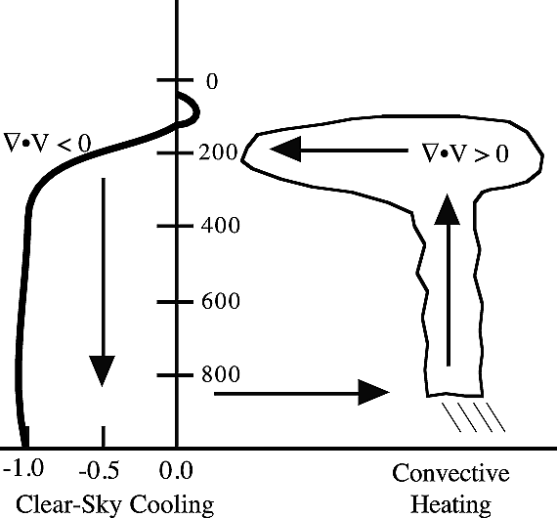
Fixed Anvil Temperature (FAT) Hypothesis [Dennis Hartmann and Kristin Larson, 2002] – Another Consideration of the Level of the TTL Base (LRMAX)
•Away from tropical deep convection, clear-sky radiative cooling quickly diminishes above 200 hPa because of the inefficiency of water vapor due to low temperatures at and above these heights, driving anvil cloud detrainment
•Above 200 hPa, longwave emission from CO₂ becomes greater than water vapor (more on this on next slide)
•Strong convergence of mass at 200 hPa in clear-sky regions drives strong divergence in convective regions (and is proposed to stay relatively constant)
Figure 1 from Geophysical Research Letters, Volume: 29, Issue: 20, Pages: 12-1-12-4, First published: 17 October 2002, DOI: (10.1029/2002GL015835)

Slide 5
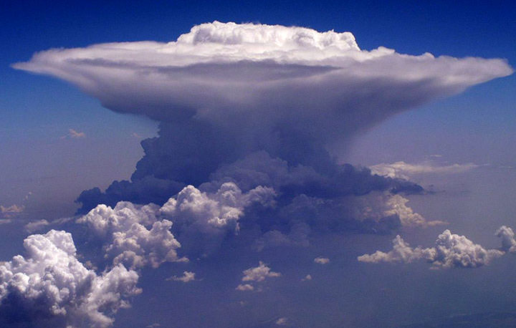
What would be the visual manifestation of the TTL?
CPT
Overshooting Top
TTL Base
Detraining Anvil (LRMAX?)
Updrafts
An example of a towering ‘cumulonimbus’ thundercloud with detraining anvil
Courtesy of www.math.nyu.edu/~gladish/teaching/eao/cloud1.jpg

Slide 6
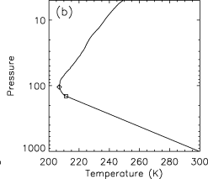
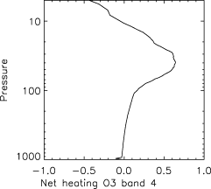
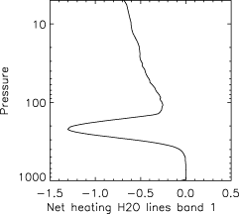
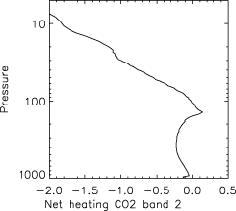
What Determines the Apparent Separation of the TTL Base from the Tropopause, e.g. the TTL Thickness?
From Thuburn and Craig (2002), henceforth TC 2002, the TTL is also referred to as the substratosphere, and heating by CO₂ in the 15 μm band (particularly at 155 hPa) forces apart the convection top from the cold-point tropopause (Figures 1 - 4 from their paper)
TC 2002 Figure 1
TC 2002 Figure 4
TC 2002 Figure 2
TC 2002 Figure 3
Water Vapor Net Cooling
CO₂ Max Heating
Near 155 hPa
Note that convective timescale shorter than physical mechanisms driving ozone variability, keeping O₃ lower and more troposphere-like even in the substratosphere!
Above Figures from TC 2002 from their Radiative Convective Model experiments
Journal of Geophysical Research: Atmospheres, Volume: 107, Issue: D2, Pages: ACL 10-1-ACL 10-10, First published: 29 January 2002, DOI: (10.1029/2001JD000448)

Slide 7
Thuburn and Craig (2002) suggest that the TTL thickness is greatest where deep convection is most vigorous, corroborated by Sunilkumar et al. (2017) (part of their Figure 6, below), which we will also briefly see in global RO statistics a bit later!
JGR Atmospheres, Volume: 122, Issue: 2, Pages: 741-754, First published: 07 January 2017, DOI: (10.1002/2016JD025217)

Slide 8
Double Tropopauses and/or Deep TTLs Away from Tropics
•Even away from high-latitudes, there may be cases in which the CPT is exceptionally high, up to 6-10 km above the first tropopause which may better bound clouds
•Often referred to as “double tropopause” cases, in which the WMO definition of a lapse rate (LR; -∂T/∂z) tropopause is when LR decreases below 2°C/km, these are particularly common in the subtropics/extratropics during winter during stratospheric intrusion events (e.g. Randel et al. 2007)
•However, there may be cases as well in which a strong inversion well below the CPT marks the vertical limit of precipitating clouds, such that these examples may be analogous to very deep “TTL-like layers”
•Signatures of multiple stable layers/tropopauses in the extratropics may also be representative of remnants of strong tropopause gradients across mid-latitude cyclones or Atmospheric Rivers (e.g. Michael Murphy’s talk from yesterday, 28 Nov 2023)

Slide 9
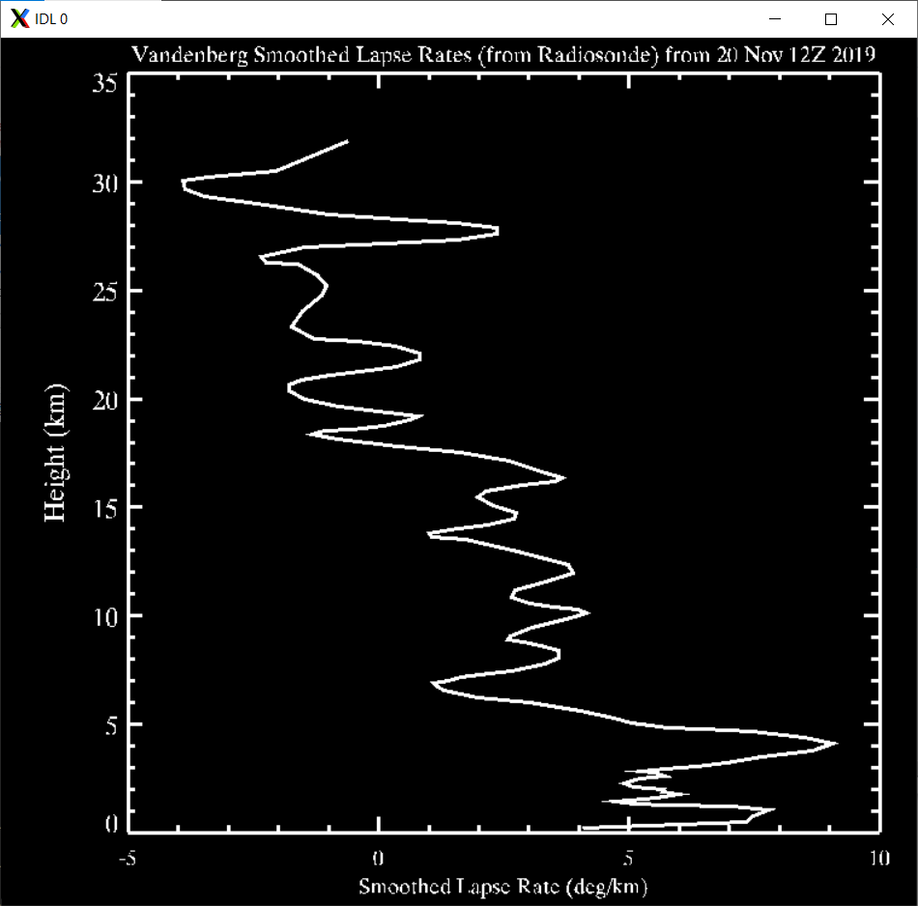
Example of a Seemingly Shallow Tropopause, a Deep Transition Layer (TTL-like) and then the true stratosphere in terms of Lapse Rates
(from Vandenberg Radiosonde, 12Z 20 Nov 2019
True Stratosphere
Lapse Rates Between about ~2-3 deg/km
Maximum Lapse Rates, generally ranging between 5-10 deg/km

Slide 10
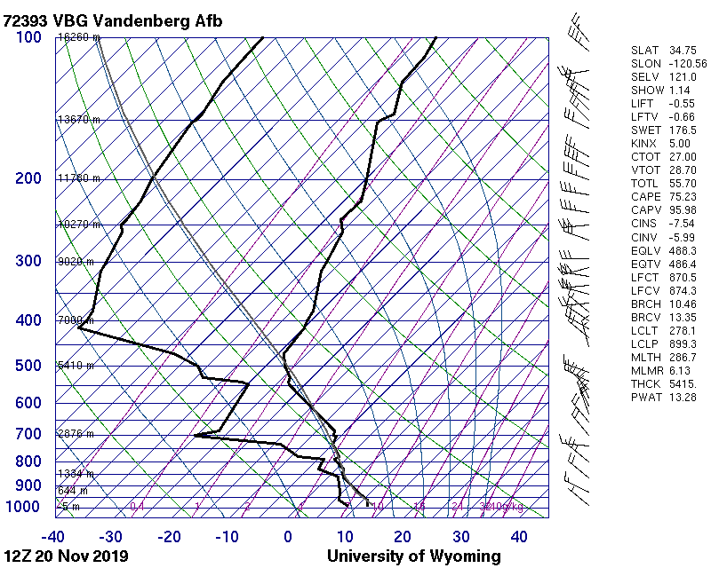
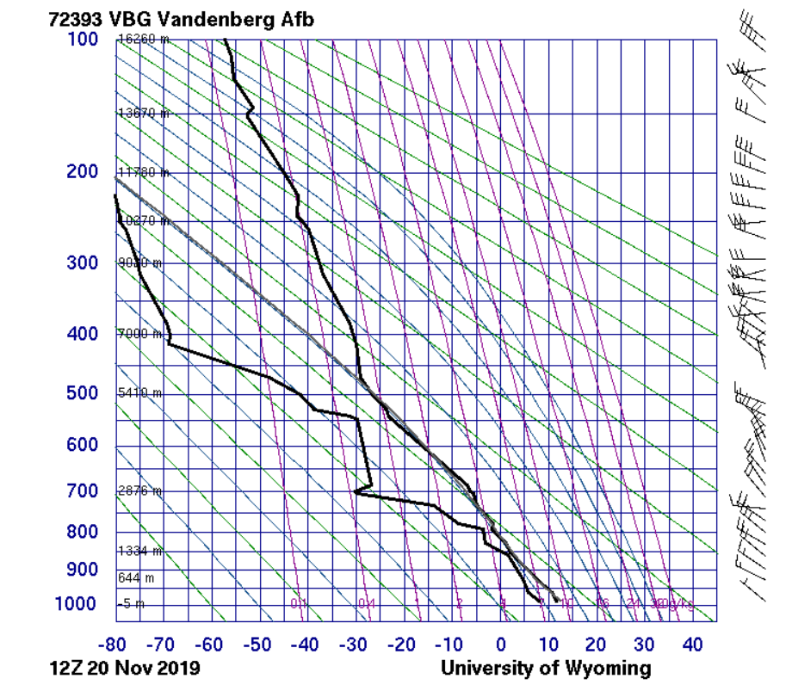
Two Different Perspectives of Viewing Temperature Profiles With Height During a Low Tropopause Event (20 November 2019, 12Z)
Skew-T Diagram
Stuve Diagram (note the different x-scale: temperature)
Tropopause Pressure ~ 460 hPa? Not based on a cold-point definition but a change in lapse rate?

Slide 11
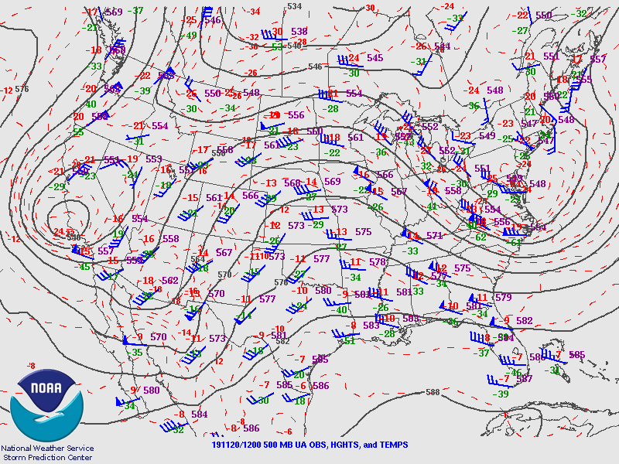
Note that the Vandenberg November 20th, 2019 case was associated with an anomalously deep upper-level low centered nearly right over southwestern CA!

Slide 12
Year-Round (Based on 20 days in March, June, September, and December 2022) Frequency of 2nd Tropopause Based on UCAR Spire Data – Global
Frequency
Highest at
the Subtropical/
Mid-Latitudes
Boundary and a
Slight secondary
Peak right at the
equator

Slide 13
What are the Goals of This Talk?
1. Introduce subtropical/mid-latitude case studies illustrating deep TTLs and/or double tropopauses and the relevant layers involved in the study
2. Calculate the modified CPT everywhere, including at polar night latitudes
a. Describe the method (height of minimum of ∂LR/∂z) and show that it works.
b. One application is illustrating how the distance between the modified CPT and coldest point in the stratosphere changes with latitude and day.
3. Calculate Statistics of the TTL Layers Based on Lapse Rate (LR) minima/maxima and characterize their importance to cloud top height (CTOP) from Polarimetric-RO (PRO) data from PAZ, using the phase difference between the horizontal and vertical components (Δϕ)
4. Construct mean profiles in different tropical and mid-latitude regions demonstrating the relationships among cloud top height, [Δϕ]_{max}, and LRMAX as estimated from ROHP profiles
5. Introduce sensitivity assessment of different thresholds for CTOP in the tropics and the relationships with LRMAX to glean new insights
a. Demonstrate that while a more conservative threshold yields mean estimates of CTOP that are below LRMAX, correlations with LRMAX are improved
b. Illustrate why too small of a ΔΦ may reduce mean bias but largely be noise above what are likely well-defined clouds

Slide 14
Data
•Extensive use of conventional RO data from various sources, including Spire-RO (UCAR) for global statistics of troposphere, tropopause metric, and TTL metrics
•Conventional PAZ and Grace-D RO and Radiosonde (RS) data for several California case studies in 2023
•Polarimetric PAZ RO Data for Cloud Top Height and LRMAX Relationships (2018-2021; >151,000 Profiles!)
•For the sensitivity analysis in an attempt to both assess and possibly refine the threshold above which we consider Δφ to represent a cloud, we also utilize IMERG/GPM precipitation data in order to make appropriate comparisons with PAZ P-RO CTOP for clouds which both datasets suggest contain precipitation.
Considerations
For the PAZ portion of the analysis, we only look for height of the LR Maximum (LRMAX) and LR Minimum (LRMIN) between 6 and 20 km; however we look for possible cloud tops (from the Δφ profiles) between the surface and 20 km. We choose 6 km as the lower threshold for LRMAX and LRMIN to filter out likely PBL effects which may extend several km above the surface.
We note that there are some noise issues related to the transition from Open to Closed Loop around 249K (which has been noted by others already at this conference, including by Kuo-Nung Wang and Ramon Padull$\acute{e}$s, which has an impact of placing LRMAX near there, but we explain how this may be related to clouds below or above this transition temperature/height and use it to characterize shallow versus deep cloud modes.

Slide 15
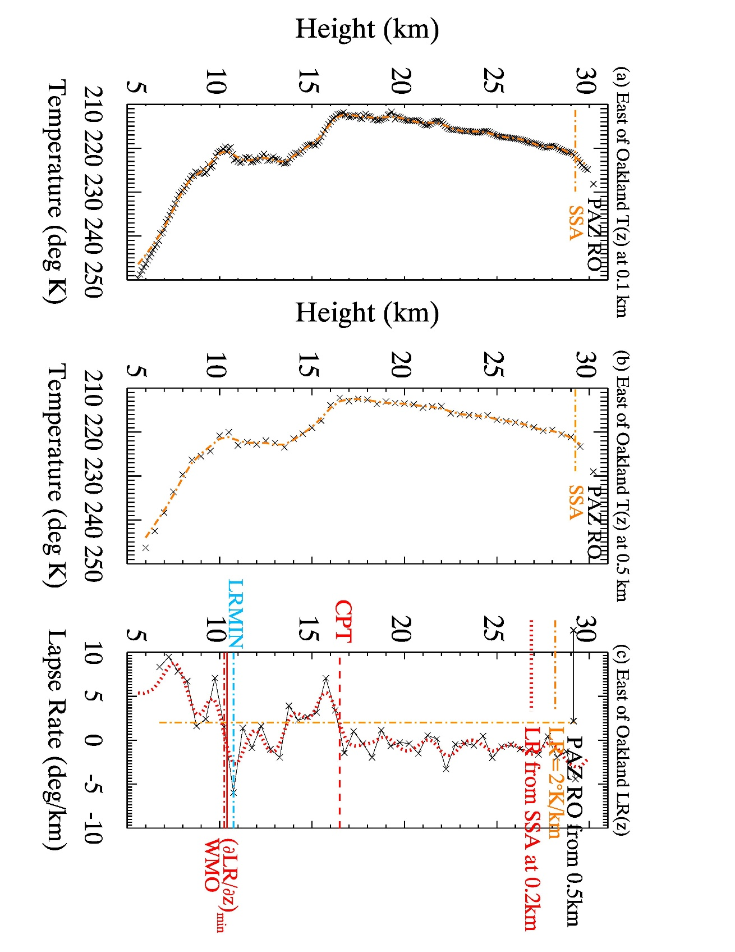
Case Study of Mid-Latitude Deep TTL-Like Case: Conventional RO profiles from PAZ of temperatures from 30 January 2023 at 17:29 Local Time (LT) at 37.3°N, 120°W, east of Oakland, CA by about 2.2° with a vertical resolution of 0.1 km. This profile followed the passage of a cold upper-level trough of low pressure, imprinting a deep TTL!
*Note on Singlular Spectrum Analysis (SSA): While typically used for time series, we employ it here for vertical profiles of temperature. SSA is related to the eigenvalue spectrum in SVD; we use it here as a noise reduction technique.
Deep TTL!

Slide 16
Case study over San Diego (30 Jan 2023) just prior to and during the passage of an upper-level trough with precipitation and a reduction in (first) tropopause height
Strong and relatively shallow LRMAX associated with the top of a moderate to strong precipitation layer by the afternoon

Slide 17
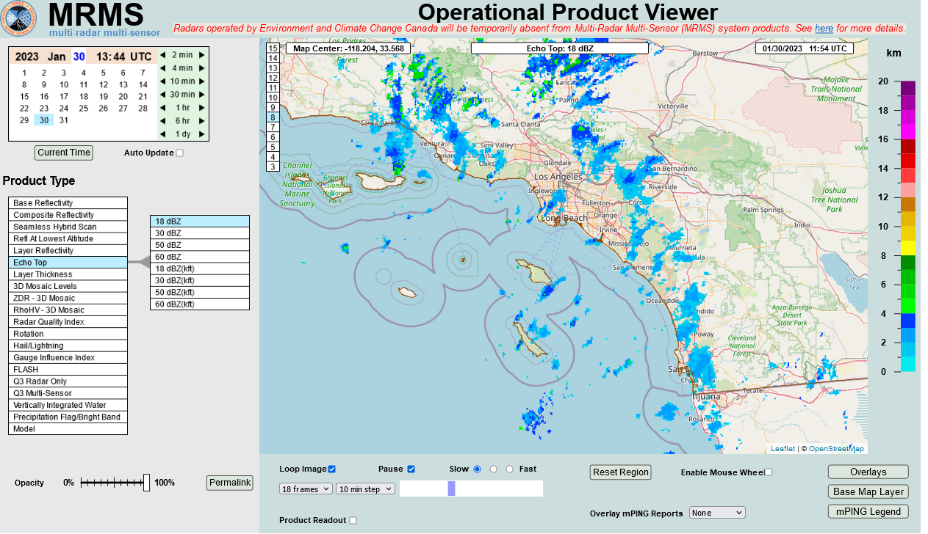
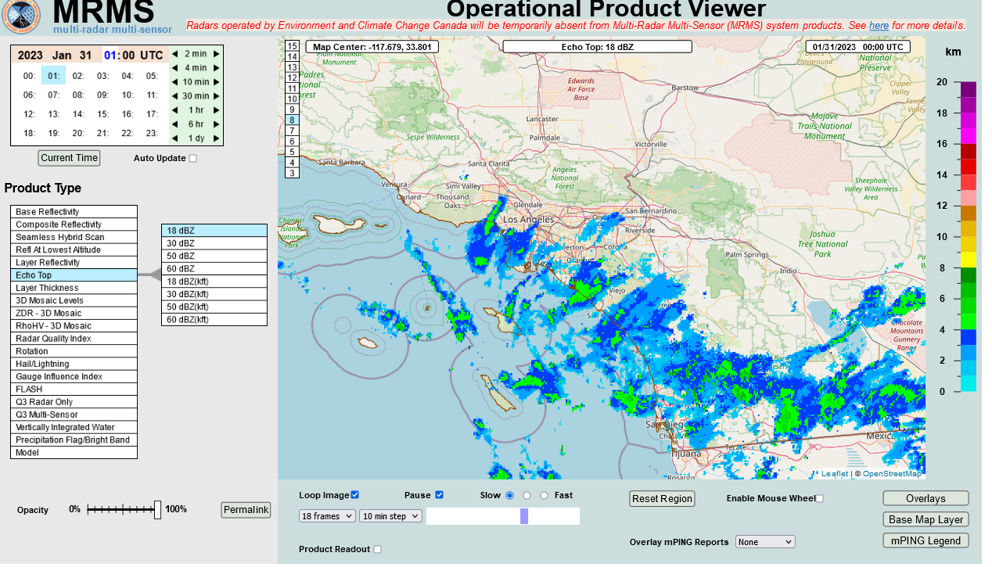
12Z 30 Jan 2023 (4 a.m. LT) Echo Top Heights over Southern CA, showing shallow (3-4 km) heights over San Diego
00Z 31 Jan 2023 (4 p.m. LT 30 Jan) Echo Top Heights over Southern CA, showing deeper heights than 12 hours earlier
Inversion around 4km corresponds with shallow echo tops around 12Z
No inversion and deeper echo tops by the afternoon of 30 Jan up to about 6 km, close to LRMAX

Slide 18
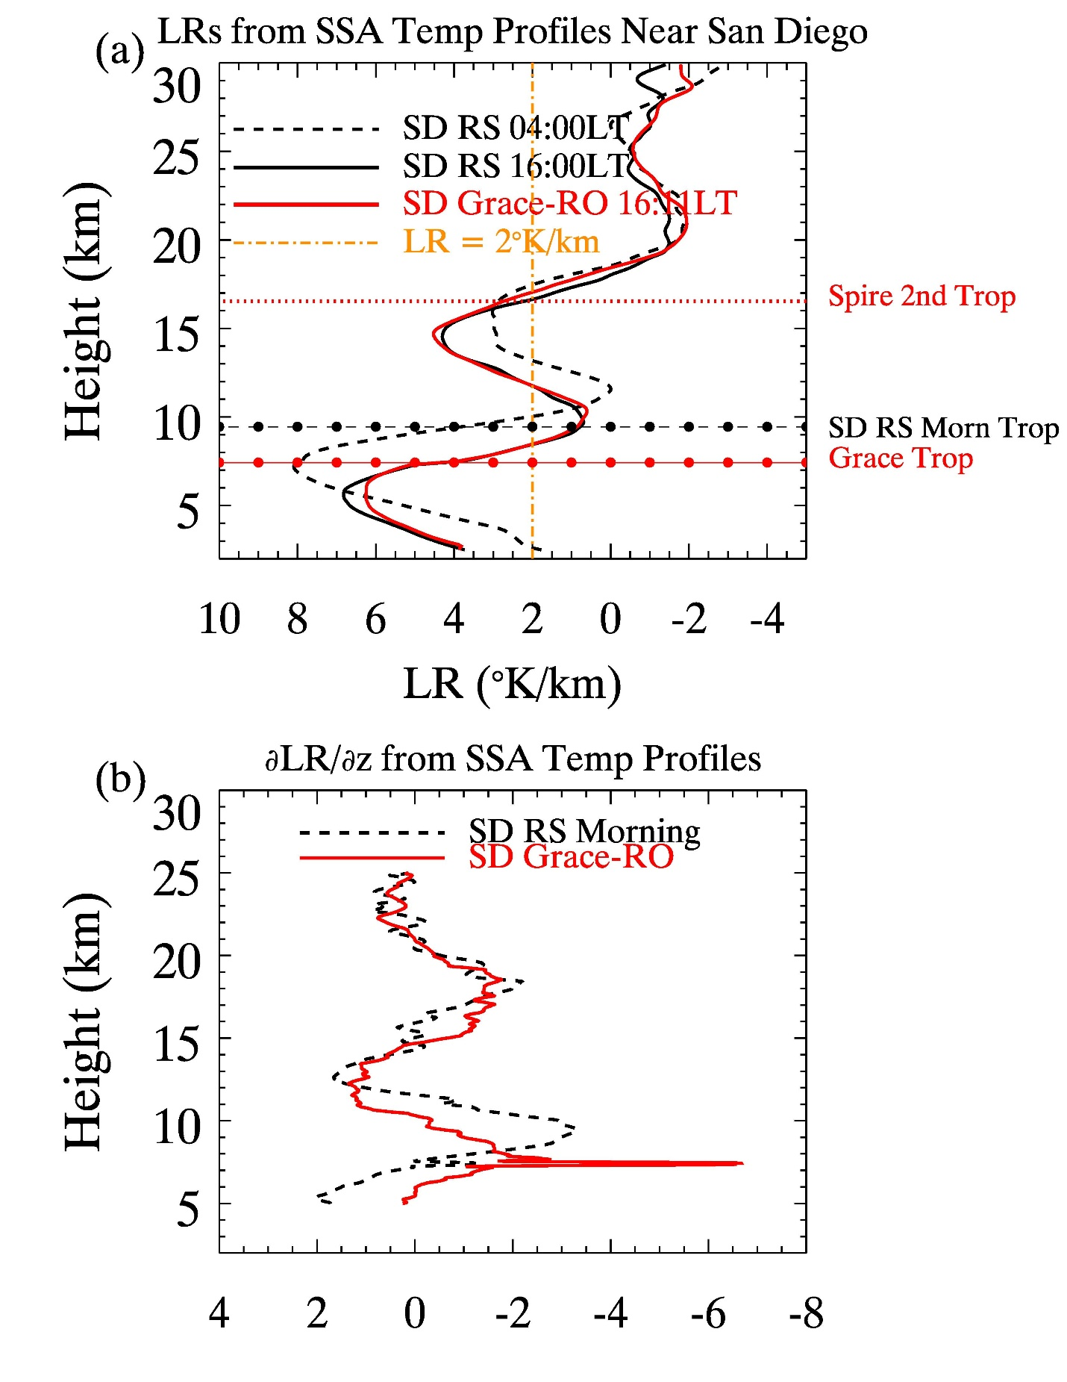
Second relative LRMAX (around 14.5 km in the afternoon) but reduced in magnitude compared to primary LRMAX below the first tropopause
∂LR/∂z Profiles, used to diagnose the modified CPT, shows the sharpness (and shallowness) of the tropopause in the afternoon (from GRACE) during the heaviest precipitation
Approach of trough in afternoon!

Slide 19
Spire RO profiles from 1-5 December 2022 of defining either the tropopause or the bottom of the TTL. Small black dots represent the coldest level of the atmosphere, and small red dots the height of (∂LR/∂z)_{min}, more related to the WMO LR tropopause. Also, 75th/90th percentiles in 6°lat bins from PAZ of CTOP from 2018-2020 December. Right: Same except June 2023 Spire and 2018-2021 June for PAZ.

Slide 20
Profiles in different tropical and mid-latitude regions demonstrating the relationships among cloud top height, [Δϕ]_{max}, and LRMAX as estimated from ROHP profiles. [Δϕ]_{max} is a proxy for precipitation strength
WP: Tropical West Pacific (5°N-15°N; 120°E-160°E), EP: Tropical East Pacific (5°N-15°N; 150°W-100°W); as per Kubar et al. (2007) and Back and Bretherton (2006), the WP has a more “top-heavy” vertical velocity and cloud profile, compared to the EP, which is associated with stronger SST gradients and a more prominent shallow and mid-level mode of convection

Slide 21
As the proxy for precipitation increases (Δφ)_{max}, cloud tops become deeper, regardless of region. There is a particularly strong distribution of CTOP at 13.5 km for WP for the heaviest precipitation
As the proxy for precipitation increases (Δφ)_{max}, LRMAX also increases, though less strongly. The mode at 9.5 km for the tropics and 7.5 km for the subtropics/extratropics diminishes as precipitation increases.

Slide 22
Mean Relationship of CTOP vs LRMAX for mean lat/lon bins for the low-latitudes for profiles in which (Δφ)_{max} > 10 mm. CTOP is about 2 km below LRMAX but there is a strong one-to-one relationship
Here, we examine whether or not reducing the threshold above which to deem a cloud top from 1 mm to lower values reduces the mean difference from LRMAX. Spoiler: It does, but at the expense of reduced sensitivity to LRMAX!

Slide 23
Exercise Repeated for PAZ CTOP versus IMERG/GPM Brightness Temperature CTH – note the continued offset of about 2 km

Slide 24
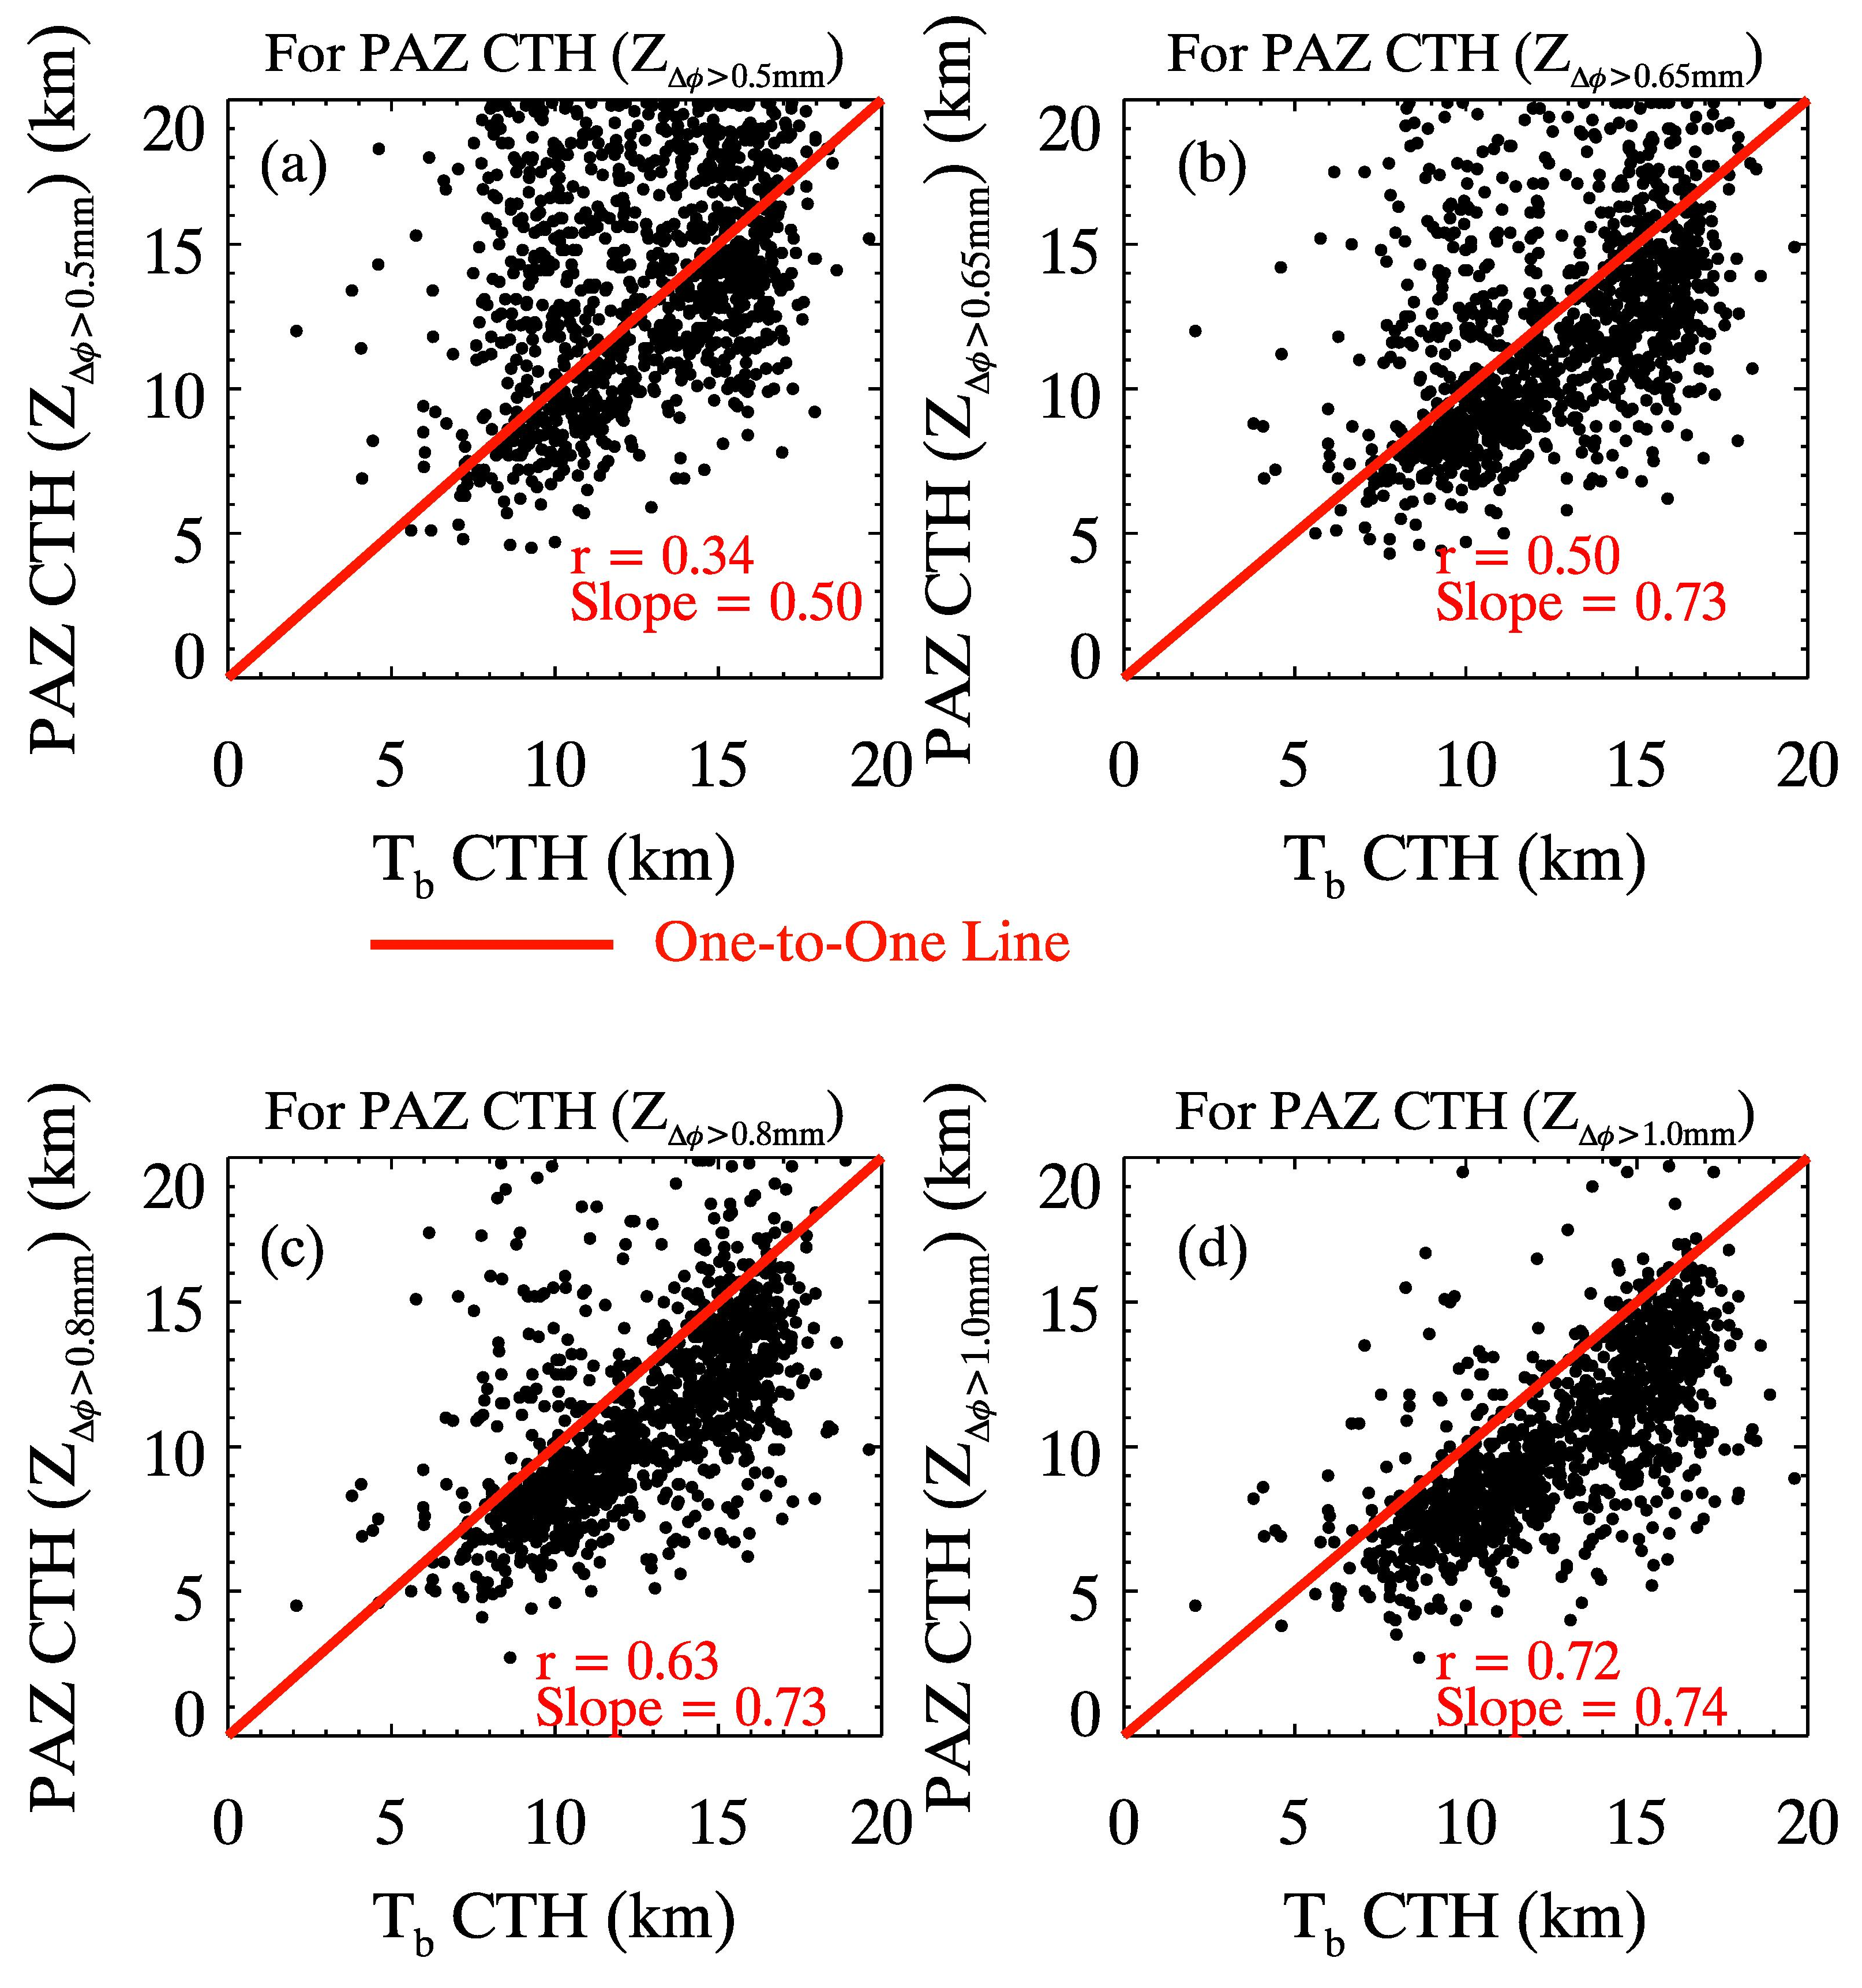
Finally, we perform a sensitivity analysis of different Δφ thresholds for PAZ CTOP versus Brightness Temperature CTH; the r-value and slope is best for Δφ of 1 mm, though with a mean shallowness of PAZ compared to IMERG/GPM. This may suggest that other factors are influencing estimates of CTOP.
*Note that these are for (Δφ)_{max} > 10 mm and rain rates from IMERG/GPM > 0.5 mmhr⁻¹

Slide 25
Summary
•Double tropopause cases or very thick TTL-like cases may maximize in the subtropics/mid-latitudes, though with a secondary lapse rate maximum above the first tropopause weaker than the magnitude of the lapse rate below the first tropopause where clouds predominantly are
•Z of (∂LR/∂z)_{min} may coincide with the WMO-LR tropopause, though may pick up the true tropopause higher up more often than not when a lower-level cloud imprints a strong signature on the LR in the middle troposphere, causing a shallow bias at times of the WMO tropopause
•PRO data are used to test the hypothesis of the maximum lapse rate in association with the tops of clouds in coincident locations. Statistically, this relationship is strongest over the low-latitudes, where double tropopauses occur less frequently than the mid-latitudes. However, using Δφ of 1mm for CTOP yields clouds statistically about 2km shallower than LRMAX over the precipitating tropics.
•To verify the ability of Δφ to capture the statistical properties of the convective regions, we found differences between the EP (East Pacific), the WP (West Pacific), and the average tropics. Some proportion of deep convective clouds in the WP reach higher heights than the EP.
•The EP has a larger percentage of heights of LRMAX below 10.5 km (59%) than the WP (45%), which might be consistent as well with the EP having a net shallower cloud profile, which would be consistent with previous studies (Back and Bretherton 2006; Kubar et al. 2007; Kubar and Hartmann 2008, etc.).

Slide 26
Thank You!
I would also like to acknowledge Dr. Kuo-Nung Wang for generous production of the PAZ polarimetric RO profiles from 2018-2021!
Please email any questions to tkubar@ucla.edu or terry.kubar@jpl.nasa.gov

