Slide 1
Impacts of data assimilation of GPSRO and unconventional data on the prediction of a Kona Storm over the Hawaiian Islands
Tien Manh Nguyen¹, Yi-Leng Chen¹ and Ying-Hwa Bill Kuo²
¹ Department of Atmospheric Sciences, University of Hawaii, Honolulu, HI
² NCAR, Boulder, Co

Slide 2
Empowering Ocean Stakeholders: Advancing the Pacific Islands Ocean Observing System (PacIOOS) – Atmospheric modeling component Project Lead: Yi-Leng Chen, Department of Atmospheric Sciences, University of Hawaii at Manoa http://www.soest.hawaii.edu/MET/Faculty/chen/chen_index.html
Significance: Provide Experimental Real-Time High-resolution Forecasts over the Pacific Islands Ocean Observing System (PacIOOS) (https://www.pacioos.hawaii.edu/) region spans across the U.S. Pacific Islands, including the State of Hawaiʻi; the territories of Guam, the Commonwealth of the Northern Mariana Islands (CNMI), and American Samoa, the Federated States of Micronesia (FSM), the Republic of the Marshall Islands (RMI), and the Republic of Palau. In collaboration with a large network of partners, PacIOOS helps inform decision-making in Pacific communities on a daily basis. The National Weather Service of the Pacific Region is one of our main partners. The ocean surface winds from our atmospheric models are used to drive a series of coastal environmental, waves and ocean models.
Sponsors: IOOS/NOAA, Office of Insular Affairs/DOI, UCAR/COMET and the United Nations Green Climate Fund
Experimental High Resolution Numerical Weather Prediction over the PacIOOS Region
WRF-ARW Hawaiian Islands
WRF-ARW American Samoa
WRF-ARW Northern Marianas/Guam
WRF-ARW Palau/Yap/Chuuk
WRF-ARW Pohnpei/Kosrea/Marshall Islands
WRF-NMM Hawaiian Islands
*We would like to acknowledge the support and assistance of UCAR to host the visits of the UHM graduate students Tien Manh Nguyen and Cameron Chuss.

Slide 3
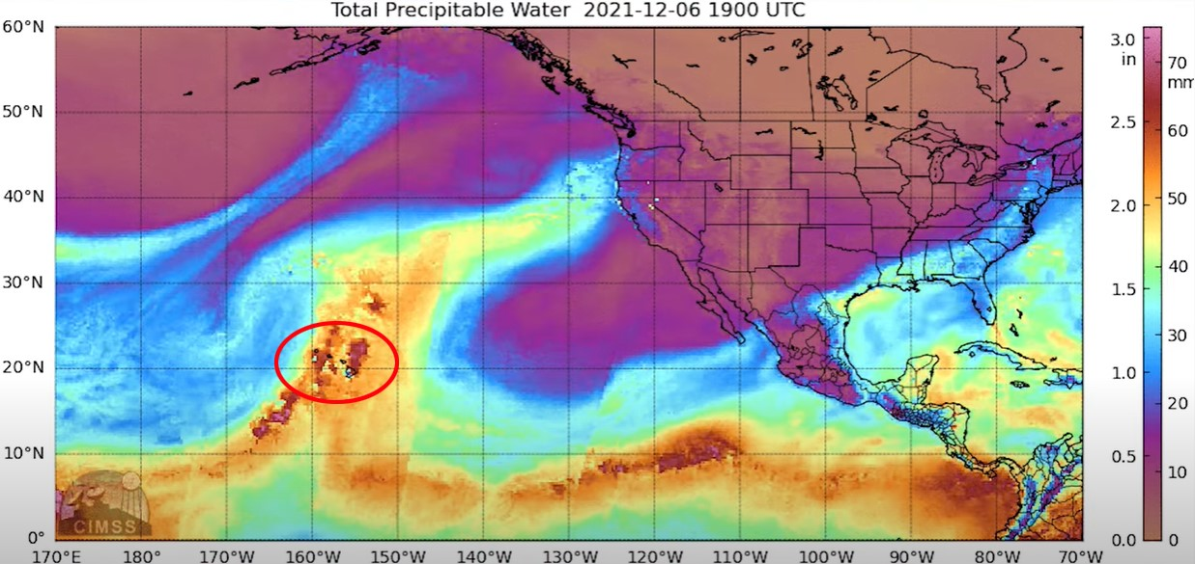
INTRODUCTION
_____________________________________________________________________
Kona Low (2021)
____________________________________________________________________
A strong Kona low developed northwest of the main Hawaiian Islands
Produced heavy rainfall and strong winds over many areas of the state
The image above displays the total precipitable water (TPW) on December 6, 2021 at 9:00 AM HST (1900UTC) (Image from NESDIS)

Slide 4
INTRODUCTION
_____________________________________________________________________
Kona Low (2021)
____________________________________________________________________
The main rain band hit the Big Island first on Sunday, December 5, then shifted slowly westward across the island chain over the next two days.
Rainfall totals were greatest over the southeastern flank of the Big Island, the south- and west-facing slopes of Haleakala, and most of Oahu, with the peak day of rainfall occurring on December 6

Slide 5
We have set up high-resolution island-scale domains (~ 1 km) nested in the regional domains with scale control data assimilation using all unconventional data including COSMIC-2 data (Tu et al., 2017, MWR, 145, 253-277. DOI: https://doi.org/10.1175/MWR-D-16-0224.1).
In this study, in collaboration with UCAR, we would like to update the data assimilation scheme for all PacIOOS domains by applying updated non-local operator for COSMIC-2 data (Chen et al., 2020). Our real-time model output will be evaluated by NWS forecasters in operational settings.

Slide 6
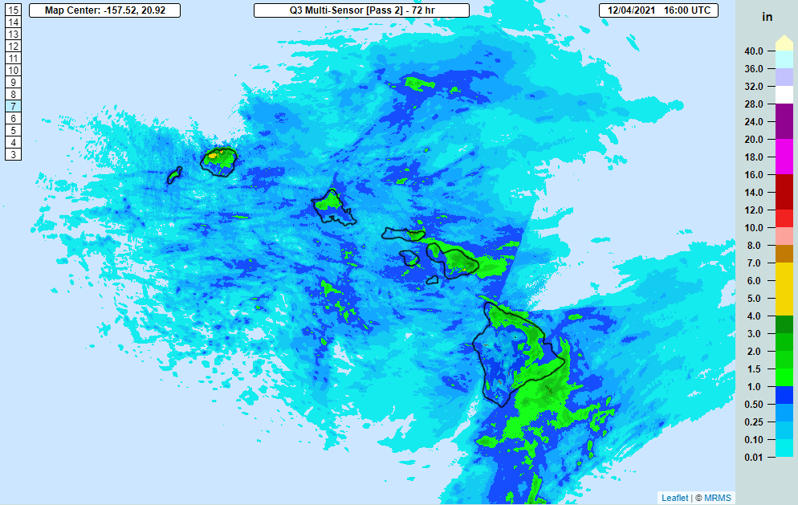
INTRODUCTION
_____________________________________________________________________
Kona Low (2021)
____________________________________________________________________
(Loop from Kevin Kodama-hydrologist at Honolulu Forecast Office)
The figure above shows the running 72-hr QPE accumulation loop from December 4 through December 7
This produced most of the event rainfall with many 5-10 inch totals and peak amounts of 10-13 inches.

Slide 7
EXPERIMENT DESIGN
_____________________________________________________________________
DATA USAGE
- GFS 0.25X0.25 degree from NCEP
- ERA-5 0.25x0.25 degree
- Global Satellite Mapping of Precipitation: GSMAP (0.1 degree)
- Experimental global product of total precipitation water (TPW): MIMIC II
- BUFFR data from NCEP used for DA: Global Telecommunications System (GTS) data, GPSRO-COSMIC2 data

Slide 8
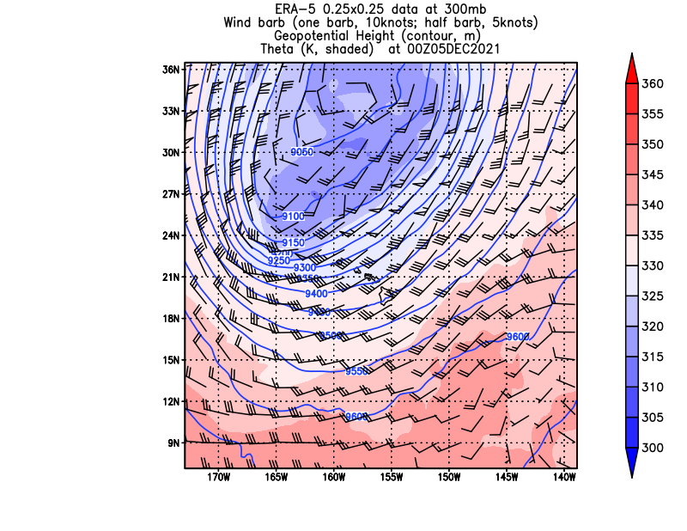
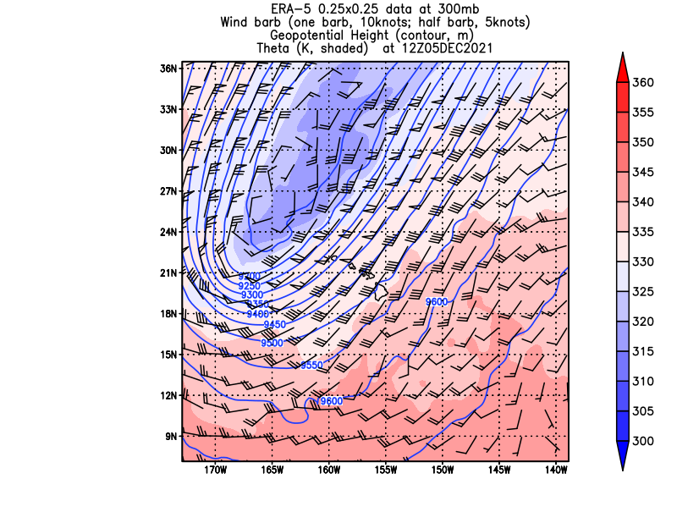
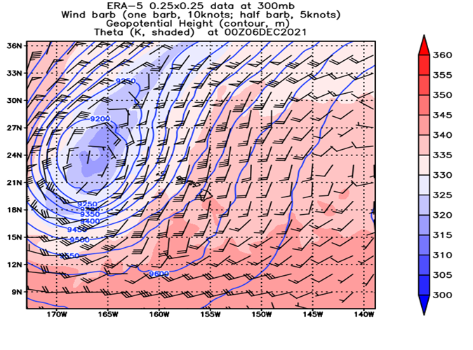
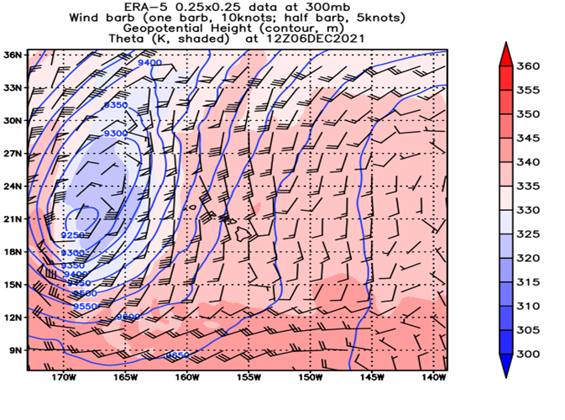
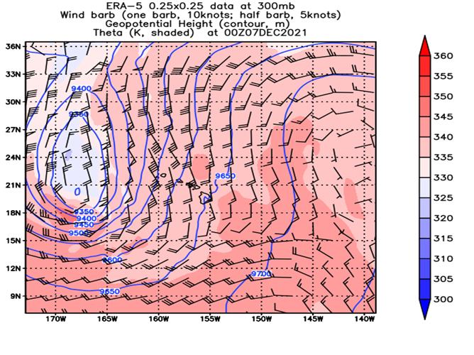
300mb Theta, GH, WIND from 00Z Decdember 5 to 00 Z December 7 2021
_____________________________________________________________________
12/5 00 Z
12/5 12 Z
12/6 00z
ERA5
GSMAP
00Z December 6
300mb Theta, GH, WIND from 00Z Decdember 5 to 00 Z December 7
UCAR
TU2017
12/6 12 Z
12/7 00Z

Slide 9
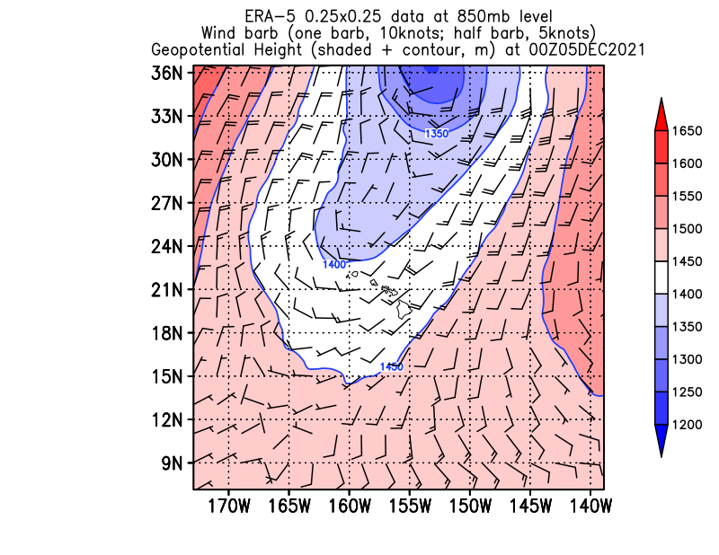
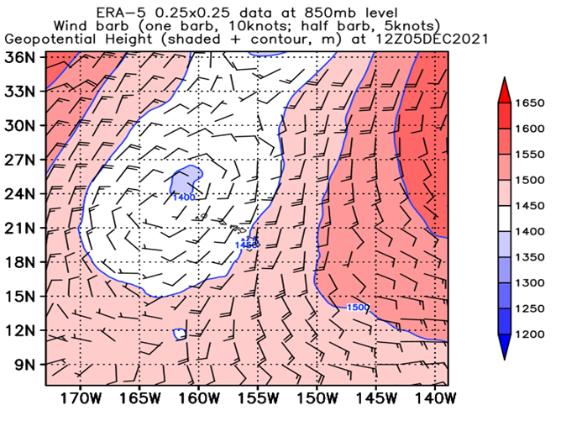
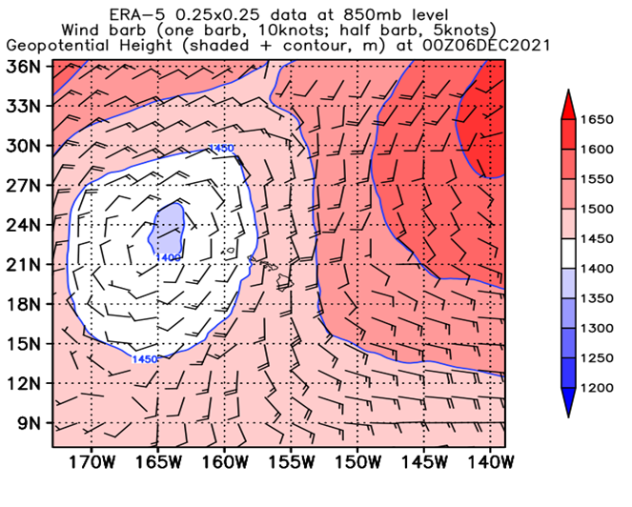
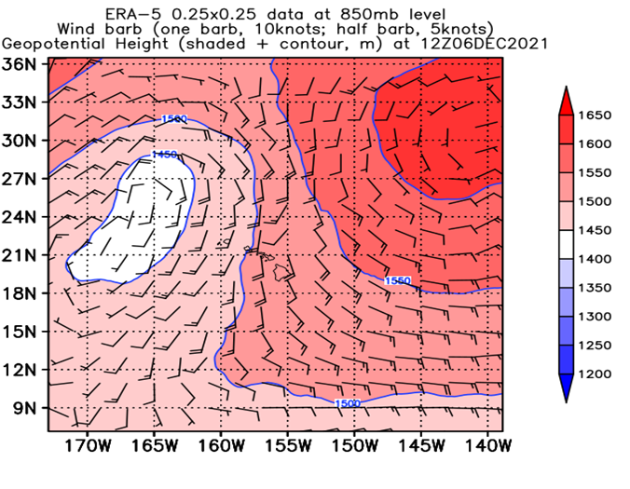
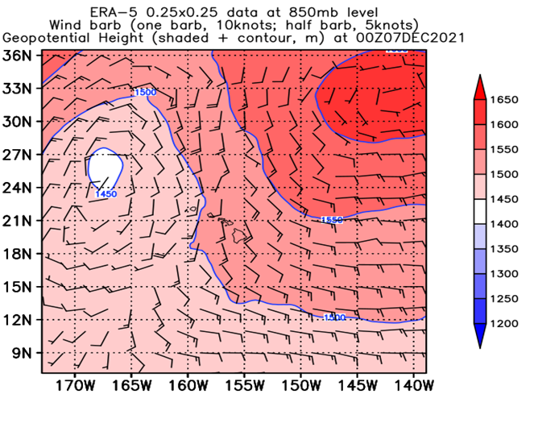
850mb Geopotential Height chart from 00Z December 5 to 00 Z December 7 2021
_____________________________________________________________________
TU2017
ERA5
UCAR
12/5 00 Z
12/5 12 Z
GSMAP
12/6 00z
850mb Geopotential Height chart from 00Z Dec 5 to 00 Z December 7 2021 every 12 hours
REALTIME
12/6 12 Z
12/7 00Z

Slide 10
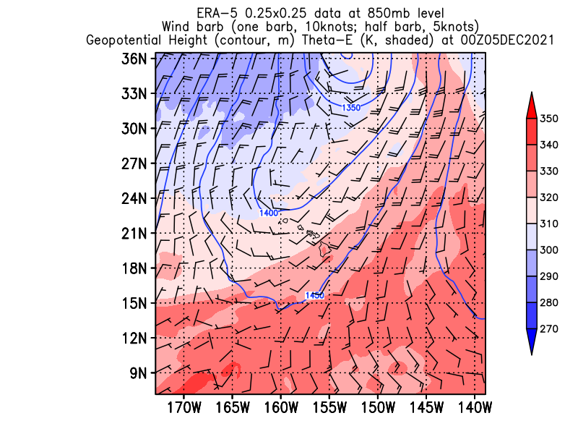
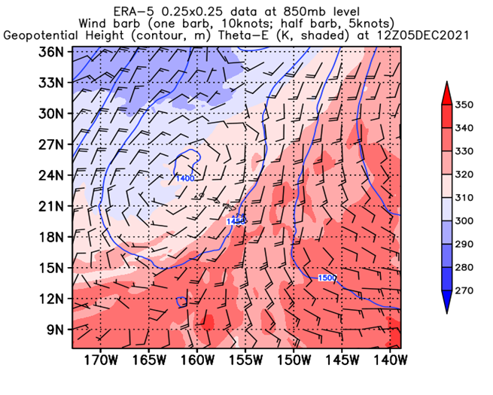
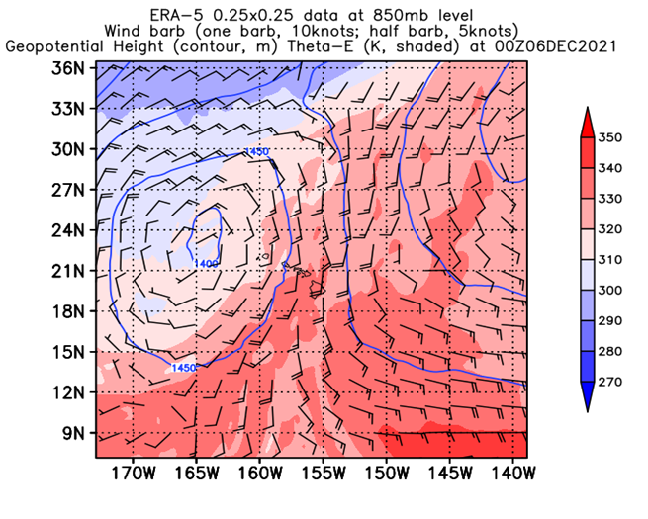
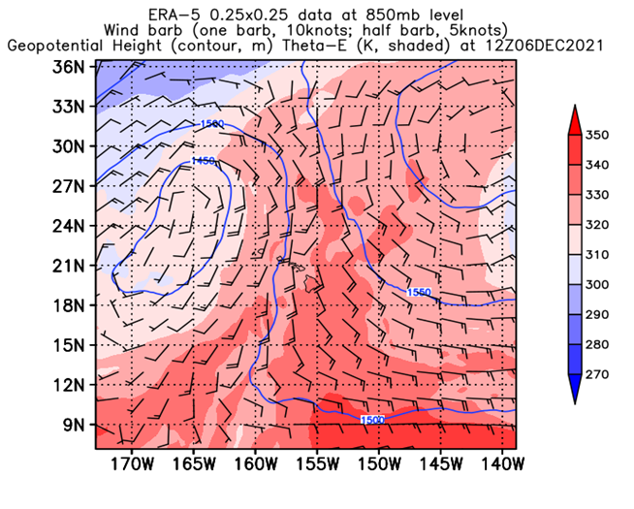
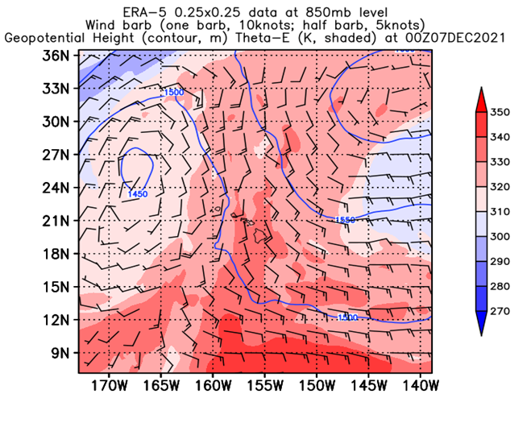
850mb Theta-E, Geopotential Height, Winds from 00Z December 5 to 00Z December 7
_____________________________________________________________________
12/5 00 Z
12/5 12 Z
GSMAP
12/6 00z
06 Z 12/05/2021)
850mb Theta-E, Geopotential Height, Winds from 00Z December 5 to 00Z December 7
TU2017
12/6 12 Z
00Z December 7
12/7 00Z

Slide 11
EXPERIMENT DESIGN
_____________________________________________________________________
- NODA: cold start at 00Z 12/06/2021 with real-time GFS data, without DA
- ALL_DA, 36h-cycle run starting 12Z 12/04/2021, t =0 at 00Z 12/06/2021, using real-time GFS data, nonlocal operator (EPH), Hawaiian Domain
UCAR, 72h-cycle run starting 00Z 12/03/2021, t = 0 at 00Z 12/06/2021, using real-time GFS data, nonlocal operator (EPH), UCAR domain
- NOHR: Same as ALL_DA but without latent heat release. - No latent heat release, 36h-cycle run starting 12Z 12/04/2021, t = 0 00Z 12/06/2021, using nonlocal operator (EPH), Hawaiian domain
NOTE: For all model runs, the lateral boundary conditions are updated at t = 0

Slide 12
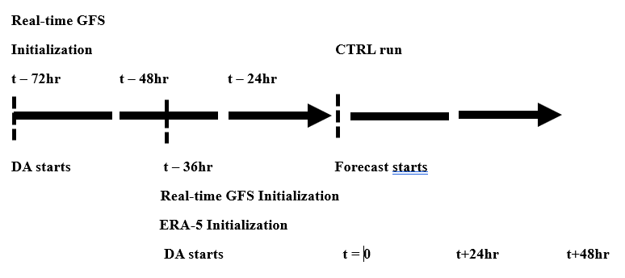
EXPERIMENT DESIGN
_____________________________________________________________________
DA PROCEDURE

Slide 13
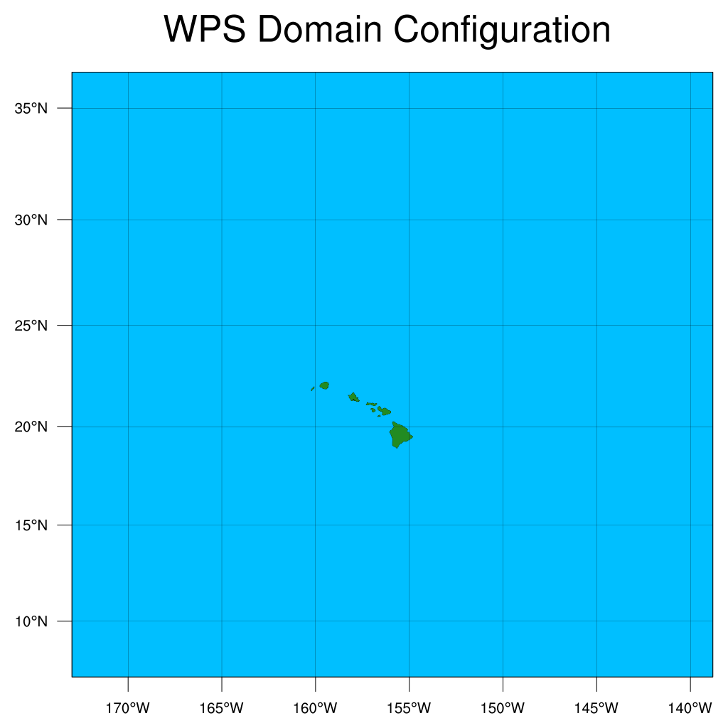
EXPERIMENT DESIGN
_____________________________________________________________________
PHYSIC OPTION
mp_physics = 6, 6, 6, ra_lw_physics = 4, 4, 4, ra_sw_physics = 4, 4, 4, radt = 30, 30, 20, sf_sfclay_physics = 1, 1, 1, sf_surface_physics = 2, 2, 2, bl_pbl_physics = 1, 1, 1, bldt = 0, 0, 0, cu_physics = 2, 2, 0, cudt = 30, 10, 4, topo_wind = 2, 2, 2,
Hawaiian domain (18 km grid)

Slide 14
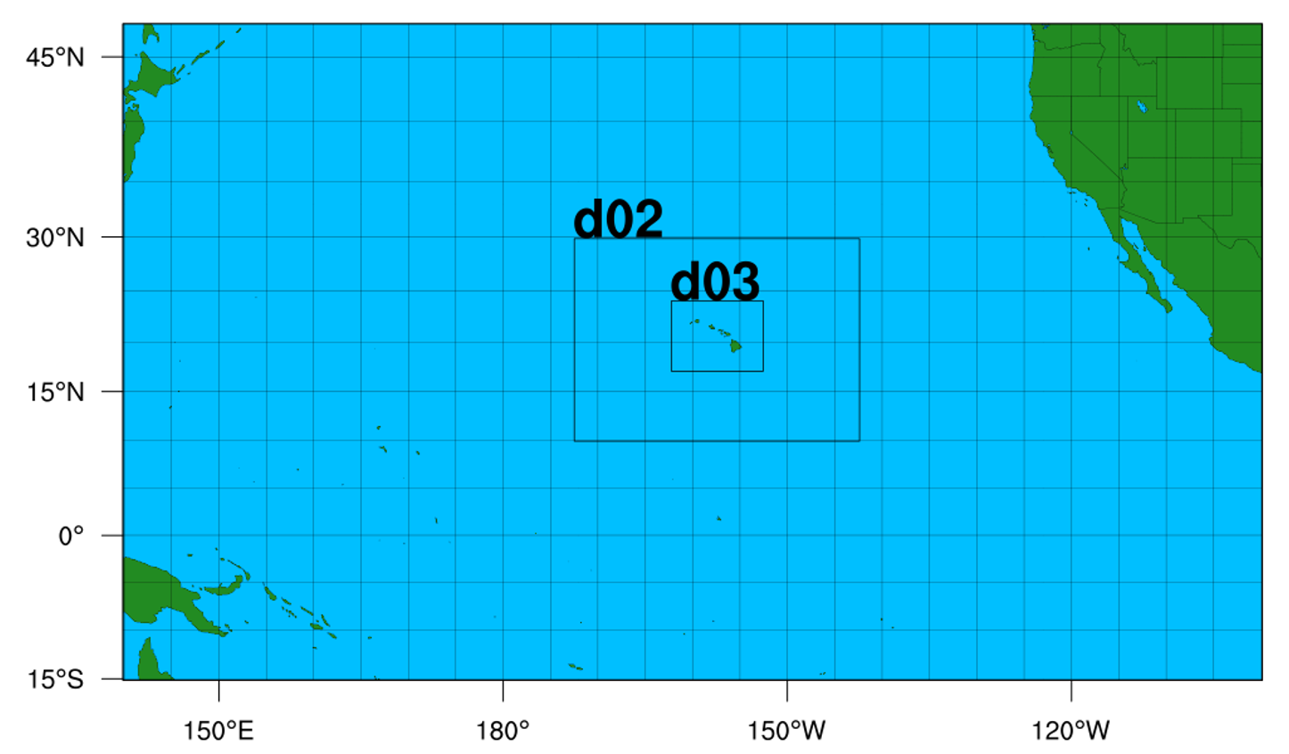
EXPERIMENT DESIGN
_____________________________________________________________________
PHYSIC OPTION
mp_physics = 6, 6, 6, ra_lw_physics = 4, 4, 4, ra_sw_physics = 4, 4, 4, radt = 30, 30, 20, sf_sfclay_physics = 1, 1, 1, sf_surface_physics = 2, 2, 2, bl_pbl_physics = 1, 1, 1, bldt = 0, 0, 0, cu_physics = 2, 2, 0, cudt = 30, 10, 4, topo_wind = 2, 2, 2,
UCAR domain

Slide 15
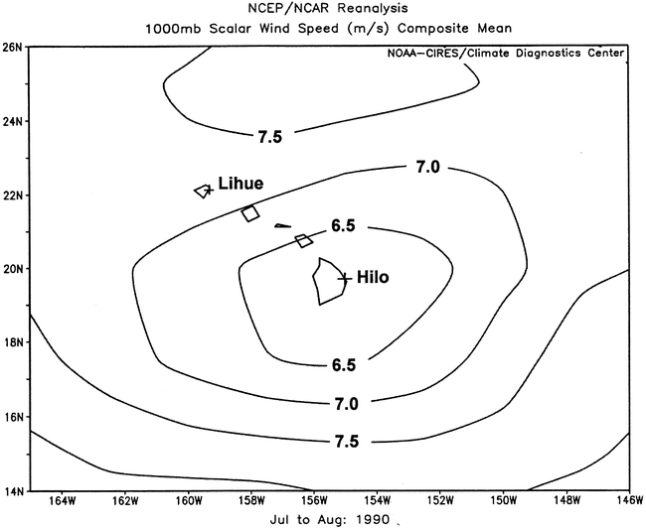
The mean wind speed (m s⁻¹) of Jul and Aug 1990 at the 1000-hPa level from NCEP–NCAR reanalysis data. Contour interval of 0.5 m s⁻¹. The symbol “+” denotes the rawinsonde sites. The wind speed minimum around the Big Island is not representative since the low-level winds from the Hilo soundings are strongly affected by terrain and local winds (after Yang et al., 2005).
Scale controlled data assimilation: Only ocean data points are assimilated. Observations over land may be affected by terrain and local winds and may not represent large-scale conditions. We assimilated COSMIC-2 data and unconventional data over the oceans to provide better initial large-scale conditions.

Slide 16
Over subtropical islands in low latitudes with complex terrain, with a small Coriolis parameter, thermally drive diurnal winds may be significant and could be well simulated by high resolution models (See the following three slides). With proper treatment of lower boundary conditions over land, the island-scale flow response (thermally driven diurnal winds and terrain effects) under given large-scale conditions will be generated by the high-resolution models (Zhang et al., 2005a,b, c; Yang et al., 2005; Carlis et al, 2010, Nguyen et al., 2010; Hitzl et al., 2014, 2020; Hsiao et al., 2020) .

Slide 17
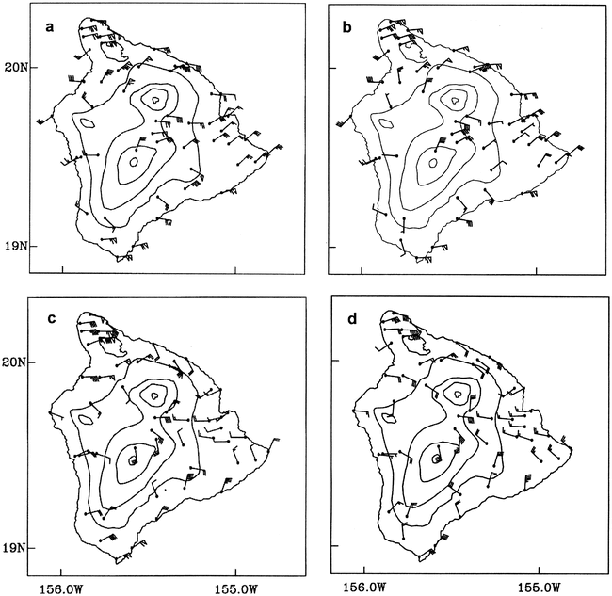
The average PAM winds during HaRP at 1400 HST for (a) observations and (b) the simulation, and at 0200 HST for (c) observations and (d) the simulation (after Yang et al., 2005)

Slide 18
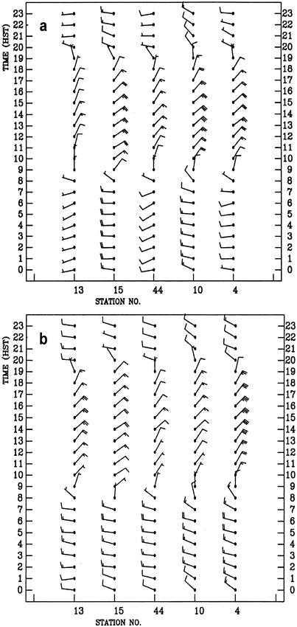
The average winds during HaRP throughout the diurnal cycle at stations 13, 15, 44, 10, and 4 on the windward lowlands west of Hilo for (a) observations and (b) the simulation (after Yang et al., 2005).

Slide 19
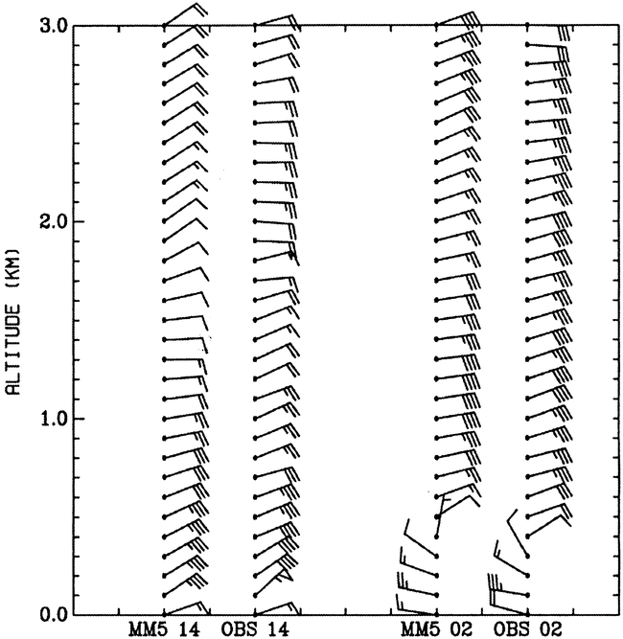
Mean wind profiles during HaRP at Hilo. MM5 14 and MM5 02 denote the simulated Hilo sounding at 1400 and 0200 HST, respectively. OBS 14 and OBS 02 denote mean wind profiles derived from Hilo rawinsonde data at 1400 and 0200 HST, respectively.(After Yang et al., 2008)

Slide 20
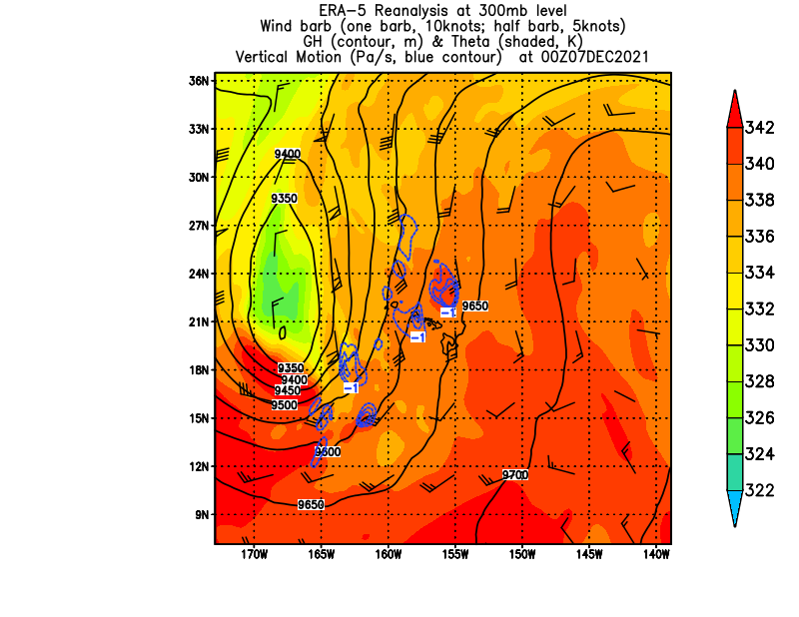
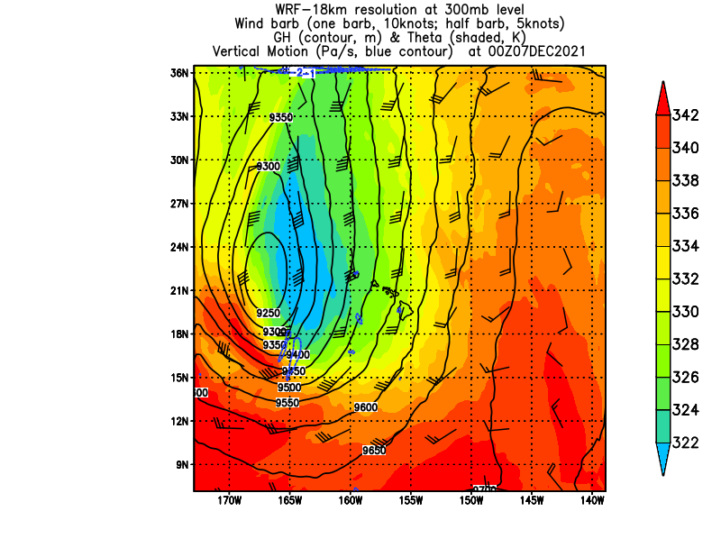
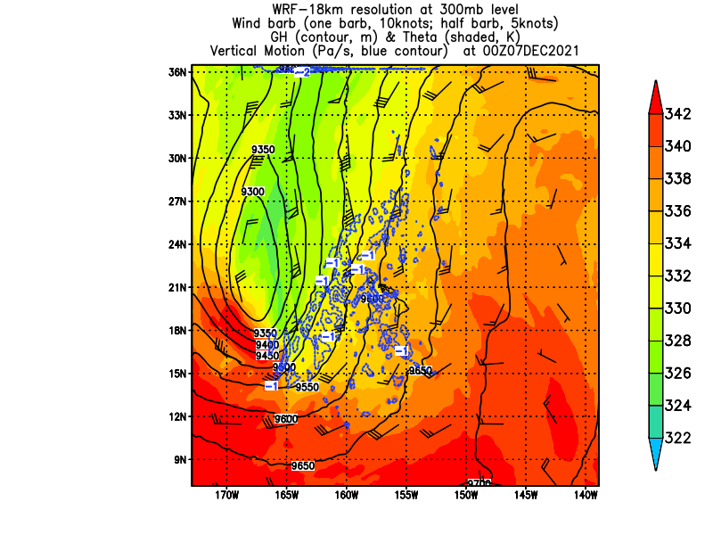
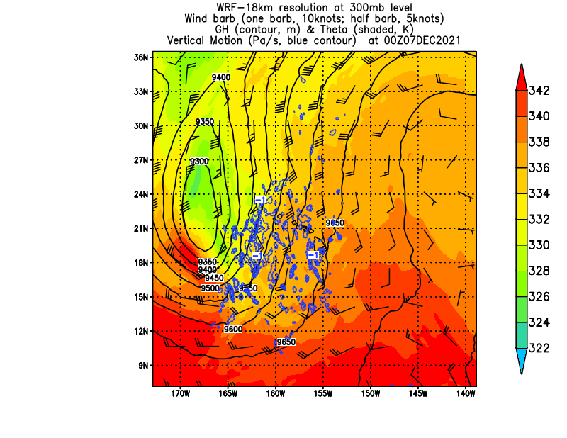
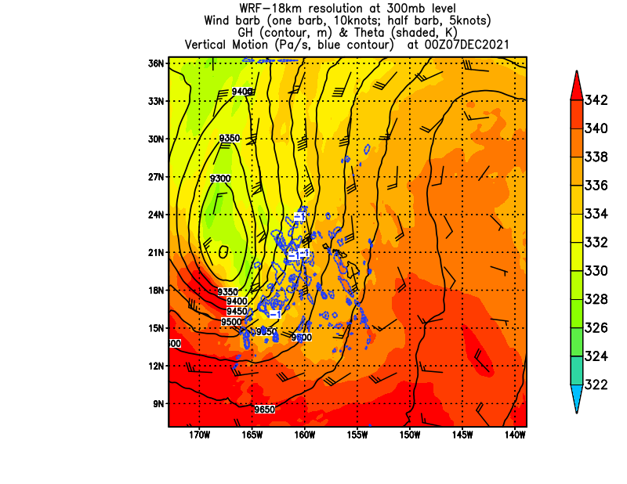
24hr forecast - 300mb Theta, GH, WIND valid at 00Z December 7 2021
ERA-5
NOHR
NODA
UCAR
ALL-DA
24hr forecast - 300mb Theta, GH, WIND valid at 00Z 12/07/2021

Slide 21
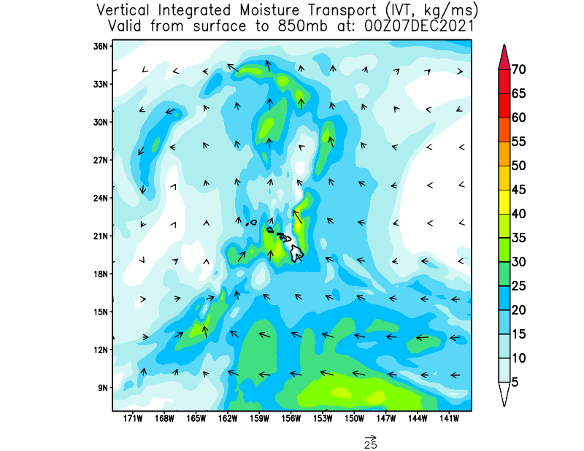
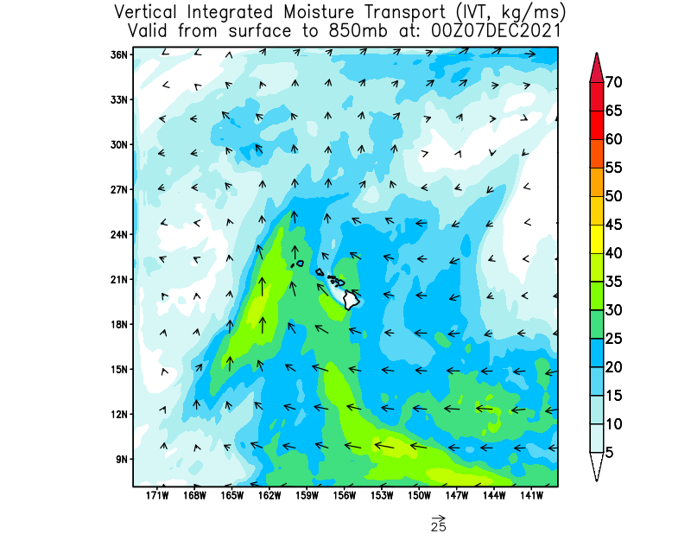
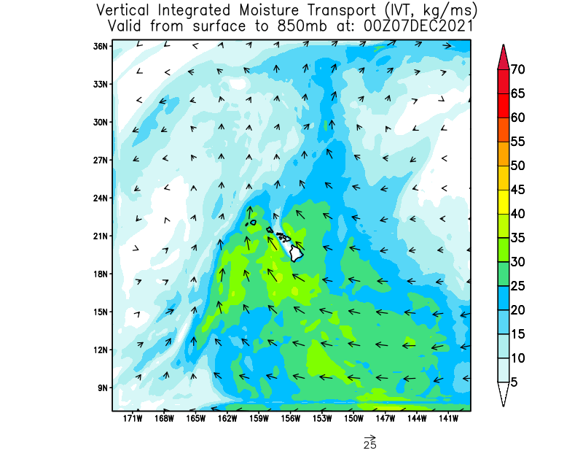
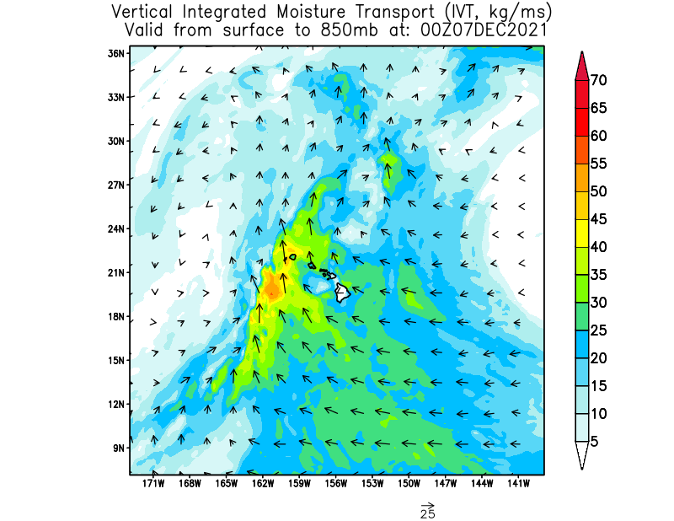
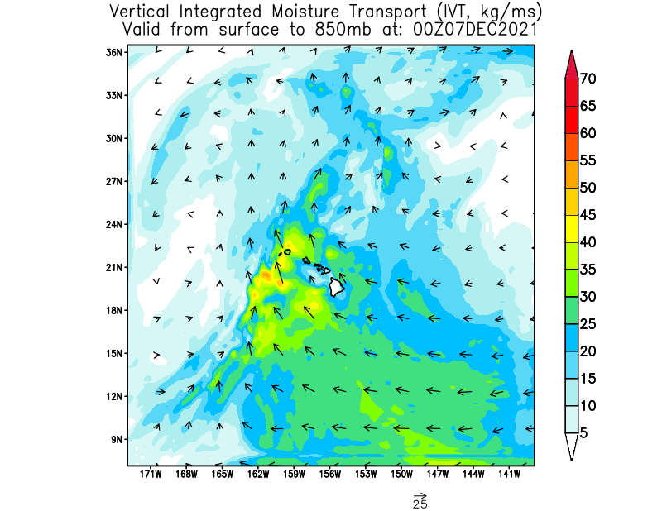
24hr forecast – IVT from surface to 850mb at 00Z 12/07/2021
_____________________________________________________________________
ERA-5
NOHR
NODA
24hr forecast – IVT from surface to 850mb at 00Z 12/07/2021
UCAR
ALL-DA

Slide 22
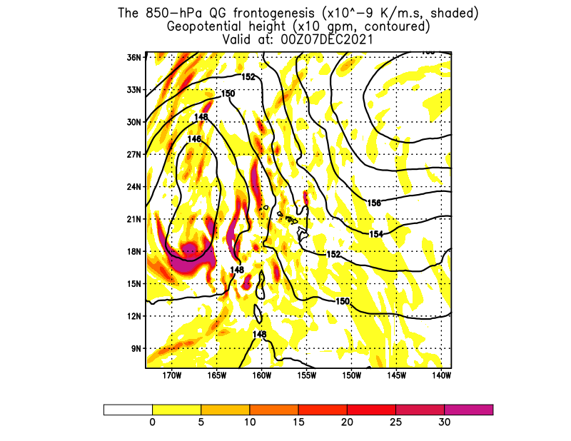
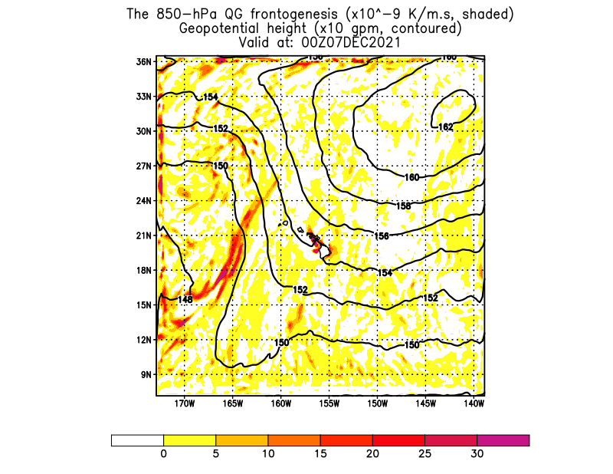
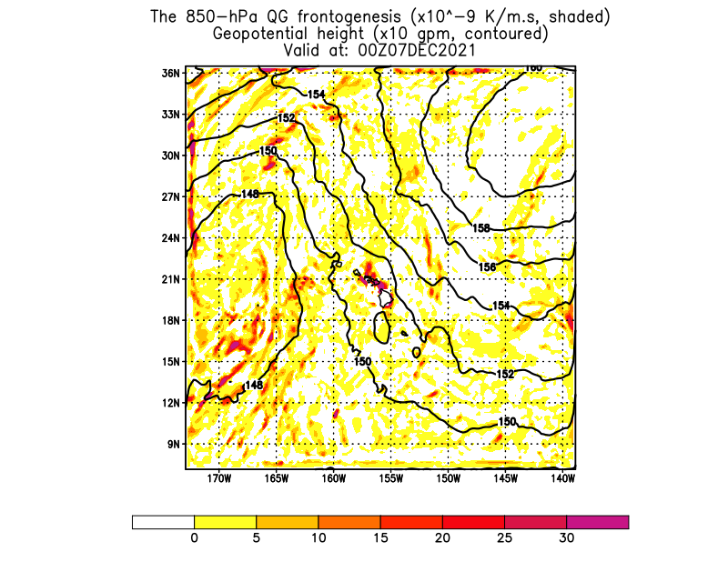
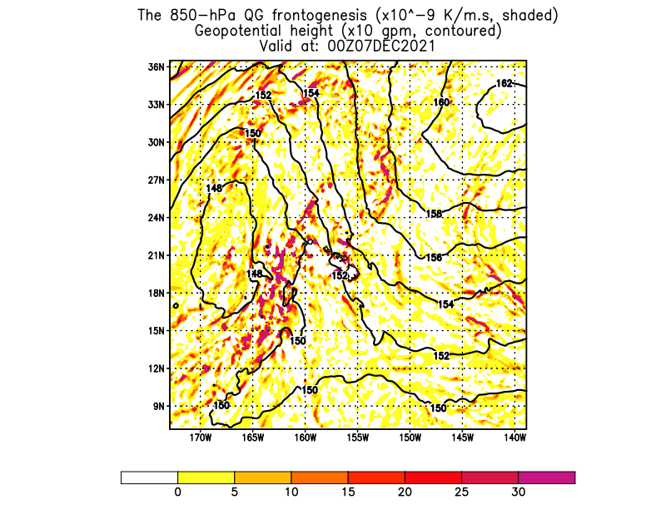
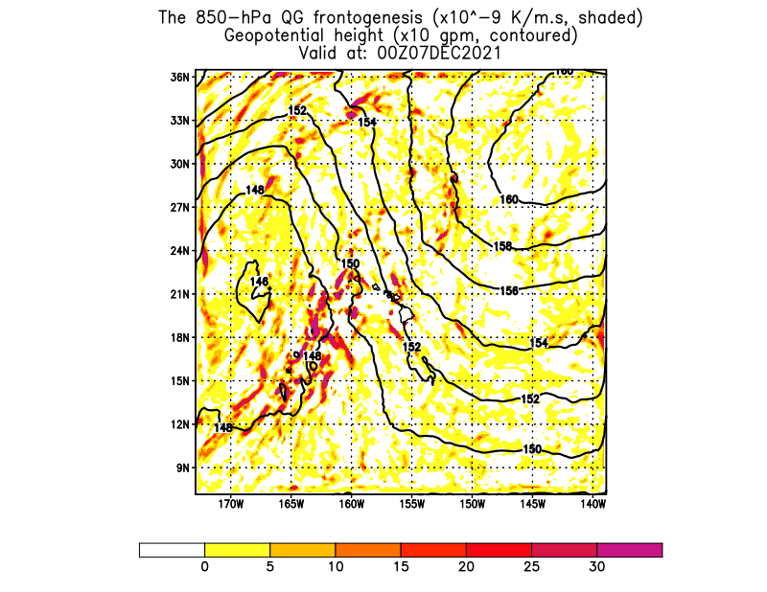
24hr forecast – 850mb Frontgenesis & Geopotential Height at 00Z 12/07/2021
_____________________________________________________________________
ERA-5
NOHR
NODA
UCAR
ALL-DA
24hr forecast – 850mb Frontgenesis & Geopotential Height at 00Z 12/07/2021

Slide 23
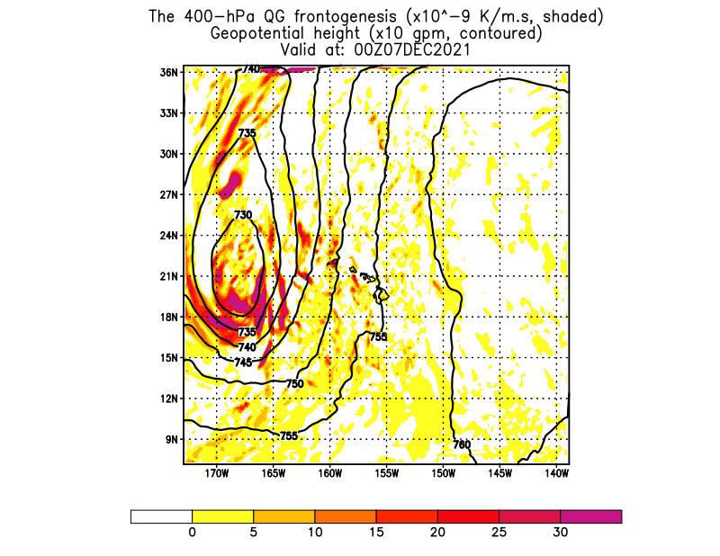
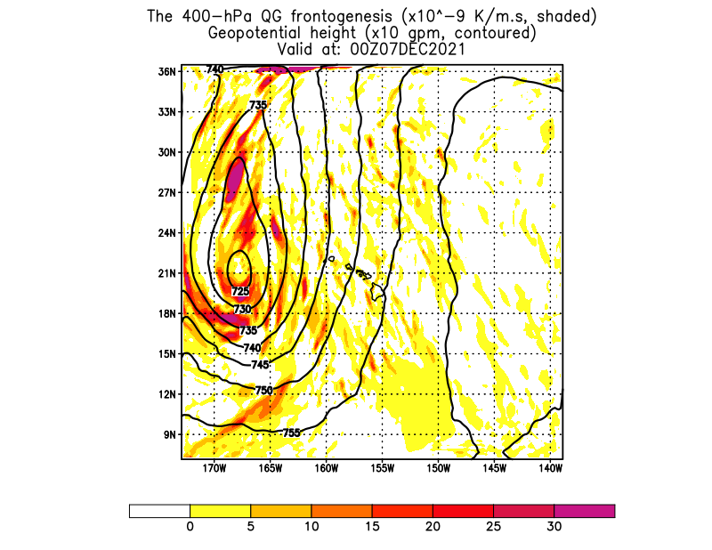
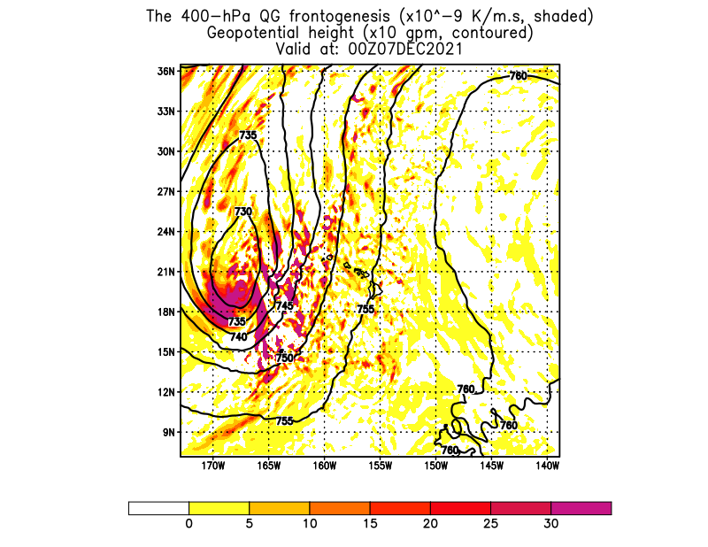
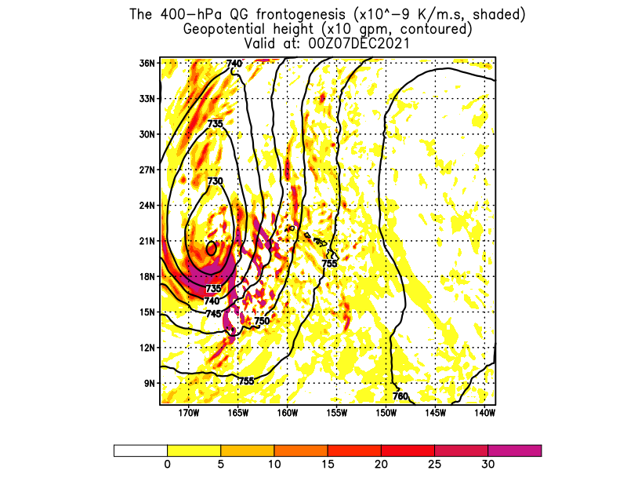
24hr forecast – 400-hPa Frontgenesis & Geopotential Height Valid at 00Z 12/07/2021
_____________________________________________________________________
ERA-5
NOHR
NODA
UCAR
ALL-DA
24hr forecast – Frontgenesis & Geopotential Height at 400-hPa Valid at 00Z 12/07/2021

Slide 24
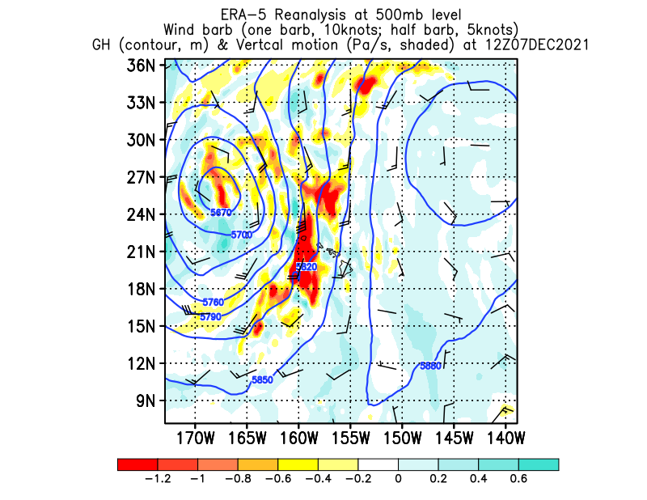
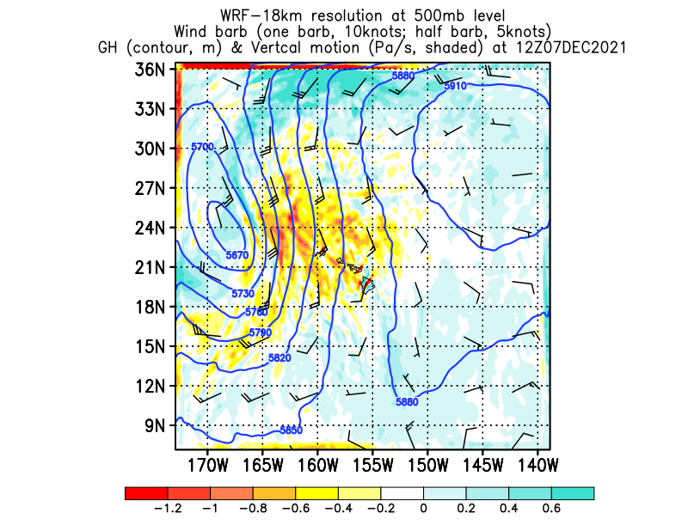
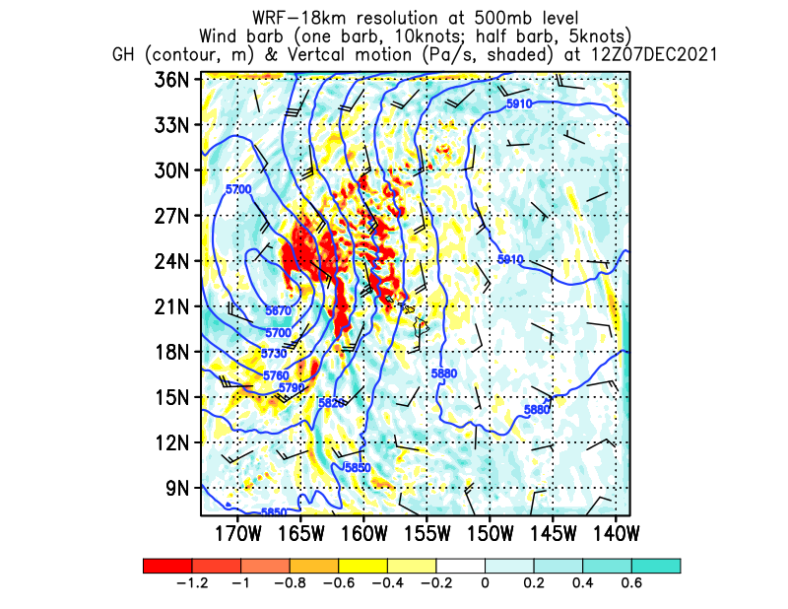
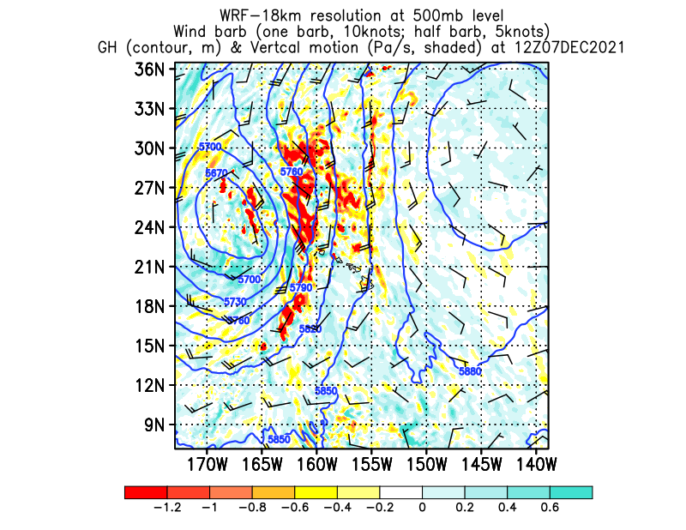
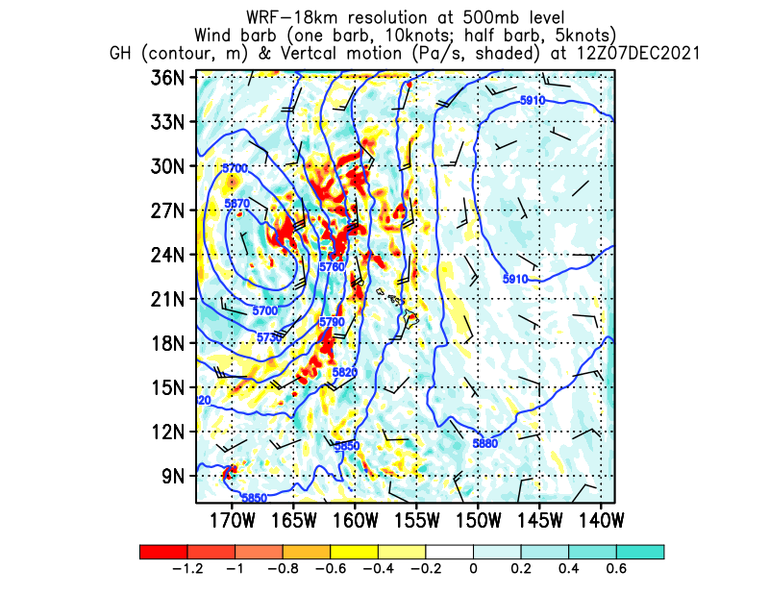
36hr forecast - 500mb Vertical motion, Geopotential Height at 12Z 12/07/2021
_____________________________________________________________________
ERA-5
NOHR
NODA
36hr forecast - 500mb Vertical motion, Geopotential Height at 12Z 12/07/2021
UCAR
ALL-DA

Slide 25
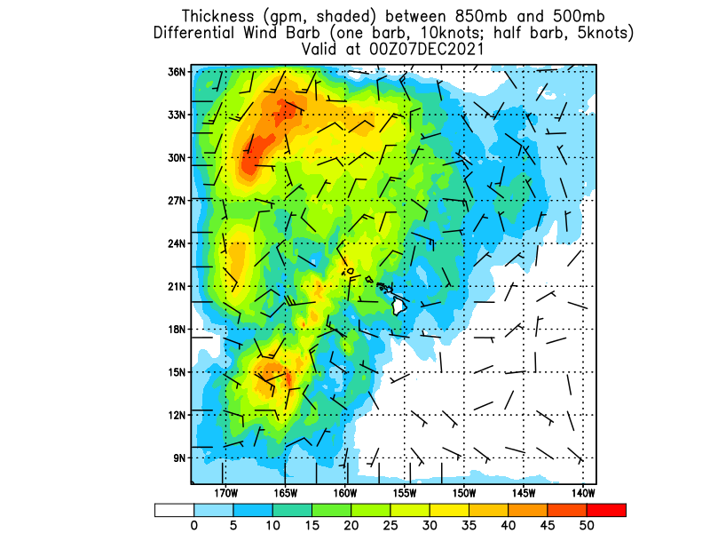
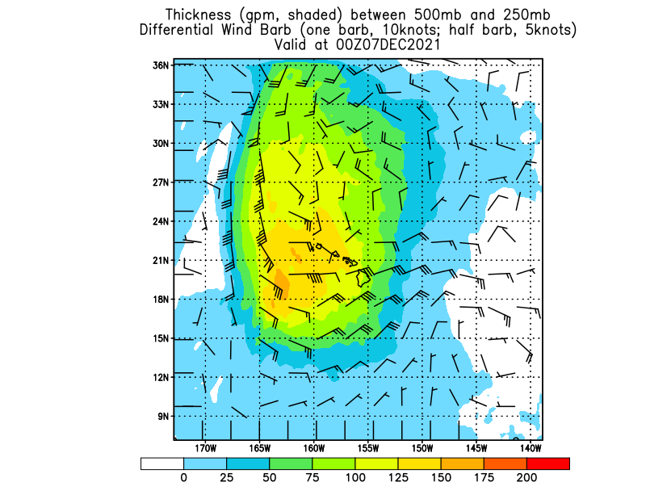
24hr forecast – Differential Wind Speed and GH GFS-DA – NOHR at 00Z 12/07/2021
_____________________________________________________________________
from 850mb to 500mb
from 500mb to 250mb

Slide 26
Conclusions and Future Work
_____________________________________________________________________
In comparison of the CTRL run with DAs including COSMIC-2 and/or unconventional data over the open ocean, forecasts of the structure of a Kona Low, baroclinic forcings and moisture transport from the tropics have improved.
The rising motion on synoptic scale is caused by the upper-level baroclinic forcing associated with a cold upper-level low and rising motion along the shear line due to low-level frontogenesis forcing. The Kona low tilted westward with a low center in the lower troposphere. It moved slowly westward and the low center in the lower troposphere is enhanced by latent heat release.
Latent heat release increases the upper-level thickness on the southeastern quadrate of the upper-level low. It also reduces the cold anomalies of the upper-level cold low.
Heavy rainfall occurs not only during the passage of the low-level shear-line associated with the low but also a large area east of the shear line with significant low-level moisture transport from the south.

Slide 27
Future Work：
Local and orographic effects are important as the south/southeastern flow impinges on the island terrain. We will study local and oropgpahic effects on localized heavy rainfall from the results from high resolution domains (< 3 km). Predicting heavy rainfall over Hawaii in the mid-Pacific is a significant challenge for two reasons: 1) Lack of conventional data; 2) uncertainties in precipitation physics in the model. In this study, we are using GPSRO and unconventional data to improve the model initial conditions with encouraging results.
In the future, we would be interested in using the Polarimetric RO observations to study the precipitation process associated with subtropical cyclones (Kona storms) as there are uncertainties in various precipitation schemes used in the model. The uncertainties affect the rainfall forecast in a maritime environment in the subtropic with relatively clean atmosphere and low concentration of ice nuclei. In particular, it would be desirable to simulate Kona storms using different microphysics schemes during the overpass of PAZ using similar procedures as Drs. S.-Y. Chen and Bill Kuo for tropical cyclones. There are six cases available (Thanks to Ramon Padullés).
We are also studying orographic precipitation associated with Mei-Yu systems in Taiwan. During 2022 Mei-Yu seasons, NCAR S-Pol and CSU SEA-POL radars were deployed in this moisture rich subtropical environment during the PRECIP 2022 Field campaign. Similra to the Kona storm cases in Hawaii, during the Mei-Yu season, cases during the overpass of PAZ over Taiwan will be simulated with various microphysics scheme. At least one case is available and hope more cases in the future.
We also will extend our work to other West Pacific Islands.

Slide 28
Thank You!!

Slide 29
References
Carlis, D., L., Y.-L. Chen, and V. Morris, 2010: Numerical simulations of island-scale airflow and the Maui vortex during summer trade-wind conditions. Mon. Wea. Rev. 138, 2706-2736.
Chen, S-.Y, Y.-H. Kuo, and C.-Y. Huang; 2020: The impact of GPS RO data on the prediction of tropical cyclogenesis using a nonlocal observation perator: An Initial Assessment. Mon. Wea. Rev., 148, 2701-2717.
Hitzl, D.E., Y.-L. Chen and F. Hsiao, 2020: Wintertime easterly and southeasterly airflow in the 'Alenuihaha Channel, Mon. Wea. Rev., 148, 1337-1362.
Hsiao, F., Y.-L. Chen, and D. E. Hitzl, 2020: Heavy Rainfall Events over Central Oahu under Weak Wind Conditions during Seasonal Transitions, Mon. Wea. Rev., 148, 4117-4141. (DOI: 10.1175/MWR-D-19-0358.1). SOEST 11404
Tu, C.-C., Y.-L. Chen, S.-Y. Chen, Y.-H. Kuo and P.-L. Lin, 2017: Impacts of including rain evaporative cooling in the initial conditions on the prediction of a coastal heavy rainfall event during TiMREX. Mon. Wea. Rev.,145, 253-277 (pdf file)
Hitzl, D.E., Y.-L. Chen and H.V. Nguyen, 2014: Numerical simulations and observations of airflow through the 'Alenuihaha Channel, Hawaii. Mon. Wea. Rev., 142, 4696-4718
Nguyen, H. V., Y.-L. Chen, and F. Fujioka, 2010: Numerical Simulations of island effects on airflow and weather during the summer over the Island of Oahu. Mon. Wea. Rev. 138, 22532280. (pdf file)
Yang, Y., Y.-L. Chen, and F. M. Fujioka, 2005: Numerical simulations of the island-induced circulation over the island of Hawaii during HaRP. Mon. Wea. Rev. 133, 3693-3713. (pdf file)
Zhang, Y., Y.-L. Chen, and K. Kodama, 2005: Validation of the coupled NCEP Mesoscale Spectral Model and an advanced Land Surface Model over the Hawaiian Islands. Part II: A high wind event. Wea. Forecasting, 20, 873-895.
Zhang, Y., Y.-L. Chen, S.-Y. Hong, H.-M. H. Juang, and K. Kodama, 2005: Validation of the coupled NCEP Mesoscale Spectral Model and an advanced Land Surface Model over the Hawaiian Islands. Part I: Summer trade wind conditions and a heavy rainfall event. Wea. Forecasting , 20, 847-872.
Zhang, Y., Y.-L. Chen, T. A. Schroeder, and K. Kodama, 2005: Numerical simulations of sea breeze circulations over northwest Hawaii. Wea. Forecasting , 20, 827-846.

