Slide 1
(For Discussion during the Workshop)
Some Ideas for Applications of Polarimetric RO Data
J. Turk, JPL/Caltech
With Contributions from Ramon Padulles, Manuel de la Torre, Kuo-Nung Wang

Slide 2
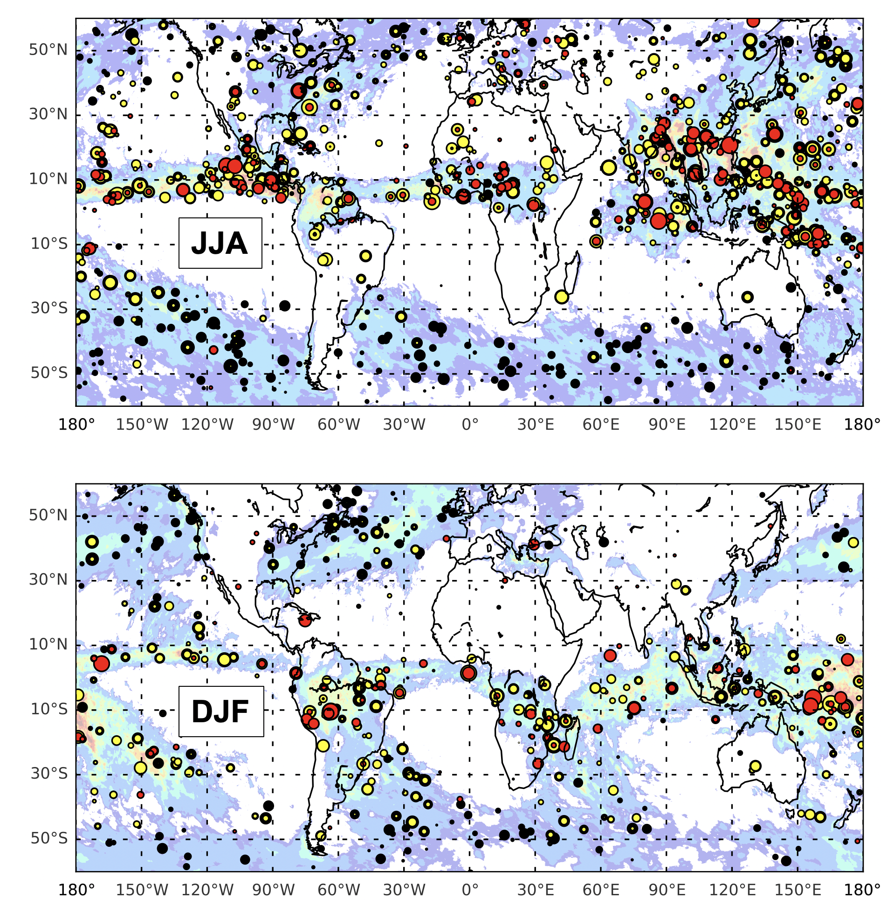
Enhanced Moisture + Precipitation Climatology
Geographical distribution of the upper percentile (top 2%) of the measured polarimetric phase shift ( Δϕ ) from all ROHP observations
Each dot color denotes a vertical region where the Δϕ from all rays were averaged
The color contour background is GPM-IMERG averaged over the same 3-month period
Geographical agreement with known global precipitation patterns
Δϕ adds an indication of vertical precipitation structure to the temperature/moisture profile
0–5 km (black) 5–10 km (yellow) 0-15 km (red)

Slide 3
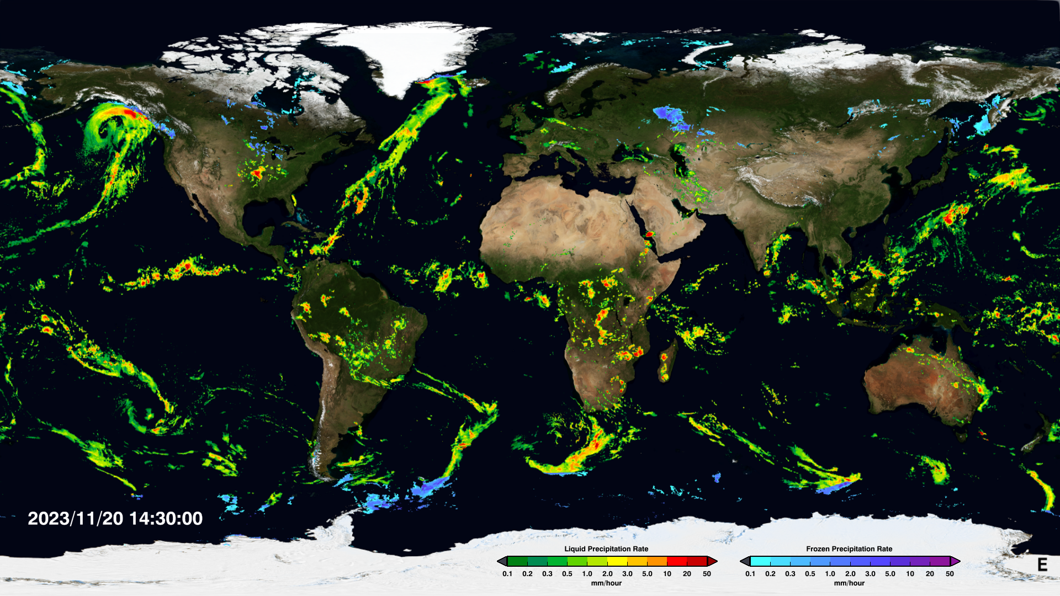
Verification of Over-Ocean Satellite Precipitation
Oceanic precipitation observations are nearly entirely dependent on satellite data
Global precipitation products (IMERG, GSMaP, CMORPH, and others) have little to no independent validation data over oceans
Above-mentioned products can be readily mapped onto lower-level RO ray paths
While not as preferred as traditional raingauge and ground radar, the pol-RO observation offers a common global, calibrated, independent reference (2018-)
Similar to use of IMERG for validation of the “non-precipitating” ROHP observations; Padulles et al, 2020)
Courtesy NASA/GPM Project
https://gpm.nasa.gov/data/imerg

Slide 4
Tropical Meteorology: Far Offshore Developing TC’s
Potential relevance to NOAA HRD APHEX (Zawislak et al 2022) initiative, for the pre-TD and “invest” regions (observations of low/mid-tropospheric humidity in the near-disturbance environment)
Locations of desired airborne dropsonde observations may be out of reach, or involve considerable ferry, limiting on-station time; pilots avoid convection → dropsondes sample the perimeter
Fortuitous STORM-PROBE observations could potentially complement dropsonde observations
Calendar Year 2020

Slide 5
Tropical Meteorology: Far Offshore Developing TC’s
Entire Calendar Year
 | All Ocean Basins |  |  |  |  |  | Only Atlantic
Year | Dep | Cat-1 | Cat-2 | Cat-3 | Cat-4 | Cat-5 | Dep | Cat-1 | Cat-2 | Cat-3 | Cat-4 | Cat-5
2019 | 253 | 25 | 15 | 23 | 10 | 3 | 57 | 4 | 5 | 5 | 0 | 0
2020 | 433 | 33 | 8 | 10 | 11 | 3 | 97 | 15 | 2 | 3 | 4 | 0
2021 | 234 | 25 | 5 | 13 | 13 | 1 | 65 | 7 | 0 | 4 | 2 | 0
June-November Only
 | All Ocean Basins |  |  |  |  |  | Only Atlantic
Year | Dep | Cat-1 | Cat-2 | Cat-3 | Cat-4 | Cat-5 | Dep | Cat-1 | Cat-2 | Cat-3 | Cat-4 | Cat-5
2019 | 182 | 10 | 4 | 16 | 5 | 0 | 49 | 3 | 2 | 4 | 0 | 0
2020 | 250 | 20 | 2 | 7 | 5 | 1 | 88 | 9 | 0 | 0 | 3 | 0
2021 | 200 | 14 | 8 | 7 | 5 | 1 | 54 | 6 | 1 | 4 | 3
STORM-PROBE simulation, GPS+GLONASS, 3-sats, 45-deg, 475-km
N of observations within proximity of TC location (at least one RO within 200-km of best track)

Slide 6
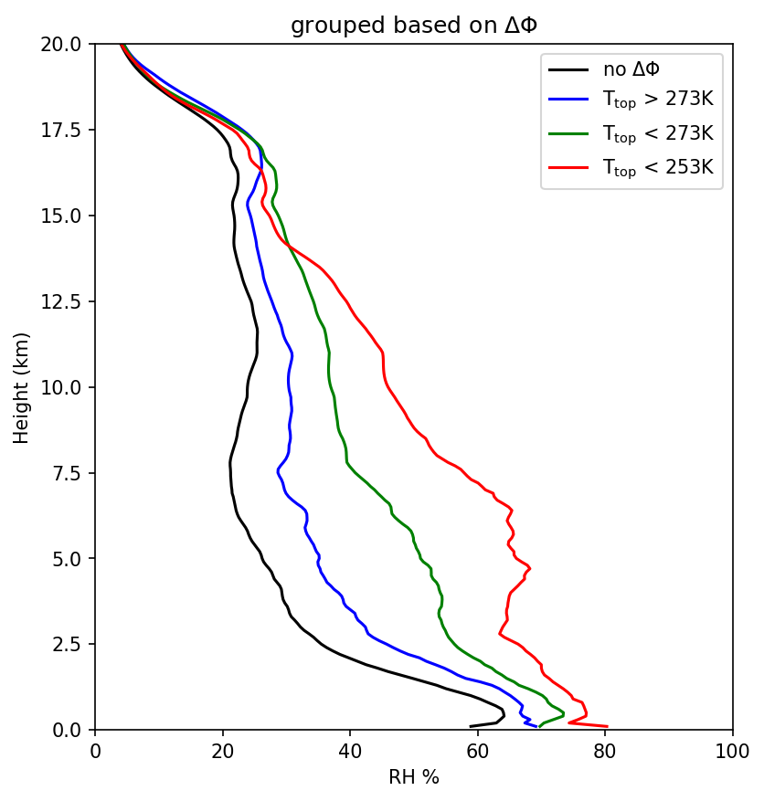
Moisture and “Depth” of Convection
All ROHP, Separated by Height of Top-Most Temperature Level where $∆φ$ > 3-mm
observations
Use the top-most level where Δ$ϕ$exceeds a threshold value above the freezing level (proxy for “radar cloud top”)
Would pinpoint layer-sensitivity to the LFT water vapor structure, as strength or “depth” of convection increases
Using $∆φ$ as a top-height proxy, indications of increased moistening in lower free troposphere
deep convection
shallow convection
Turk at al, 2021:
https://doi.org/10.1175/JTECH-D-21-0044.1

Slide 7
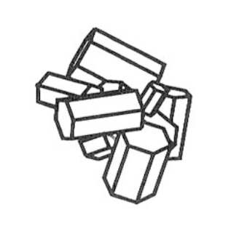
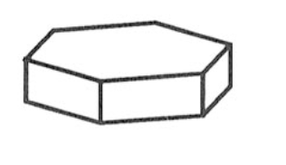
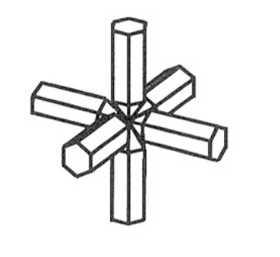
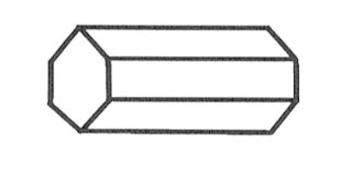
Ice Crystal Scattering- Shape Assumptions
RT simulations require specifying the drop size distribution (DSD)
Axis ratio vs D_{eq} relation for rain is sufficient, but ice can take on complex shapes and composition
Leads to high variability at W-band and higher
At L-band, nearly all hydrometeors are Rayleigh-sized
inscribed ellipse
aggregate
plate
simplifications of actual ice and snow crystals
rain
bullet rosette
column
GNSS 1.4 GHz ($λ$ = 19-cm)
ATMS or GMI 165 GHz channel ($λ=1.8$-mm)
2-mm

Slide 8
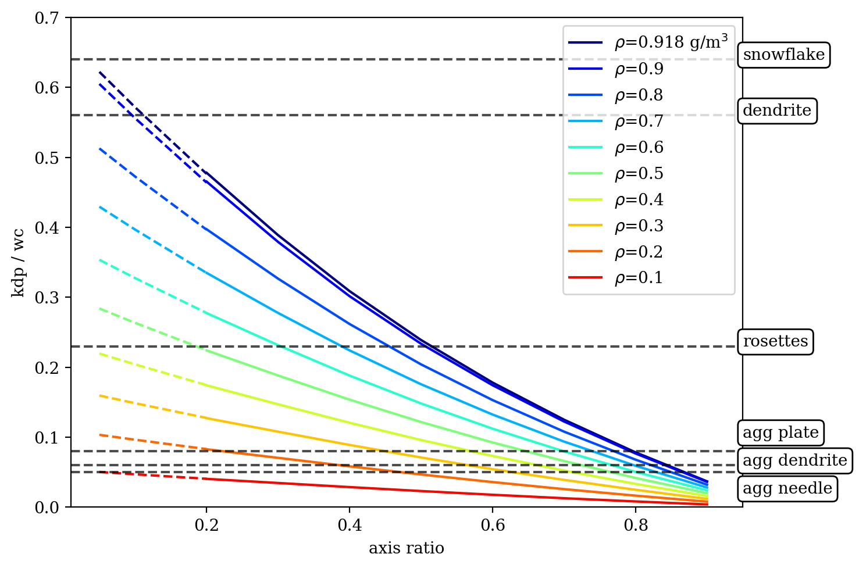
Ice Crystal Scattering- Shape Assumptions
b
High-density (approaching pure ice) and low axis ratio spheroids agree better with single pristine ice crystals
a
ice density
axis ratio= a/b
Computed with ADDA (Yurkin and Hoekstra, 2011)
K_{dp} / M Ratio
Low-density spheroids (with a relatively wide range of axis ratio) agree with the results using aggregates
Courtesy Ramon Padullés
Axis Ratio
The long wavelength (19-cm) favors the agreement found using simple k_{dp}-M approximations (power-law relationships sufficient)
https://doi.org/10.1109/TGRS.2021.3065119

Slide 9
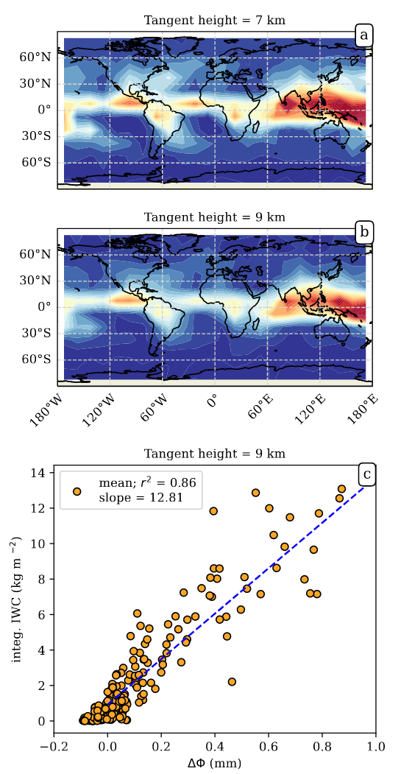
Applications: Integrated Ice Water Path
Δ$ϕ$ is measured from a coarse (~200-km path) horizontal scale limb-sounding perspective:
The observation is “naturally averaged” for the user, who may re-grid other finer scale data anyhow to match model horizontal scales
Upper levels avoids propagation through mixed-phase or rain below; direct sensing of upper level ice
Δ$ϕ$ and M dependent upon 3rd moment of the DSD
Δ$ϕ$shown to be capable of (precipitation-sized) ice water path estimates - Augment other IWP datasets? (eg CloudSat, MLS, etc)
https://doi.org/10.5194/acp-2022-300
https://doi.org/10.5194/acp-20-12633-2020
deep convection
shallow convection

Slide 10
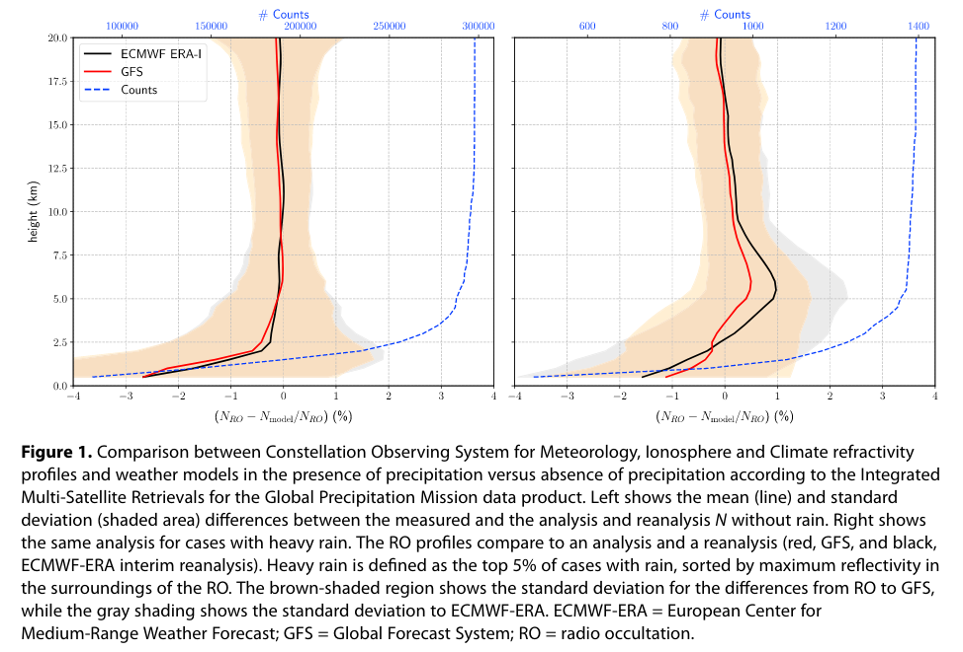
Weather Model Diagnostics
Refractivity (N) Bias (%)
Evaluation of model bias under heavy precipitation conditions is often done by conditioning upon independent precipitation data (e.g., GPM IMERG, TRMM, etc)
Δ$ϕ$signal is coincident with the moisture observation, independent, not (currently) assimilated
Pinpoint details of model bias under heavy precipitation conditions.
Heavy Rain
No Rain
de la Torre et al, 2018: Signatures of Heavy Precipitation on the Thermodynamics of Clouds Seen From Satellite: Changes Observed in Temperature Lapse Rates and Missed by Weather Analyses
https://doi.org/10.1029/2017JD028170

Slide 11
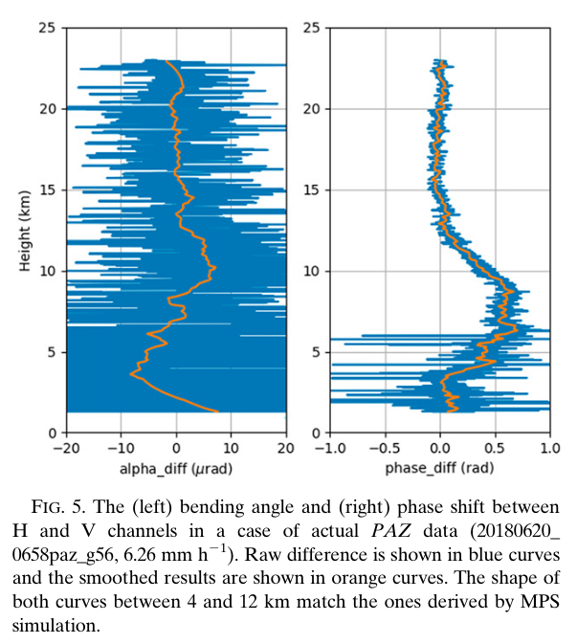
Polarimetric RO Bending Angle
Angle Diff (urad)
Phase Diff (rad)
RO bending angle ($α$) data are routinely assimilated into weather forecast models
To assimilate the polarimetric Δ$ϕ$signal, a forward operator that simulates the Δ$ϕ$(from the model condensed water state) is required
The RO processing extracts the bending angle at both polarizations (difference is the “polarimetric bending angle” due to precipitation)
May offer a more straightforward way to assimilate pol-RO observations
Wang, K.-N. et al. The Effects of Heavy Precipitation on Polarimetric Radio Occultation (PRO) Bending Angle Observations. J. Atmos. Oceanic Tech., 39, 149–161 (2022). https://doi.org/10.1175/JTECH-D-21-0032.1

